Slide 1
Transfiguration Sunday
Year B
2 Kings 2:1-12
Psalm 50:1-6
2 Corinthians 4:3-6
Mark 9:2-9

Slide 2
As they continued walking and talking, a chariot of fire and horses of fire separated the two of them, and Elijah ascended in a whirlwind into heaven.
2 Kings 2:11

Slide 3
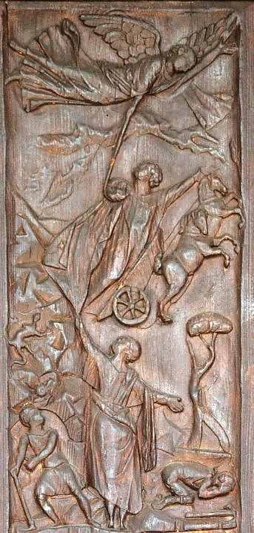
Elijah is Taken Up into Heaven
early 5th century
Santa Sabina
Rome, Italy

Slide 4
The mighty one, God the LORD, speaks and summons the earth from the rising of the sun to its setting.
Psalm 50:1

Slide 5
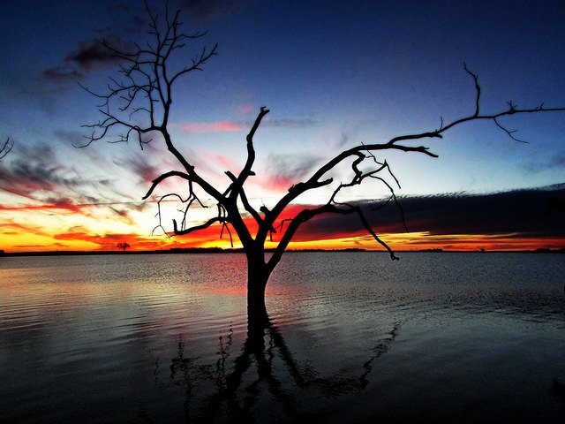
Sunset Sets the Sky Ablaze -- Spencer Neuharth (USFWS), Waubay National Wildlife Refuge, SD

Slide 6
For it is the God who said, "Let light shine out of darkness," … the light of the knowledge of the glory of God in the face of Jesus Christ.
2 Corinthians 4:6ac

Slide 7
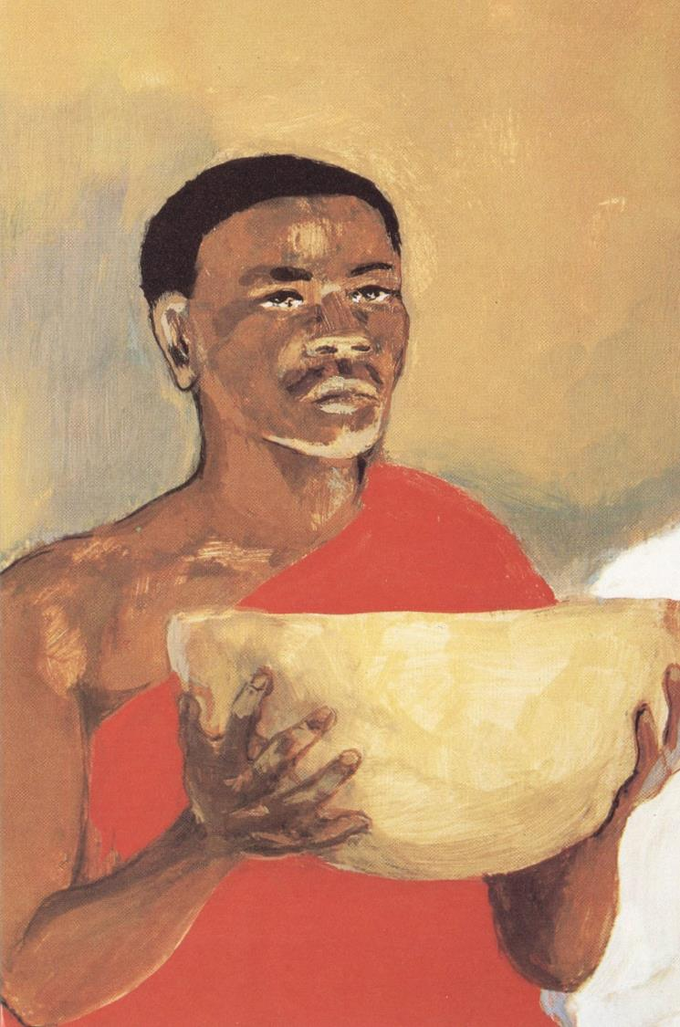
Jesus, Last Supper
JESUS MAFA
Cameroon

Slide 8
… Jesus took with him Peter and James and John, and led them up a high mountain apart, by themselves. And he was transfigured before them,
Mark 9:2b

Slide 9
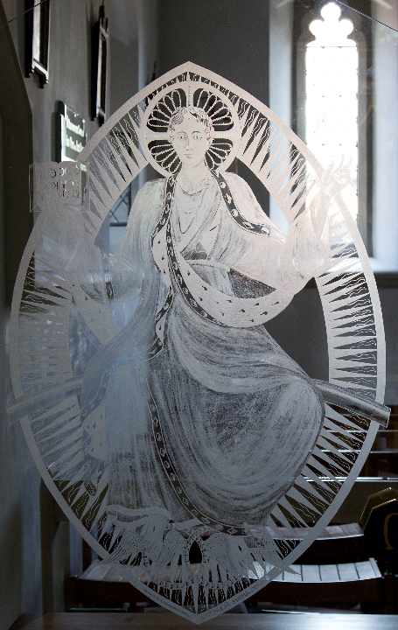
Transfigured
Glass etching
Church of St Birinus
Dorchester-on-Thames, England

Slide 10
and his clothes became dazzling white, such as no one on earth could bleach them.
Mark 9:3

Slide 11
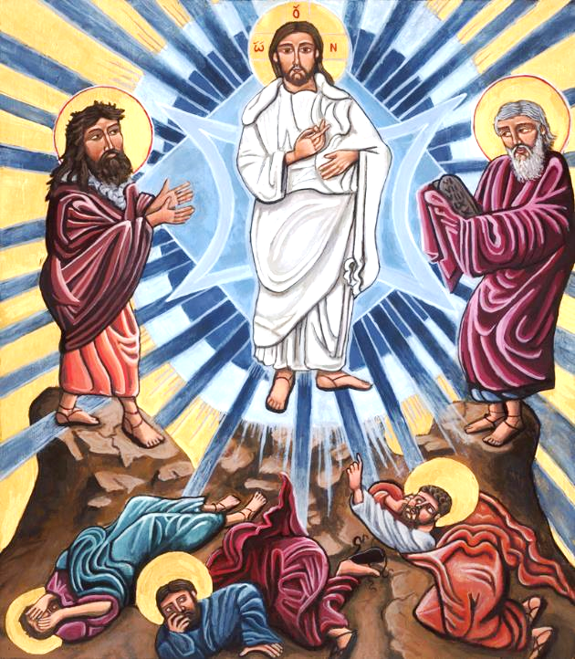
Transfiguration
Kelly Latimore
Glendale, OH

Slide 12
And there appeared to them Elijah with Moses, who were talking with Jesus.
Mark 9:4

Slide 13
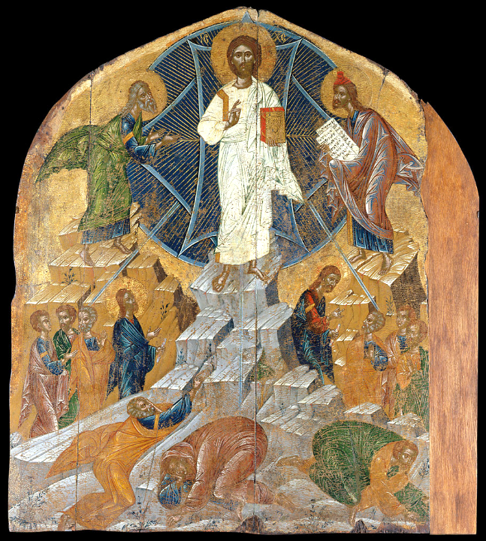
Transfiguration of Jesus Icon
Benaki Museum
Athens, Greece

Slide 14
Then Peter said to Jesus, "Rabbi, it is good for us to be here; let us make three dwellings, one for you, one for Moses, and one for Elijah."
Mark 9:5

Slide 15
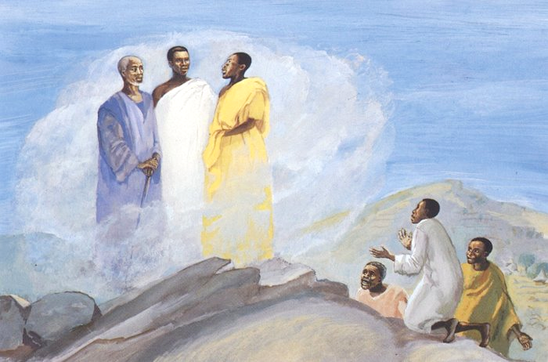
Transfiguration of Christ -- JESUS MAFA

Slide 16
He did not know what to say, for they were terrified.
Mark 9:6

Slide 17
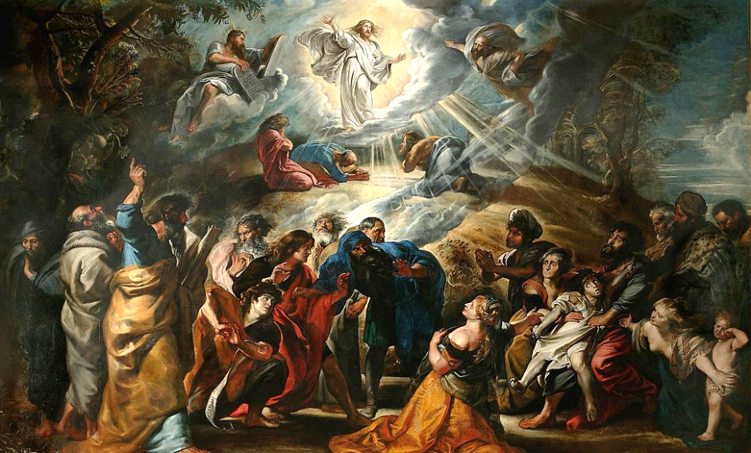
Transfiguration -- Peter Paul Rubens, Museum of Fine Arts, Nancy, France

Slide 18
Then a cloud overshadowed them, and from the cloud there came a voice, "This is my Son, the Beloved; listen to him!"
Mark 9:7

Slide 19
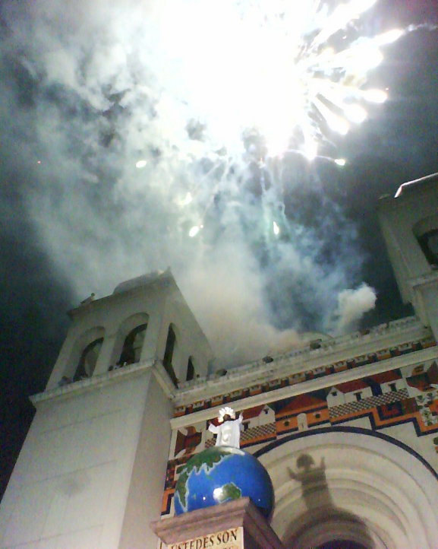
Transfiguracion del Divino Salvador del Mundo
Metropolitan Cathedral
San Salvador,
El Salvador

Slide 20
Suddenly when they looked around, they saw no one with them any more, but only Jesus.
Mark 9:8

Slide 21
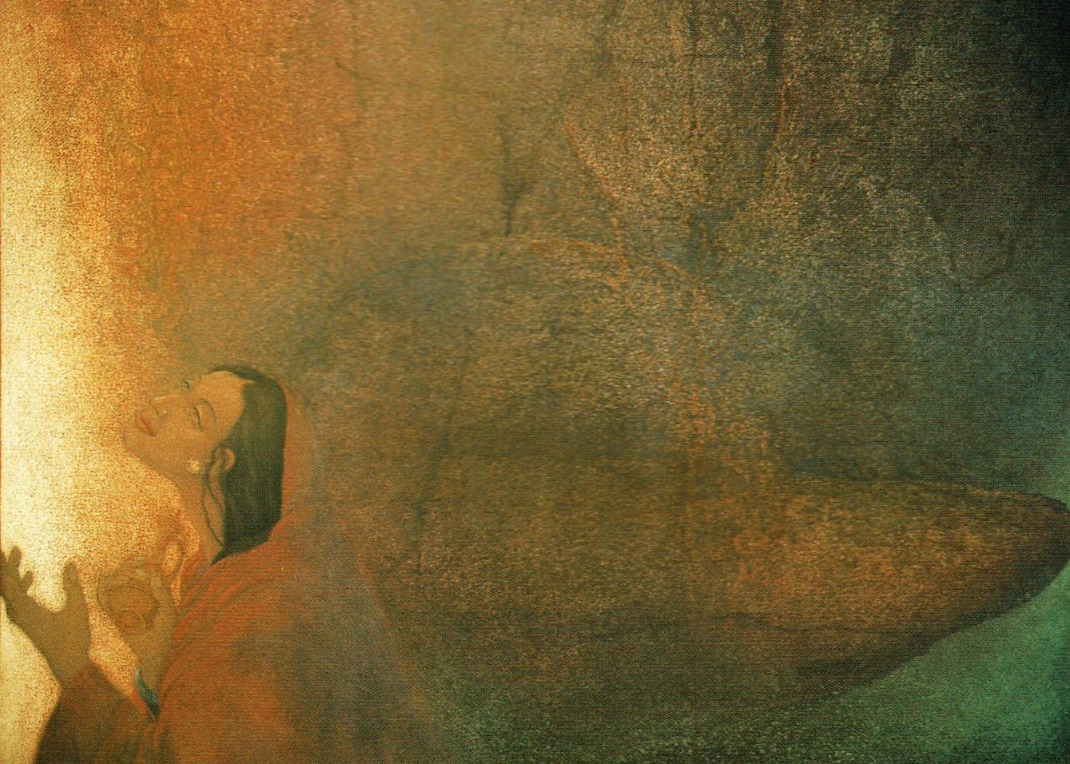
The Altar of God -- Frank Wesley

Slide 22
As they were coming down the mountain, he ordered them to tell no one about what they had seen, until after the Son of Man had risen from the dead.
Mark 9:9

Slide 23
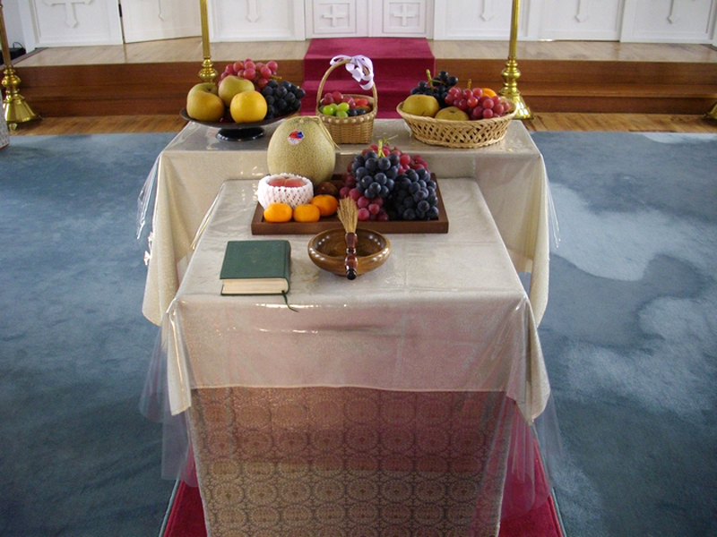
Blessing of First Fruits on the Great Feast of the Transfiguration of Jesus -- Tokyo, Japan

Slide 24
Credits
New Revised Standard Version Bible, copyright 1989, Division of Christian Education of the National Council of the Churches of Christ in the United States of America. Used by permission. All rights reserved.
https://www.flickr.com/photos/paullew/14428162876 – Fr Lawrence Lew, O.P.
https://commons.wikimedia.org/wiki/File:Waubay_NWR_Sunset_(9737733990).jpg
http://diglib.library.vanderbilt.edu/act-imagelink.pl?RC=54325
https://www.flickr.com/photos/paullew/7692795524/
https://kellylatimoreicons.com/contact/
https://commons.wikimedia.org/wiki/File:The_Transfiguration_-_Google_Art_Project_(715792).jpg
http://diglib.library.vanderbilt.edu/act-imagelink.pl?RC=48307
https://commons.wikimedia.org/wiki/File:Transfiguration-Rubens.JPG
http://commons.wikimedia.org/wiki/File:Transfiguracion_del_Divino_Salvador_del_Mundo.jpg
Estate of Frank Wesley, http://www.frankwesleyart.com/main_page.htm
https://commons.wikimedia.org/wiki/File:Fruits_Transfiguration_jp.jpg
Additional descriptions can be found at the Art in the Christian Tradition image library, a service of the Vanderbilt Divinity Library, http://diglib.library.vanderbilt.edu/. All images available via Creative Commons 3.0 License.

