Slide 1
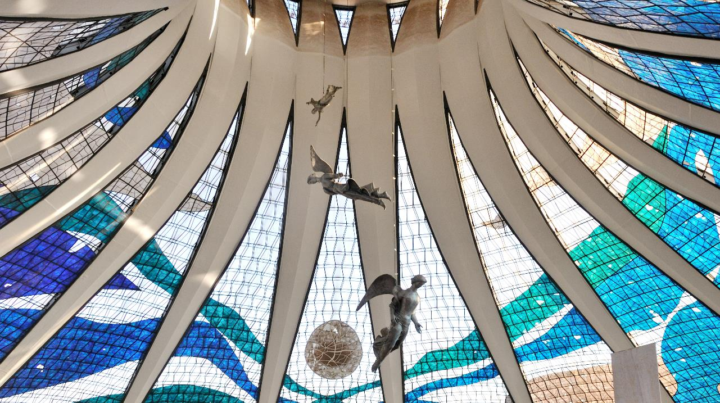
Third Sunday of Advent
Year B
Isaiah 61:1-4, 8-11
Psalm 126
or Luke 1:46b-55
1 Thessalonians 5:16-24
John 1:6-8, 19-28

Slide 2
For I the LORD love justice …
Isaiah 61:8a

Slide 3
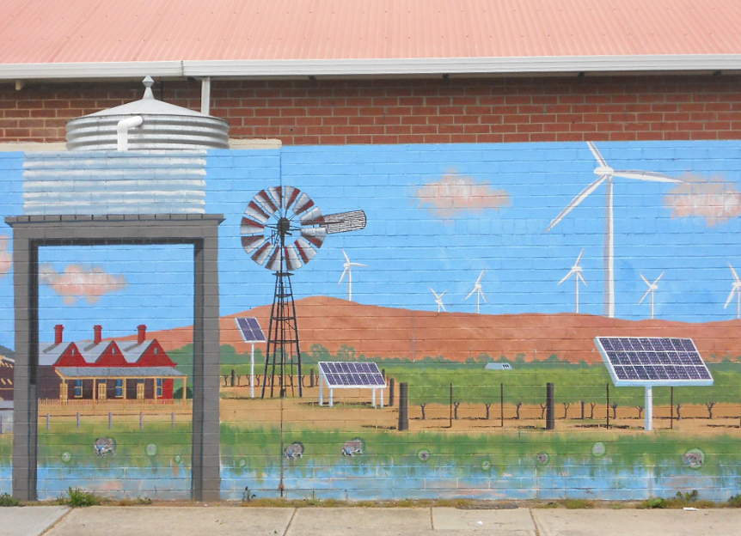
"Sustainability" -- Building mural, Adelaide, Australia

Slide 4
For as … a garden causes what is sown in it to spring up,
Isaiah 61:11a

Slide 5
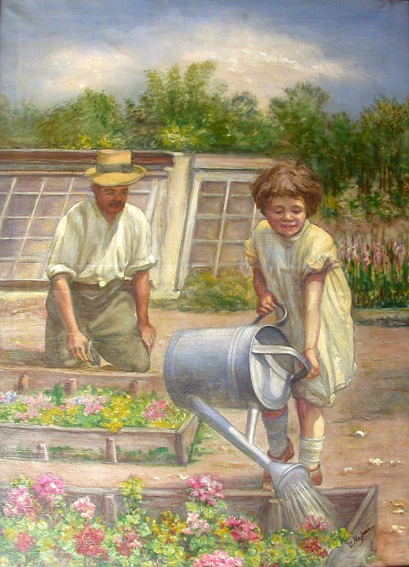
Working in the Garden
Carl Massmann before 1929

Slide 6
… so the Lord GOD will cause righteousness and praise to spring up before all the nations.
Isaiah 61:11b

Slide 7
Hands Across the Globe -- Truthseeker Digital Commons

Slide 8
Then our mouth was filled with laughter, and our tongue with shouts of joy …
Psalm 126:2a

Slide 9
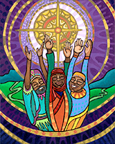
Shining Hope -- Lauren Wright Pittman

Slide 10
Those who go out weeping,
bearing the seed for sowing,
Psalm 126:6a

Slide 11
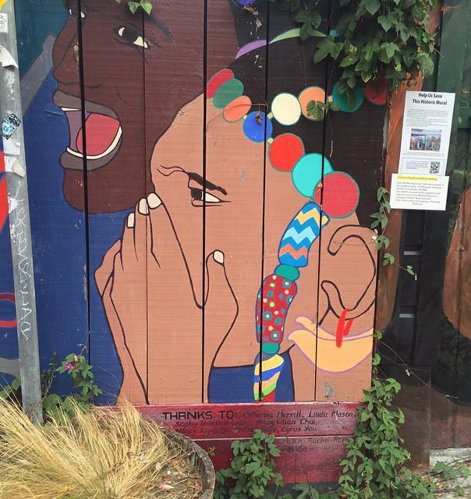
Grief
Mural in the
Mission District
San Francisco, CA

Slide 12
shall come home with shouts of joy, carrying their sheaves.
Psalm 126:6b

Slide 13
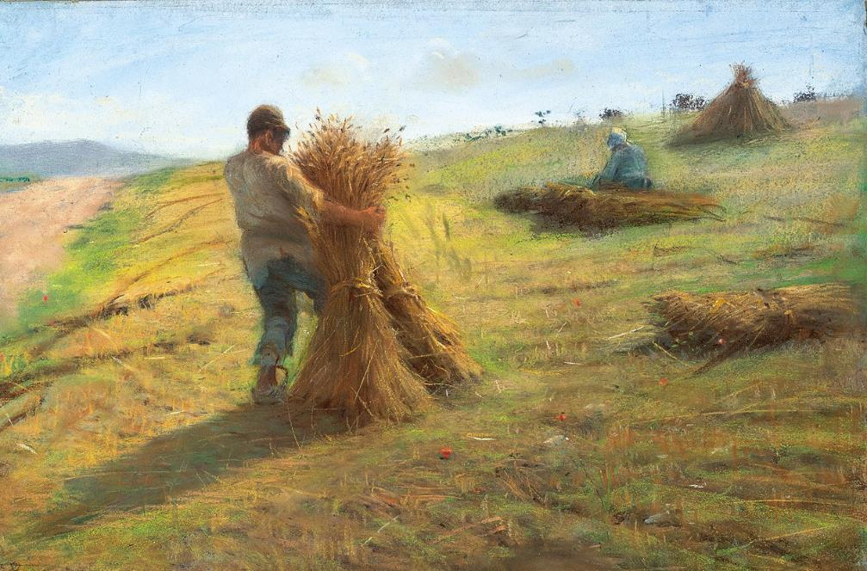
Grain Harvest -- Federigo Rossano

Slide 14
Rejoice always,
pray without ceasing,
give thanks … for this is the will of God in Christ Jesus for you.
1 Thessalonians 5:16, 17, 18a

Slide 15
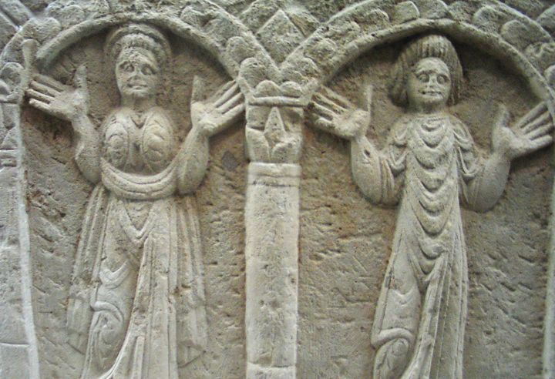
Coptic Praise and Prayer Orans figures from Bawit, Egypt -- Louvre Museum, Paris

Slide 16
"My soul magnifies the Lord,
and my spirit rejoices in God my Savior …"
Luke 1:46b, 47

Slide 17
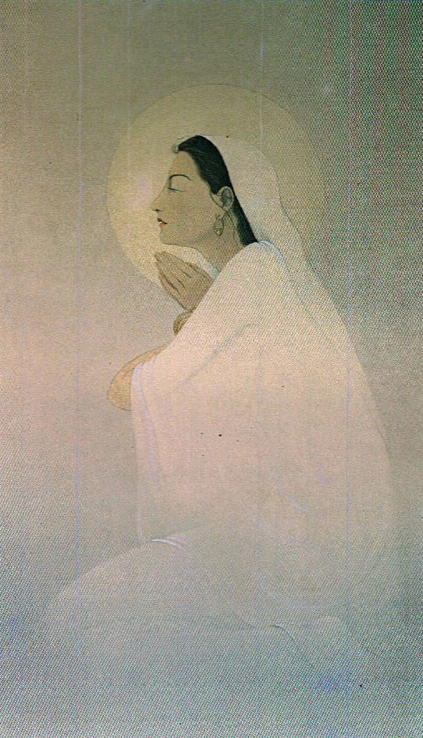
The Magnificat on Silk
Frank Wesley

Slide 18
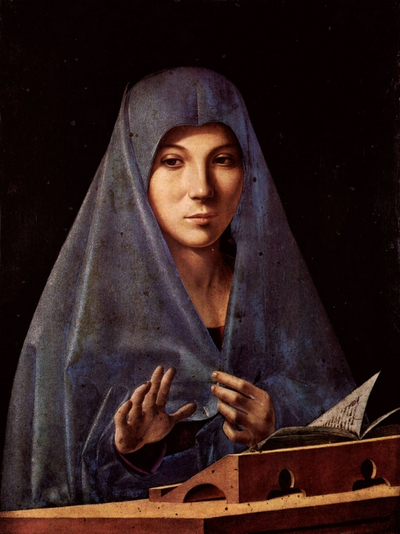
Mary of the Magnificat
Antonello da Messina National Museum, Palermo, Italy

Slide 19
There was a man sent from God, whose name was John.
John 1:6, 7a

Slide 20
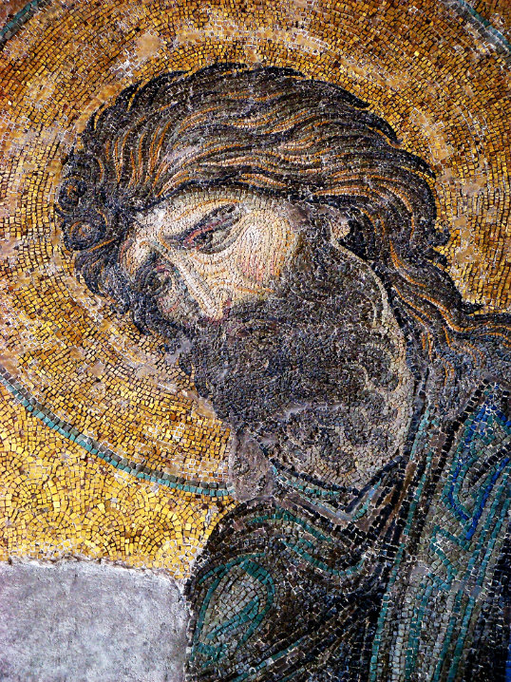
John the Baptist
Mosaic,
Hagia Sophia
Istanbul, Turkey

Slide 21
He came as a witness to testify to the light, so that all might believe through him.
John 1:7

Slide 22
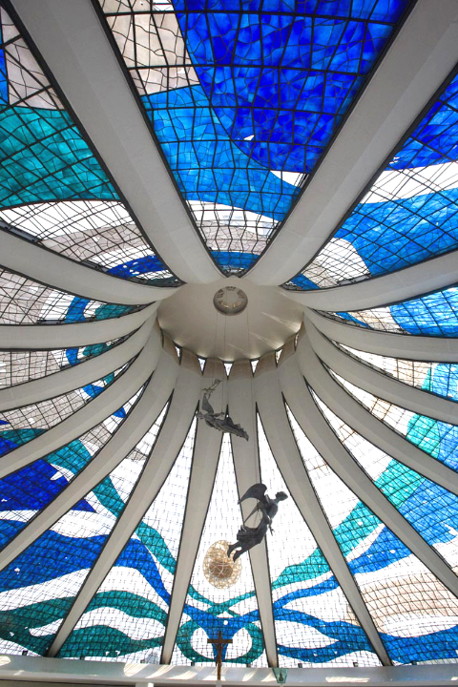
Light from the Dome
Oscar Niemeyer
Brasilia Cathedral
Brasilia, Brazil

Slide 23
He himself was not the light, but he came to testify to the light.
John 1:8

Slide 24
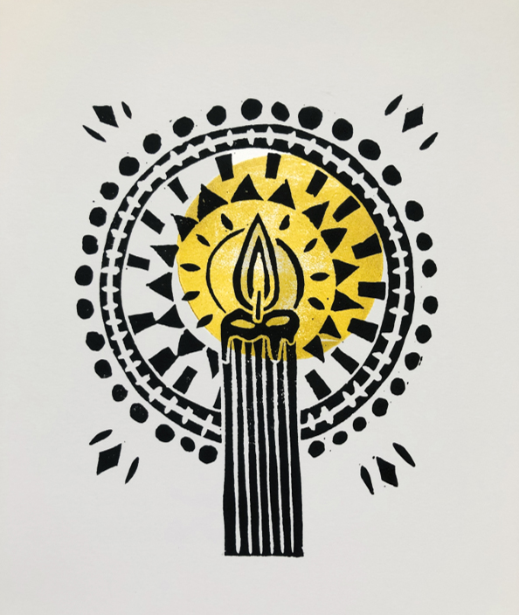
Advent Candle
Lauren Plummer

Slide 25
Credits
New Revised Standard Version Bible, copyright 1989, Division of Christian Education of the National Council of the Churches of Christ in the United States of America. Used by permission. All rights reserved.
https://www.flickr.com/photos/mikecogh/5014852692/ - Michael Coughlan
https://commons.wikimedia.org/wiki/File:Carl_Massmann_Gartenarbeit.jpg
https://commons.wikimedia.org/wiki/File:Human_Fraternity.png
Lauren Wright Pittman, http://www.lewpstudio.com/
https://www.flickr.com/photos/15117071790 – merri
https://commons.wikimedia.org/wiki/File:Federigo_Rossano_-_Grain_Harvest.jpg
http://diglib.library.vanderbilt.edu/act-imagelink.pl?RC=54464
Estate of Frank Wesley, http://www.frankwesleyart.com/main_page.htm
https://commons.wikimedia.org/wiki/File:Antonello_da_Messina_-_Virgin_Annunciate_-_Galleria_Regionale_della_Sicilia,_Palermo.jpg
https://www.flickr.com/photos/frenchieb/590576803 – F. Tronchin
http://www.flickr.com/photos/babasteve/3124402502/
http://diglib.library.vanderbilt.edu/act-imagelink.pl?RC=57132 – Lauren Plummer
Additional descriptions can be found at the Art in the Christian Tradition image library, a service of the Vanderbilt Divinity Library, http://diglib.library.vanderbilt.edu/. All images available via Creative Commons 3.0 License.

