Slide 1
Seventh Sunday of Easter
Year B
Acts 1:15-17, 21-26
Psalm 1
1 John 5:9-13
John 17:6-19

Slide 2
Then they prayed and said, "Lord, you know everyone's heart.
Acts 1:24

Slide 3
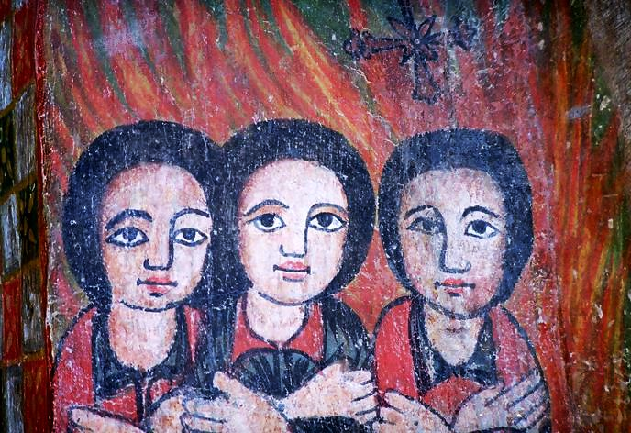
Three Women Praying -- Church of Gondar, Ethiopia

Slide 4
They are like trees planted by streams of water, which yield their fruit in its season, and their leaves do not wither.
Psalm 1:3a

Slide 5
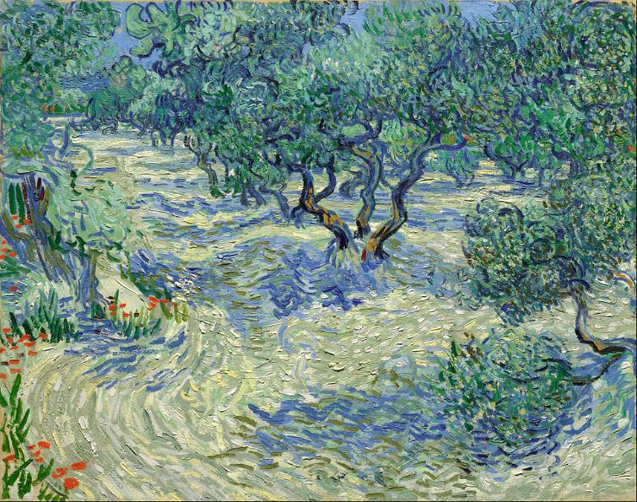
Olive Orchard -- Vincent van Gogh, Nelson-Atkins Museum of Art, Kansas City, MO

Slide 6
And this is the testimony: God gave us eternal life, and this life is in his Son.
1 John 5:11

Slide 7
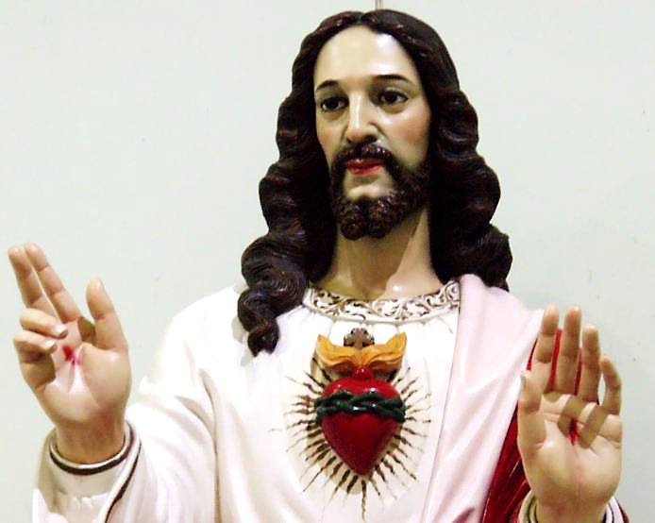
Jesus Christ of the Sacred Heart -- Philippines

Slide 8
And now I am no longer in the world, but they are in the world …
John 17:11a

Slide 9
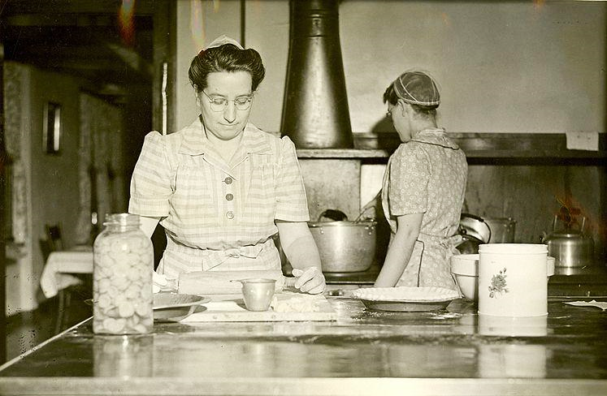
Mennonite Voluntary Service members helping in the Home for the Aged -- Eureka, IL

Slide 10
Holy Father, protect them in your name that you have given me, so that they may be one, as we are one.
John 17:11

Slide 11
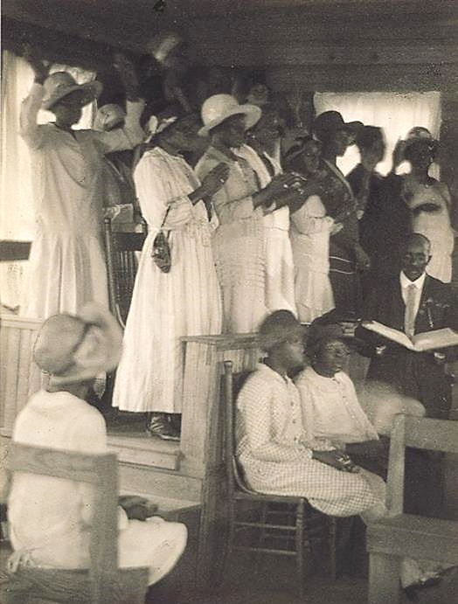
African-American Church Service,
Rural South
Doris Ulmann

Slide 12
While I was with them, I protected them … I guarded them, and not one of them was lost except the one destined to be lost …
John 17:12ac

Slide 13
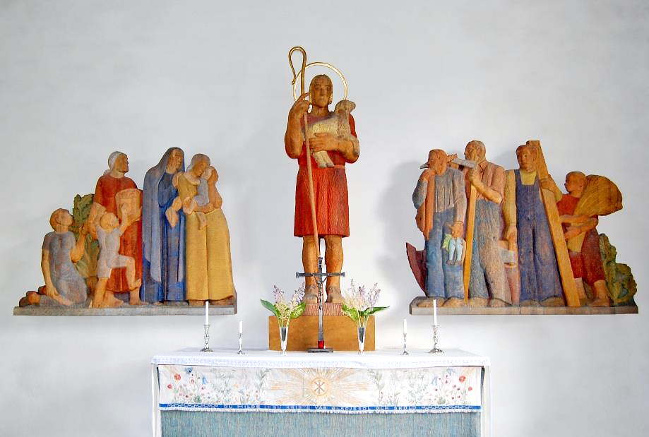
The Good Shepherd -- Gunnar Torhamn, Soderakra Church, Sweden

Slide 14
But now I am coming to you, and I speak these things in the world so that they may have my joy made complete in themselves.
John 17:13

Slide 15
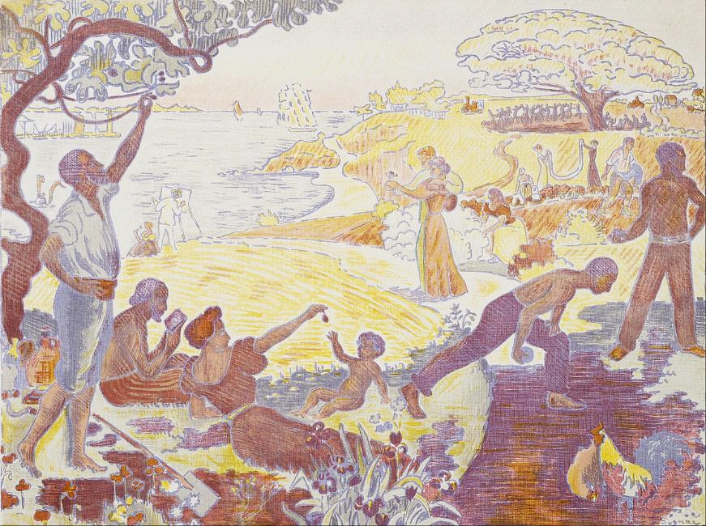
The Joy of Life -- Paul Signac, Museum of Fine Arts, Houston, TX

Slide 16
I have given them your word, and the world has hated them because they do not belong to the world …
John 17:14

Slide 17
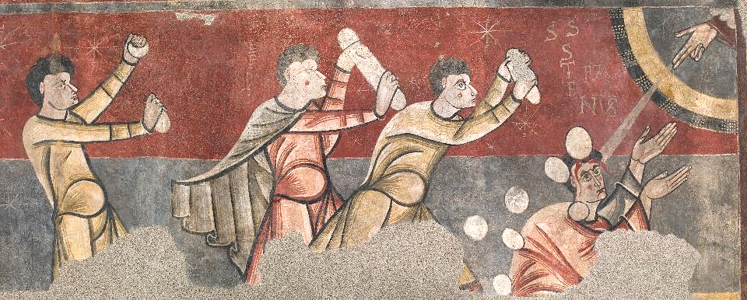
The Stoning of Stephen -- Museu Nacional d'Art de Catalunya, Barcelona, Spain

Slide 18
I am not asking you to take them out of the world, but I ask you to protect them from the evil one.
John 17:15

Slide 19
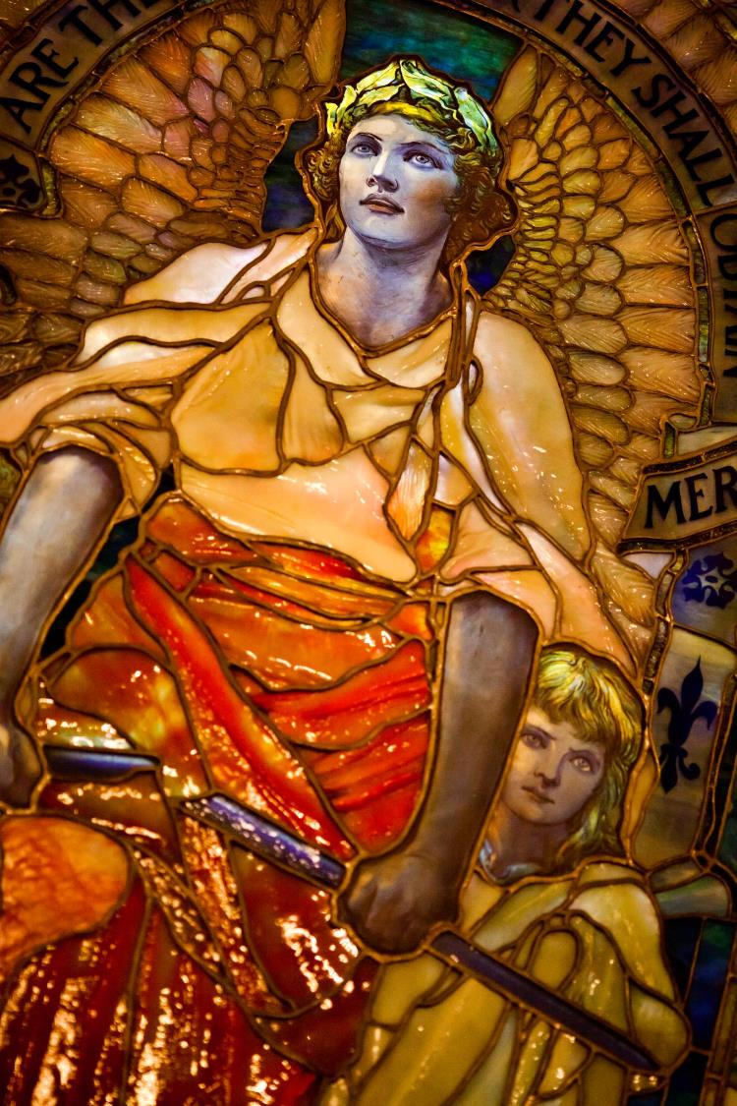
Blessed Are the Merciful
Louis Tiffany
Arlington Street Church
Boston, MA

Slide 20
Sanctify them in the truth; your word is truth.
John 17:17

Slide 21
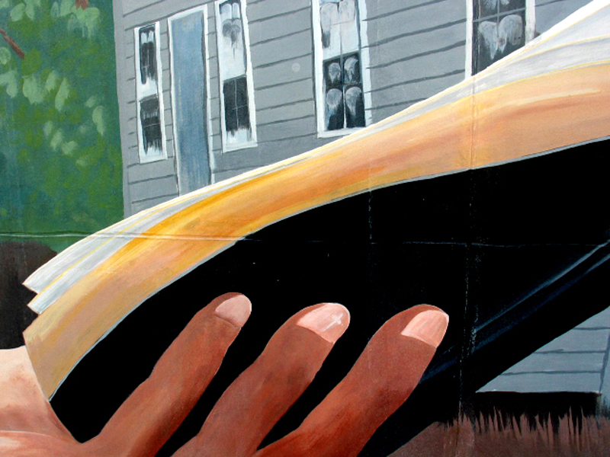
Detail, Billy Graham Preaching from the Bible -- Florida Bible Institute, Palatka, FL

Slide 22
As you have sent me into the world, so I have sent them into the world.
John 17:18

Slide 23
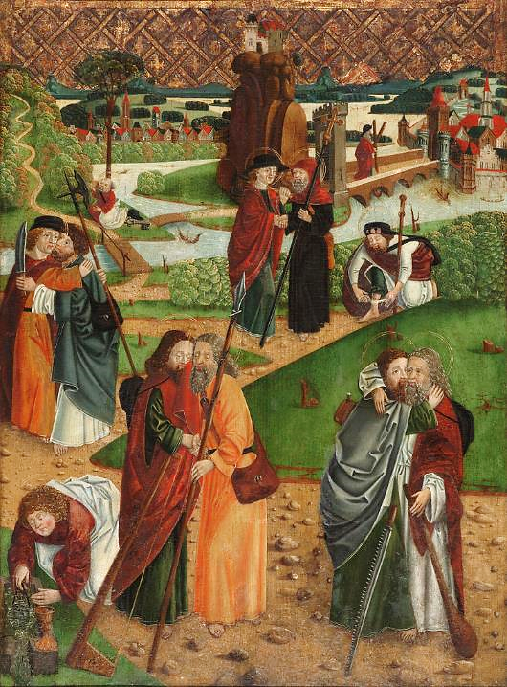
The Apostles' Farewell
Master S. H.
Pokrajinski muzej Ptuj Ormož Ptuj, Slovenia

Slide 24
Credits
New Revised Standard Version Bible, copyright 1989, Division of Christian Education of the National Council of the Churches of Christ in the United States of America. Used by permission. All rights reserved.
https://www.flickr.com/photos/acullador/2065354564/
http://diglib.library.vanderbilt.edu/act-imagelink.pl?RC=54486
https://commons.wikimedia.org/wiki/File:Vincent_van_Gogh_-_Olive_Orchard_-_Google_Art_Project.jpg
https://commons.wikimedia.org/wiki/File:Pie_Baker_1951_(6942859612).jpg
https://commons.wikimedia.org/wiki/File:Ulmann,_African-American_Church.jpg
http://commons.wikimedia.org/wiki/File:S%C3%B6der%C3%A5kra_kyrka04.JPG
https://commons.wikimedia.org/wiki/File:Paul_Signac_-_In_the_Time_of_Harmony-_The_Joy_of_Life--Sunday_by_the_Sea_-_Google_Art_Project.jpg
https://commons.wikimedia.org/wiki/File:Barcelona_MNAC_Stoning_of_St-Stephen.jpg
https://www.flickr.com/photos/thomashawk/5391897874/ - Thomas Hawk
http://www.flickr.com/photos/csessums/5318762762
https://commons.wikimedia.org/wiki/File:The_Apostles_Farewell_-_Master_S.H._-_Google_Cultural_Institute.jpg
Additional descriptions can be found at the Art in the Christian Tradition image library, a service of the Vanderbilt Divinity Library, http://diglib.library.vanderbilt.edu/. All images available via Creative Commons 3.0 License.

