Slide 1
Second Sunday of Easter
Acts 4:32-35
Psalm 133
1 John 1:1-2:2
John 20:19-31
Year B

Slide 2
Now the whole group of those who believed were of one heart and soul, and no one claimed private ownership of any possessions …
Acts 4:32a

Slide 3
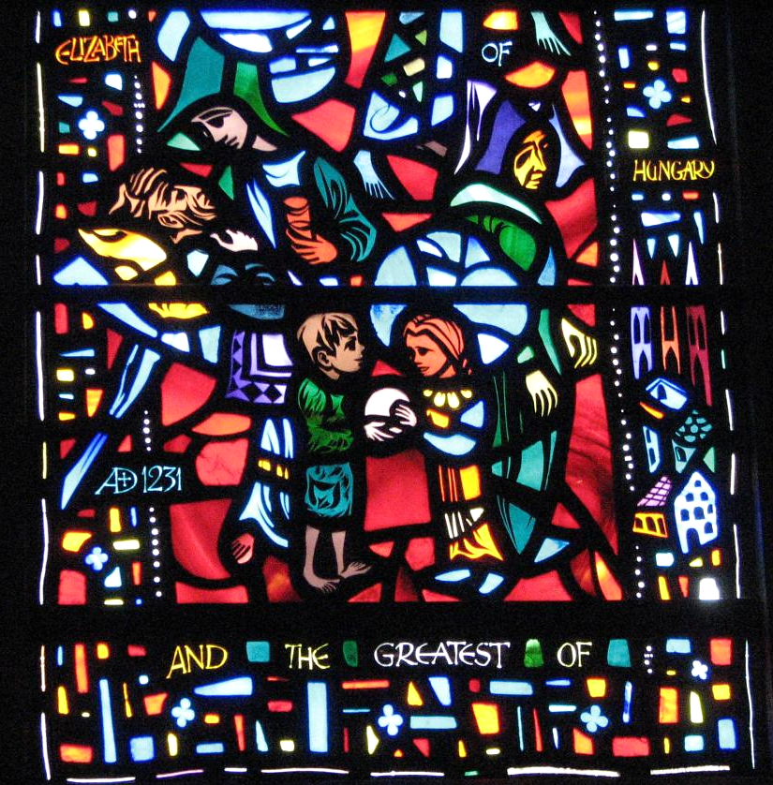
Caring and Sharing -- Washington National Cathedral, Washington, DC

Slide 4
How very good and pleasant it is when kindred live together in unity!
Psalm 133:1

Slide 5
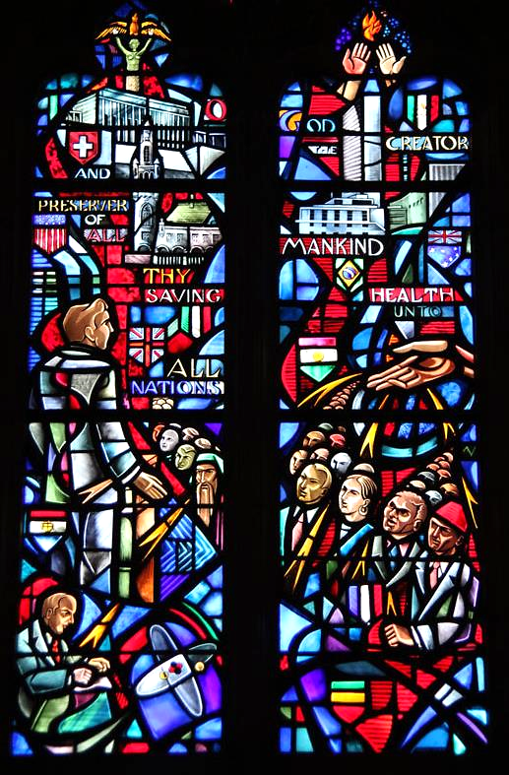
Prayer for All Conditions of Men
Gaudin and Willet Studios
National Cathedral
Washington, DC

Slide 6
But if we walk in the light as he himself is in the light, we have fellowship with one another …
1 John 1: 7a

Slide 7
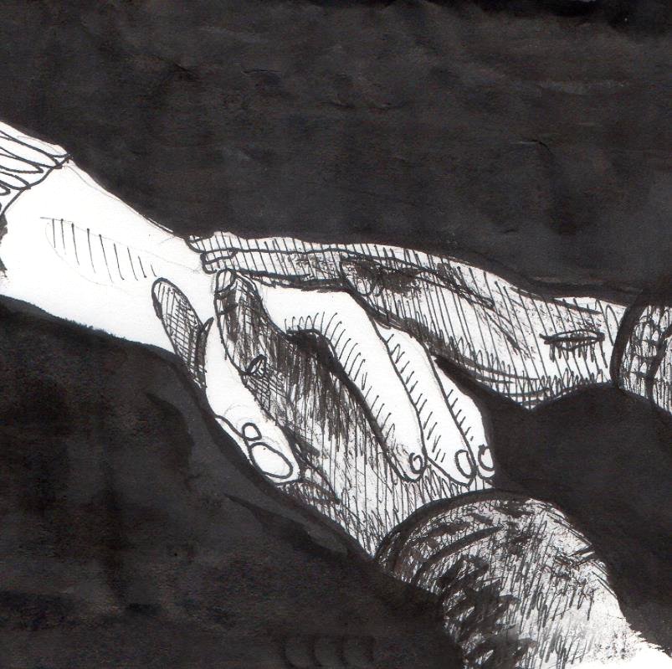
Holding Hands -- Liz Valente

Slide 8
When it was evening on that day … Jesus came and stood among them and said, "Peace be with you."
John 20:19ac

Slide 9
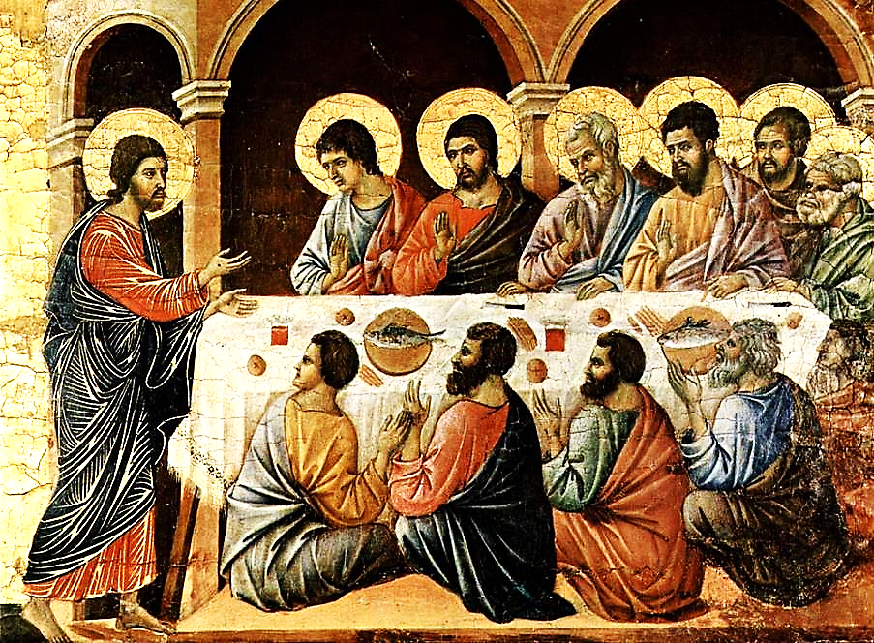
Christ Appears to the Disciples -- Duccio, Altar of Duomo, Siena, Italy

Slide 10
When he had said this, he breathed on them and said to them, "Receive the Holy Spirit."
John 20:22

Slide 11
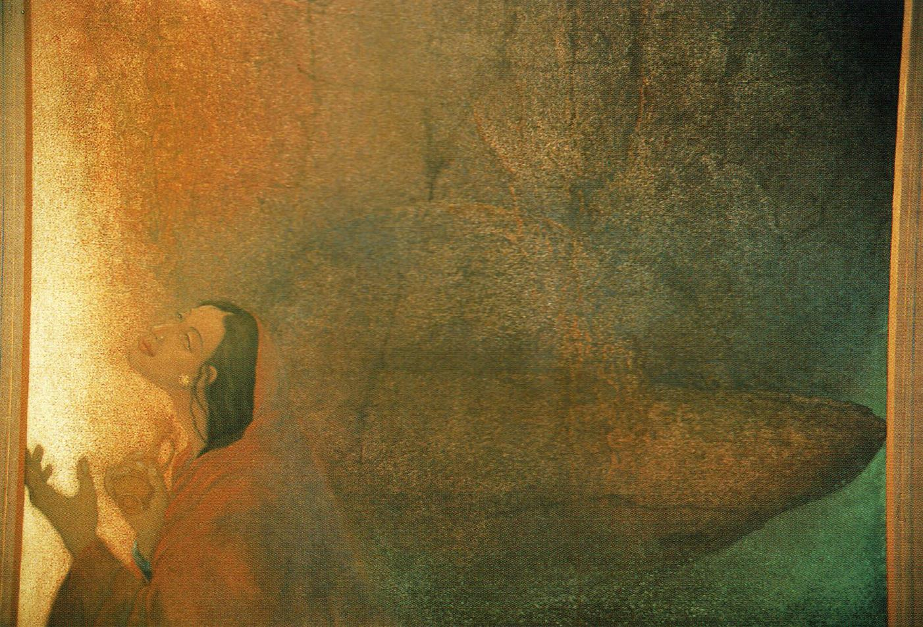
Altar of God -- Frank Wesley

Slide 12
But Thomas … one of the twelve, was not with them when Jesus came.
John 20:24

Slide 13
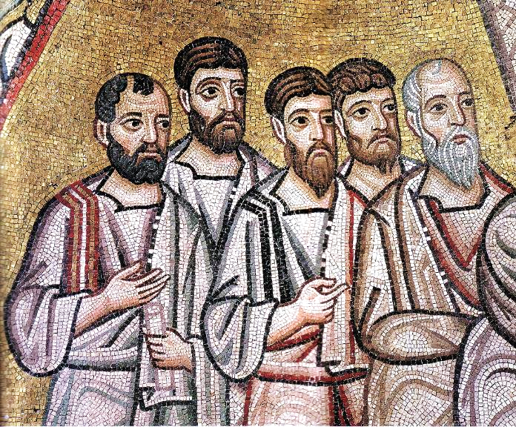
Disciples, detail from Doubting Thomas -- Hosios Loukas Monastery, Boeotia, Greece

Slide 14
So the other disciples told him, "We have seen the Lord." But he said to them,
John 20:25a

Slide 15
"Unless I see the mark of the nails in his hands, and put my finger in the mark of the nails and my hand in his side, I will not believe."
John 20:25b

Slide 16
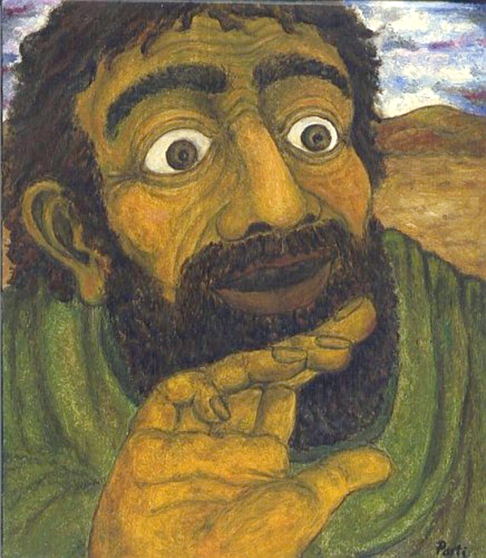
Doubting Thomas -- Zoltán Joó, Panel painting, Hungary

Slide 17
A week later … Thomas was with them … Jesus came and stood among them and said, "Peace be with you."
John 20:26

Slide 18
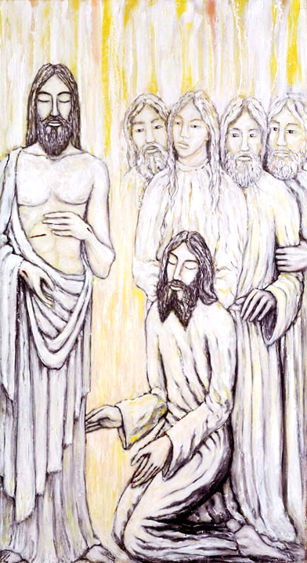
Jesus Appears to Thomas
Jacek Andrzej Rossakiewicz

Slide 19
Then he said to Thomas, "Put your finger here and see my hands. Reach out your hand and put it in my side. Do not doubt but believe."
John 20:27

Slide 20
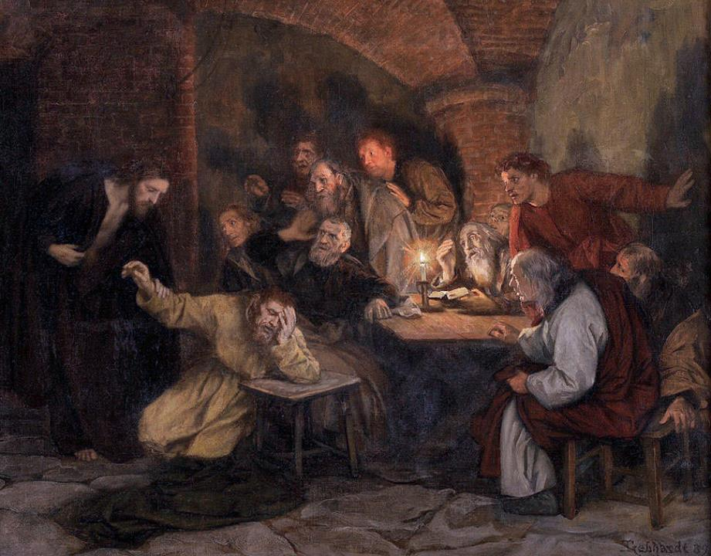
Thomas the Doubter
Eduard von Gebhard
Kunsthandel Meerbusch, Germany

Slide 21
Thomas answered him,
"My Lord and my God!"
John 20:28

Slide 22
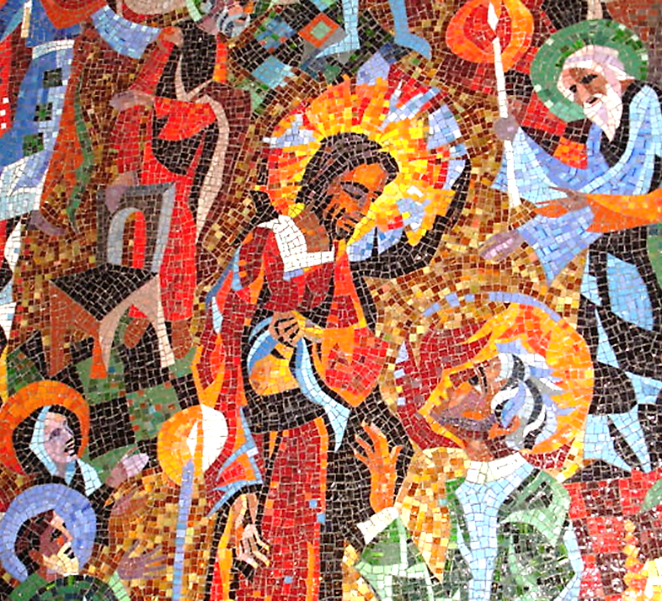
Christ with Thomas
Rowan and Irene LeCompte Washington Cathedral, DC

Slide 23
Jesus said to him, "Have you believed because you have seen me? Blessed are those who have not seen and yet have come to believe."
John 20:29

Slide 24
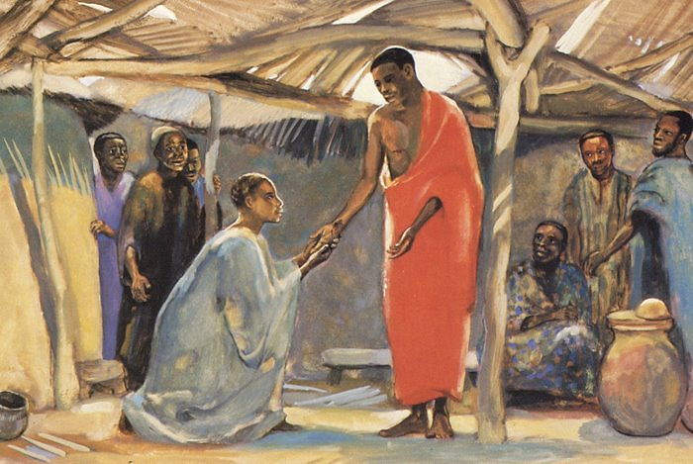
Jesus Appears to Thomas -- JESUS MAFA, Cameroon

Slide 25
Credits
New Revised Standard Version Bible, copyright 1989, Division of Christian Education of the National Council of the Churches of Christ in the United States of America. Used by permission. All rights reserved.
http://www.flickr.com/photos/reabhecc/5423531686/
http://commons.wikimedia.org/wiki/File:Clerestory_window_-_North_Nave_02_-_National_Cathedral_-_DC.JPG
Liz Valente, https://www.instagram.com/donalizvalente/
https://commons.wikimedia.org/wiki/File:Duccio_di_Buoninsegna_017.jpg
Estate of Frank Wesley, http://www.frankwesleyart.com/main_page.htm
https://commons.wikimedia.org/wiki/File:Hosios_Loukas_(narthex)_-_South_wall_(Doubting_Thomas)_04_detail.jpg
https://commons.wikimedia.org/wiki/File:Hitetlen_Tam%C3%A1s.jpg
https://commons.wikimedia.org/wiki/File:Rossakiewicz_Appear.jpg
https://commons.wikimedia.org/wiki/File:Thomas_the_Doubter_by_Eduard_von_Gebhardt.jpg
sshttps://www.flickr.com/photos/maryannsolari/5119341372/
http://diglib.library.vanderbilt.edu/act-imagelink.pl?RC=48302
Additional descriptions can be found at the Art in the Christian Tradition image library, a service of the Vanderbilt Divinity Library, http://diglib.library.vanderbilt.edu/. All images available via Creative Commons 3.0 License.

