Slide 1
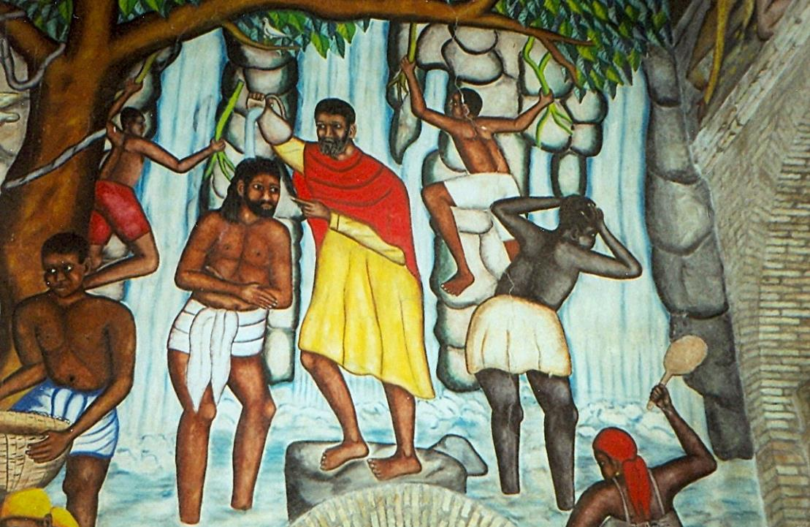
Second Sunday of Advent
Year B
Isaiah 40:1-11 • Psalm 85:1-2, 8-13 • 2 Peter 3:8-15a • Mark 1:1-8

Slide 2
A voice cries out: "In the wilderness prepare the way of the LORD, make straight in the desert a highway for our God."
Isaiah 40:3

Slide 3
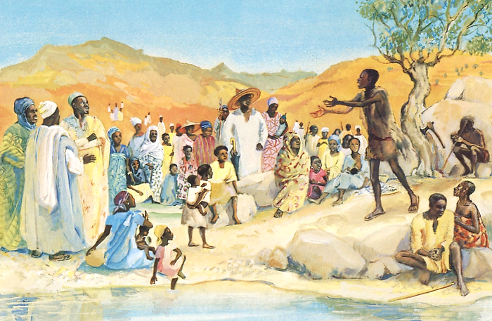
John the Baptist Preaching -- JESUS MAFA, Cameroon

Slide 4
He will feed his flock like a shepherd; he will gather the lambs in his arms, and carry them in his bosom,
and gently lead the mother sheep.
Isaiah 40:11

Slide 5
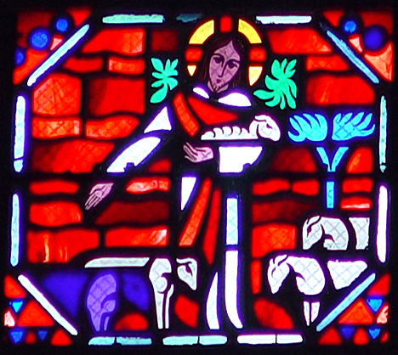
Christ the Good Shepherd -- Le Breton/Gaudin, Amiens Cathedral, Amiens, France

Slide 6
Steadfast love and faithfulness will meet; righteousness and peace
will kiss each other.
Psalm 85:10

Slide 7
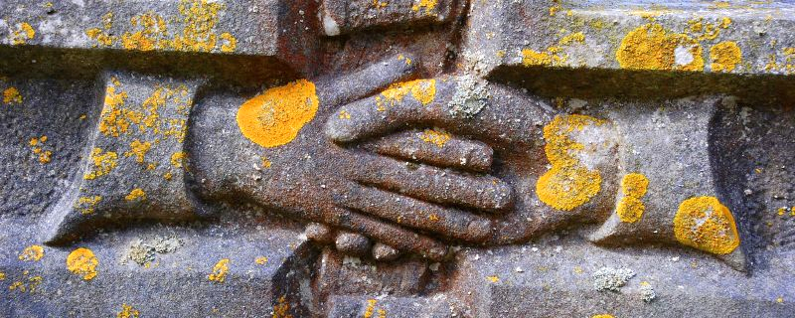
Love and Faithfulness Meet -- St. Michaels Church, Golden Grove, Wales

Slide 8
The Lord is not slow about his promise, as some think of slowness, but is patient with you …
2 Peter 3:9a

Slide 9
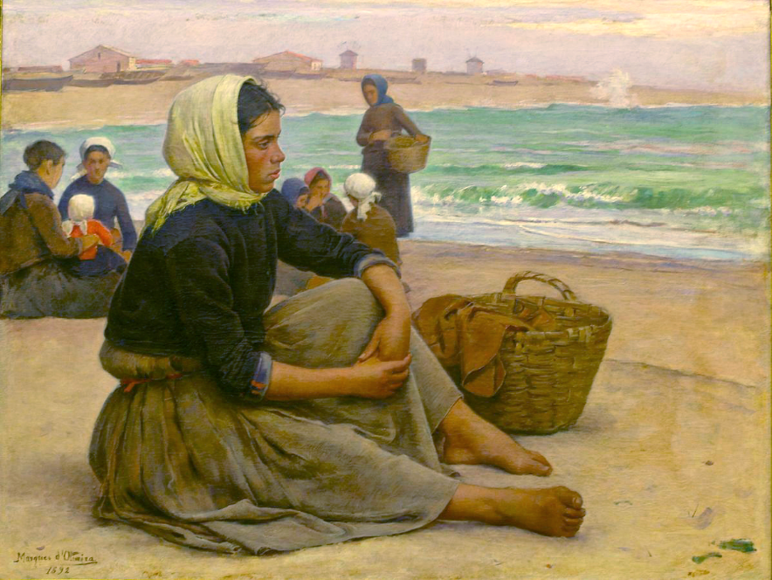
Waiting for the Boats -- Joao Marques de Oliveira, National Museum, Lisbon, Portugal

Slide 10
The beginning of the good news of Jesus Christ, the Son of God.
Mark 1:1

Slide 11
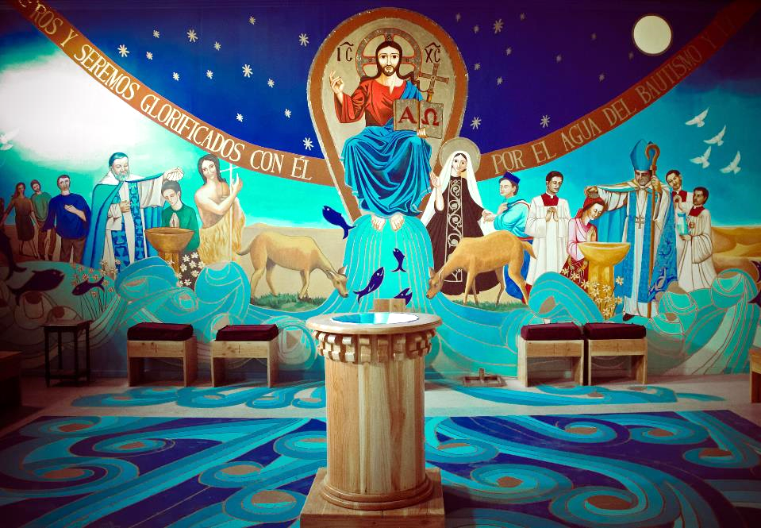
Christ of Baptism -- Church of La Tirana, La Tirana, Chile

Slide 12
As it is written in the prophet Isaiah, "See, I am sending my messenger ahead of you, who will prepare your way;
Mark 1:2

Slide 13
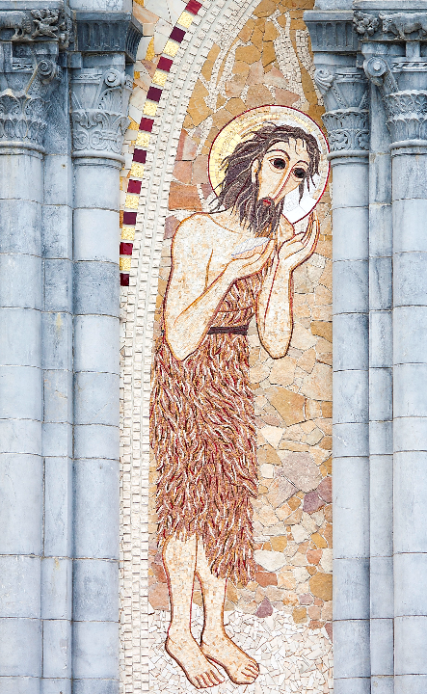
John the Baptist
Mosaic
Rosary Basilica
Lourdes, France

Slide 14
the voice of one crying out in the wilderness: 'Prepare the way of the Lord, make his paths straight …'"
Mark 1:3

Slide 15
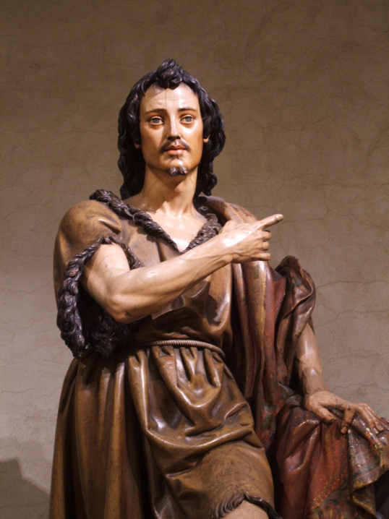
John the Baptist
Juan Martinez Montanes
Metropolitan Museum of Art
New York, NY

Slide 16
John the baptizer appeared in the wilderness, proclaiming a baptism of repentance for the forgiveness of sins.
Mark 1:4

Slide 17
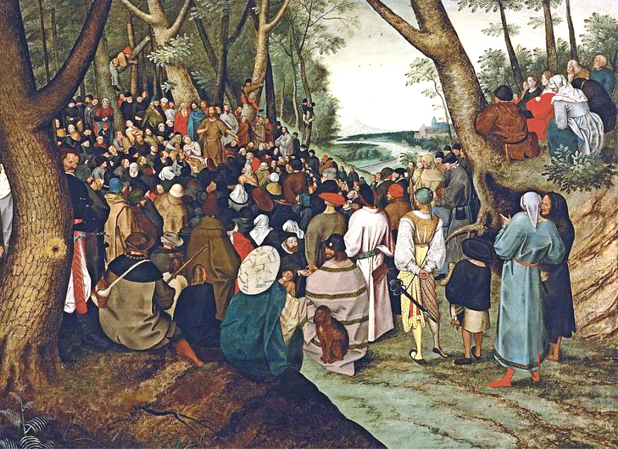
John the Baptist Preaching -- Pieter Brueghel the Younger

Slide 18
And people from the whole Judean countryside and all the people of Jerusalem were going out to him, and were baptized by him in the river Jordan …
Mark 1:5a

Slide 19
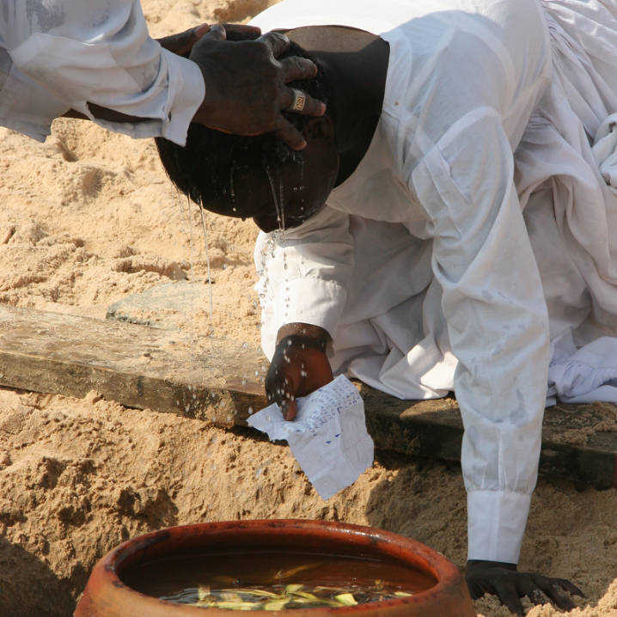
Pentecostal Baptism
Cotonou, Benin

Slide 20
Now John was clothed with camel's hair, with a leather belt around his waist, and he ate locusts and wild honey.
Mark 1:6

Slide 21
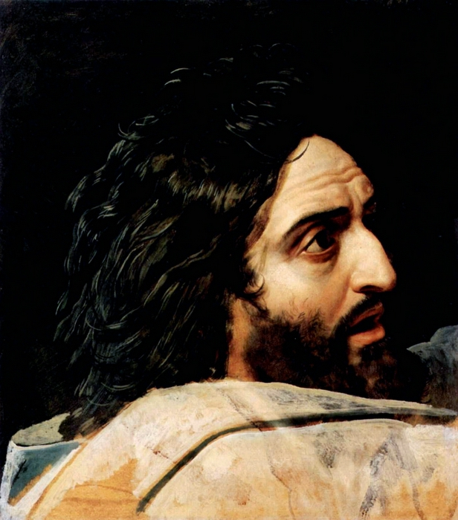
Preparatory sketch of John the Baptist
Aleksandr Ivanov Tretyakov Gallery, Moscow, Russia

Slide 22
He proclaimed, "The one who is more powerful than I is coming after me; I am not worthy to stoop down and untie the thong of his sandals.
Mark 1:7

Slide 23
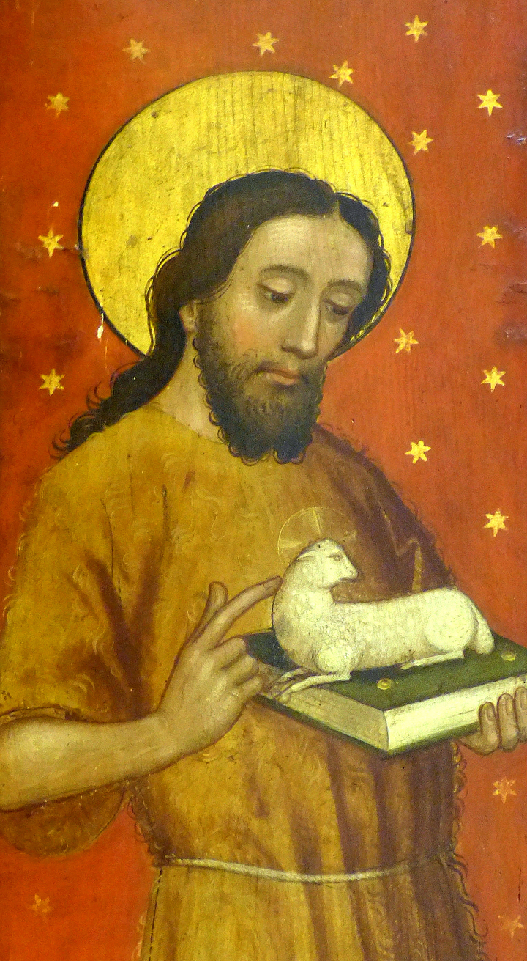
John the Baptist
Church of St. John and St. Martin
Schwabach, Germany

Slide 24
I have baptized you with water; but he will baptize you with the Holy Spirit."
Mark 1:8

Slide 25
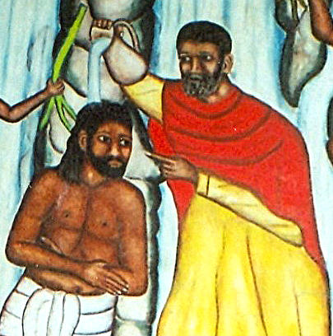
John the Baptist and Jesus
Castera Bazile
Former Cathedral of the Holy Trinity
Port-au-Prince, Haiti

Slide 26
Credits
New Revised Standard Version Bible, copyright 1989, Division of Christian Education of the National Council of the Churches of Christ in the United States of America. Used by permission. All rights reserved.
http://diglib.library.vanderbilt.edu/act-imagelink.pl?RC=48386
http://diglib.library.vanderbilt.edu/act-imagelink.pl?RC=51560
https://www.flickr.com/photos/sevendipity/1410013612/
https://commons.wikimedia.org/wiki/File:Waiting_for_the_boats_(1892)_-_Marques_de_Oliveira_(1853-1927)_(16215690116).jpg
https://www.flickr.com/photos/qarqa/6984519426 – Macaarena Viza
https://www.flickr.com/photos/paullew/7430552174/ - Fr Lawrence Lew
https://www.flickr.com/photos/ninepennies/1376556356/
https://commons.wikimedia.org/wiki/File:Pieter_Brueghel_(II)_-_St_John_the_Baptist_Preaching_to_the_Multitude.jpg
http://www.yorckproject.de
Ferdinand Reus, Flickr Creative Commons
https://commons.wikimedia.org/wiki/File:Schwabach_Stadtkirche_-_Katharinenaltar_Fl%C3%BCgel_4a.jpg
http://commons.wikimedia.org/wiki/File:PortAuPrinceMural.jpg
https://www.flickr.com/photos/jamesstringer/2746317561/ - James Stringer
Additional descriptions can be found at the Art in the Christian Tradition image library, a service of the Vanderbilt Divinity Library, http://diglib.library.vanderbilt.edu/. All images available via Creative Commons 3.0 License.

