Slide 1
Twenty-Fourth Sunday after Pentecost
Year B
Ruth 1:1-18 and Psalm 146 Deuteronomy 6:1-9 and Psalm 119:1-8
Hebrews 9:11-14 • Mark 12:28-34

Slide 2
Naomi said to her two daughters-in-law, "Go back … to your mother's house. May the LORD deal kindly with you, as you have dealt with me.
Ruth 1:8ac

Slide 3
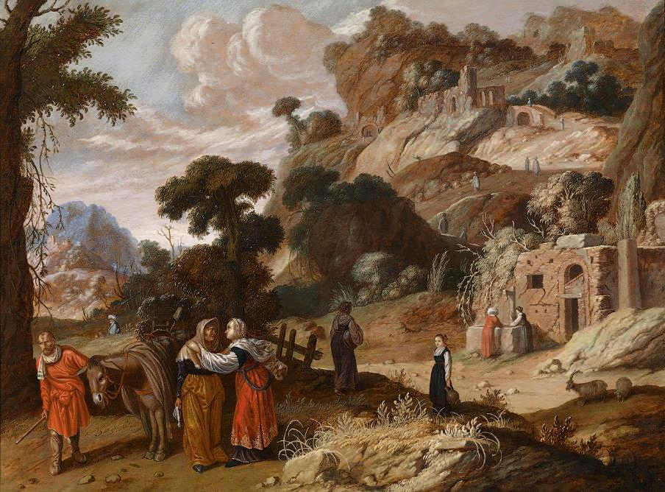
Naomi Entreats Ruth to Return to Her Home -- Jacob Pynas, Dutch, before 1650

Slide 4
But Ruth said, "Do not press me to leave you or to turn back from following you!
Ruth 1:16a

Slide 5
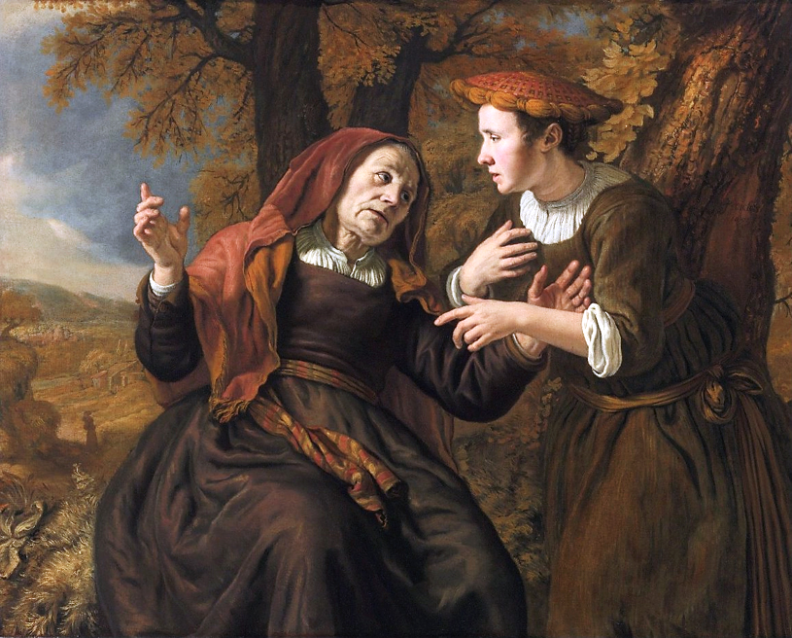
Naomi and Ruth -- Jan Victors, Agnes Etherington Art Centre, Kingston, Ontario, CA

Slide 6
Where you go, I will go; Where you lodge, I will lodge; your people shall be my people, and your God my God.
Ruth 1:16b

Slide 7
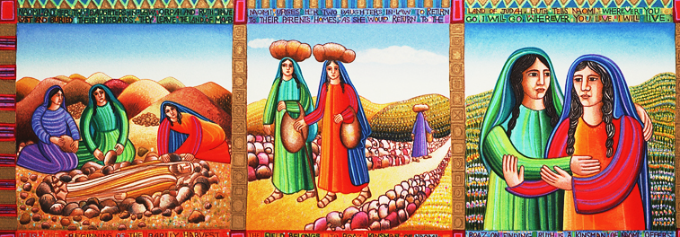
Naomi and Ruth from The Story of Ruth -- John August Swanson, serigraph, 1991

Slide 8
The LORD watches over the strangers; he upholds the orphan and the widow …
Psalm 146

Slide 9
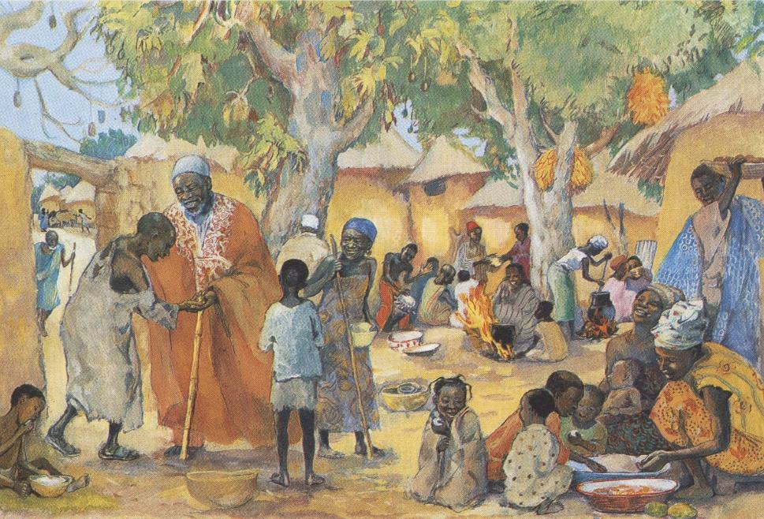
The Poor Invited to the Feast -- JESUS MAFA, Cameroon

Slide 10
You shall love the LORD your God with all your heart, and with all your soul, and with all your might.
Deuteronomy 6:5

Slide 11
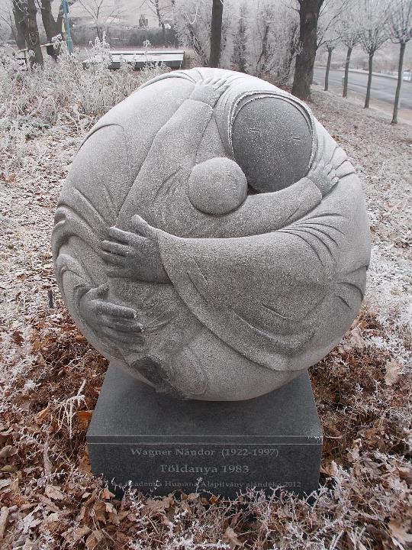
Mother Earth
Nandor Wagner
Budapest, Hungary

Slide 12
Christ came as a high priest … not with the blood of goats and calves, but with his own blood, thus obtaining eternal redemption.
Hebrews 9:11a, 12b

Slide 13
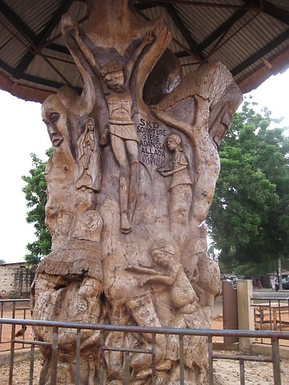
Christ Crucified on a Tree
Ouidah, Benin

Slide 14
One of the scribes came near and … asked him, "Which commandment is the first of all?"
Mark 12:28ac

Slide 15
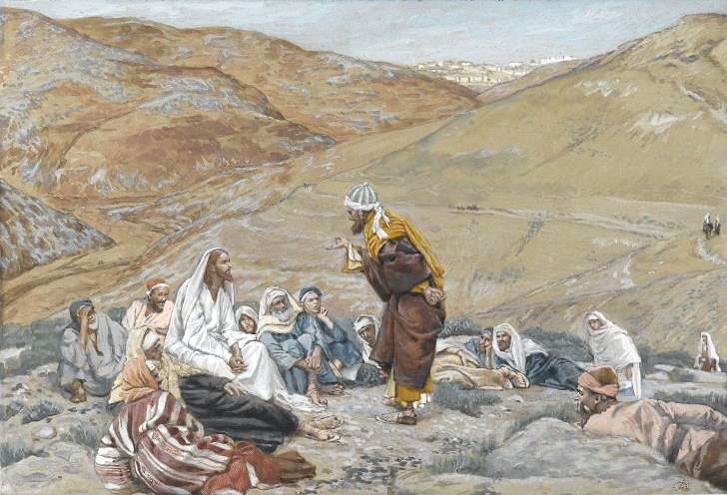
The Scribe Stood to Tempt Jesus -- James Tissot, Brooklyn Museum, New York, NY

Slide 16
Jesus answered, "The first is, 'Hear, O Israel: the Lord our God, the Lord is one;
Mark 2:29

Slide 17
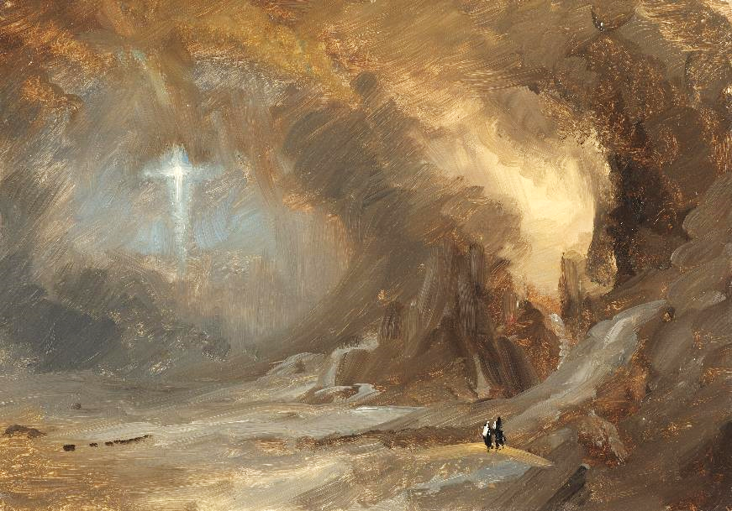
Vision -- Frederic Church, Cooper-Hewitt Museum, New York, NY

Slide 18
you shall love the Lord your God with all your heart, and with all your soul, and with all your mind, and with all your strength.'
Mark 12:30

Slide 19
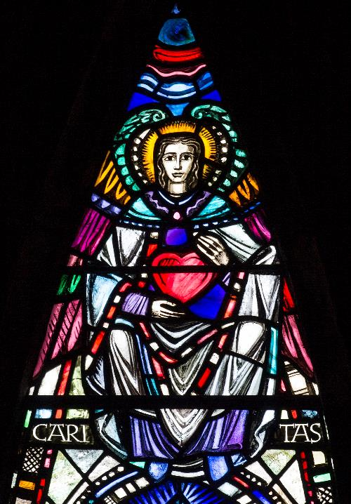
Caritas
William Wilson
St. Mungo Cathedral
Glasgow, Scotland

Slide 20
The second is this, 'You shall love your neighbor as yourself.' There is no other commandment greater than these."
Mark 12:31

Slide 21
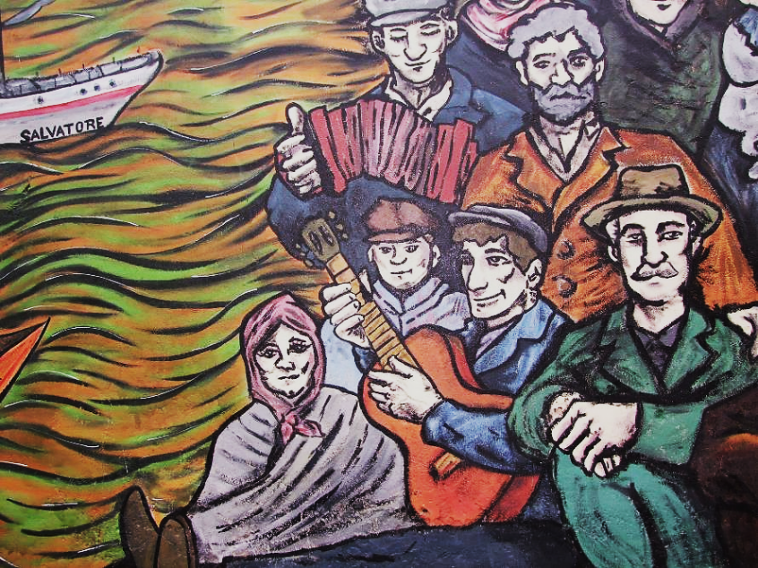
Immigrantes 2 -- Yuliana Cha

Slide 22
Then the scribe said to him, "You are right, Teacher; … When Jesus saw that he answered wisely, he said to him, "You are not far from the kingdom of God."
Mark 12:32a, 34a

Slide 23
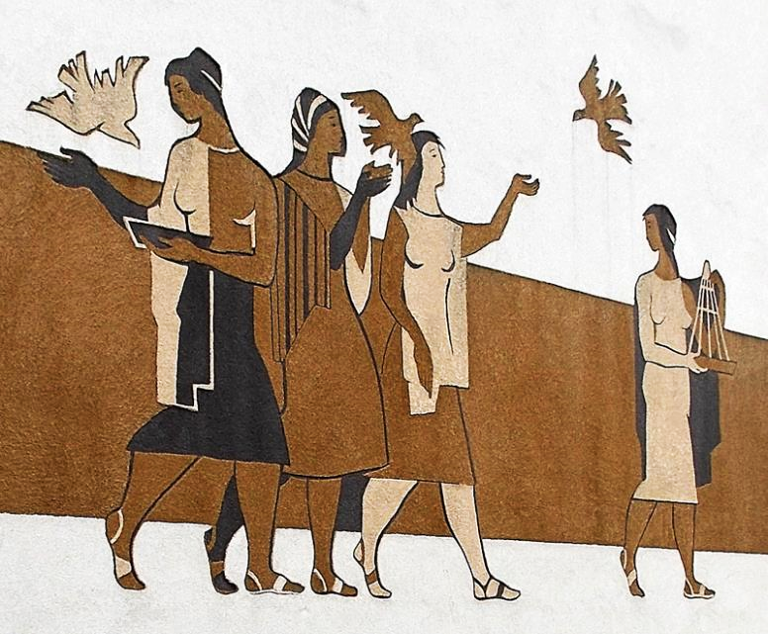
Peace -- Andre Michnay, Oroszlány, Hungary

Slide 24
Credits
New Revised Standard Version Bible, copyright 1989, Division of Christian Education of the National Council of the Churches of Christ in the United States of America. Used by permission. All rights reserved.
https://commons.wikimedia.org/wiki/File:1795-William-Blake-Naomi-entreating-Ruth-Orpah.jpg - H. Churchyard
https://commons.wikimedia.org/wiki/File:%27Ruth_and_Naomi%27_by_Jan_Victors,_1653.jpg
http://www.johnaugustswanson.com/default.cfm/PID%3d1.2.9-7.html – Copyright 1991, with permission.
http://www.librairie-emmanuel.fr (contact page: https://www.librairie-emmanuel.fr/contact)
https://commons.wikimedia.org/wiki/File:Mother_of_Earth_sculpture_by_Nandor_Wagner,_Ostrom_street,_2017_Budapest.jpg
https://www.flickr.com/photos/tlongacre/4275148699/
https://commons.wikimedia.org/wiki/File:Brooklyn_Museum_-_The_Scribe_Stood_to_Tempt_Jesus_(Le_scribe_se_leva_pour_tenter_J%C3%A9sus)_-_James_Tissot_-_overall.jpg
http://commons.wikimedia.org/wiki/File:Frederic_Edwin_Church_-_Vision_of_the_Cross_-_Google_Art_Project.jpg
https://www.flickr.com/photos/paullew/8539356086/ - Fr Lawrence Lew
https://commons.m.wikimedia.org/wiki/File:Inmigrantes_2.JPG
https://commons.wikimedia.org/wiki/File:L%C3%A1nyok,_madarakkal_(Michnay_Andrea),_2018_Oroszl%C3%A1ny.jpg
Additional descriptions can be found at the Art in the Christian Tradition image library, a service of the Vanderbilt Divinity Library, http://diglib.library.vanderbilt.edu/. All images available via Creative Commons 3.0 License.

