Slide 1
Nineteenth Sunday after Pentecost
Year B
Esther 7:1-6, 9-10; 9:20-22 and Psalm 124
Numbers 11:4-6, 10-16, 24-29 and Psalm 19:7-14
James 5:13-20 • Mark 9:38-50

Slide 2
"What is your petition, Queen Esther? It shall be granted you. And what is your request? Even to the half of my kingdom, it shall be fulfilled."
Esther 7:2

Slide 3
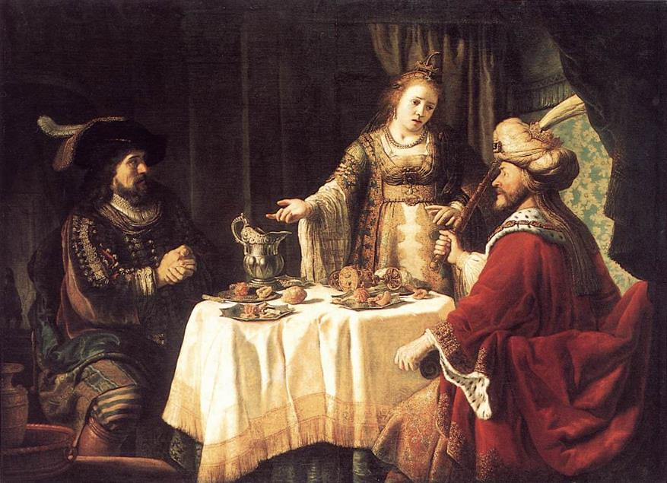
The Banquet of Esther and Ahasuerus -- Jan Victors, Kassel, Germany

Slide 4
Then Queen Esther answered,
"If I have won your favor, O king … let my life be given me … and the lives of my people."
Esther 7:3ab

Slide 5
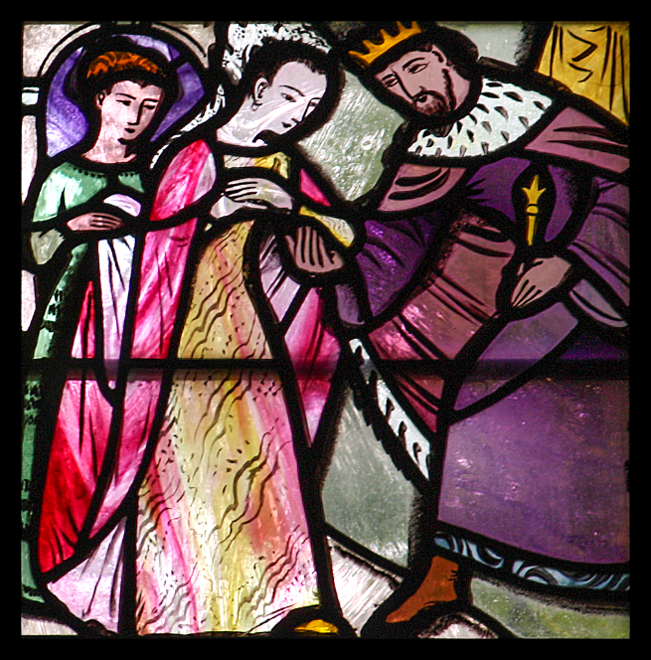
Esther and Ahasuerus
Charles Blakeman
Our Lady of Victories
London, England

Slide 6
Our help is in the name of the LORD, who made heaven and earth.
Psalm 124:8

Slide 7
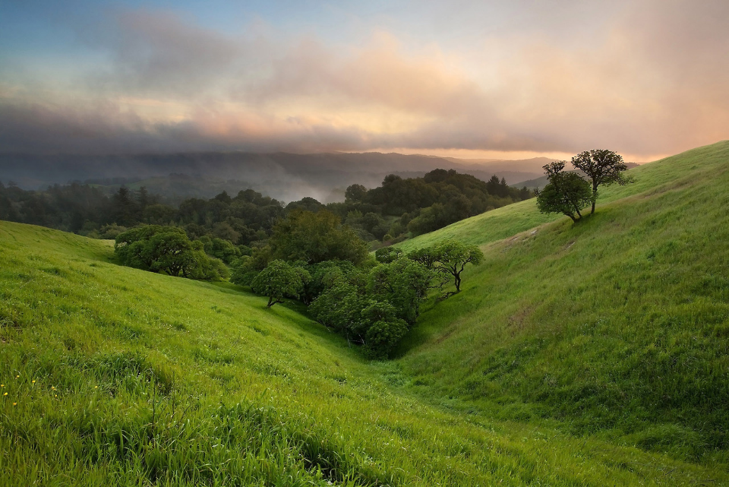
Earth's Beauty-- Russian Ridge Open Space, California

Slide 8
So Moses said to the LORD …
I am not able to carry all this people alone, for they are too heavy for me.
Numbers 11:11a, 14

Slide 9
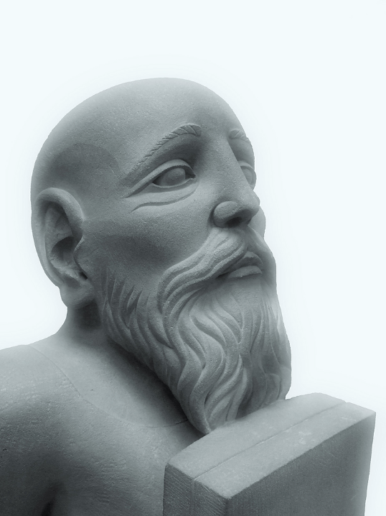
Head of Moses
Wolverhampton Art Gallery
United Kingdom

Slide 10
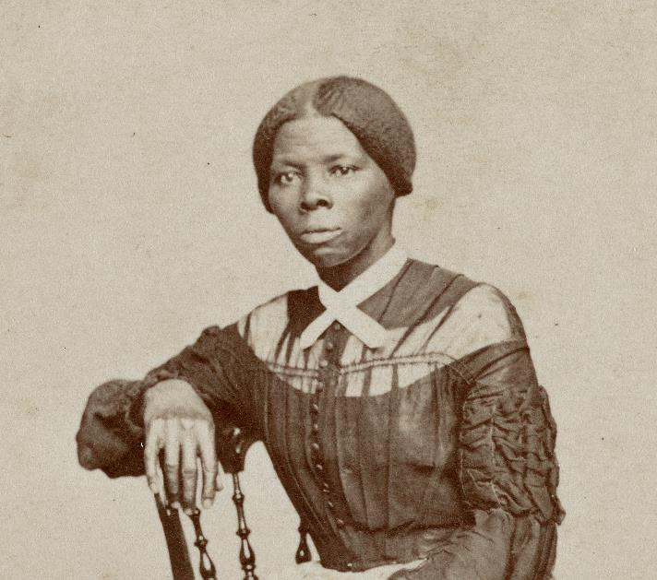
Harriet Tubman, known as the "Black Moses"
Smithsonian National Museum of African American History & Culture

Slide 11
Are any among you suffering? They should pray. Are any cheerful?
They should sing songs of praise.
James 5:13

Slide 12
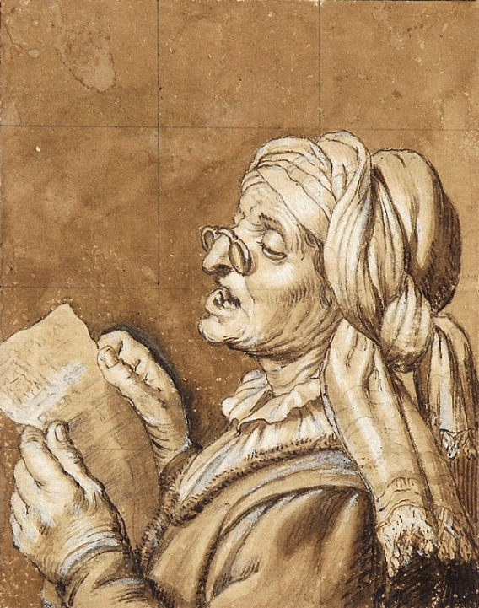
Woman Singing
Gerard van Honthorst
National Museum
Warsaw, Poland

Slide 13
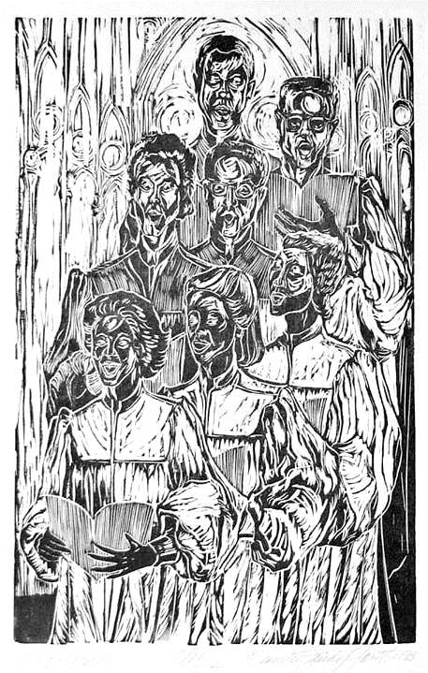
Choir
Annette Fortt Gandy
Silver Spring, MD

Slide 14
Are any among you sick? They should call for the elders of the church and have them pray over them, anointing them with oil in
the name of the Lord.
James 5:14

Slide 15
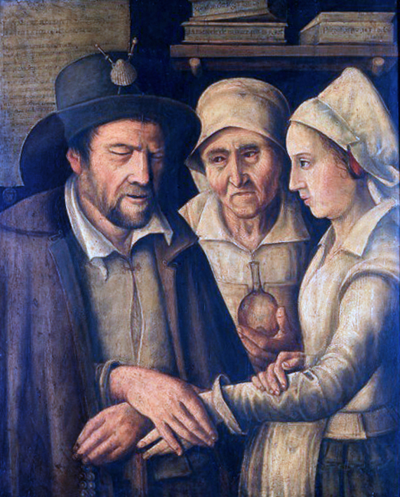
Healing by Laying On of Hands
Maistre Robert
Wellcome Trust, UK

Slide 16
Therefore confess your sins to one another, and pray for one another … prayer … is powerful and effective.
James 5:16ac

Slide 17
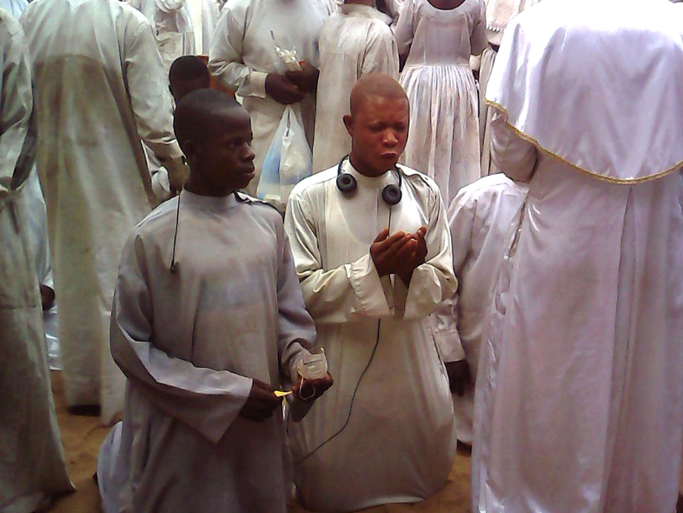
Pilgrimage Prayer -- Seme, Senegal

Slide 18
John said to him, "Teacher, we saw someone casting out demons in your name, and we tried to stop him, because he was not following us."
Mark 9:38

Slide 19
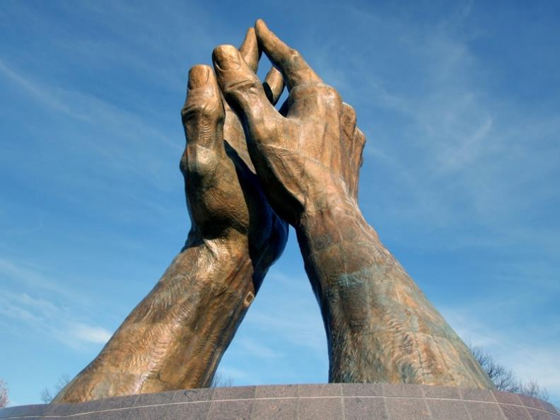
Healing Hands -- Oral Roberts University, Tulsa, Oklahoma

Slide 20
But Jesus said, "Do not stop him … Whoever is not against us is for us."
Mark 9:39a, 40

Slide 21
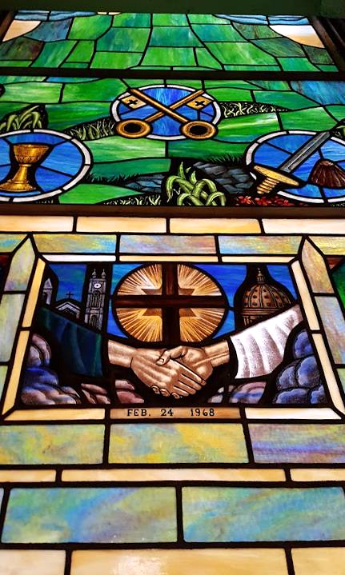
The Ecumenical Window
Old Stone Church Cleveland, OH

Slide 22
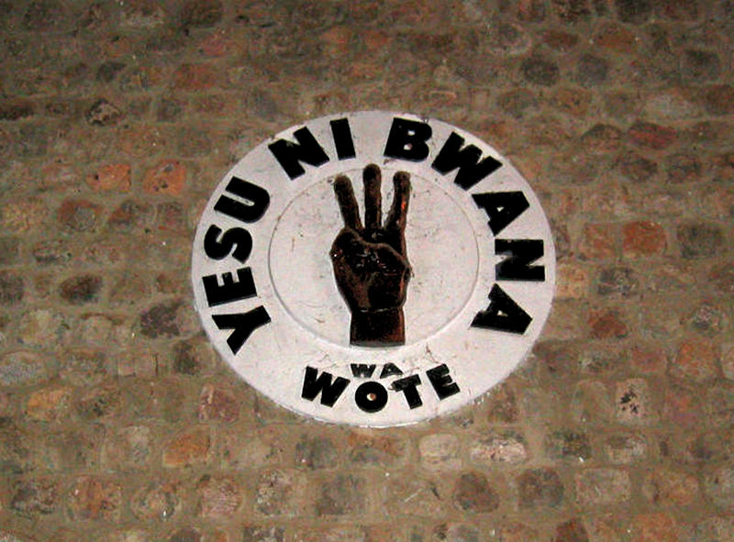
Jesus is Lord -- Mulungwishi Methodist Church, DRCongo

Slide 23
Salt is good; but if salt has lost its saltiness, how can you season it? Have salt in yourselves, and be at peace with one another."
Mark 9:50

Slide 24
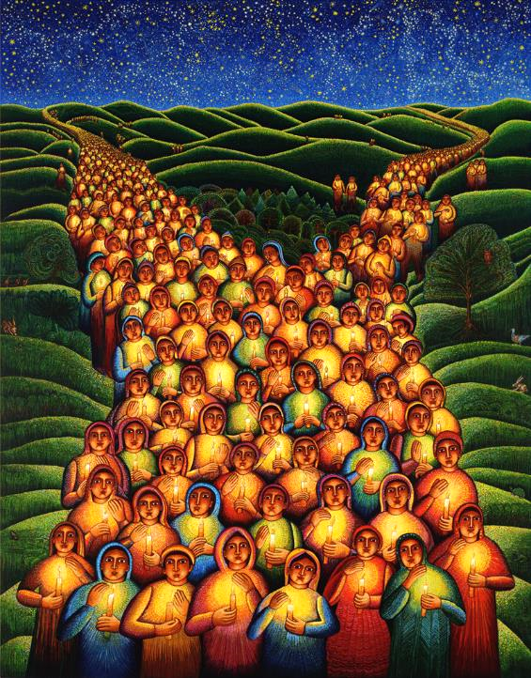
Festival of Lights
John August Swanson

Slide 25
Credits
New Revised Standard Version Bible, copyright 1989, Division of Christian Education of the National Council of the Churches of Christ in the United States of America. Used by permission. All rights reserved.
https://commons.wikimedia.org/wiki/File:Jan_Victors_-_The_Banquet_of_Esther_and_Ahasuerus_-_WGA25059.jpg
https://www.flickr.com/photos/paullew/8493819053 - Fr. Lawrence Lew
https://www.flickr.com/photos/junaidrao/36468986901 - junaidrao
https://www.flickr.com/photos/futurilla/5842958073
https://commons.wikimedia.org/wiki/File:Carte-de-visite_portrait_of_Harriet_Tubman.jpg
https://commons.wikimedia.org/wiki/File:Honthorst_Old_woman_singing.jpg
annettefortt.com
https://commons.wikimedia.org/wiki/File:%22Maistre_Robert%22_healing_by_laying-on_of_hands._Oil_painting_Wellcome_V0018251.jpg
https://commons.wikimedia.org/wiki/File:Youth_praying.jpg
https://commons.wikimedia.org/wiki/File:Praying_member.jpg – Live.philips
https://www.flickr.com/photos/josephleenovak/4288827165/
https://www.flickr.com/photos/timevanson/27393027736 – Tim Evanson
https://www.flickr.com/photos/umccongo/2188556374
https://www.flickr.com/photos/wallyg/14890407643 - Wally Gobetz
Additional descriptions can be found at the Art in the Christian Tradition image library, a service of the Vanderbilt Divinity Library, http://diglib.library.vanderbilt.edu/. All images available via Creative Commons 3.0 License.

