Slide 1
Seventeenth Sunday after Pentecost
Year B
Proverbs 1:20-33 and Psalm 19 or Wisdom of Solomon 7:26 - 8:1 • Isaiah 50:4-9a and Psalm 116:1-9
James 3:1-12 • Mark 8:27-38

Slide 2
Wisdom cries out in the street; in the squares she raises her voice.
… "How long will scoffers delight in their scoffing and fools hate knowledge?"
Proverbs 1:20

Slide 3
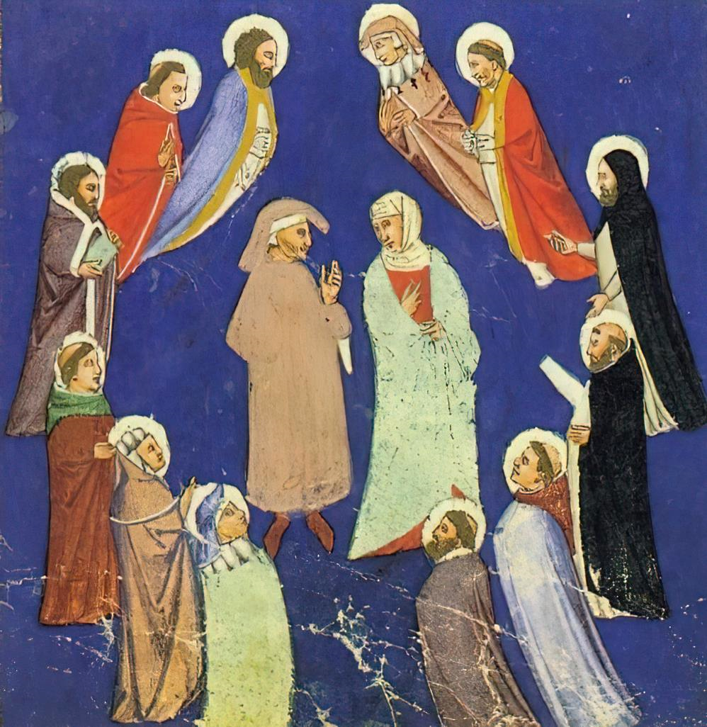
Twelve Teachers of Wisdom -- 15th century, Royal Library, Copenhagen, Denmark

Slide 4
Let the words of my mouth and the meditation of my heart be acceptable to you, O LORD, my rock and my redeemer.
Psalm 19

Slide 5
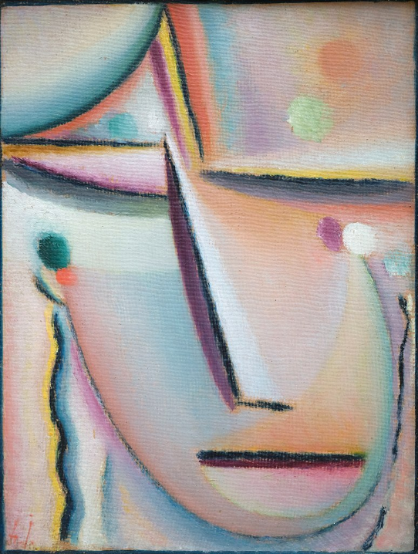
Meditation (Prayer)
Alexej von Jawlensky
Lenbachhaus
Munich, Germany

Slide 6
I gave my back to those who struck me, and my cheeks to those who pulled out the beard; I did not hide my face from insult and spitting.
Isaiah 50:6

Slide 7
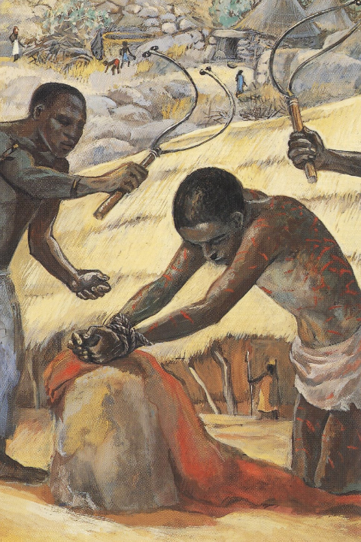
Flagellation
JESUS MAFA
Cameroon

Slide 8
… no one can tame the tongue … With it we bless the Lord and Father, and with it we curse those who are made in the likeness of God.
James 3:8a, 9

Slide 9
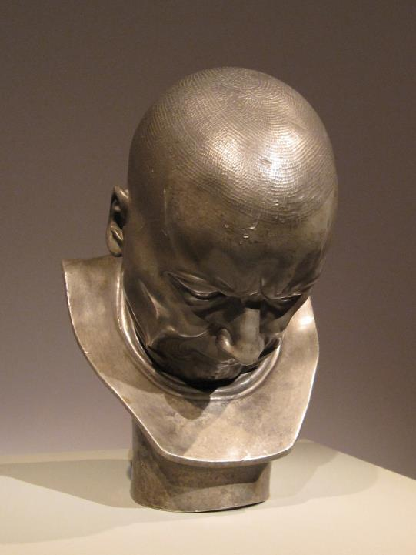
Hypocrite and Slanderer
Franz Messerschmidt
Metropolitan Museum
New York, NY

Slide 10
Jesus went on with his disciples to the villages of Caesarea Philippi; and on the way he asked his disciples, "Who do people say that I am?"
Mark 8:27

Slide 11
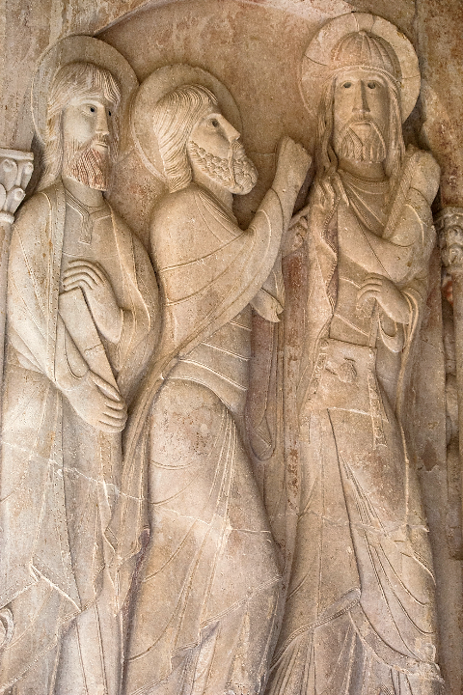
Christ with Disciples
Abbey of Santo Domingo de Silos
Santo Domingo de Silos, Spain

Slide 12
And they answered him, "John the Baptist; and others, Elijah; and still others, one of the prophets."
Mark 8:28

Slide 13
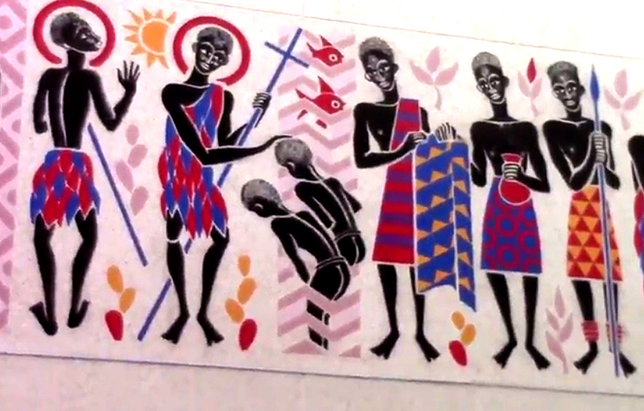
John the Baptist -- Father George Saget, Keur Moussa Abbey, Senegal

Slide 14
He asked them, "But who do you say that I am?" Peter answered him, "You are the Messiah."
Mark 8:29

Slide 15
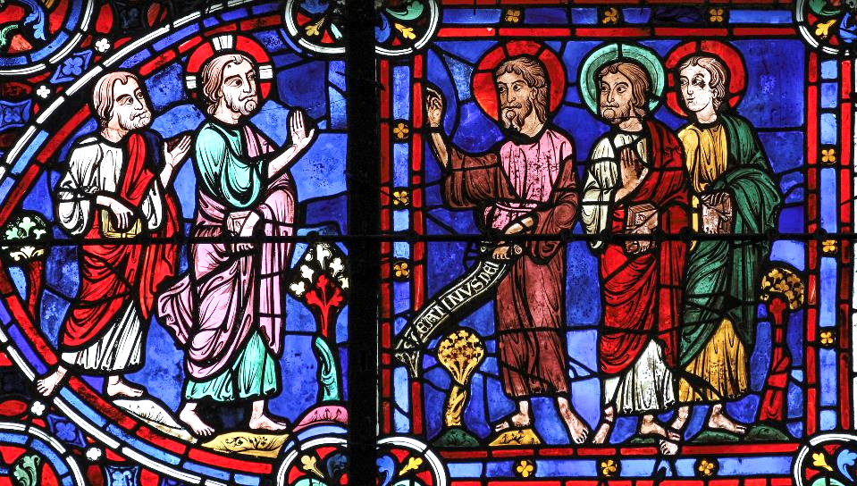
Behold the Lamb of God, Peter Acclaims Christ -- Chartres Cathedral, Chartres, France

Slide 16
Then he began to teach them that the Son of Man must undergo great suffering, and be rejected by the elders, the chief priests, and the scribes, and be killed, and after three days rise again.
Mark 8:31

Slide 17
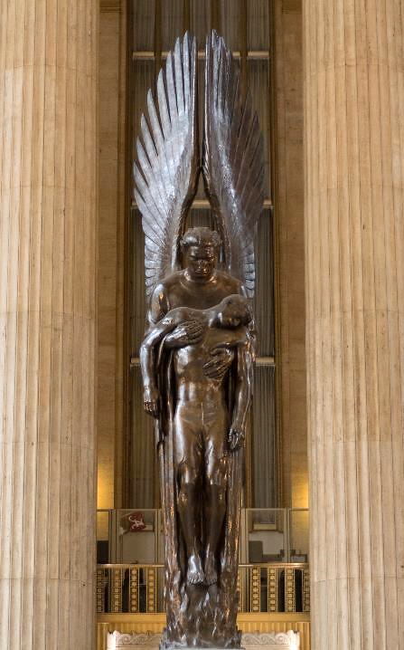
Angel of the Resurrection
World War II Memorial
Philadelphia, PA

Slide 18
He said all this quite openly. And Peter took him aside and began to rebuke him.
Mark 8:32

Slide 19
But turning and looking at his disciples, he rebuked Peter and said, "Get behind me, Satan! For you are setting your mind not on divine things but on human things."
Mark 8:33

Slide 20
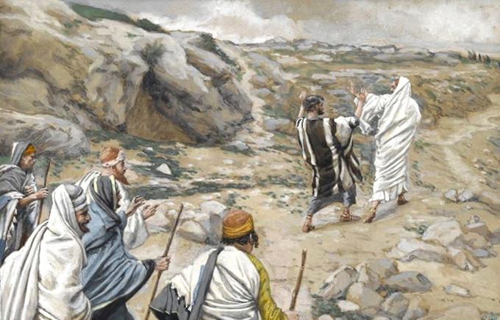
"Get Thee Behind Me, Satan!" -- James Tissot, Brooklyn Museum, New York, NY

Slide 21
He called the crowd with his disciples, and said to them, "If any want to become my followers, let them deny themselves and take up their cross and follow me.
Mark 8:35

Slide 22
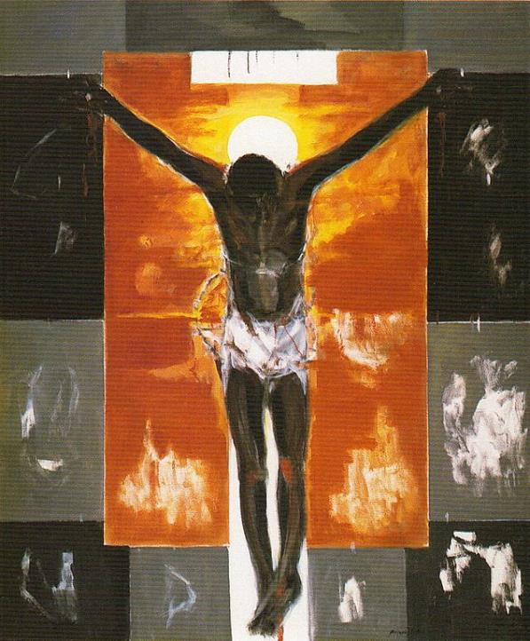
Cristo Negro
Ruiz Anglada
Sastago Palace
Zaragoza, Spain

Slide 23
For those who want to save their life will lose it, and those who lose their life for my sake, and for the sake of the gospel, will save it."
Mark 8:35

Slide 24
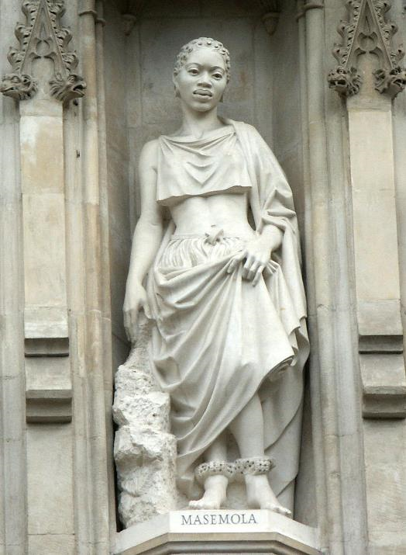
Manche Masemola, South African Martyr
Westminster Abbey
London, England

Slide 25
Credits
New Revised Standard Version Bible, copyright 1989, Division of Christian Education of the National Council of the Churches of Christ in the United States of America. Used by permission. All rights reserved.
https://commons.wikimedia.org/wiki/File:Dante_Pd10_Kopenhagen_MS_Thott_411.2.jpg
https://commons.wikimedia.org/wiki/File:Jawlensky_Meditation_Das_Gebet_1290067.jpg
http://diglib.library.vanderbilt.edu/act-imagelink.pl?RC=48274
http://commons.wikimedia.org/wiki/File:Franz_Xaver_Messerschmidt_002.JPG
https://www.flickr.com/photos/paullew/8616284980/
www.robertharding.com
https://www.flickr.com/photos/paullew/16120011720 - Fr Lawrence Lew, O.P.
https://commons.wikimedia.org/wiki/File:Angel_of_the_Resurrection.jpg
http://commons.wikimedia.org/wiki/File:Brooklyn_Museum_-_Get_Thee_Behind_Me_Satan_(R%C3%A9tire-toi_Satan)_-_James_Tissot.jpg
https://commons.wikimedia.org/wiki/File:Ruizanglada_-_Cristo_Negro_180x150_1995_A-L_-_Catalogo_1995_Palacio_de_Sastago_Zaragoza.jpg
https://commons.wikimedia.org/wiki/File:WestminsterAbbey-Martyrs.jpg - Jean-Christophe BENOIST
Additional descriptions can be found at the Art in the Christian Tradition image library, a service of the Vanderbilt Divinity Library, http://diglib.library.vanderbilt.edu/. All images available via Creative Commons 3.0 License.

