Slide 1
Twelfth Sunday after Pentecost
Year B
2 Samuel 18:5-9, 15, 31-33 and Psalm 130
1 Kings 19:4-8 and Psalm 34:1-8 • Ephesians 4:25-5:2 John 6:35, 41-51

Slide 2
"O my son Absalom, my son, my son Absalom! Would I had died instead of you, O Absalom, my son, my son!"
2 Samuel 18:33b

Slide 3
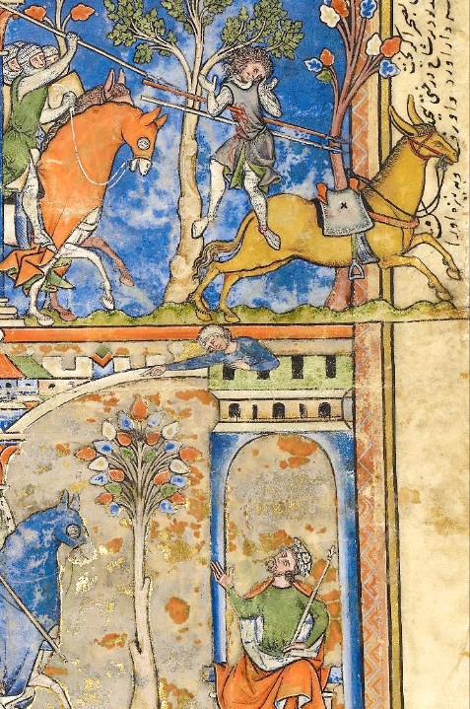
Death of Absalom,
King David Grieves
Morgan Picture Bible
Getty Center
Los Angeles, CA

Slide 4
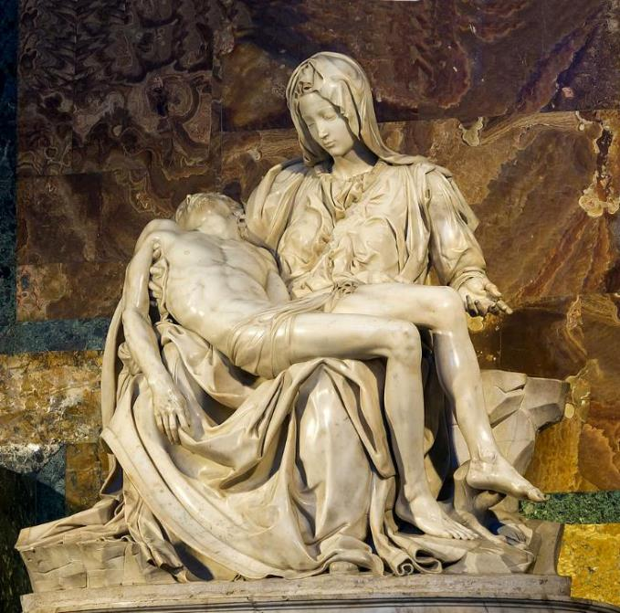
Pieta -- Michelangelo, St. Peter's Basilica, Vatican City

Slide 5
Out of the depths I cry to you, O LORD. Lord, hear my voice!
Psalm 130:1-2a

Slide 6
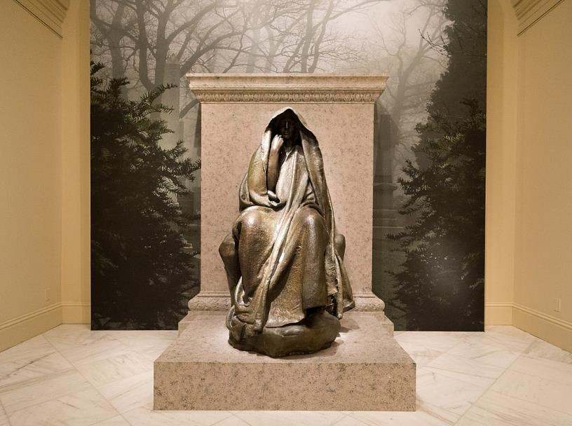
Adams Memorial -- Augustus Saint-Gaudens, Smithsonian Museum of American Art, Washington, DC

Slide 7
Suddenly an angel touched him and said to him, "Get up and eat." He looked, and there at his head was a cake baked on hot stones, and a jar of water.
1 Kings 19:5b-6a

Slide 8
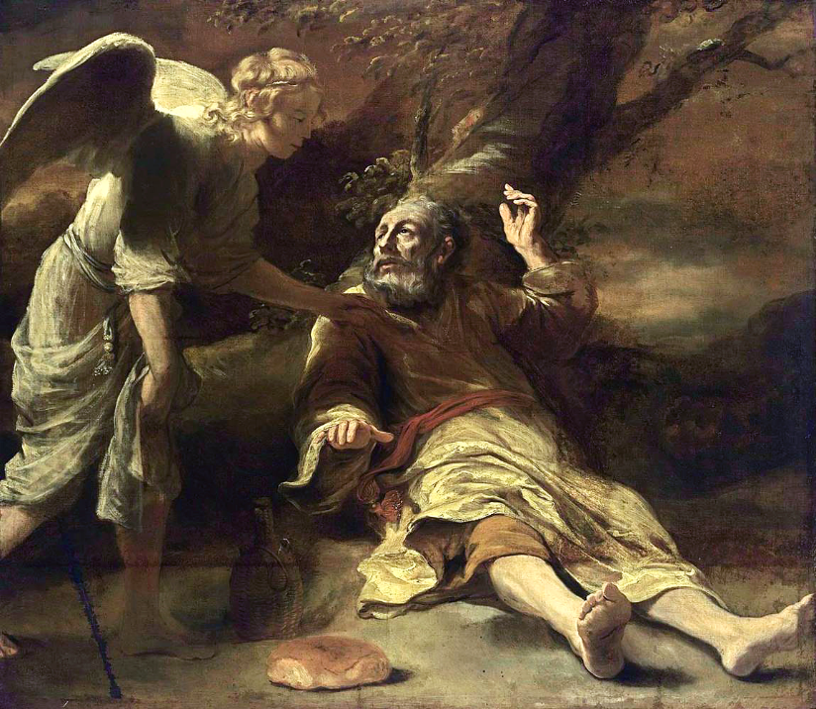
Elijah and the Angel
Ferdinand Boll

Slide 9
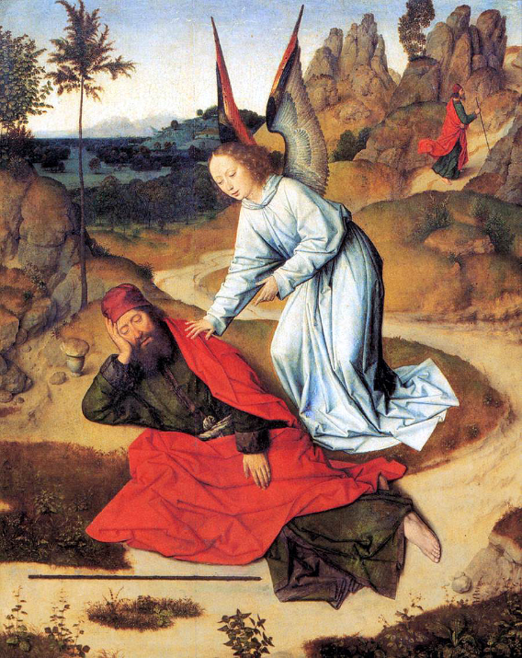
Elijah and the Angel
Dieric Bouts
St. Peter's Church
Leuven, Belgium

Slide 10
O taste and see that the LORD is good; happy are those who take refuge in him.
Psalm 34:8

Slide 11
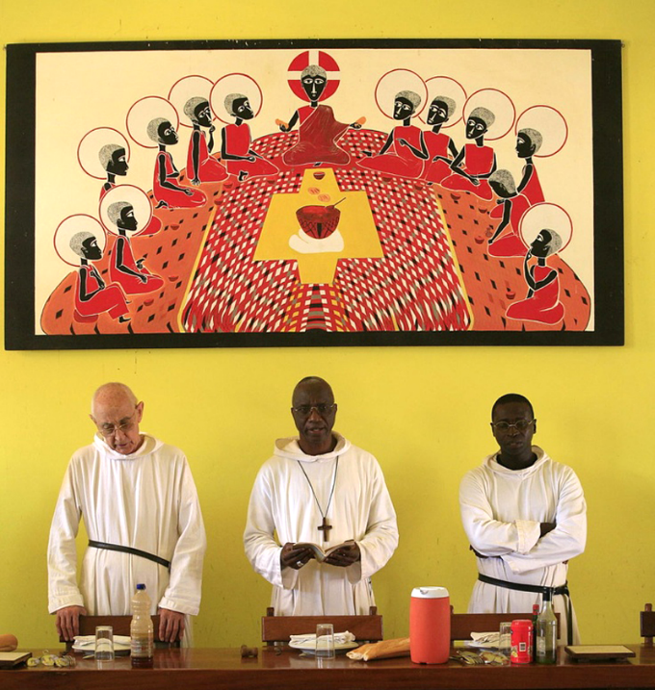
Blessing of the Meal
Robert Harding
Keur Moussa Abbey
Senegal

Slide 12
Put away from you all bitterness and wrath and anger and wrangling and slander, together with all malice,
Ephesians 4:31

Slide 13
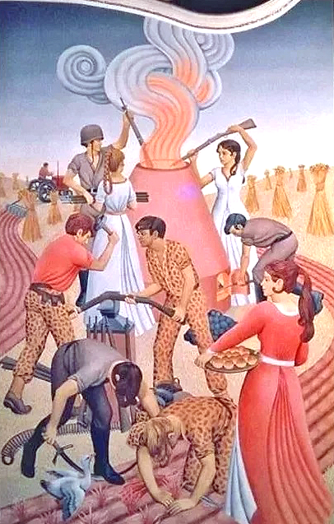
Swords into Plowshares
Peter Koenig

Slide 14
Let no evil talk come out of your mouths, but only what is useful for building up … so that your words may give grace to those who hear.
Ephesians 4:29ac

Slide 15
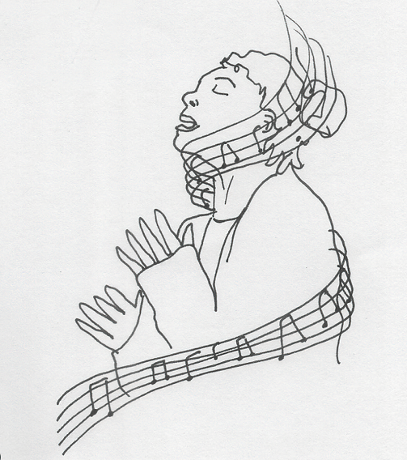
Praise -- Liz Valente

Slide 16
and be kind to one another, tenderhearted, forgiving one another, as God in Christ has forgiven you.
Ephesians 4:32

Slide 17
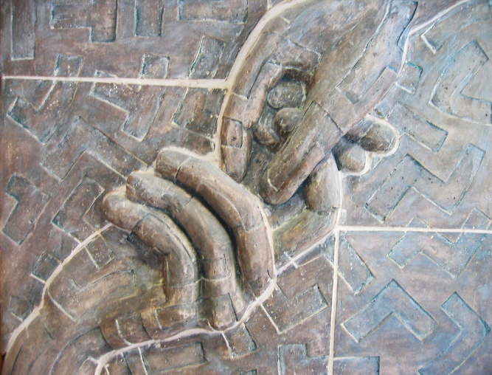
Hand of God -- Church wall sculpture, [Taiwan]

Slide 18
Jesus said to them, "I am the bread of life.
John 6:35a

Slide 19
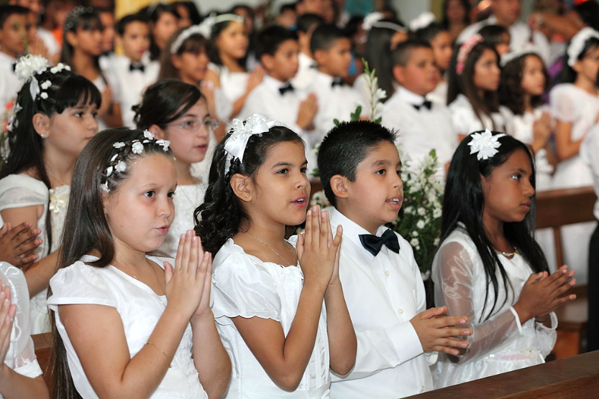
Celebrating First Communion

Slide 20
No one can come to me unless drawn by the Father who sent me …
John 6:44

Slide 21
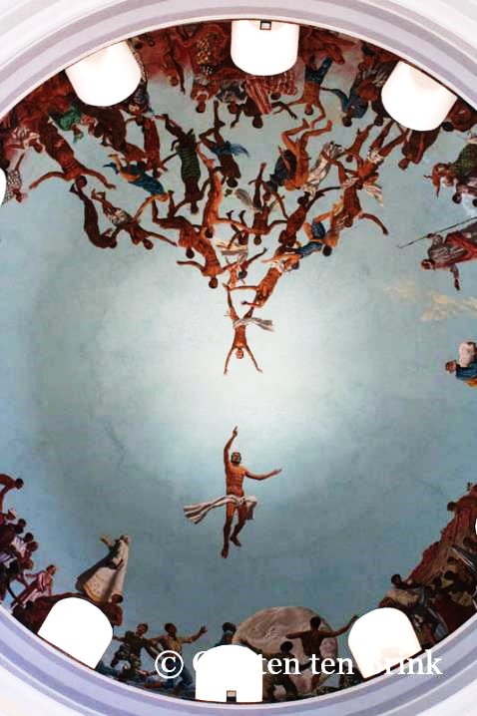
[Coming to God]
Cathedral Dome
Dakar, Senegal

Slide 22
Very truly, I tell you, whoever believes has eternal life.
John 6:47

Slide 23
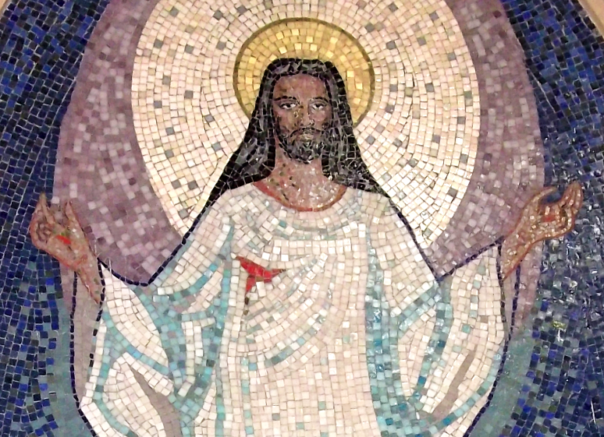
The Resurrected Christ -- Church of San Sebastian, Porto Alegre, Brazil

Slide 24
I am the bread of life.
John 6:48

Slide 25
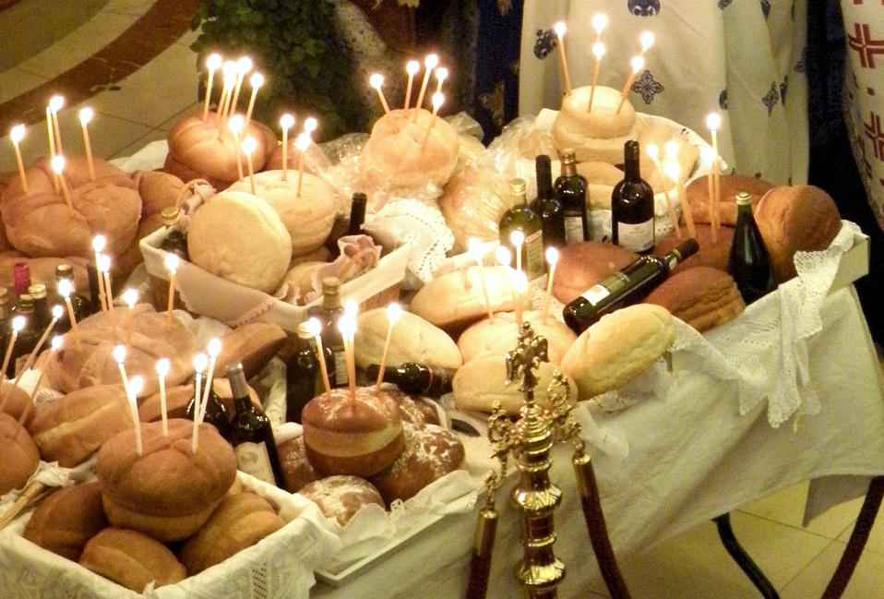
Artoklasia, Breaking of Bread -- Annunciation of the Virgin Greek Orthodox Cathedral, Toronto, Canada

Slide 26
Credits
New Revised Standard Version Bible, copyright 1989, Division of Christian Education of the National Council of the Churches of Christ in the United States of America. Used by permission. All rights reserved.
https://commons.wikimedia.org/wiki/File:Leaf_from_the_Morgan_Picture_Bible_-_Google_Art_Project.jpg
https://commons.wikimedia.org/wiki/File:Michelangelo%27s_Piet%C3%A0_Saint_Peter%27s_Basilica_Vatican_City.jpg - Jebulon
https://commons.wikimedia.org/wiki/File:Smithsonian-Saint-Gaudens-Adams_Memorial-2264.jpg
https://www.flickr.com/photos/americanartmuseum/3662422645/
https://commons.wikimedia.org/wiki/File:Ferdinand_Bol_-_Elijah_Fed_by_an_Angel_-_WGA2360.jpg
https://commons.wikimedia.org/wiki/File:Dieric_Bouts_-_Prophet_Elijah_in_the_Desert_-_WGA03015.jpg
www.robertharding.com
Peter Winfried (Canisius) Koenig, https://www.pwkoenig.co.uk/
Liz Valente, https://www.instagram.com/donalizvalente/
https://www.flickr.com/photos/benny_lin/266525995/
https://commons.wikimedia.org/wiki/File:Celebrating_the_First_Communion_-_Celebrando_la_Primera_Comuni%C3%B3n.JPG - Ricardoricardo618
https://www.flickr.com/photos/carsten_tb/22260925034/ - Carsten ten Brink
https://commons.wikimedia.org/wiki/File:0000_Mosaics_of_Resurrection_of_Christ.JPG - Eugenio Hansen, OFS
http://commons.wikimedia.org/wiki/File:2013-08-14--Artoklasia_during_Feast_of_the_Dormition_of_the_Virgin_Mary.JPG
Additional descriptions can be found at the Art in the Christian Tradition image library, a service of the Vanderbilt Divinity Library, http://diglib.library.vanderbilt.edu/. All images available via Creative Commons 3.0 License.

