Slide 1
Ninth Sunday after Pentecost
Year B
2 Samuel 7:1-14a and Psalm 89:20-37 • Jeremiah 23:1-6 and Psalm 23 • Ephesians 2:11-22 • Mark 6:30-34, 53-56

Slide 2
Go and tell my servant David … the LORD declares to you that the LORD will make you a house.
2 Samuel 7:5a, 11b

Slide 3
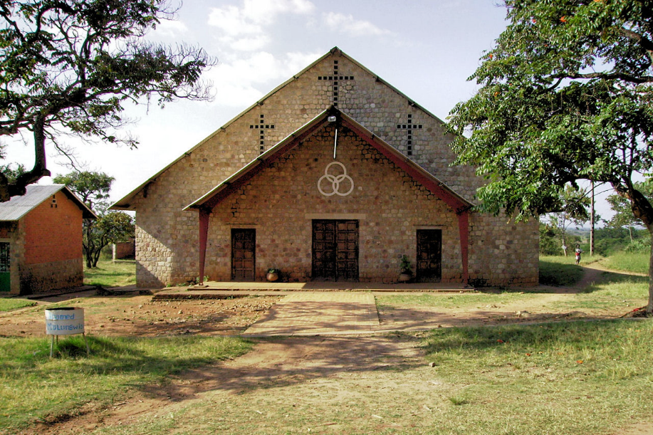
Mulungwishi United Methodist Church, Mulungwishi, Democratic Republic of Congo

Slide 4
I will raise up shepherds over them who will shepherd them, and they shall not fear any longer … says the Lord.
Jeremiah 23:4ac

Slide 5
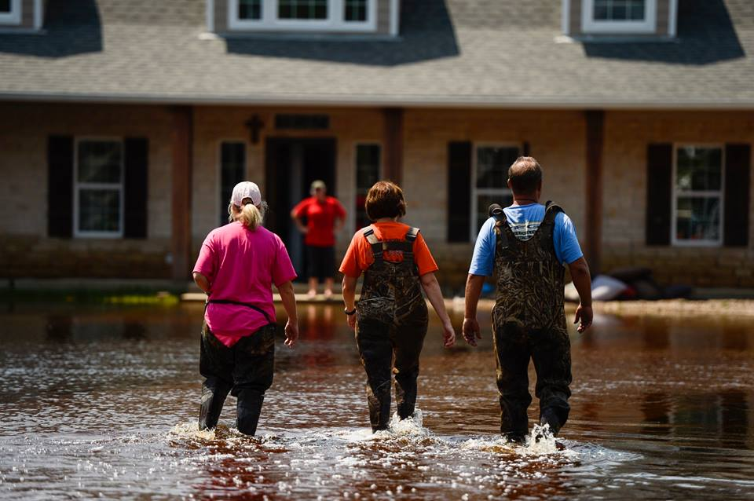
Hurricane Harvey Relief -- Orange, Texas

Slide 7
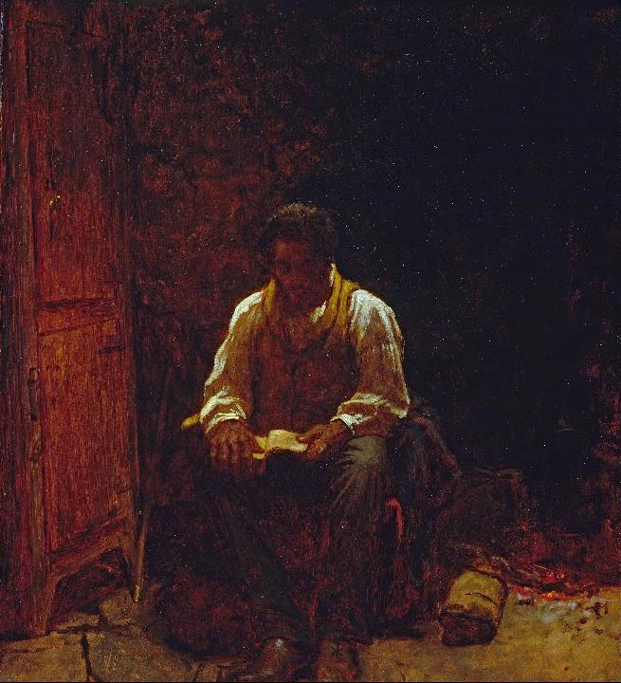
The Lord is My Shepherd
Eastman Johnson
Smithsonian Museum of American Art
Washington, DC

Slide 9
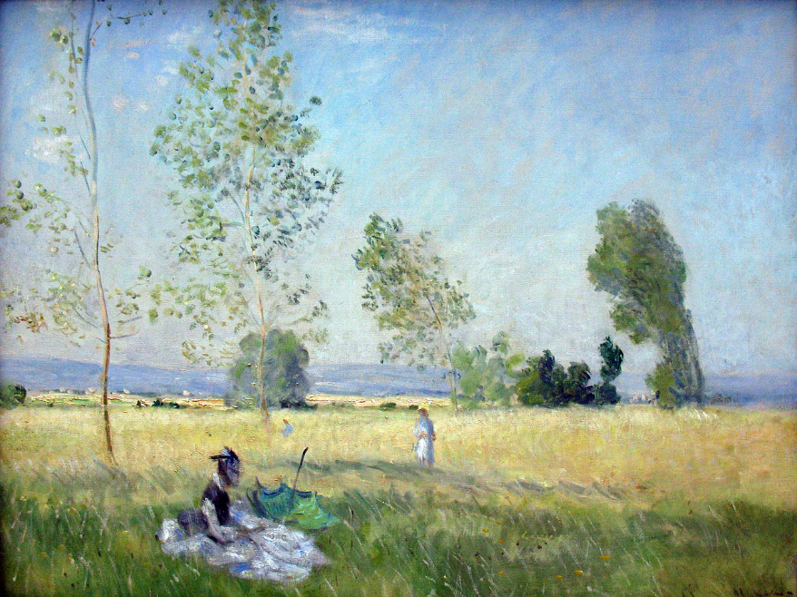
Summer -- Claude Monet, Alte Nationalgalerie, Berlin, Germany

Slide 11
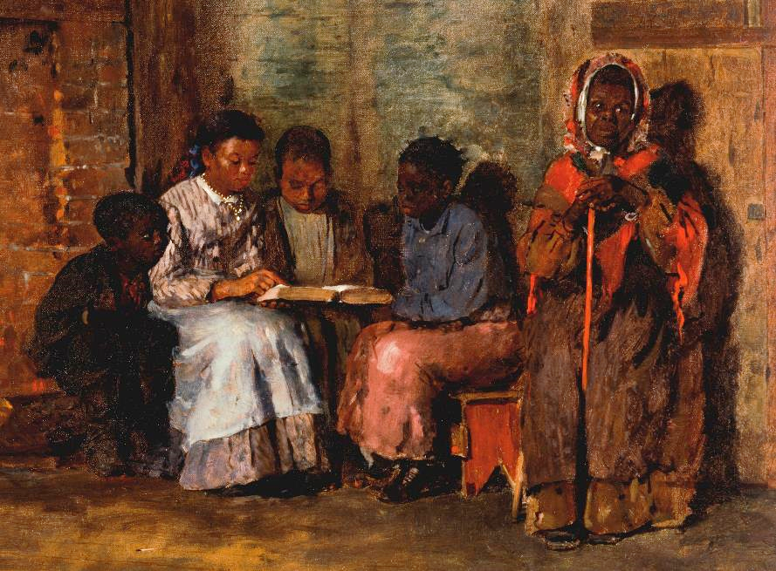
Sunday Morning in Virginia -- Winslow Homer, Cincinnati Art Museum, Cincinnati, OH

Slide 13
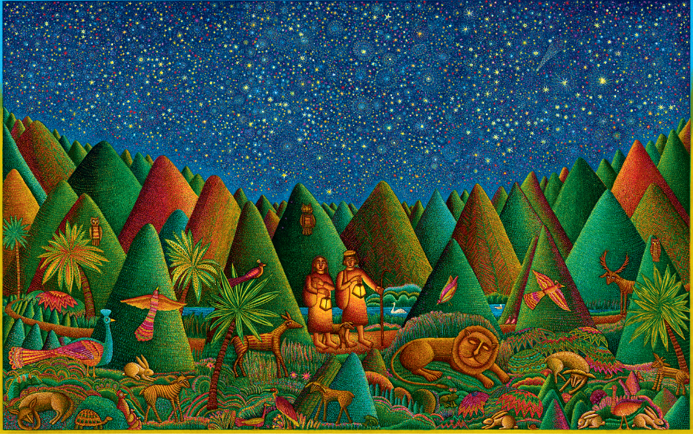
Psalm 23 -- John August Swanson, serigraph, 2010

Slide 15
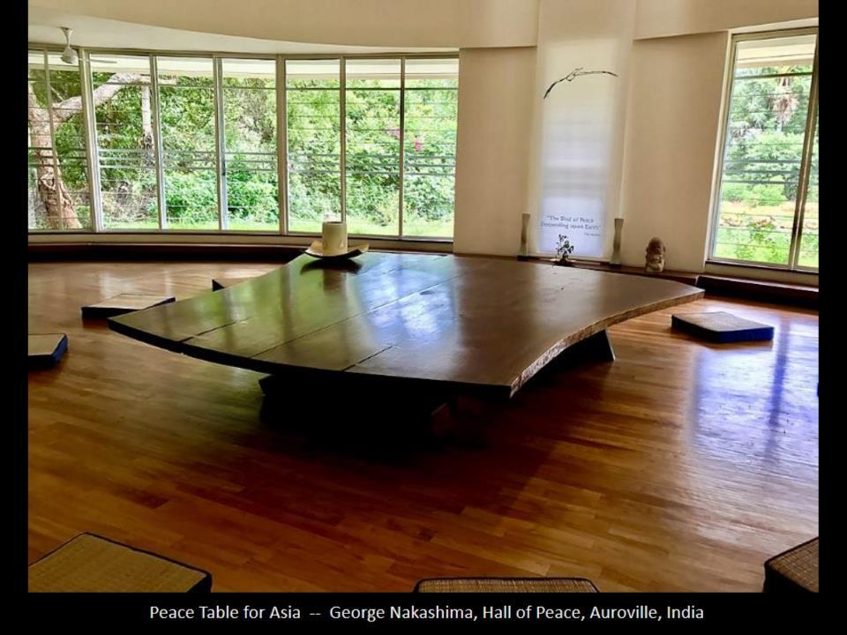

Slide 16
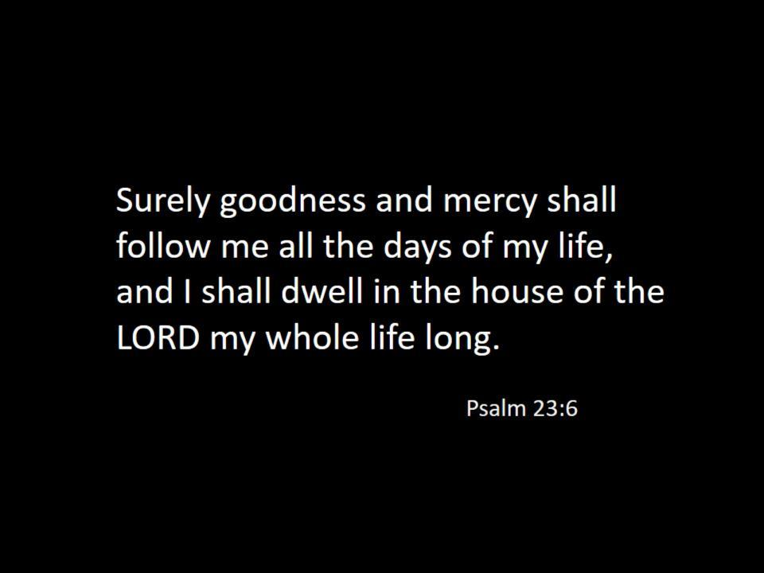

Slide 17
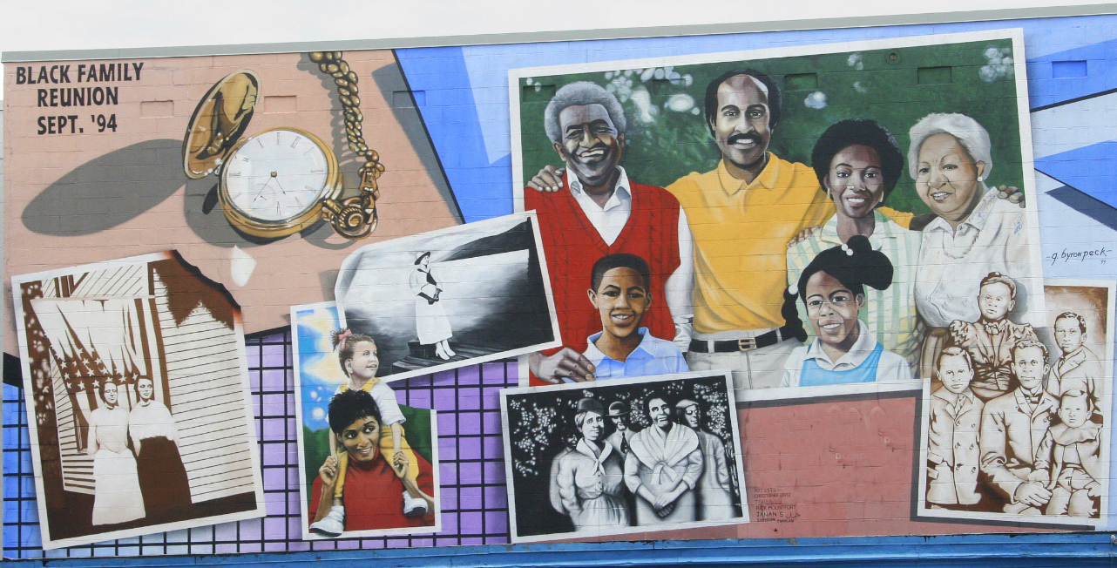
Black Family Reunion -- G. Byron Peck, Washington, DC

Slide 18
with Christ Jesus himself as the cornerstone … you also are built together spiritually into a dwelling place for God.
Ephesians 2:20b, 22b

Slide 19
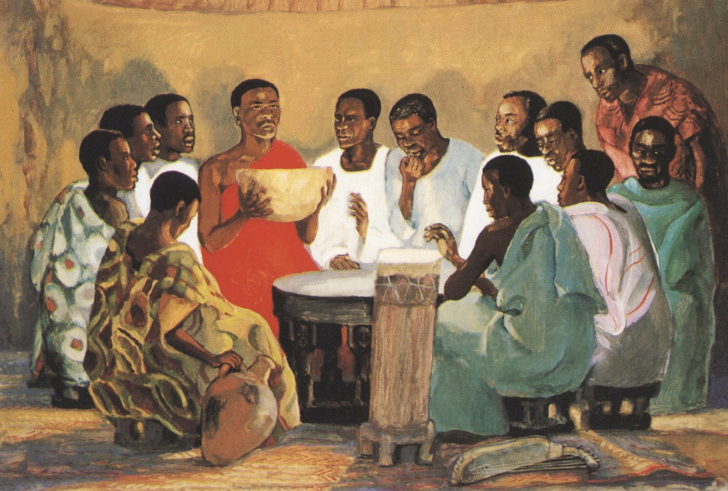
The Lord's Supper -- JESUS MAFA, Cameroon

Slide 20
he saw a great crowd; and he had compassion for them, because they were like sheep without a shepherd;
Mark 6:34b

Slide 21
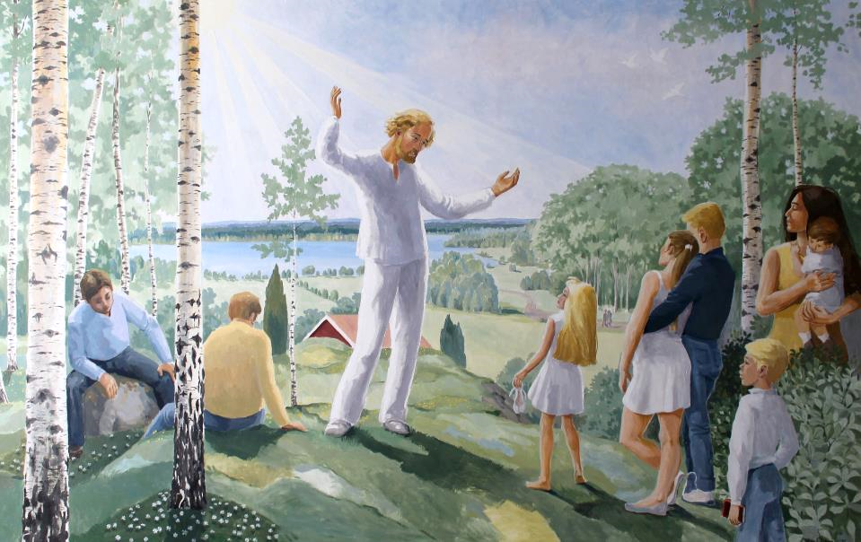
Jesus Preaching in the Present -- Soraby Kyrka, Rottne, Sweden

Slide 22
they laid the sick in the marketplaces, and begged him that they might touch even the fringe of his cloak; and all who touched it were healed.
Mark 6:56b

Slide 23
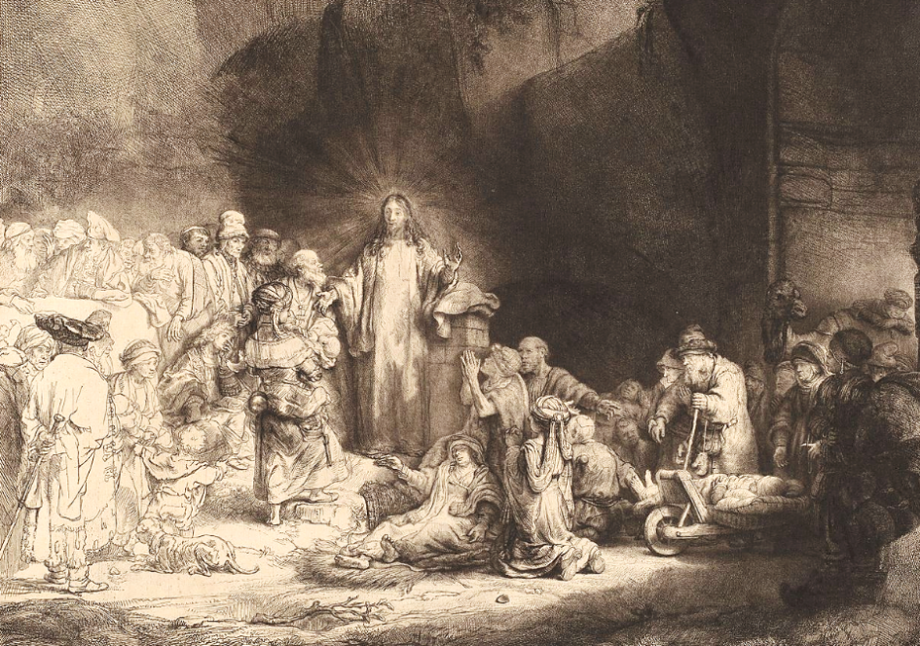
Christ Preaching -- Rembrandt, Rijksmuseum, Amsterdam, Netherlands

Slide 24
Credits
New Revised Standard Version Bible, copyright 1989, Division of Christian Education of the National Council of the Churches of Christ in the United States of America. Used by permission. All rights reserved.
https://www.flickr.com/photos/umccongo/2198525053
https://commons.wikimedia.org/wiki/File:Hurricane_Harvey_Relief_Sept_2017_(36487862313).jpg
http://commons.wikimedia.org/wiki/File:Eastman_Johnson_-_The_Lord_Is_My_Shepherd_-_Google_Art_Project.jpg
https://commons.wikimedia.org/wiki/File:1874_Monet_Sommer_anagoria.JPG
https://commons.wikimedia.org/wiki/File:Winslow_Homer_-_Sunday_Morning_in_Virginia_-_Google_Art_Project.jpg
PSALM 23 - copyright 2010 by John August Swanson, www.JohnAugustSwanson.com
https://commons.wikimedia.org/wiki/File:Table_of_Peace_in_Auroville_Township.jpg
https://www.flickr.com/photos/bootbearwdc/256870136
http://www.librairie-emmanuel.fr (contact page: https://www.librairie-emmanuel.fr/contact)
https://commons.wikimedia.org/wiki/File:S%C3%B6raby_kyrka_Tavla_021.JPG
https://commons.wikimedia.org/wiki/File:Rembrandt_van_Rijn_-_Christ_Preaching_(The_Hundred_Guilder_Print)_-_Google_Art_Project.jpg
Additional descriptions can be found at the Art in the Christian Tradition image library, a service of the Vanderbilt Divinity Library, http://diglib.library.vanderbilt.edu/. All images available via Creative Commons 3.0 License.

