Slide 1
Eighth Sunday after Pentecost
Year B
2 Samuel 6:1-5, 12b-19 and Psalm 24 • Amos 7:7-15 and Psalm 85:8-13 • Ephesians 1:3-14 • Mark 6:14-29

Slide 2
David and all the house of Israel were dancing before the LORD with all their might, with songs and lyres and harps and tambourines and castanets and cymbals.
2 Samuel 6:5

Slide 3
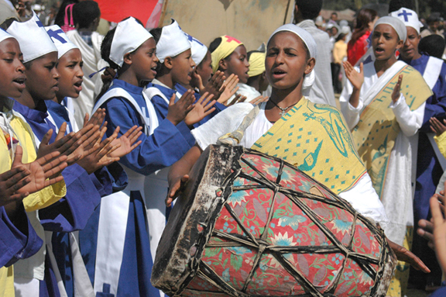
Celebration of Timket -- Addis Ababa, Ethiopia

Slide 4
The earth is the Lord's
and all that is in it,
the world, and those who live in it;
Psalm 24:1

Slide 5
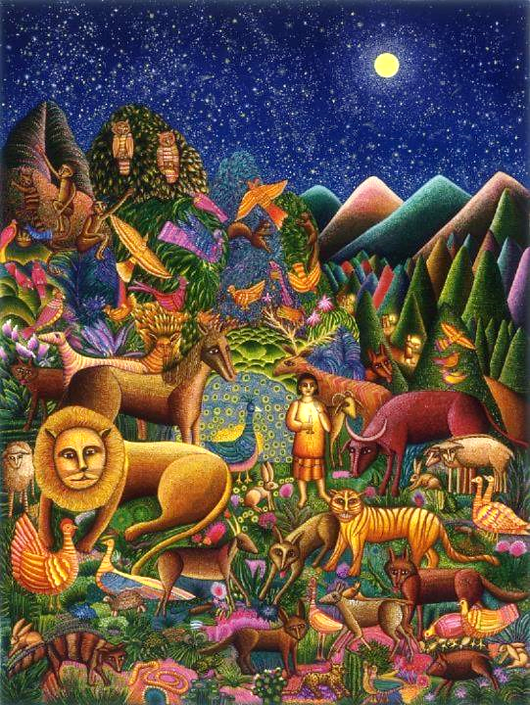
Peaceable Kingdom
John August Swanson
Seriograph, 1994

Slide 6
… Amos answered … "the Lord took me from following the flock … and said … 'Go, prophesy to my people Israel.' "
Amos 7:14b, 15ac

Slide 7
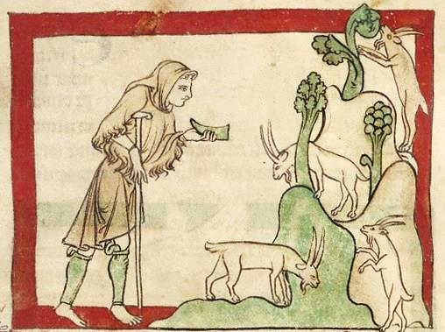
The Prophet Amos, about 1250 - 1260, J. Paul Getty Museum, Los Angeles, CA

Slide 8
Faithfulness will spring up from the ground, and righteousness will look down from the sky.
Psalm 85:11

Slide 9
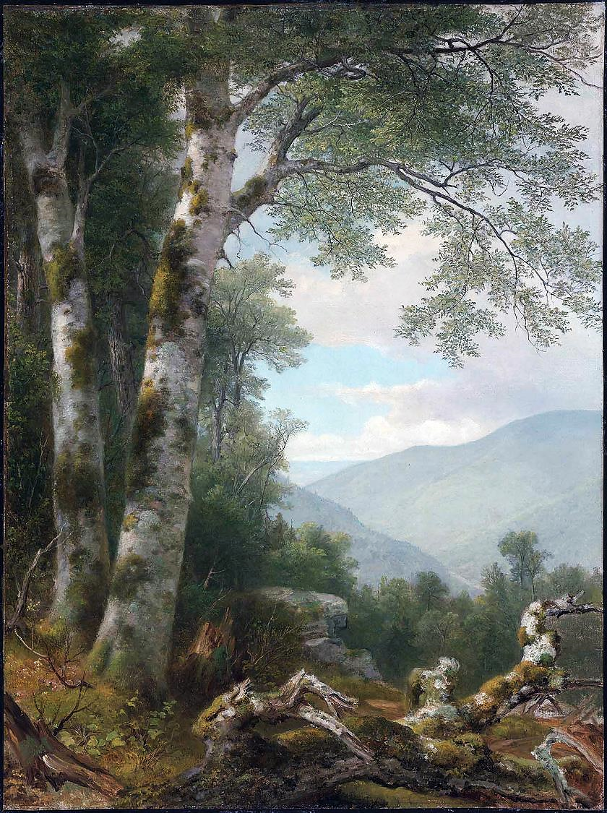
Landscape with Birches
Asher Durand
Museum of Fine Arts
Boston, MA

Slide 10
He destined us for adoption as his children through Jesus Christ …
Ephesians 1:5a

Slide 11
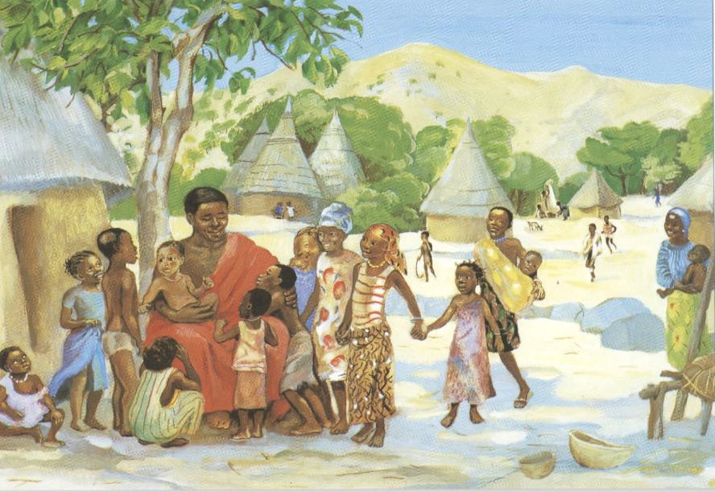
Jesus Welcomes the Children -- JESUS MAFA

Slide 12
Herod … sent men who arrested John … For John had been telling Herod, "It is not lawful for you to have your brother's wife."
Mark 6:17a, 18

Slide 13
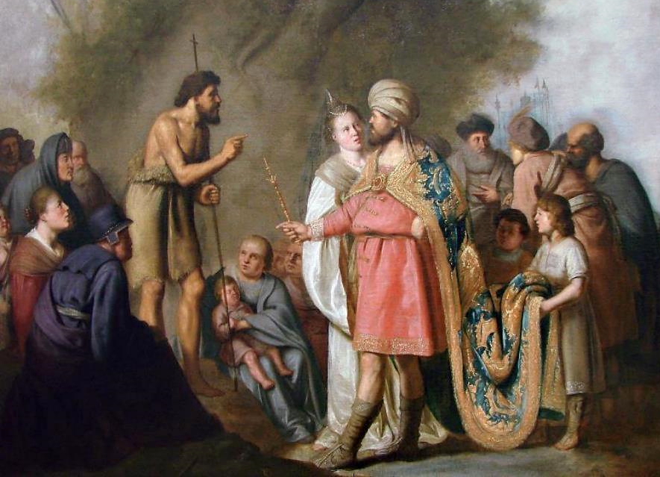
Jean the Baptist Preaching before Herod -- Pieter de Grebber, Palais des Beaux-Art, Lille, France

Slide 14
When his daughter Herodias … danced … the king said to the girl, "Ask me for whatever you wish, and I will give it."
Mark 6:22ac

Slide 15
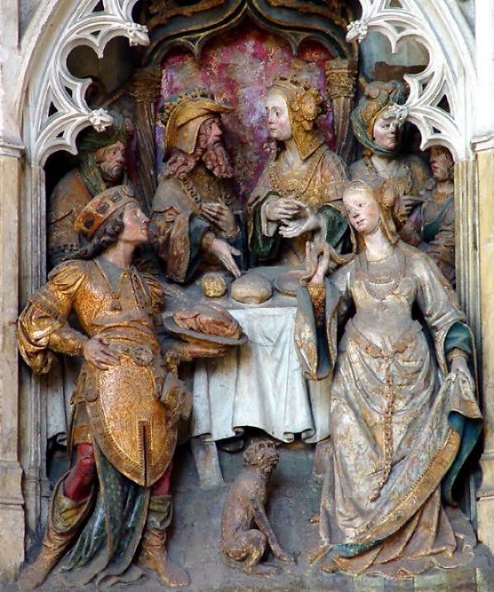
Martyrdom and Death of John the Baptist
Amiens Cathedral
Amiens, France

Slide 16
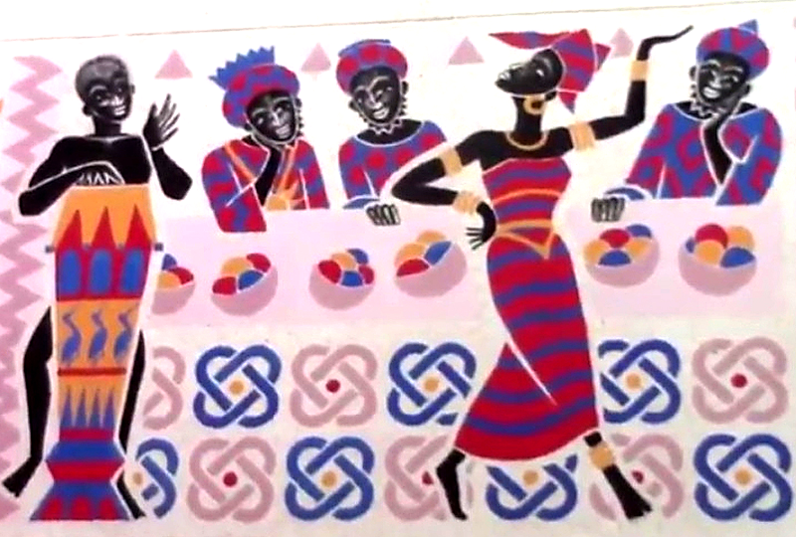
Salome Dances at the Feast of Herod -- Father Georges Saget, Keur Moussa Abbey, Senegal

Slide 17
She went out and said to her mother, "What should I ask for?" She replied, "The head of John the baptizer."
Mark 6:24

Slide 18
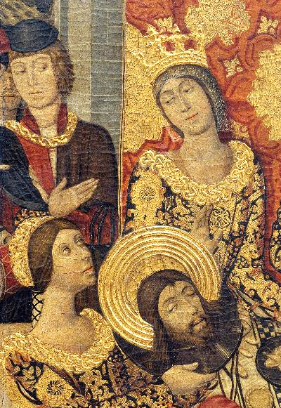
Herod's Banquet, detail
Museu Nacional d'Art de Catalunya
Barcelona, Spain

Slide 19
… she rushed back to the king and requested, "I want you to give me at once the head of John the Baptist on a platter."
Mark 6:25

Slide 20
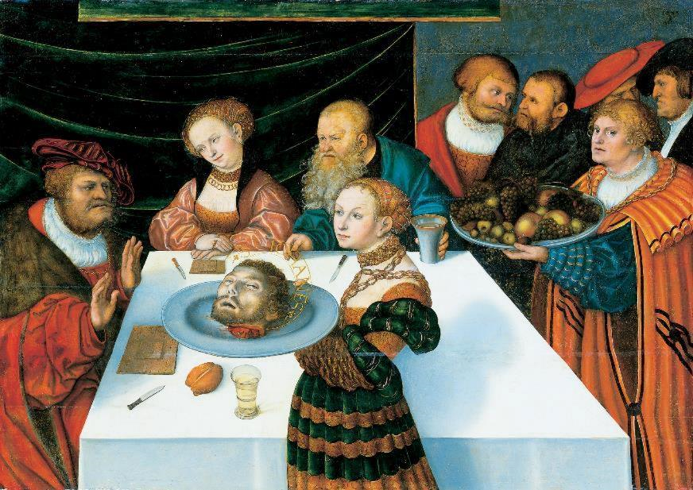
The Feast of Herod -- Lucas Cranach the Elder, Stadel, Frankfurt, Germany

Slide 21
When his disciples heard about it, they came and took his body, and laid it in a tomb.
Mark 6:29

Slide 22
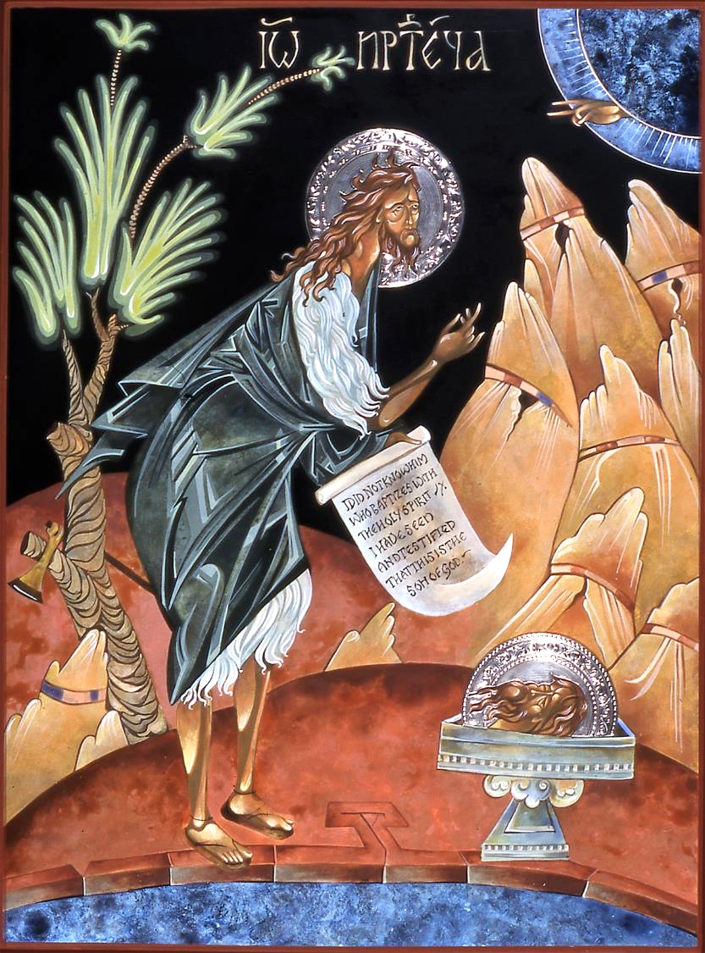
John the Baptist Icon
Mary Jane Miller

Slide 23
Credits
New Revised Standard Version Bible, copyright 1989, Division of Christian Education of the National Council of the Churches of Christ in the United States of America. Used by permission. All rights reserved.
https://www.flickr.com/photos/andrewheavens/88544244/ - Andrew Heavens
www.JohnAugustSwanson.com, copyright 1994 by John August Swanson
http://www.getty.edu/museum/media/images/web/larger/30595401.jpg
https://commons.wikimedia.org/wiki/File:Asher_Brown_Durand_-_Landscape_with_Birches_-_63.268_-_Museum_of_Fine_Arts.jpg
http://diglib.library.vanderbilt.edu/act-imagelink.pl?RC=48395
https://commons.wikimedia.org/wiki/File:Mus%C3%A9e_de_Lille_P._F._de_Grebber.jpg
http://diglib.library.vanderbilt.edu/act-imagelink.pl?RC=29346
www.robertharding.com
https://commons.wikimedia.org/wiki/File:Pedro_Garc%C3%ADa_de_Benabarre_and_workshop_-_Herod%27s_Banquet_-_Google_Art_Project.jpg
https://commons.wikimedia.org/wiki/File:Lucas_Cranach_d.%C3%84._-_Gastmahl_des_Herodes_(St%C3%A4delsches_Kunstinstitut).jpg
Mary Jane Miller, https://www.millericons.com/
Additional descriptions can be found at the Art in the Christian Tradition image library, a service of the Vanderbilt Divinity Library, http://diglib.library.vanderbilt.edu/. All images available via Creative Commons 3.0 License.

