Slide 1
Nativity of the Lord III
Year B
Isaiah 52:7-10
Psalm 98
Hebrews 1:1-4, (5-12)
John 1:1-14

Slide 2
How beautiful upon the mountains are the feet of the messenger who announces peace …
Isaiah 52:7

Slide 3
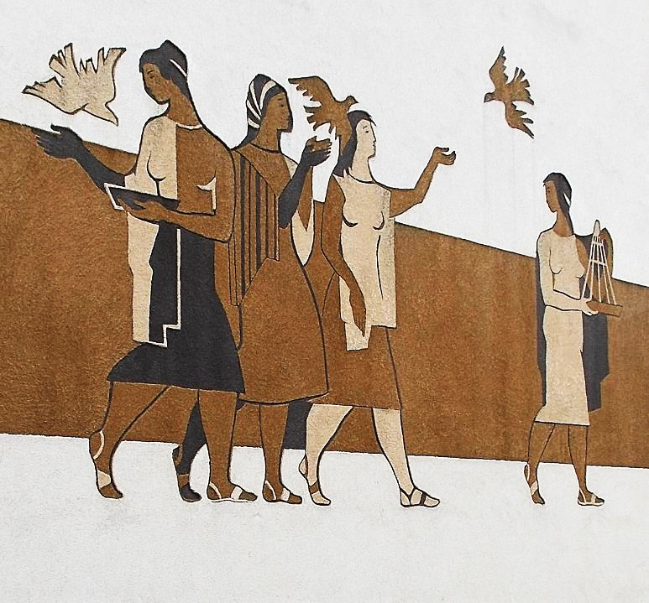
Peace
Andrea Michnay
Oroszlány,
Hungary

Slide 4
Make a joyful noise to the LORD, all the earth;
Psalm 98

Slide 5
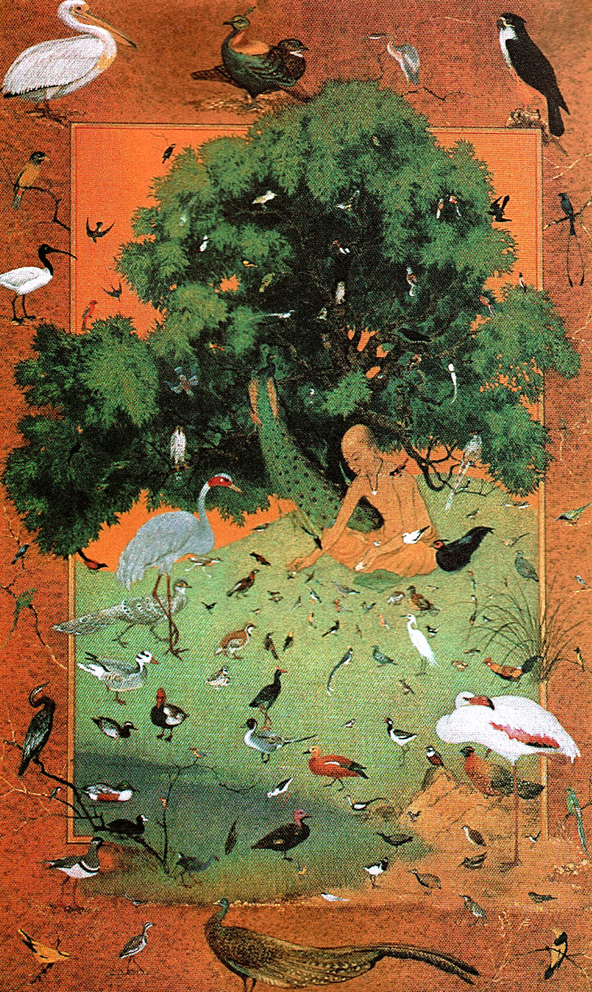
St. Francis with Birds
Frank Wesley

Slide 6
… when he brings the firstborn into the world, he says, "Let all God's angels worship him."
Hebrews 1:6b

Slide 7
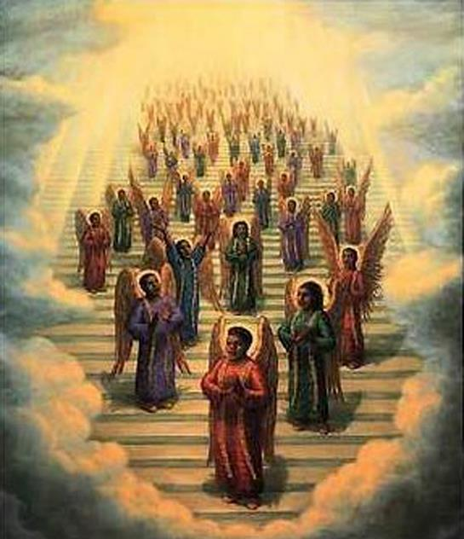
Gospel Choir of Angels -- Tim Ashkar

Slide 8
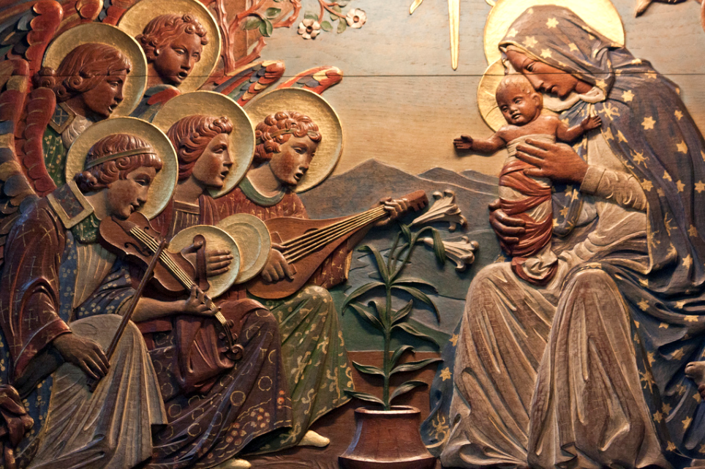
Angels Worship the Christ Child -- St. Giles Cathedral, Edinburgh, Scotland

Slide 9
In the beginning was the Word, and the Word was with God,
and the Word was God.
John 1:1

Slide 10
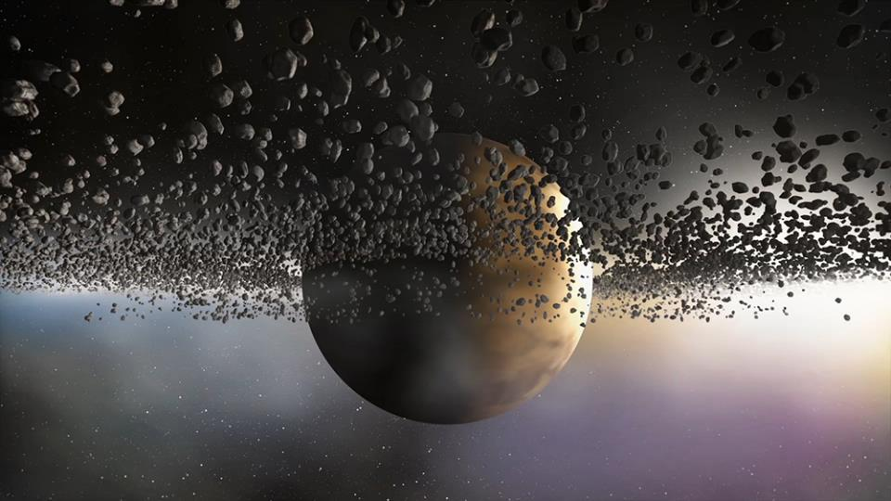
God’s Authority – “In the beginning …” – Seth Drum, graphic art

Slide 11
… in him was life, and the life was the light of all people.
John 1:4

Slide 12
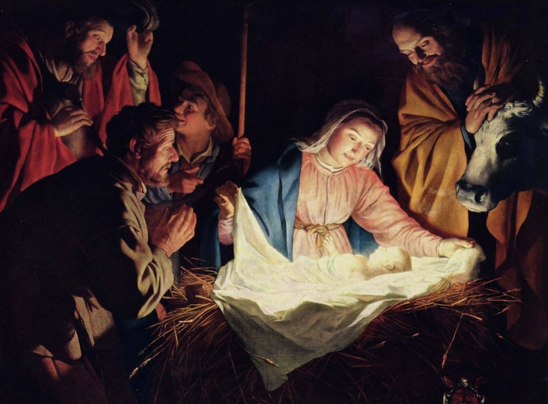
Adoration of the Shepherds -- Gerrit van Honthorst, Wallraf-Richartz Museum, Cologne, GDR

Slide 13
The true light, which enlightens everyone, was coming into the world.
John 1:9

Slide 14
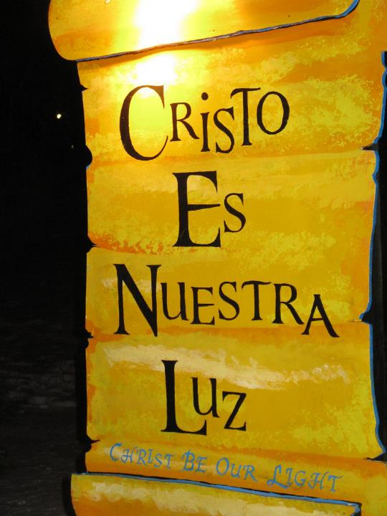
Christ Be Our Light
LaSalette Festival
Attleboro, MA

Slide 15
And the Word became flesh and lived among us … full of grace and truth.
John 1:14ac

Slide 16
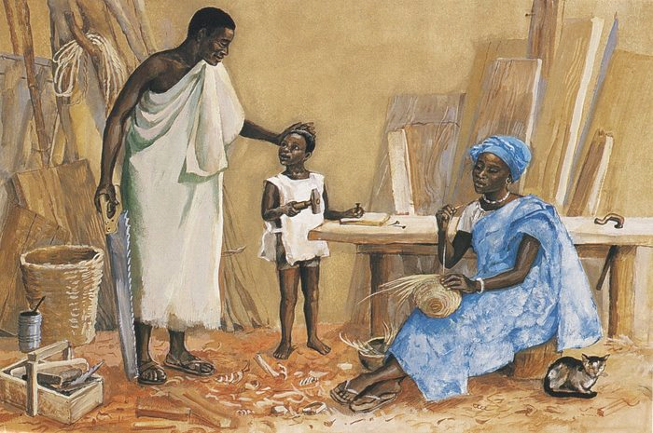
Jesus as a Child -- JESUS MAFA, Cameroon

Slide 17
Credits
New Revised Standard Version Bible, copyright 1989, Division of Christian Education of the National Council of the Churches of Christ in the United States of America. Used by permission. All rights reserved.
https://commons.wikimedia.org/wiki/File:L%C3%A1nyok,_madarakkal_(Michnay_Andrea),_2018_Oroszl%C3%A1ny.jpg
Estate of Frank Wesley, http://www.frankwesleyart.com/main_page.htm
https://commons.wikimedia.org/wiki/File:19th_century_black_heaven.jpg
https://www.flickr.com/photos/paullew/6611391645 - Fr Lawrence Lew, O.P.
https://www.flickr.com/photos/seth_drum/34308713902 - Seth Drum
http://www.yorckproject.de
http://www.flickr.com/photos/heartlover1717/4141462290/
http://diglib.library.vanderbilt.edu/act-imagelink.pl?RC=48304
Additional descriptions can be found at the Art in the Christian Tradition image library, a service of the Vanderbilt Divinity Library, http://diglib.library.vanderbilt.edu/. All images available via Creative Commons 3.0 License.

