Slide 1
Nativity of the Lord II
Year B
Isaiah 62:6-12
Psalm 97
Titus 3:4-7
Luke 2:(1-7), 8-20

Slide 2
In that region there were shepherds living in the fields, keeping watch over their flock by night.
Luke 2:8

Slide 3
Then an angel of the Lord stood before them, and the glory of the Lord shone around them, and they were terrified.
Luke 2:9

Slide 4
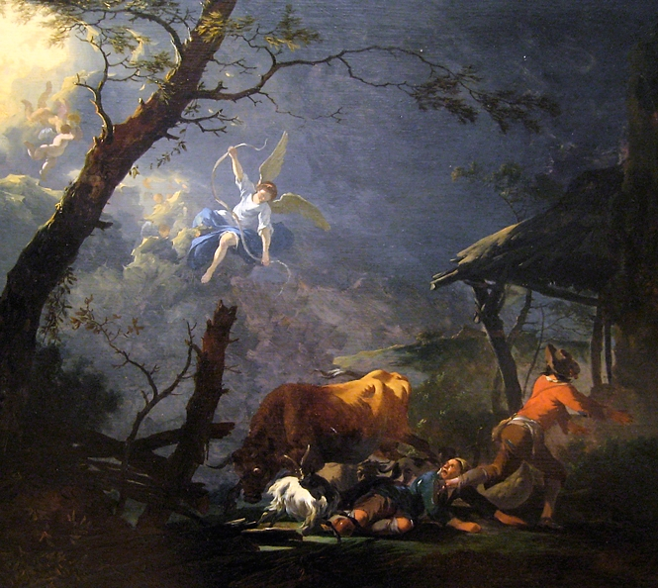
Annunciation to the Shepherds
Legion of Honor Museum
San Francisco

Slide 5
But the angel said to them, "Do not be afraid; for see--I am bringing you good news of great joy for all the people:
Luke 2:10

Slide 6
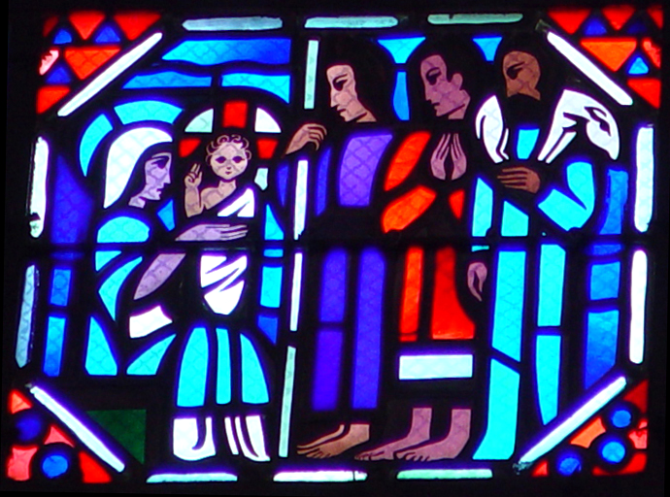
The Shepherds Visit the Christ Child -- Gaudin/Le Breton, Amiens Cathedral, Amiens, France

Slide 7
to you is born this day in the city of David a Savior, who is the Messiah, the Lord.
Luke 2:11

Slide 8
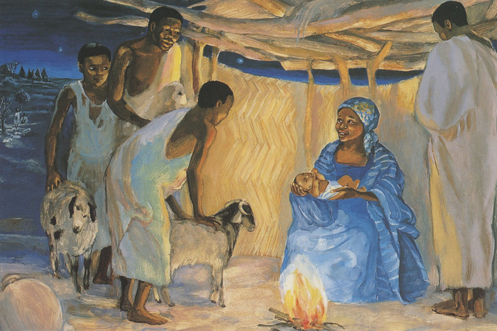
The Birth of Jesus with Shepherds -- JESUS MAFA, Cameroon

Slide 9
This will be a sign for you: you will find a child wrapped in bands of cloth and lying in a manger."
Luke 2:12

Slide 10
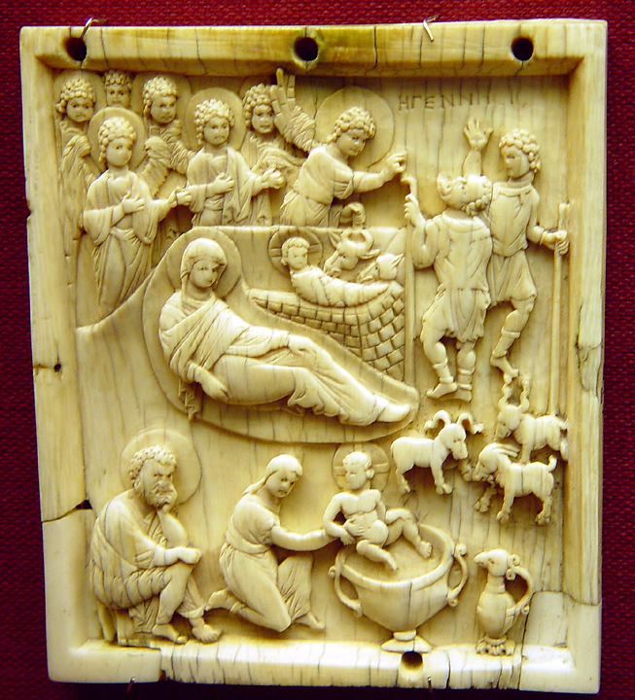
The Nativity
Ivory devotional panel
Victoria and Albert Museum
London, England

Slide 11
And suddenly there was with the angel a multitude of the heavenly host, praising God and saying,
Luke 2:13

Slide 12
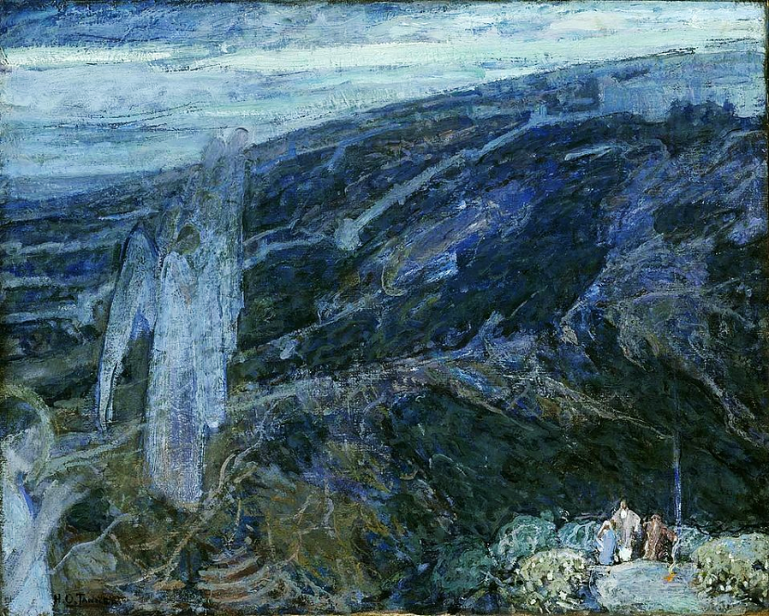
Angels Appearing to the Shepherds -- Henry Ossawa Tanner, Smithsonian American Art Museum, DC

Slide 13
"Glory to God in the highest heaven, and on earth peace among those whom he favors!"
Luke 2:14

Slide 14
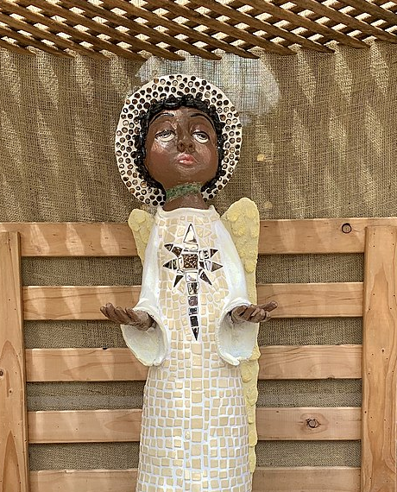
Nativity Angel
Parliament House
Brisbane, Australia

Slide 15
When the angels had left them and gone into heaven, the shepherds said to one another, "Let us go now to Bethlehem and see this thing that has taken place, which the Lord has made known to us."
Luke 2:15

Slide 16
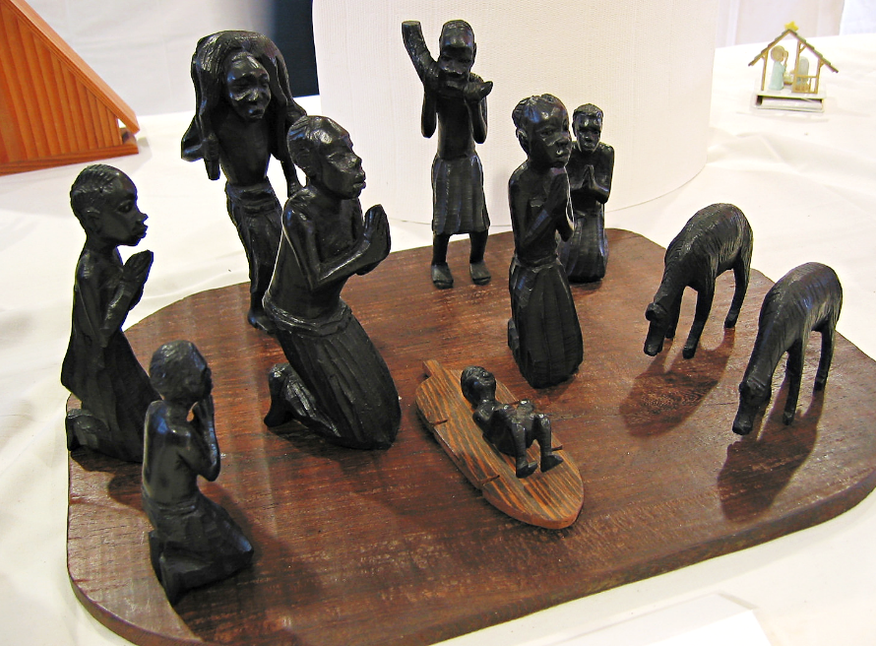
African Nativity -- Church of the Epiphany, Decatur, GA

Slide 17
So they went with haste and found Mary and Joseph, and the child lying in the manger.
Luke 2:16

Slide 18
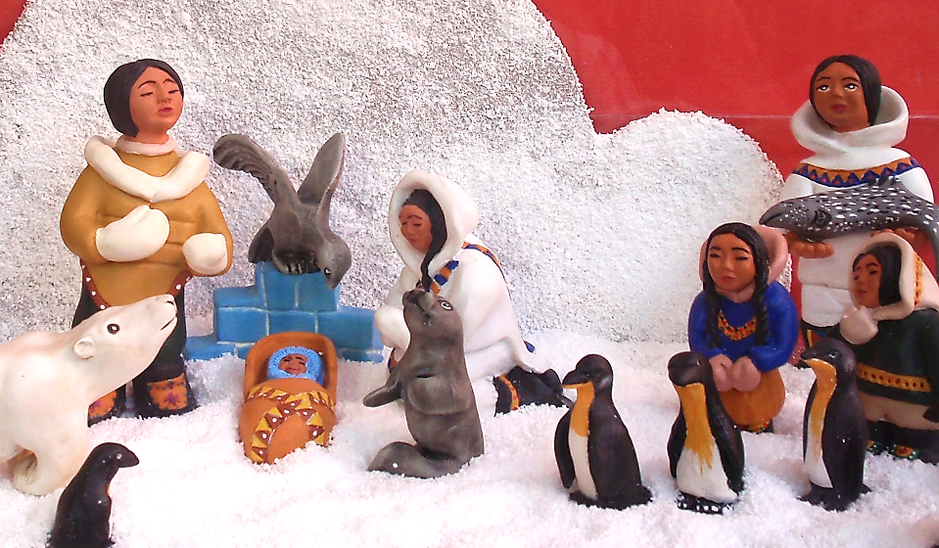
Inuit Nativity -- Padron House Museum, Galdar, Spain

Slide 19
When they saw this, they made known what had been told them about this child;
Luke 2:17

Slide 20
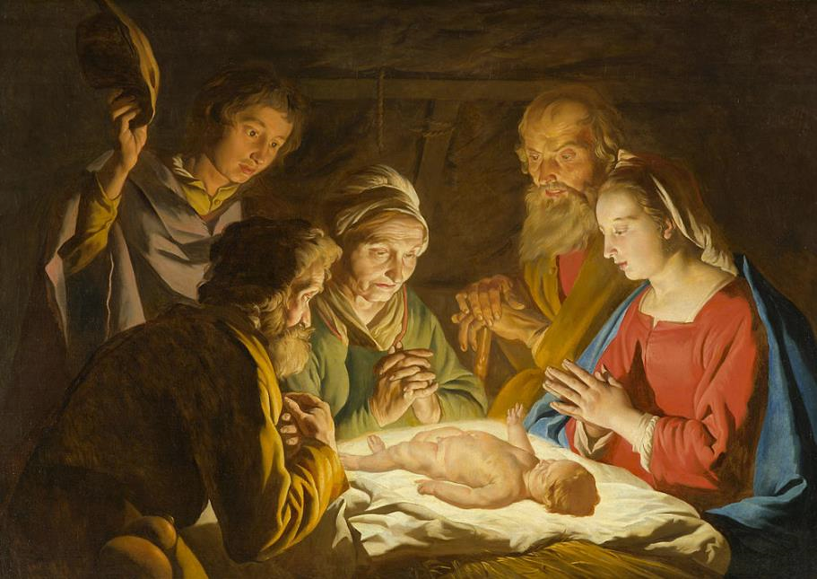
The Nativity -- Matthias Stom, North Carolina Museum of Art, Raleigh, NC

Slide 21
and all who heard it were amazed at what the shepherds told them.
Matthew 2:18

Slide 22
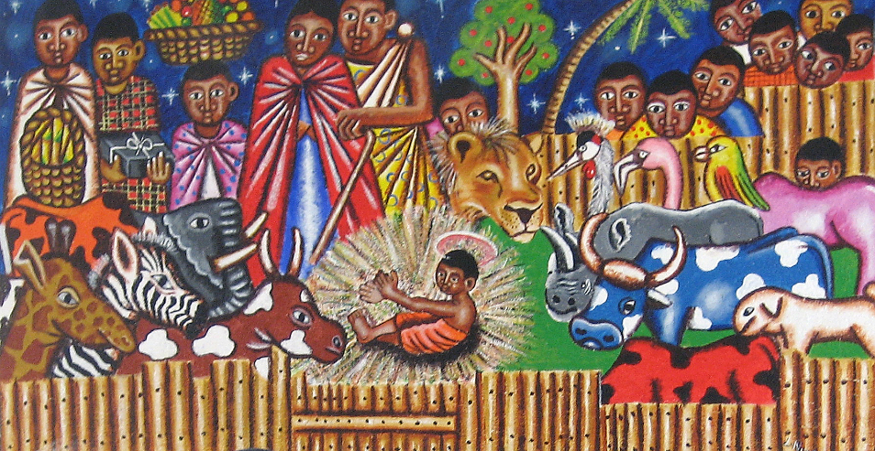
Nativity from a church in Kenya

Slide 23
But Mary treasured all these words and pondered them in her heart.
Luke 2:19

Slide 24
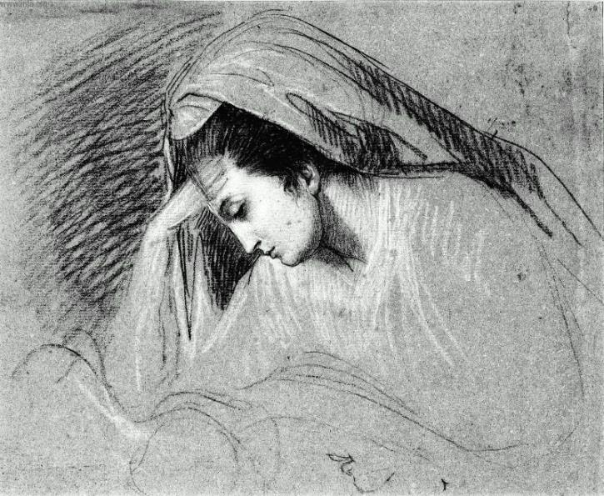
Study for The Nativity -- John Singleton Copley, Museum of Fine Arts, Boston, MA

Slide 25
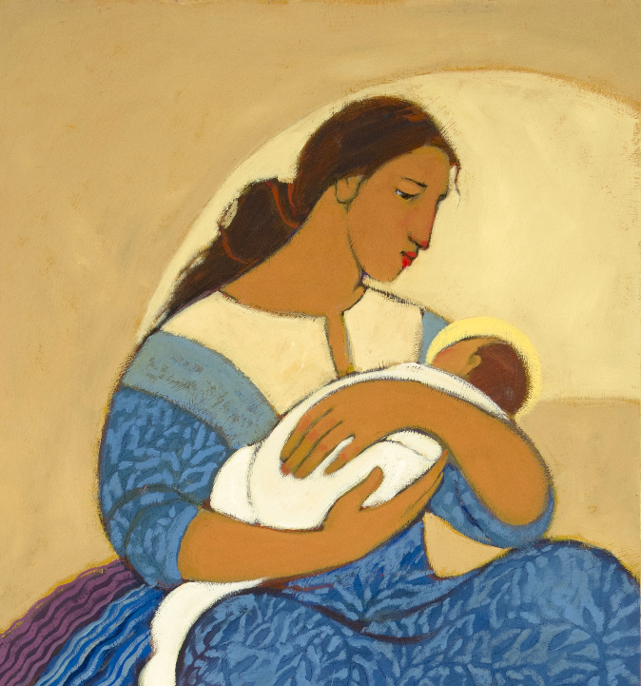
Mary and Jesus
Kathleen Peterson
Spring City, UT

Slide 26
The shepherds returned, glorifying and praising God for all they had heard and seen, as it had been told them.
Luke 2:20

Slide 27
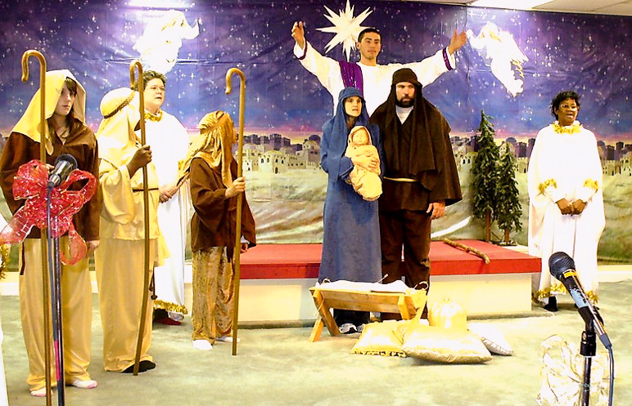
?
Church Nativity Scene -- Columbia, SC

Slide 28
Credits
New Revised Standard Version Bible, copyright 1989, Division of Christian Education of the National Council of the Churches of Christ in the United States of America. Used by permission. All rights reserved.
http://www.flickr.com/photos/17884832@N00/2642469436
http://diglib.library.vanderbilt.edu/act-imagelink.pl?RC=51557
http://diglib.library.vanderbilt.edu/act-imagelink.pl?RC=48387
http://diglib.library.vanderbilt.edu/act-imagelink.pl?RC=31702
https://commons.wikimedia.org/wiki/File:Henry_Ossawa_Tanner_-_Angels_Appearing_before_the_Shepherds.jpg
https://commons.wikimedia.org/wiki/File:Nativity_scene_at_Parliament_House,_Brisbane_in_2019,_details.jpg
https://www.flickr.com/photos/apmethodist/4166667978/
https://www.flickr.com/photos/azuaje/5321600328
https://commons.m.wikimedia.org/wiki/File:The_Adoration_of_the_Shepherds_-_Matthias_Stom_(Stomer)_-_Google_Cultural_Institute.jpg
https://www.flickr.com/photos/genvessel/537858093
http://www.mfa.org/
https://www.kathleenpetersonart.com
https://www.flickr.com/photos/geraldbrazell/4212594648
Additional descriptions can be found at the Art in the Christian Tradition image library, a service of the Vanderbilt Divinity Library, http://diglib.library.vanderbilt.edu/. All images available via Creative Commons 3.0 License.

