Slide 1
First Sunday in Lent
Year B
Genesis 9:8-17
Psalm 25:1-10
1 Peter 3:18-22
Mark 1:9-15

Slide 2
"I establish my covenant with you, that never again shall … there be a flood to destroy the earth.
Genesis 9:11

Slide 3
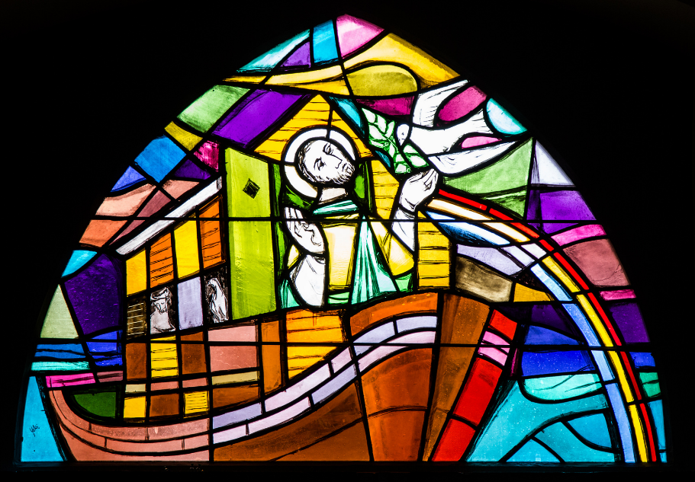
The Dove Returning to Noah -- Emile Aebischer, Parish Church, Gruyeres, Switzerland

Slide 4
I have set my bow in the clouds,
and it shall be a sign of the covenant between me and the earth."
Genesis 9:13

Slide 5
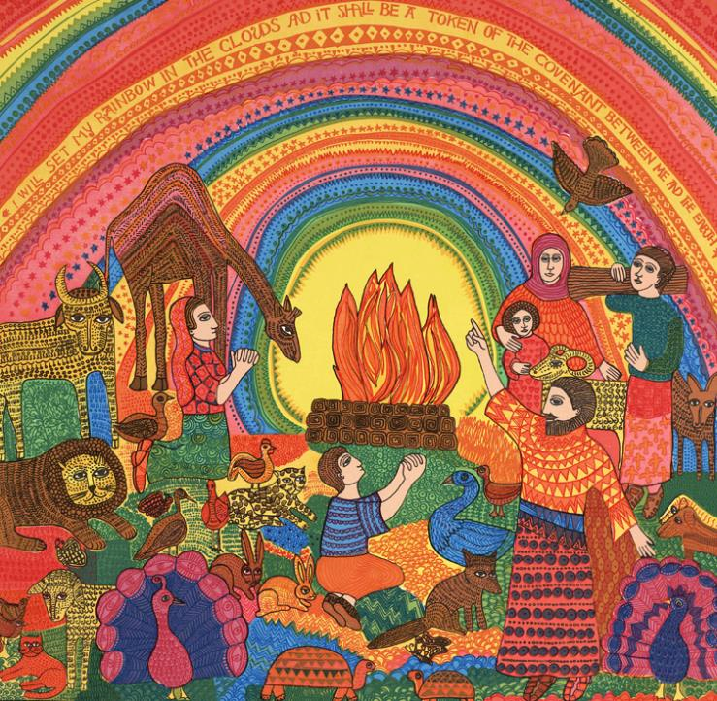
Rainbow Covenant
John August Swanson

Slide 6
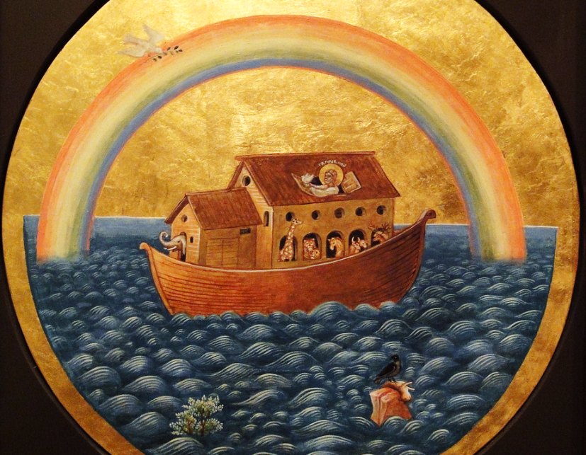
Noah's Ark Icon -- Natalia Ermakova, St Nicholas Russian Orthodox Church, Amsterdam

Slide 7
All the paths of the LORD are steadfast love and faithfulness …
Psalm 25:10

Slide 8
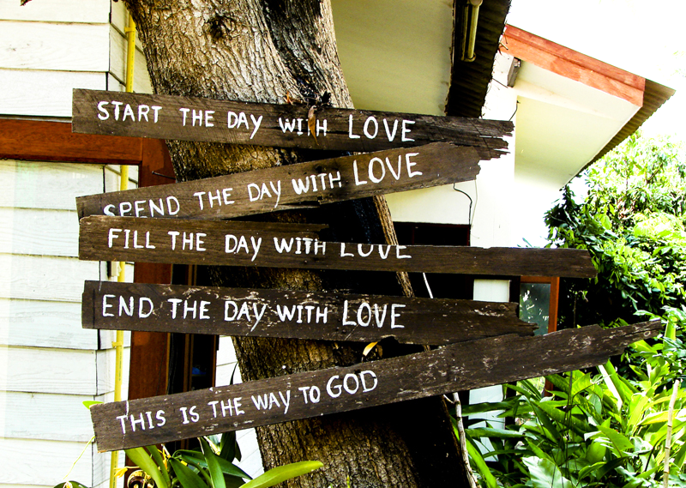
This is the Way to God -- Doi Inthanon National Park, Thailand

Slide 9
God waited patiently in the days of Noah … And baptism, which this prefigured, now saves you.
1 Peter 3:20b, 21a

Slide 10
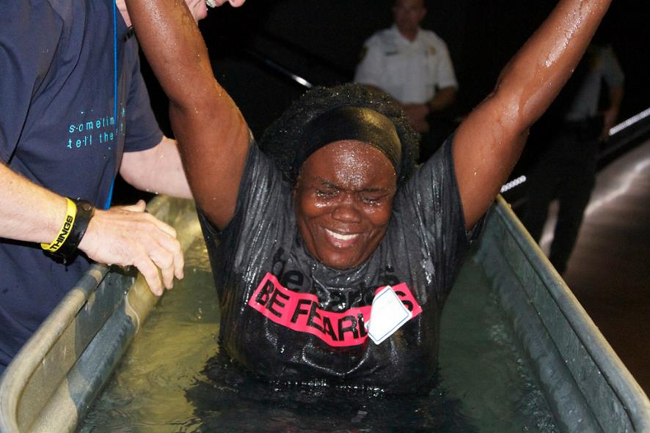
"She was Fearless and Joyful!" -- Church by the Glades, Coral Springs, FL

Slide 11
In those days Jesus came from Nazareth of Galilee and was baptized by John in the Jordan.
Mark 1:9

Slide 12
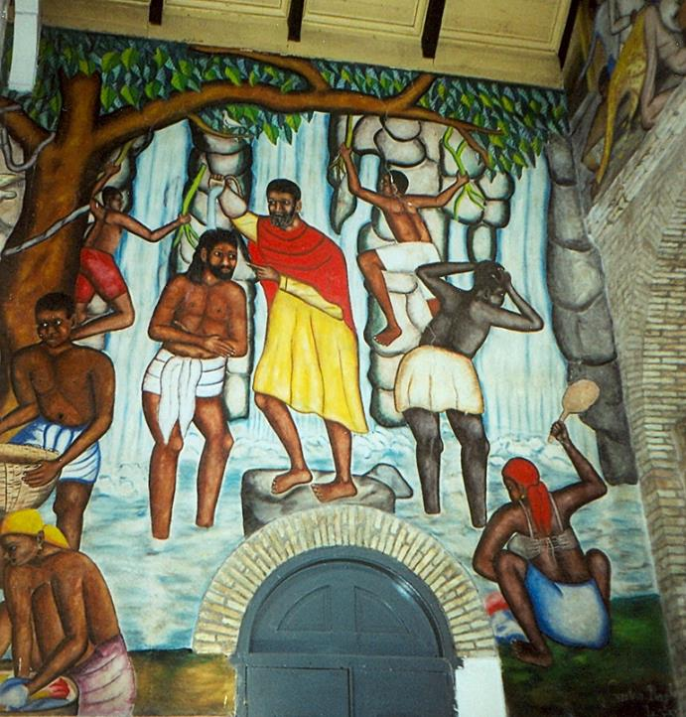
Baptism of Christ
Castera Bazile
Cathedral of the Holy Trinity
Port-au-Prince, Haiti

Slide 13
And just as he was coming up out of the water, he saw the heavens torn apart and the Spirit descending like a dove on him.
Mark 1:10

Slide 14
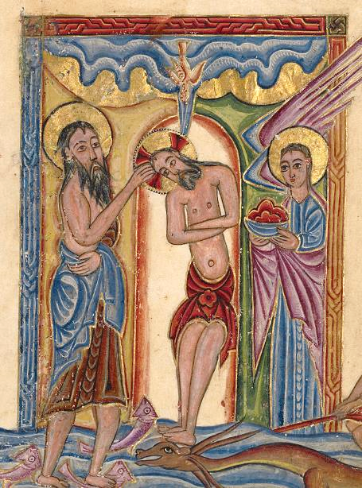
Baptism of Christ
Mesrop of Khizan
Getty Center
Los Angeles, CA

Slide 15
And a voice came from heaven, "You are my Son, the Beloved; with you I am well pleased."
Mark 1:11

Slide 16
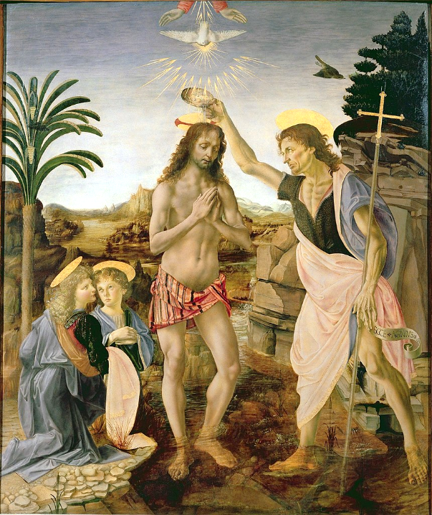
Baptism of Christ
Andrea del Verrocchio and Leonardo da Vinci
Uffizi Gallery
Florence, italy

Slide 17
And the Spirit immediately drove him out into the wilderness.
Mark 1:12

Slide 18
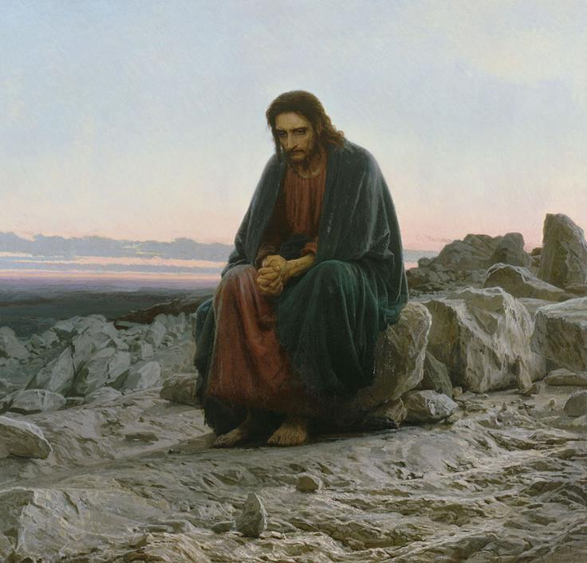
Christ in the Wilderness
Ivan Kramskoi
Moscow, Russia

Slide 19
He was in the wilderness forty days, tempted by Satan; and he was with the wild beasts; and the angels waited on him.
Mark 1:13

Slide 20
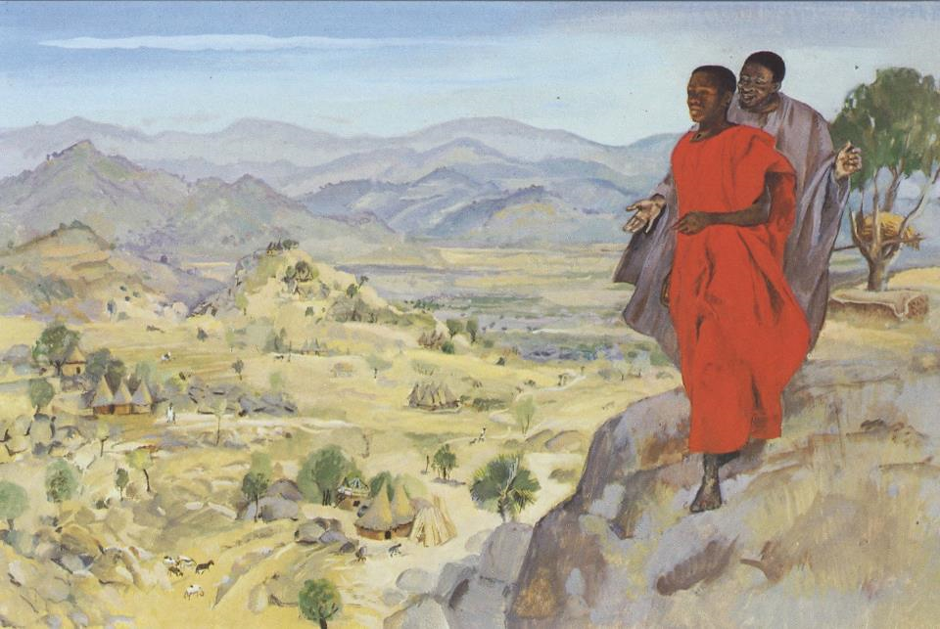
Jesus is Tempted -- JESUS MAFA, Cameroon

Slide 21
Now after John was arrested, Jesus came to Galilee, proclaiming the good news of God,
Mark 1:14

Slide 22
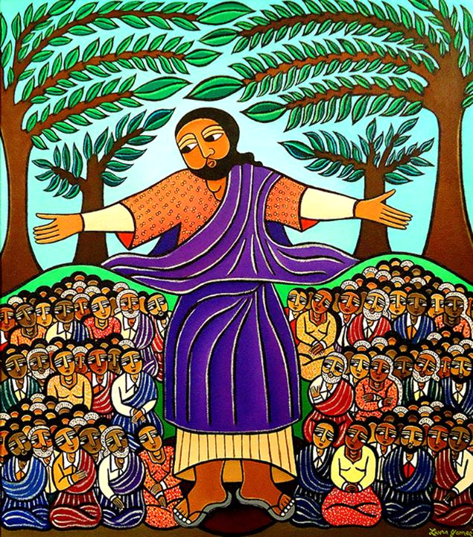
Sermon on the Mount
Laura James

Slide 23
and saying, "The time is fulfilled, and the kingdom of God has come near; repent, and believe in the good news."
Mark 1:15

Slide 24
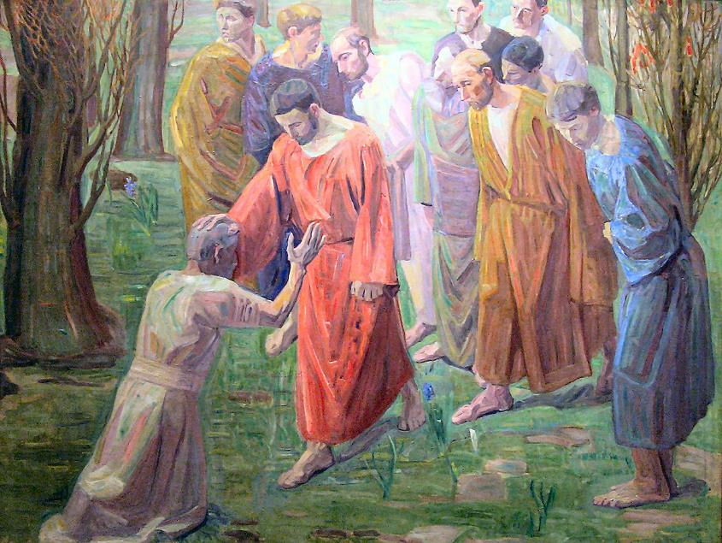
Healing of a Leper -- Niels Larsen Stevns, 1913

Slide 25
Credits
New Revised Standard Version Bible, copyright 1989, Division of Christian Education of the National Council of the Churches of Christ in the United States of America. Used by permission. All rights reserved.
https://www.flickr.com/photos/paullew/32915437885/ - Brother Lawrence, OP
www.JohnAugustSwanson.com - copyright 1974 by John August Swanson
https://www.flickr.com/photos/jimforest/4338027250/ - Jim Forest
https://www.flickr.com/photos/mastababa/2398441001/
https://www.flickr.com/photos/cbglades/6208357676/
http://commons.wikimedia.org/wiki/File:PortAuPrinceMural.jpg
https://commons.wikimedia.org/wiki/File:Mesrop_of_Khizan_(Armenian,_active_1605_-_1651)_-_The_Baptism_of_Christ_-_Google_Art_Project.jpg
https://commons.wikimedia.org/wiki/File:Andrea_del_Verrocchio,_Leonardo_da_Vinci_-_Baptism_of_Christ_-_Uffizi.jpg
http://www.flickr.com/photos/duckmarx/402675938/
http://diglib.library.vanderbilt.edu/act-imagelink.pl?RC=48312
https://www.laurajamesart.com/collections/religious/
https://commons.wikimedia.org/wiki/File:Niels_Larsen_Stevns-_Spedalske.jpg - Gunnar Bach Pedersen
Additional descriptions can be found at the Art in the Christian Tradition image library, a service of the Vanderbilt Divinity Library, http://diglib.library.vanderbilt.edu/. All images available via Creative Commons 3.0 License.

