Slide 1
First Sunday after Christmas Day
Year B
Isaiah 61:10-62:3
Psalm 148
Galatians 4:4-7
Luke 2:22-40

Slide 2
For as the earth brings forth its shoots, and as a garden causes what is sown in it to spring up,
Isaiah 61:11a

Slide 3
so the Lord GOD will cause righteousness and praise to spring up before all the nations.
Isaiah 61:11b

Slide 4
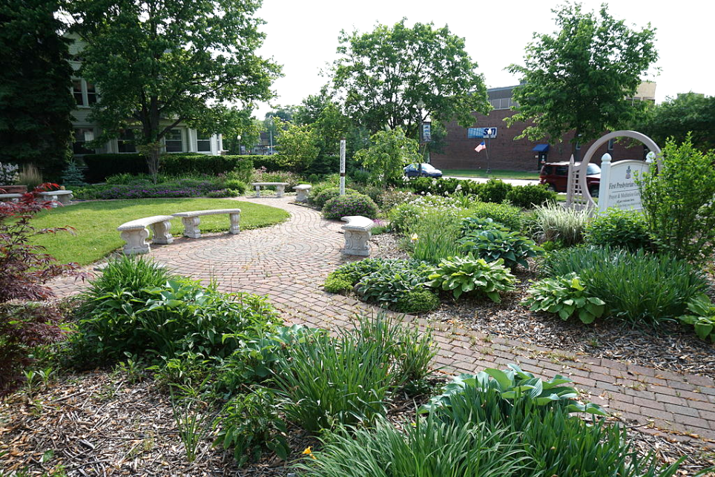
Meditation Garden -- First Presbyterian Church, Saline, MI

Slide 5
Praise the LORD from the earth … Mountains and all hills, fruit trees and all cedars!
Psalm 148:7a, 9

Slide 6
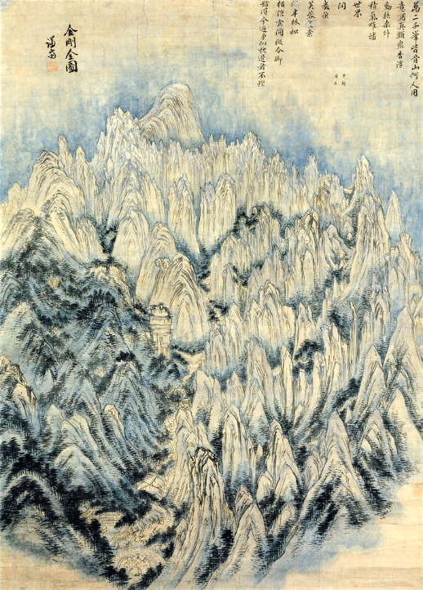
Mt. Kumgang
Jeong Seon
Ho Am Art Museum
Seoul, Korea

Slide 7
God has sent the Spirit of his Son into our hearts, crying, "Abba! Father!"
Galatians 4:6b

Slide 8
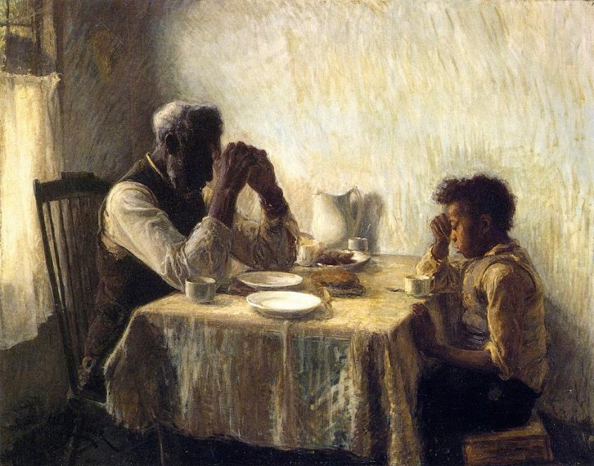
Thankful -- Henry Ossawa Tanner

Slide 9
When the time came for their purification according to the law of Moses, they brought him up to Jerusalem to present him to the Lord.
Luke 2:22

Slide 10
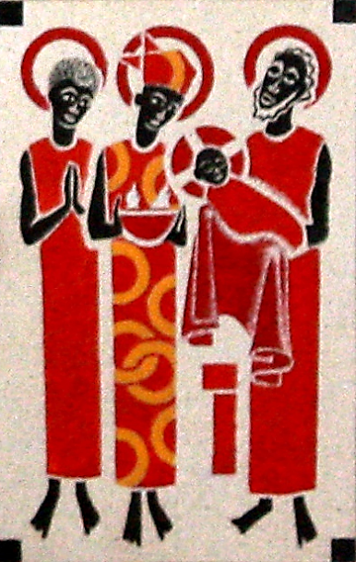
Presentation in the Temple
Keur Moussa Abbey
Keur Moussa,
Senegal

Slide 11
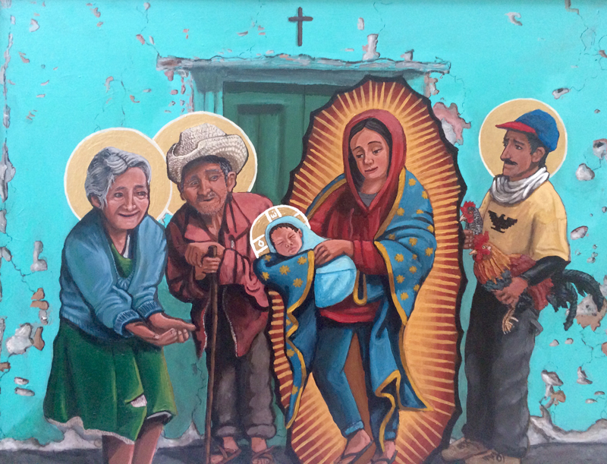
Presentation of Christ in the Temple -- Kelly Latimore, Longview, TX

Slide 12
Guided by the Spirit, Simeon came into the temple; and when the parents brought in the child Jesus, to do for him what was customary under the law,
Luke 2:27

Slide 13
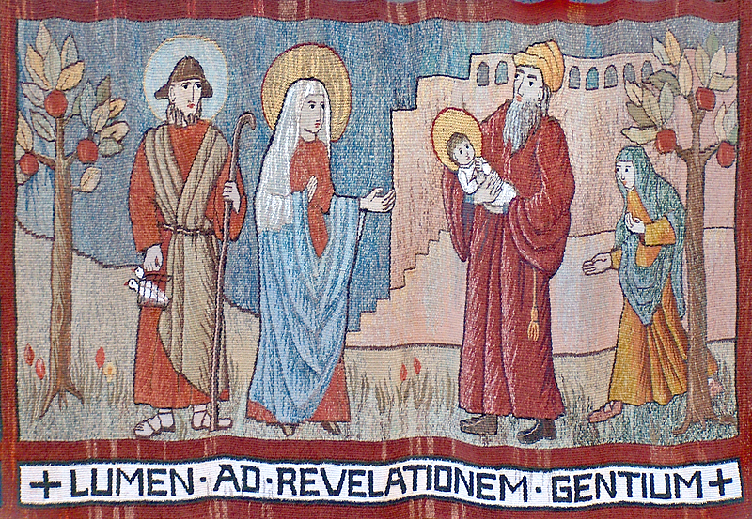
Presentation in the Temple Tapestry -- Abbey of St. Walburga, Virginia Dale, CO

Slide 14
Simeon took him in his arms and praised God, saying, "Master, now you are dismissing your servant in peace, according to your word;
Luke 2:28-29

Slide 15
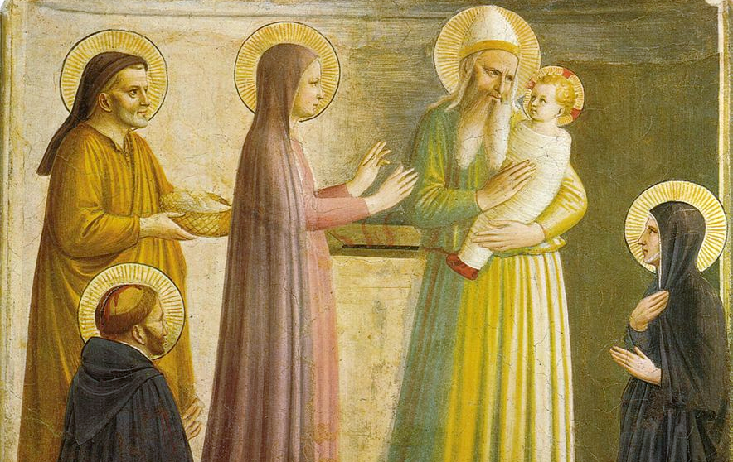
Presentation in the Temple -- Fra Angelico, San Marco, Florence, Italy

Slide 16
for my eyes have seen your salvation … a light for revelation to the Gentiles and for glory to your people Israel."
Luke 2:30, 32

Slide 17
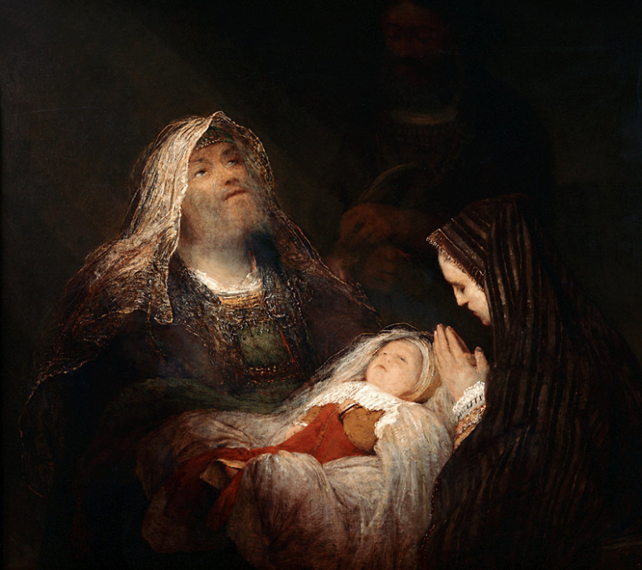
Simeon’s Song of Praise
Aert de Gelder
Mauritshuis
The Hague, Netherlands

Slide 18
Then Simeon … said to his mother Mary, "This child is destined for the falling and the rising of many in Israel, and to be a sign that will be opposed …
Luke 2:34

Slide 19
so that the inner thoughts of many will be revealed--and a sword will pierce your own soul too."
Luke 2:35

Slide 20
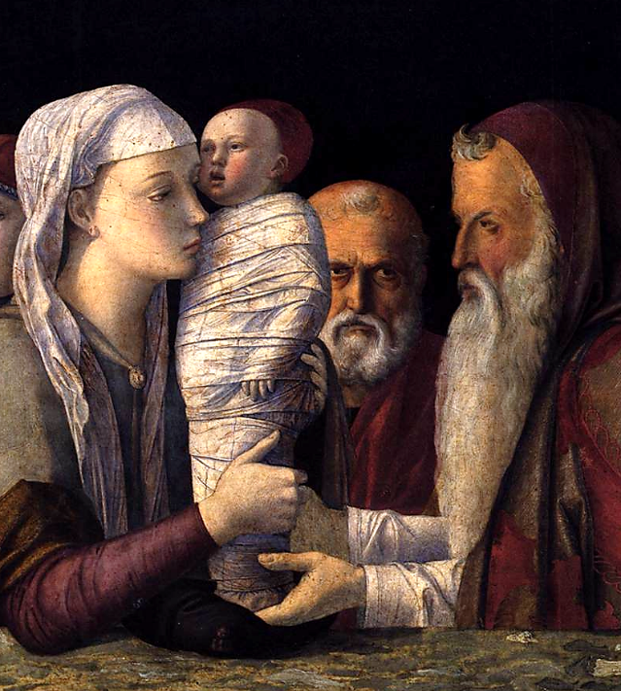
Presentation in the Temple, detail
Andrea Mantegna Gemaldegalerie Berlin, Germany

Slide 21
There was also a prophet, Anna … She was of a great age … She never left the temple but worshiped there with fasting and prayer night and day.
Luke 2:36a, 37b

Slide 22
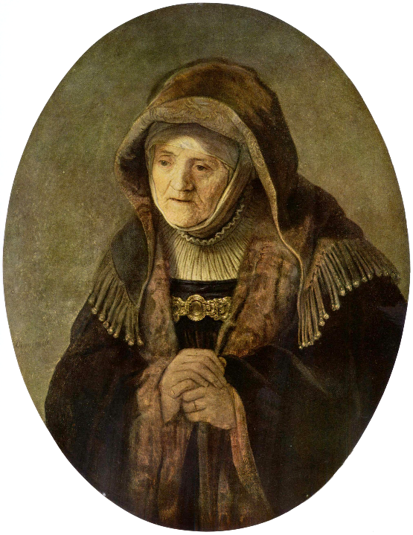
The Prophetess Anna
Rembrandt
Kunsthistorisches Museum
Vienna, Austria

Slide 23
At that moment she came, and began to praise God and to speak about the child to all who were looking for the redemption of Jerusalem.
Luke 2:38

Slide 24
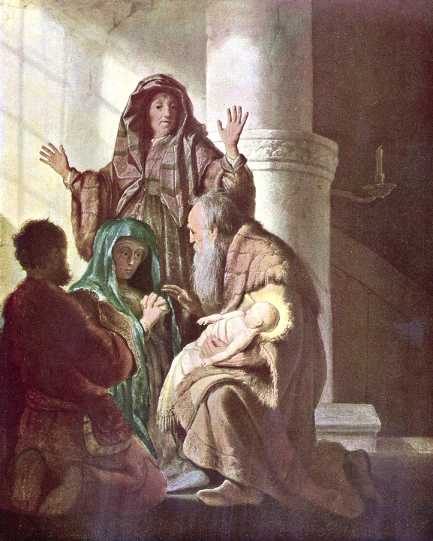
Presentation in the Temple
Attributed to Rembrandt
Kunsthalle Museum
Hamburg, Germany

Slide 25
When they had finished everything required by the law of the Lord, they returned to Galilee, to their own town of Nazareth.
Luke 2:39

Slide 26
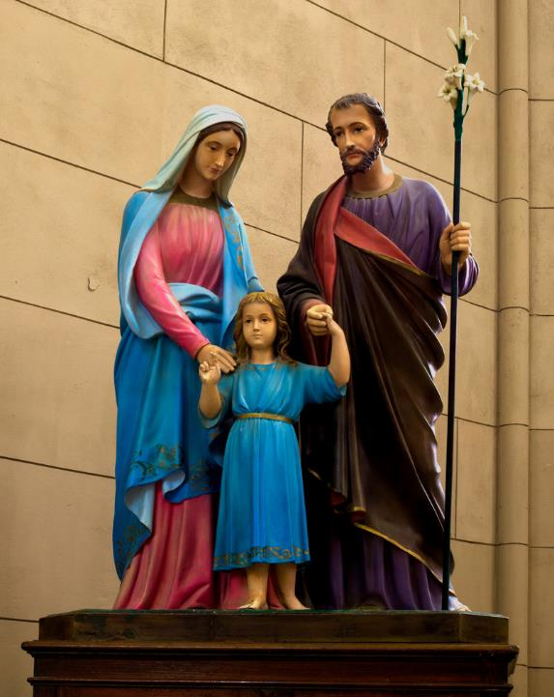
The Holy Family
Basilica of Notre Dame
Lujan, Philippines

Slide 27
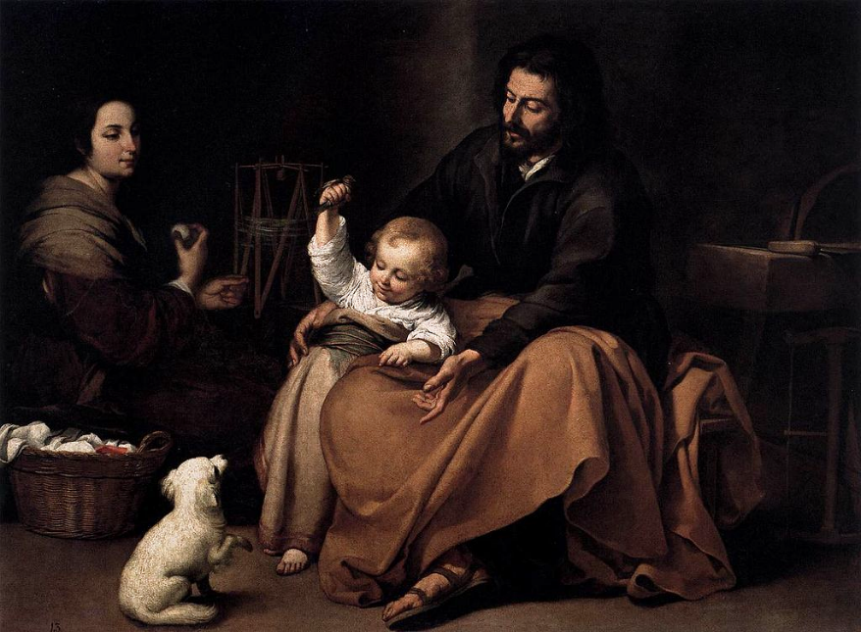
The Holy Family -- Esteban Murillo, Prado Museum, Madrid, Spain

Slide 28
The child grew and became strong, filled with wisdom; and the favor of God was upon him.
Luke 2:40

Slide 29
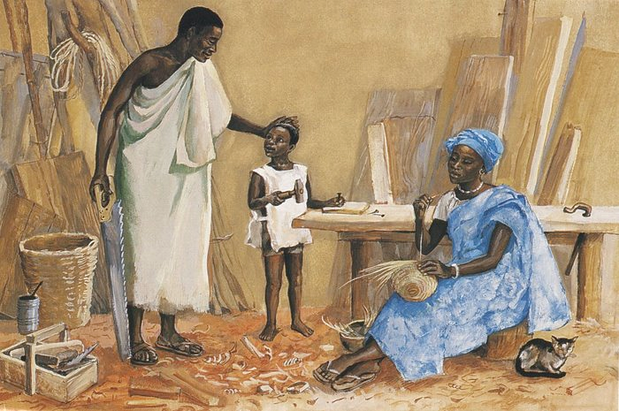
Joseph, Jesus and Mary in Nazareth -- JESUS MAFA

Slide 30
Credits
New Revised Standard Version Bible, copyright 1989, Division of Christian Education of the National Council of the Churches of Christ in the United States of America. Used by permission. All rights reserved.
https://commons.wikimedia.org/wiki/File:Saline_May_2015_11_(First_Presbyterian_Church_Prayer_%26_Meditation_Garden).jpg
https://commons.wikimedia.org/wiki/File:Korean_painting-Geumgang_jeondo-01.jpg
https://commons.wikimedia.org/wiki/File:The_Thankful_Poor,_1894._Henry_Ossawa_Tanner.jpg
https://commons.wikimedia.org/wiki/File:KeurMoussaAutel.jpg
https://kellylatimoreicons.com/contact/
https://www.flickr.com/photos/edithosb/204407845/
https://commons.wikimedia.org/wiki/File:Presentation_of_Jesus_at_the_Temple_by_Fra_Angelico_(San_Marco_Cell_10).jpg
http://commons.wikimedia.org/wiki/File:Aert_de_Gelder_-_Het_loflied_van_Simeon.jpg
https://commons.wikimedia.org/wiki/File:Giovanni_Bellini_-_Presentation_at_the_Temple_-_WGA01642.jpg
https://commons.wikimedia.org/wiki/File:Rembrandt_Harmensz._van_Rijn_085.jpg
https://commons.wikimedia.org/wiki/File:Rembrandt_Harmensz._van_Rijn_056.jpg
https://commons.wikimedia.org/wiki/File:VirgenMaria-SanJose-Ni%C3%B1oJes%C3%BAs-BasilicaLujan.jpg - Ezarate
https://commons.wikimedia.org/wiki/File:Bartolom%C3%A9_Esteban_Perez_Murillo_-_The_Holy_Family_with_a_Bird_-_WGA16356.jpg
http://diglib.library.vanderbilt.edu/act-imagelink.pl?RC=48304
Additional descriptions can be found at the Art in the Christian Tradition image library, a service of the Vanderbilt Divinity Library, http://diglib.library.vanderbilt.edu/. All images available via Creative Commons 3.0 License.

