Slide 1
Wednesday of Holy Week
Year A
Isaiah 50:4-9a • Psalm 70 • Hebrews 12:1-3 • John 13:21-32

Slide 2
I gave my back to those who struck me, and my cheeks to those who pulled out the beard; I did not hide my face from insult and spitting.
Isaiah 50:6

Slide 3
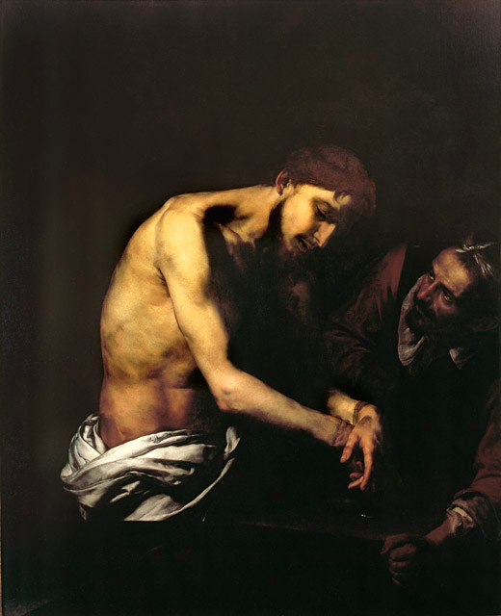
Flagellation of Christ
Jusepe de Ribera
Girolamini Gallery Naples, Italy

Slide 4
… since we are surrounded by so great a cloud of witnesses, … let us run with perseverance the race that is set before us …
Hebrews 12:1a, c

Slide 5
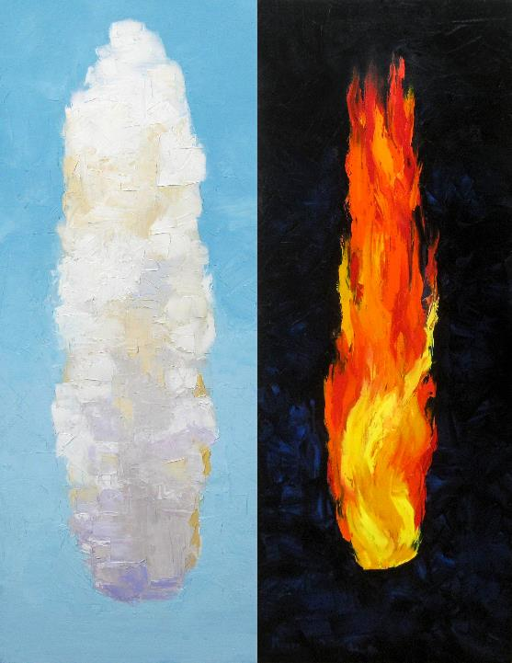
Guidance Day and Night
Mike Moyers

Slide 6
After saying this Jesus was troubled in spirit, and declared, "Very truly, I tell you, one of you will betray me."
John 13:21

Slide 7
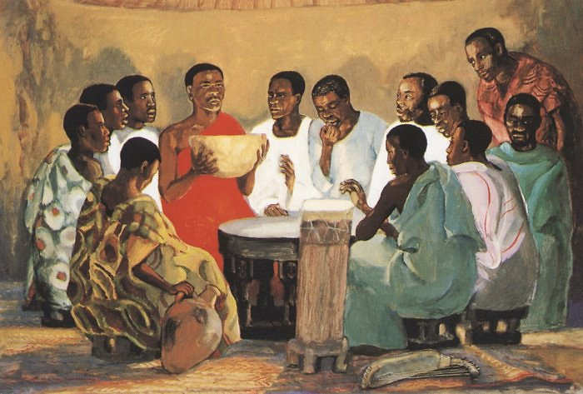
Last Supper -- JESUS MAFA, Cameroon

Slide 8
Jesus said to him, "Do quickly what you are going to do."
John 13:27b

Slide 9
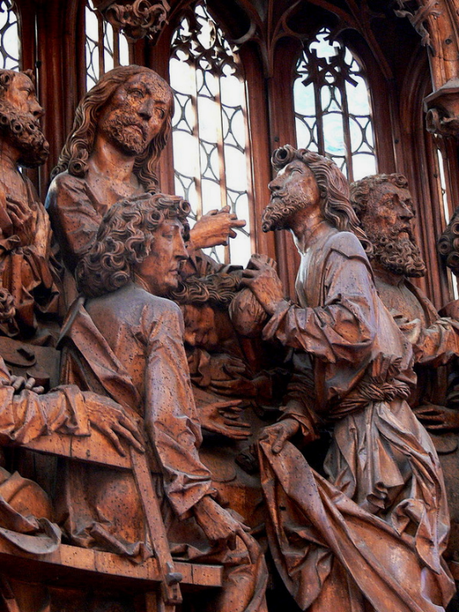
Detail of Christ Speaking to Judas, from Last Supper
Tilman Riemenschneider
Church of St. James
Rothenburg ob der Tauber, Germany

Slide 10
Some thought that, because Judas had the common purse, Jesus was telling him, "Buy what we need for the festival"; or, that he should give something to the poor.
John 13:29

Slide 11
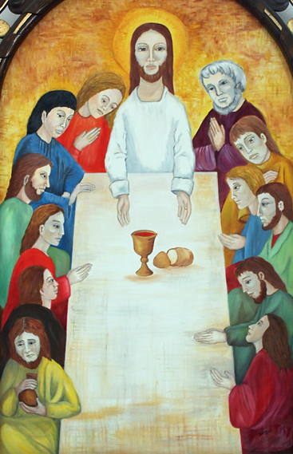
Last Supper
Cathedral of Sancti Spiritus
Sancti Spiritus, Cuba

Slide 12
Jesus said, "Now the Son of Man has been glorified, and God has been glorified in him.
John 13:31b

Slide 13
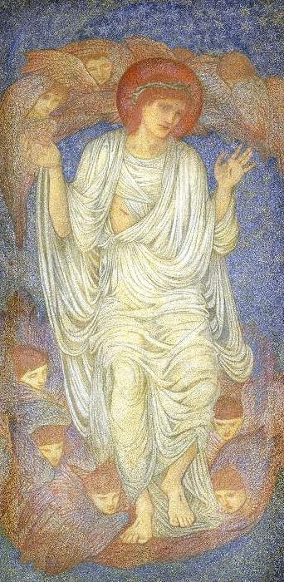
Christ in Glory
Edward Burne-Jones
Brooklyn Museum
New York City

Slide 14
Credits
New Revised Standard Version Bible, copyright 1989, Division of Christian Education of the National Council of the Churches of Christ in the United States of America. Used by permission. All rights reserved.
https://commons.wikimedia.org/wiki/File:The_Flagellation_of_ChrisSpagnGirolamNaples.jpg
Mike Moyers, https://www.mikemoyersfineart.com/
http://diglib.library.vanderbilt.edu/act-imagelink.pl?RC=48272
http://commons.wikimedia.org/wiki/File:Heilig-Blut-Altar_-_Abendmahl_04.jpg
http://commons.wikimedia.org/wiki/File:2012-02-Kathedrale_Sancti_Spiritus_04_anagoria.JPG
http://commons.wikimedia.org/wiki/File:Brooklyn_Museum_-_Christ_in_Glory_(Salvator_Mundi)_-_Sir_Edward_Coley_Burne-Jones_-_overall.jpg
Additional descriptions can be found at the Art in the Christian Tradition image library, a service of the Vanderbilt Divinity Library, http://diglib.library.vanderbilt.edu/. All images available via Creative Commons 3.0 License.

