Slide 1
Third Sunday in Lent
Year A
Exodus 17:1-7 • Psalm 95 • Romans 5:1-11 • John 4:5-42

Slide 2
The LORD said to Moses…
“Strike the rock, and water will come out of it, so that the people
may drink.”
Exodus 17:5a, 6a

Slide 3
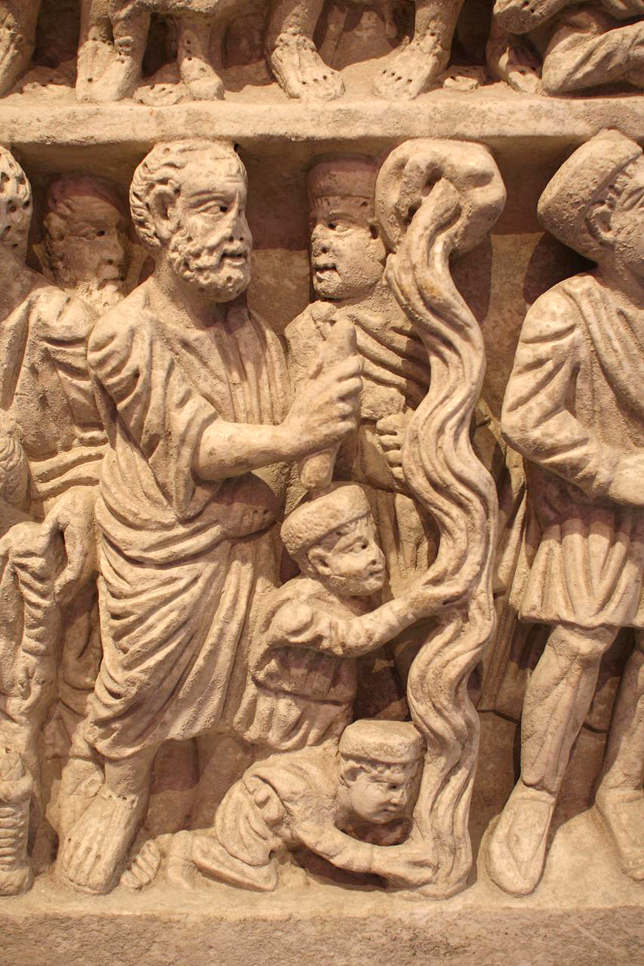
Moses Bringing Forth Life-giving Water
Sarcophagus

Slide 4
In his hand are the depths of the earth; the heights of the mountains are his also.
The sea is his, for he made it, and
the dry land, which his hands
have formed.
Psalm 95:4-5

Slide 5
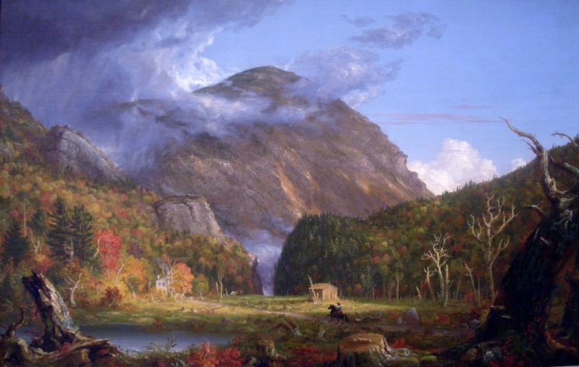
Crawford Notch -- Thomas Cole, National Gallery of Art, Washington, DC

Slide 6
…we have peace with God through our Lord Jesus Christ,
Romans 5:1a

Slide 7
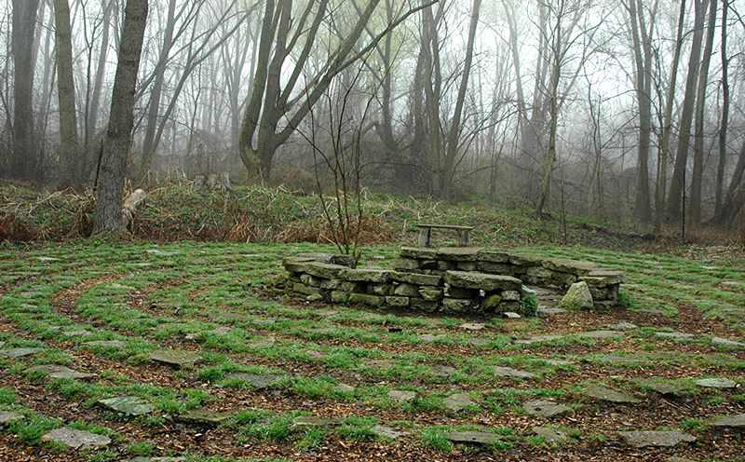
Turtle Peace Labyrinth -- Teaneck Creek Conservancy, Teaneck, NJ

Slide 8
The Samaritan woman said to him, "How is it that you, a Jew, ask a drink of me, a woman of Samaria?"
John 4:9

Slide 9
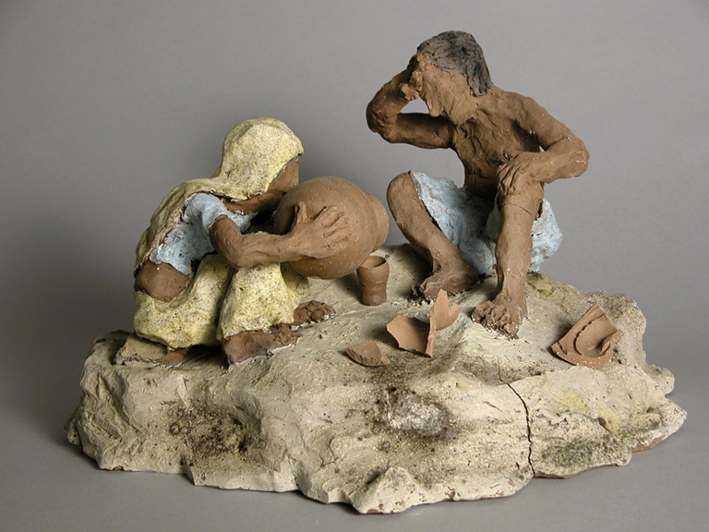
Christ and the Samaritan Woman -- Austin Miller

Slide 10
Jesus answered her, "If you knew… who it is that is saying to you, 'Give
me a drink,' you would have asked him, and he would have given you living water."
John 4:10

Slide 11
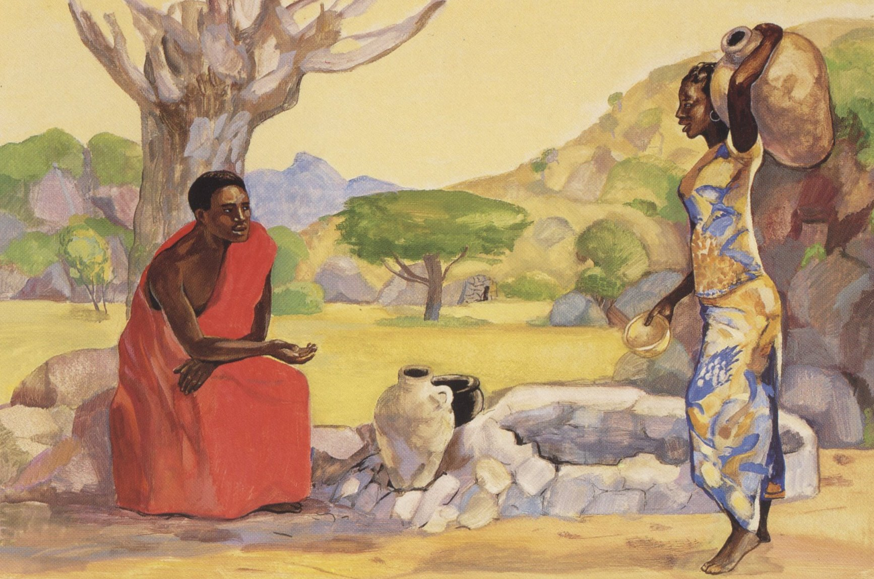
Jesus and the Samaritan Woman -- Jesus MAFA, Cameroon

Slide 12
The woman said to him, "Sir, you have no bucket, and the well is deep. Where do you get that living water?
John 4:11

Slide 13
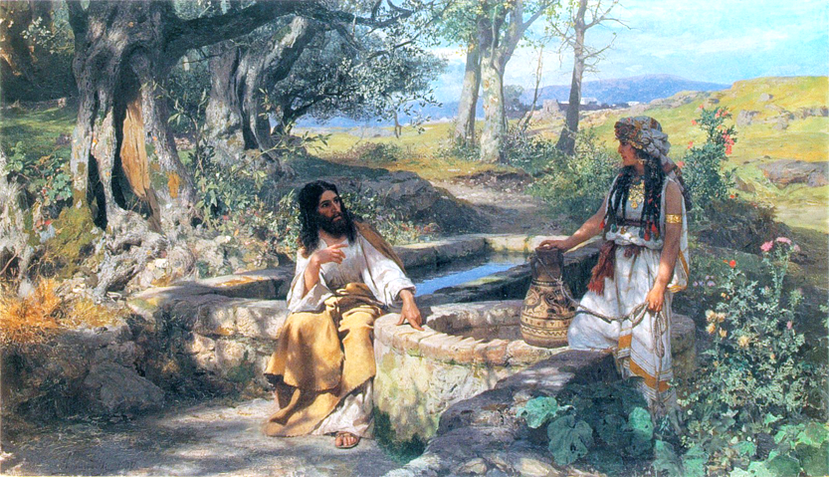
Christ and the Samaritan Woman -- Henryk Siemiradzki, Lviv Art Gallery, Lviv, Ukraine

Slide 14
Jesus said to her, "The water that I will give will become in them a spring of water gushing up to eternal life."
John 4:13a, 14b

Slide 15
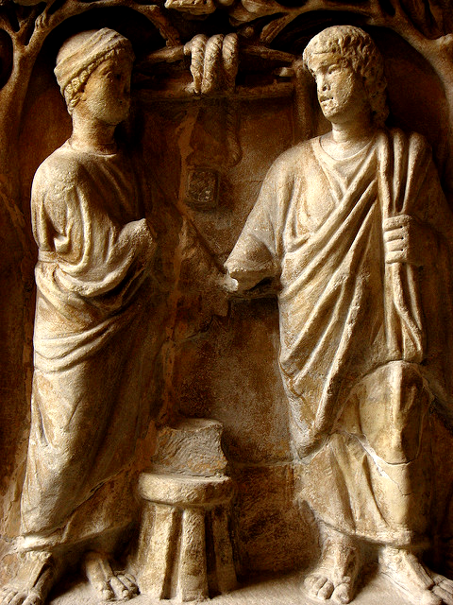
Christ and the Samaritan Woman
Tree Sarcophagus, 4th c., Louvre, Paris

Slide 16
The woman said to him, "I know that Messiah is coming…when he comes, he will proclaim all things to us."
John 4:25

Slide 17
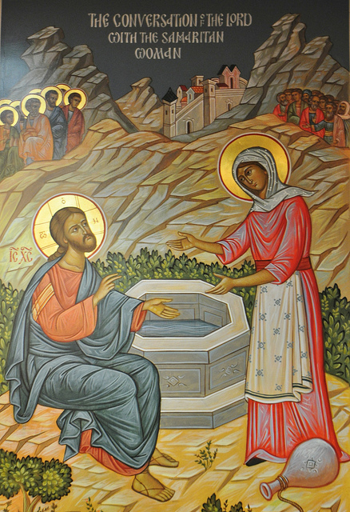
Christ and the Samaritan Woman
Holy Trinity Orthodox Church

Slide 18
Jesus said to her, "I am he, the one who is speaking to you."
John 4:26

Slide 19
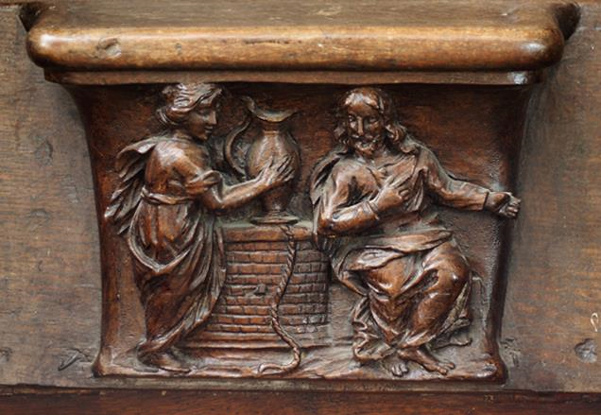
Christ and the Samaritan Woman -- Saint-Sulpice, Favieres, France

Slide 20
Just then his disciples came. They were astonished that he was speaking with a woman, but no one said, …"Why are you speaking with her?"
John 4:27

Slide 21
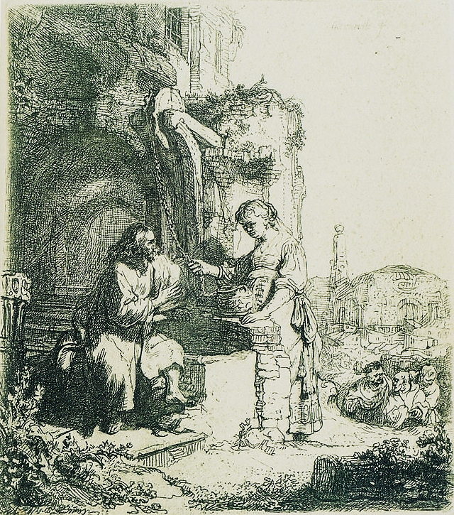
Christ and the Samaritan Woman
Rembrandt

Slide 22
Then the woman…went back to the city. She said to the people,
"Come and see a man who told me everything I have ever done! He cannot be the Messiah, can he?"
John 4:28

Slide 23
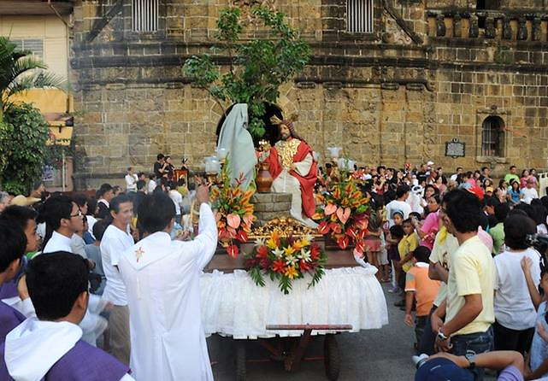
The Woman at the Well -- Paete, Philippines

Slide 24
So when the Samaritans came to him, they asked him to stay with them; and he stayed there two days.
John 4:40

Slide 25
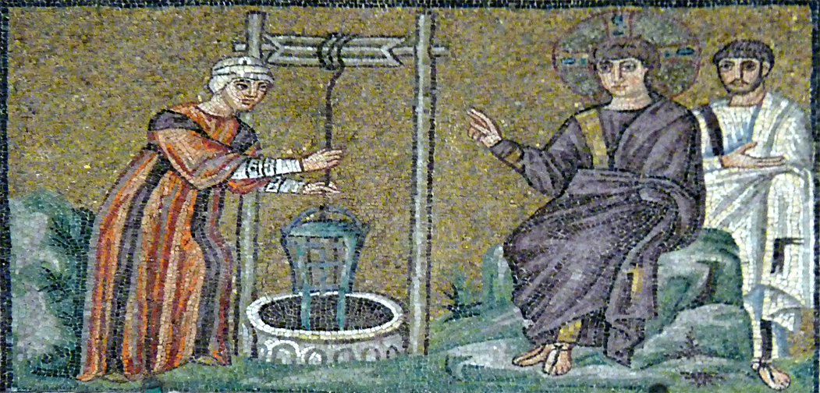
Christ and the Samaritan Woman -- San Apollinare Nuovo, Ravenna, Italy

Slide 26
They said to the woman, "It is no longer because of what you said that we believe, for we have heard for ourselves, and we know that this is truly the Savior of the world."
John 4:42

Slide 27
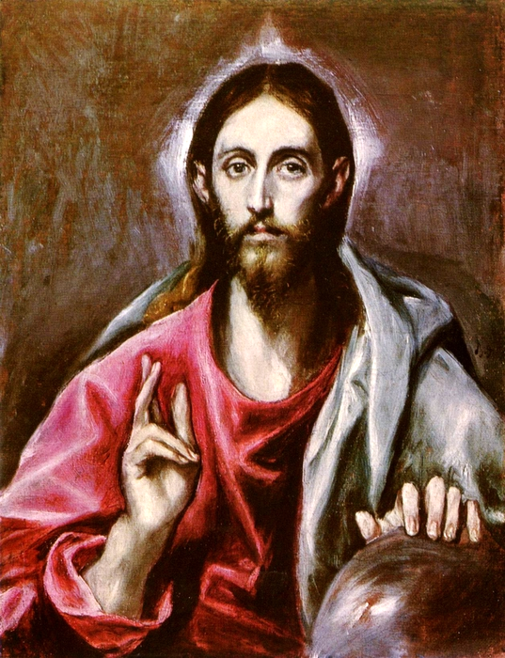
Savior of the World, or Christ Pantocrator
El Greco
National Gallery of Scotland, Edinburgh, Scotland

Slide 28
Credits
New Revised Standard Version Bible, copyright 1989, Division of Christian Education of the National Council of the Churches of Christ in the United States of America. Used by permission. All rights reserved.
http://www.flickr.com/photos/sacred_destinations/2624518984/s
https://commons.wikimedia.org/wiki/File:Thomas_Cole_-_A_View_of_the_Mountain_Pass_Called_the_Notch_of_the_White_Mountains.jpg
https://commons.m.wikimedia.org/wiki/File:Turtle_Peace_Labyrinth.jpg
http://www.flickr.com/photos/two_r_better/158783308/
http://www.librairie-emmanuel.fr (contact page: https://www.librairie-emmanuel.fr/contact)
http://commons.wikimedia.org/wiki/File:Siemiradzki-Chrystus_i_Samarytanka.jpg
https://www.flickr.com/photos/pelegrino/1366122359
https://www.flickr.com/photos/frted/8186047331 - Ted
http://commons.wikimedia.org/wiki/File:Saint-Sulpice-de-Favi%C3%A8res_stalles_481.JPG
https://commons.wikimedia.org/wiki/File:Christ_and_the_Samaritan_Woman_among_Ruins.jpg
http://www.flickr.com/photos/jonicdao/5644704405/
https://www.flickr.com/photos/damiavos/14310341562 - Damian Entwhistle
www.yorckproject.de
Additional descriptions can be found at the Art in the Christian Tradition image library, a service of the Vanderbilt Divinity Library, http://diglib.library.vanderbilt.edu/. All images available via Creative Commons 3.0 License.

