Slide 1
Thanksgiving Day
Year A
Deuteronomy 8:7-18 and Psalm 65 • 2 Corinthians 9:6-15 Luke 17:11-19

Slide 2
For the LORD your God is bringing you into a good land … a land whose stones are iron and from whose hills you may mine copper.
Deuteronomy 8:7a, 9b

Slide 3
Miner, Pennsylvania
WPA Poster
Library of Congress
Washington, DC

Slide 4
Those who live at earth's farthest bounds are awed by your signs;
you make the gateways of the morning and the evening shout for joy.
Psalm 65:8

Slide 5
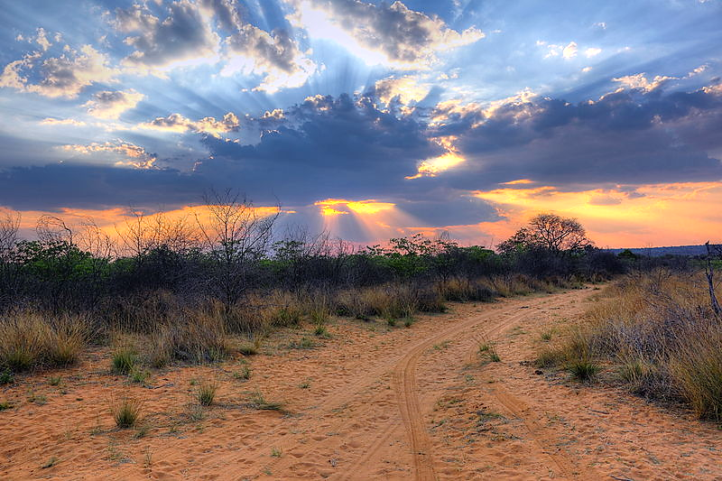
Sunset -- Heinrich Pniok, Waterberg Plateau, Namibia

Slide 6
… you are in the Spirit, since the Spirit of God dwells in you.
Romans 8:9b

Slide 7
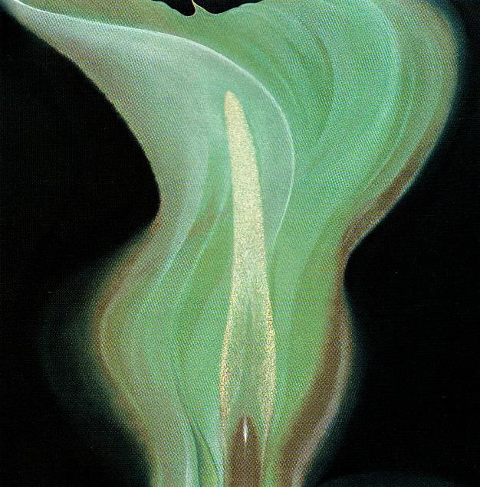
Resurrection -- Frank Wesley

Slide 8
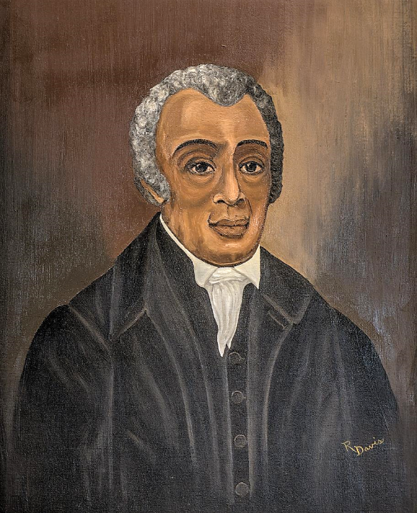
Richard Allen
Founder and First Bishop of the African Methodist Episcopal Church

Slide 9
And he told them many things in parables, saying: "Listen! A sower went out to sow.
Matthew 13:3

Slide 10
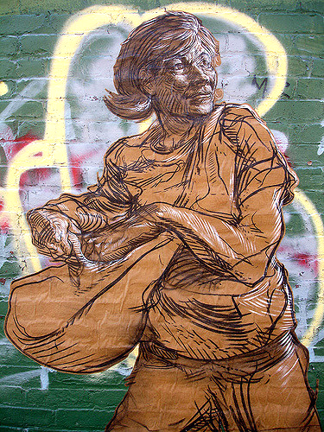
Sally Sows
Street mural, Brooklyn, NY

Slide 11
And as he sowed, some seeds fell on the path, and the birds came and ate them up.
Matthew 13:4

Slide 12
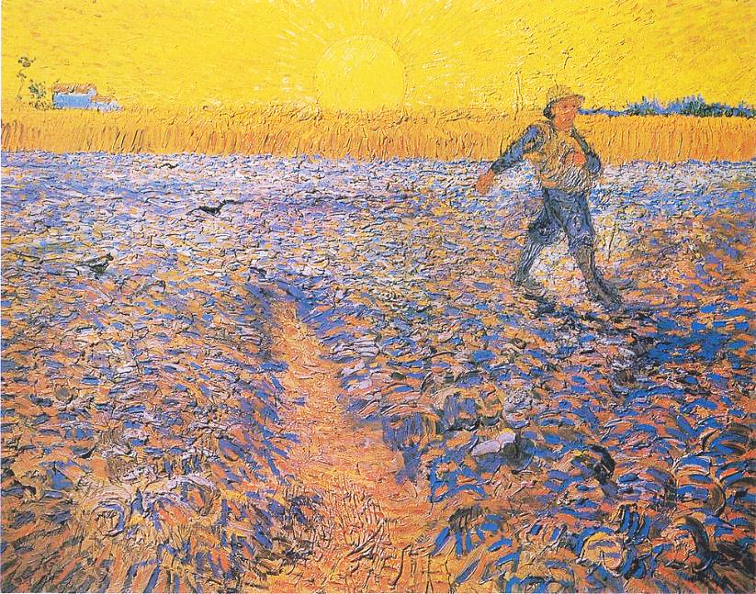
Sower at Sunset -- Vincent van Gogh Kroller-Muller Museum, Otterlo, Netherlands

Slide 13
Other seeds fell on rocky ground, where they did not have much soil, and they sprang up quickly, since they had no depth of soil.
Matthew 13:5

Slide 14
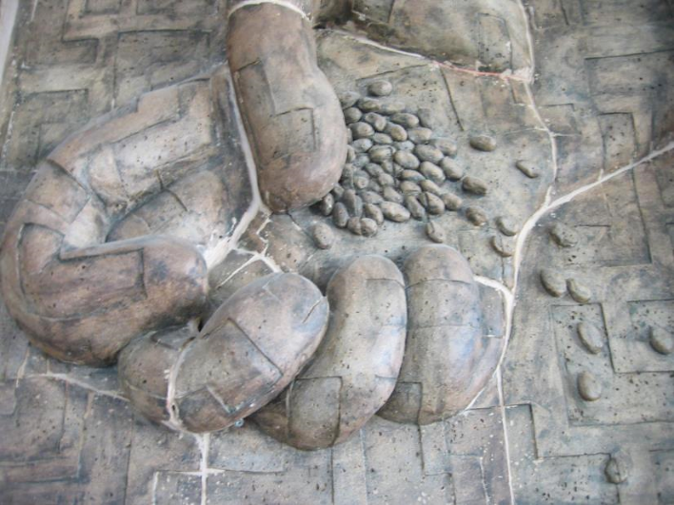
Sowing Seed -- Unidentified church sculpture, Taiwan

Slide 15
But when the sun rose, they were scorched; and since they had no root, they withered away.
Matthew 13:6

Slide 16
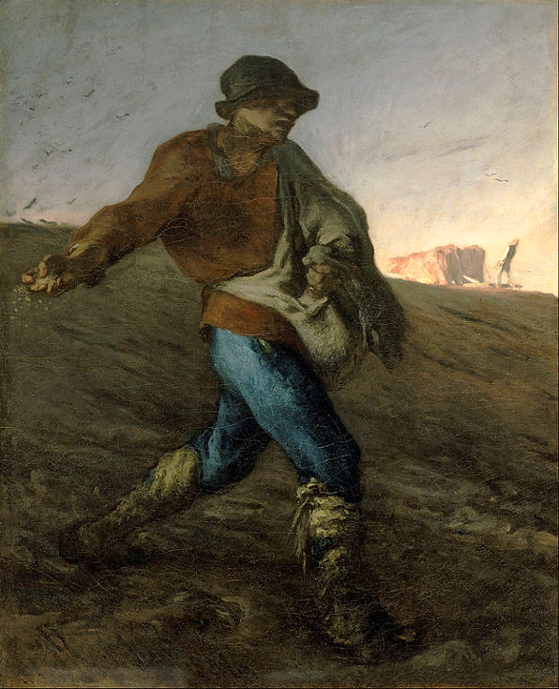
The Sower
Jean-Francois Millet Boston Museum of Fine Arts Boston, MA

Slide 17
Other seeds fell among thorns, and the thorns grew up and choked them.
Matthew 13:7

Slide 18
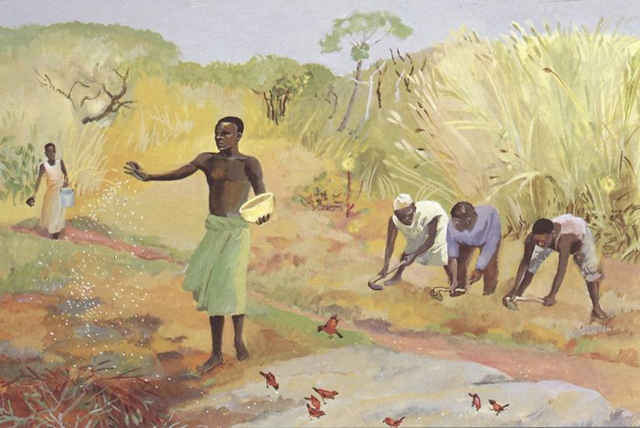
Parable of the Sower -- JESUS MAFA, Cameroon

Slide 19
Other seeds fell on good soil and brought forth grain, some a hundredfold, some sixty, some thirty.
Matthew 13:8

Slide 20
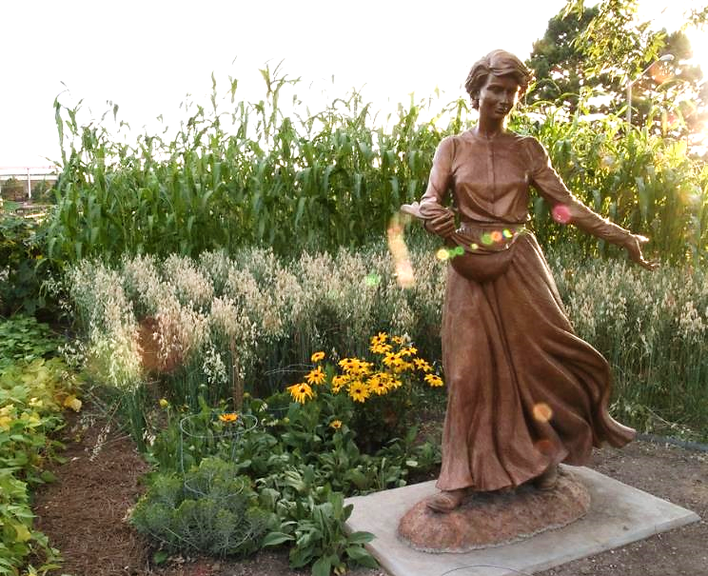
Seed and the Sower -- Cheyenne Botanic Gardens, Cheyenne, WY

Slide 21
But as for what was sown on good soil, this is the one who hears the word and understands it, who indeed bears fruit and yields ...
Matthew 13:23

Slide 22
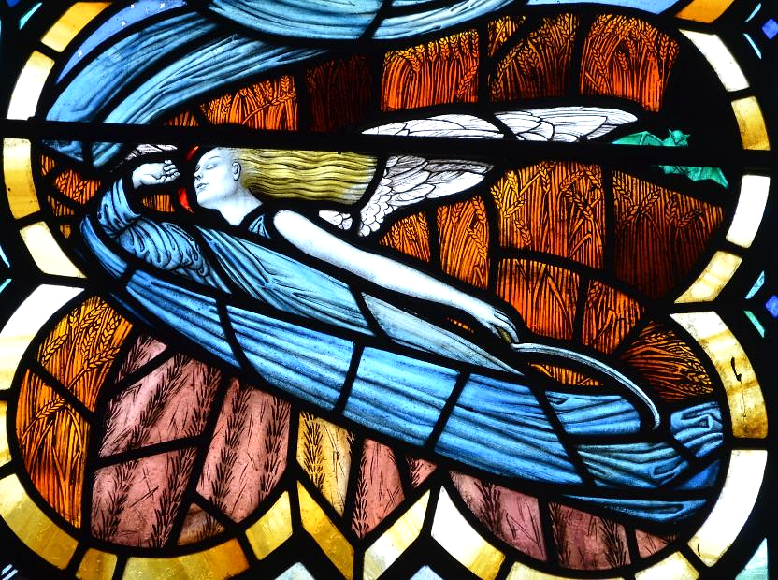
The Reaper -- William Morris & Co., Marden, England

Slide 23
Credits
New Revised Standard Version Bible, copyright 1989, Division of Christian Education of the National Council of the Churches of Christ in the United States of America. Used by permission. All rights reserved.
https://commons.wikimedia.org/wiki/File:Pennsylvania_LCCN98518434.tif
https://commons.m.wikimedia.org/wiki/File:Crepuscular_rays_at_Sunset_near_Waterberg_Plateau.jpg
Estate of Frank Wesley, http://www.frankwesleyart.com/main_page.htm
https://commons.wikimedia.org/wiki/File:19-22-011-museum.jpg
https://www.flickr.com/photos/guy_on_the_streets/185485832/
https://commons.wikimedia.org/wiki/File:Van_Gogh_-_S%C3%A4mann_bei_untergehender_Sonne.jpeg
https://www.flickr.com/photos/benny_lin/266525738
https://commons.wikimedia.org/wiki/File:Jean-Fran%C3%A7ois_Millet_-_The_Sower_-_Google_Art_Project.jpg
http://diglib.library.vanderbilt.edu/act-imagelink.pl?RC=48309
https://www.flickr.com/photos/ljguitar/1099799640/
https://www.flickr.com/photos/jpguffogg/12618857873/
Additional descriptions can be found at the Art in the Christian Tradition image library, a service of the Vanderbilt Divinity Library, http://diglib.library.vanderbilt.edu/. All images available via Creative Commons 3.0 License.

