Slide 1
Second Sunday in Lent
Year A
Genesis 12:1-4a • Psalm 121 • Romans 4:1-5, 13-17
John 3:1-17 or Matthew 17:1-9

Slide 2
Now the LORD said to Abram,
“…in you all the families of the earth shall be blessed."
Genesis 12:1a, 3b

Slide 3
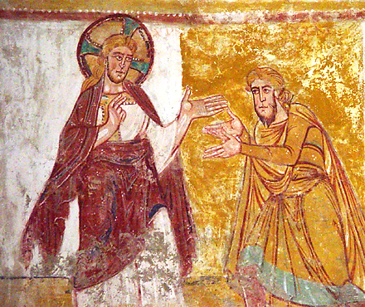
The Calling of Abraham -- Abbey of Saint-Savin, Vienne, France

Slide 4
I lift up my eyes to the hills-- from where will my help come?
My help comes from the LORD, who made heaven and earth.
Psalm 121:1-2

Slide 5
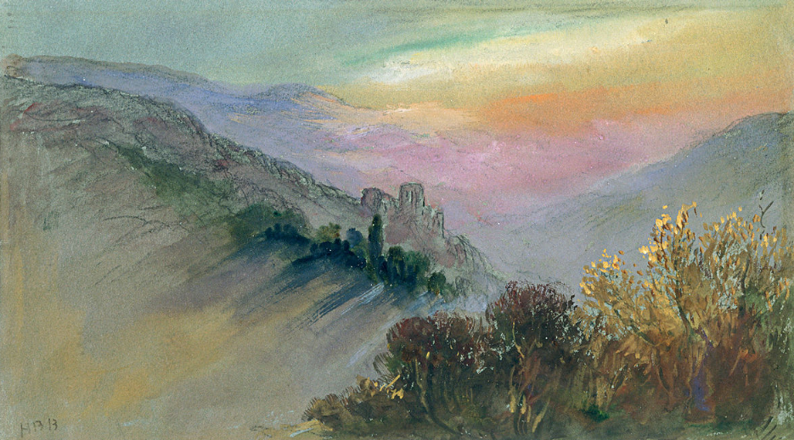
Mountain Landscape -- Hercules Brabazon, Phillips Collection, Washington, DC

Slide 6
The LORD will keep your going out and your coming in from this time on and forevermore.
Psalm 121:8

Slide 7
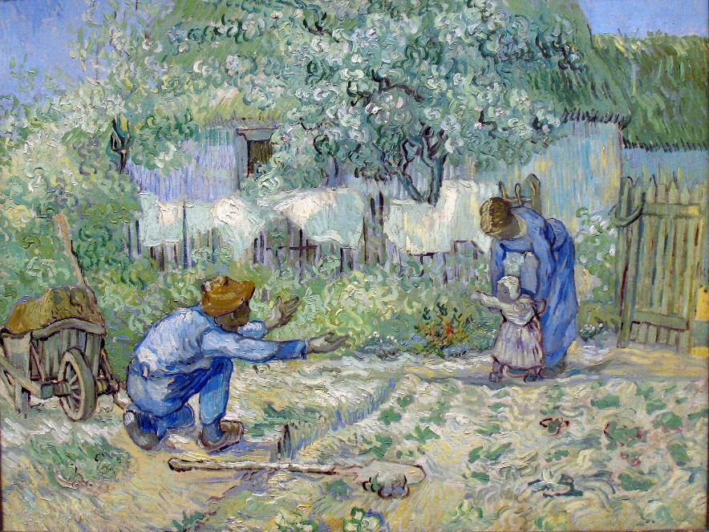
First Steps -- Vincent Van Gogh, Metropolitan Museum of Art, New York

Slide 8
For the promise…did not come to Abraham or to his descendants through the law but through the righteousness of faith.
Romans 4:13

Slide 9
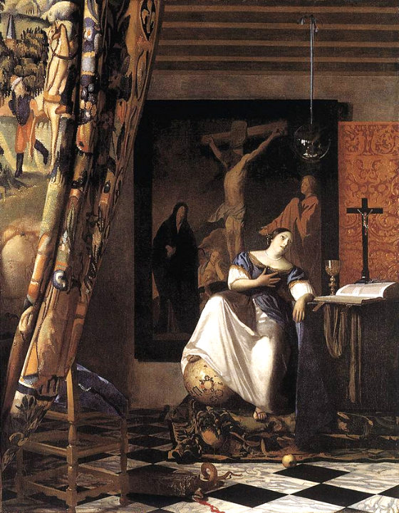
Allegory of Faith
Johannes Vermeer
Metropolitan Museum of Art
New York City

Slide 10
Now there was a Pharisee named Nicodemus, a leader of the Jews.
John 3:1

Slide 11
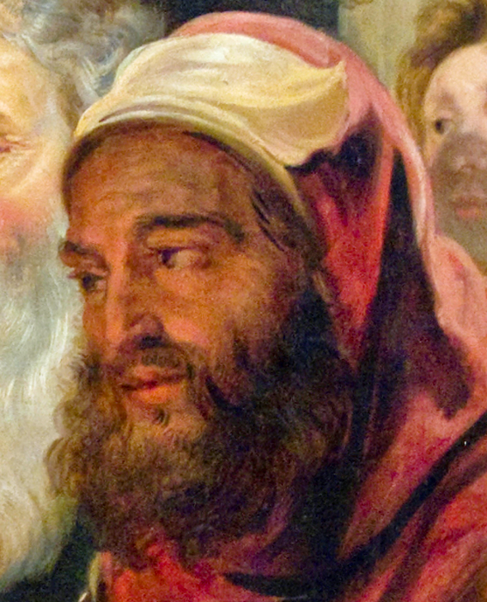
Christ Instructing Nicodemus (detail)
Jacob Jordaens
Royal Museum
Brussels, Belgium

Slide 12
He came to Jesus by night and said to him, "Rabbi, we know that you are a teacher who has come from God; for no one can do these signs that you do apart from the presence of God."
John 3:2

Slide 13
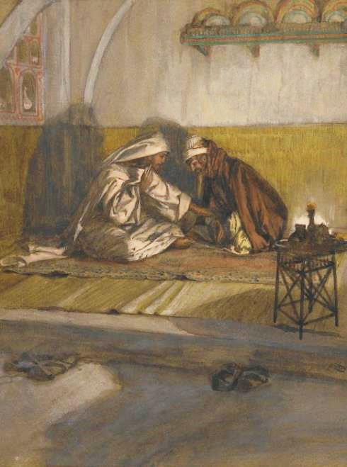
Christ and Nicodemus
James Tissot
Brooklyn Museum
New York, NY

Slide 14
Jesus answered him, "Very truly, I tell you, no one can see the kingdom of God without being born from above."
John 3:3

Slide 15
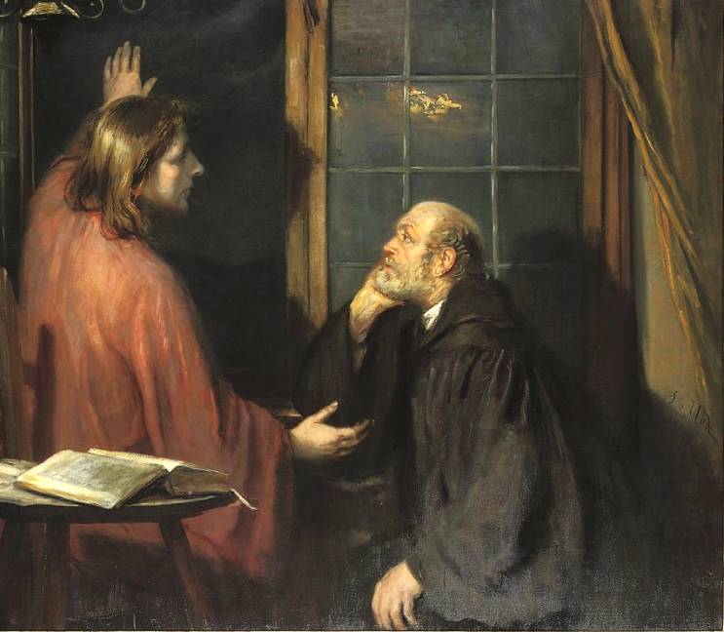
Nicodemus and Christ -- Fritz von Uhde

Slide 16
Nicodemus said to him, "How can anyone be born after having grown old? Can one enter a second time into the mother's womb and be born?"
John 3:4

Slide 17
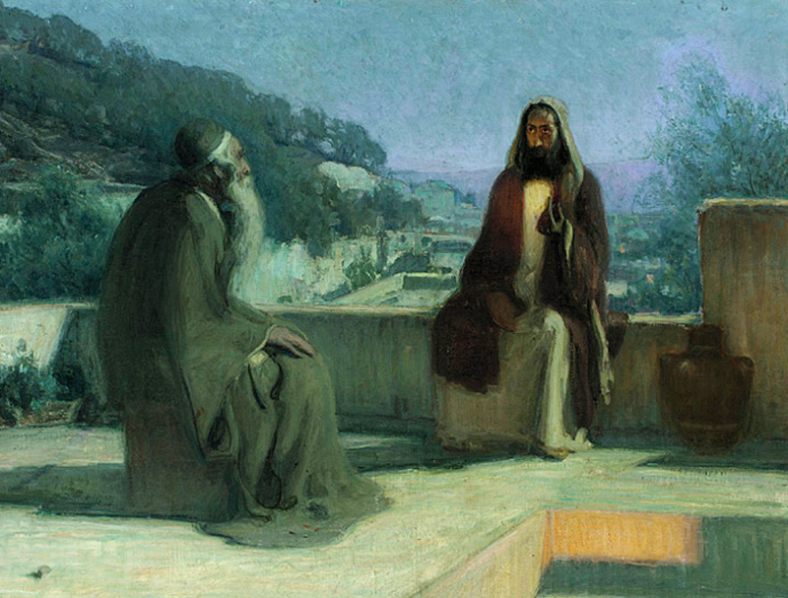
Nicodemus and Jesus on a Rooftop -- Henry Ossawa Tanner, Philadelphia Museum of Art

Slide 18
Jesus answered, "Very truly, I tell you, no one can enter the kingdom of God without being born of water and Spirit.”
John 3:5

Slide 19
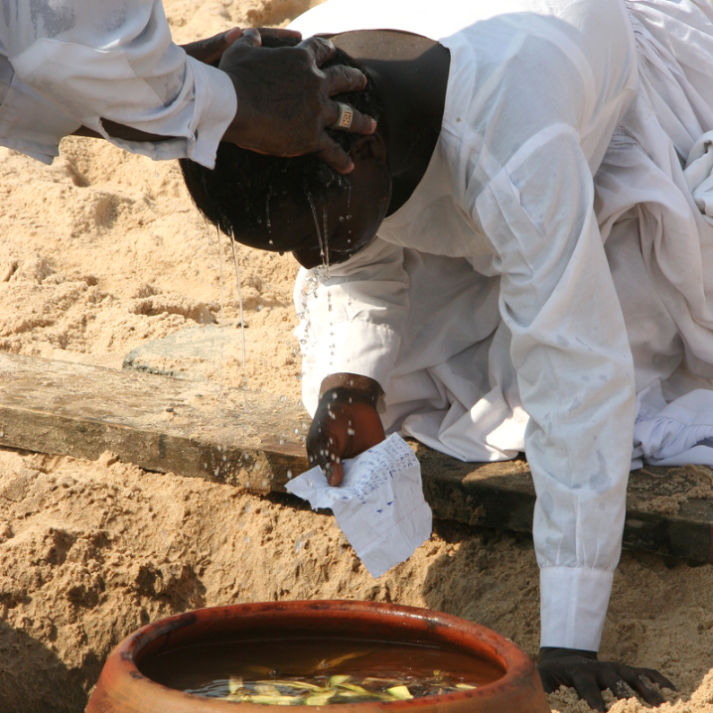
Benin Baptism
Cotonou, Benin

Slide 20
The wind blows where it chooses, and you hear the sound of it, but you do not know where it comes from or where it goes. So it is with everyone who is born of the Spirit."
John 3:8

Slide 21
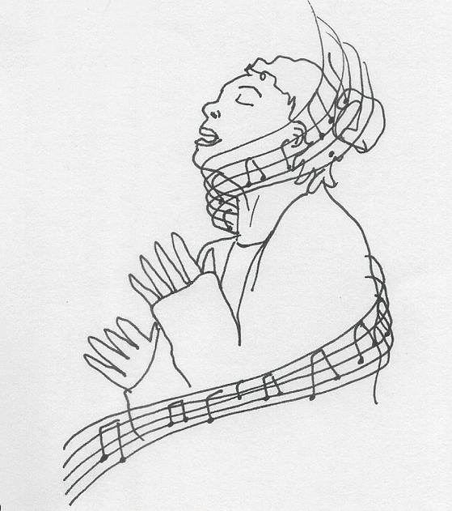
Praise -- Liz Valente

Slide 22
"For God so loved the world that he gave his only Son, so that everyone who believes in him may not perish but may have eternal life.”
John 3:16

Slide 23
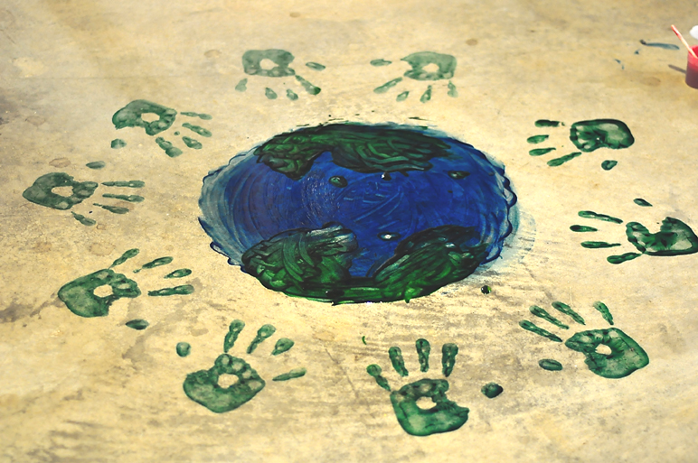
The Whole World in God’s Hands -- Courtney Carmody

Slide 24
Credits
New Revised Standard Version Bible, copyright 1989, Division of Christian Education of the National Council of the Churches of Christ in the United States of America. Used by permission. All rights reserved.
http://diglib.library.vanderbilt.edu/act-imagelink.pl?RC=33460
https://commons.wikimedia.org/wiki/File:Hercules_Brabazon_-_Mountain_Landscape_-_Google_Art_Project.jpg
http://commons.wikimedia.org/wiki/File:1890_van_Gogh_First_Steps_-_after_Millet_anagoria.JPG
http://commons.wikimedia.org/wiki/File:Vermeer_The_Allegory_of_the_Faith.jpg
http://www.flickr.com/photos/oxfordshire_church_photos/6218045171/
https://commons.wikimedia.org/wiki/File:Brooklyn_Museum__Interview_between_Jesus_and_Nicodemus_(Entretien_de_J%C3%A9sus_et_de_Nicod%C3%A8me)_-_James_Tissot.jpg
https://commons.wikimedia.org/wiki/File:Fritz_von_Uhde_-_Christus_und_Nikodemus_(ca.1886).jpg
http://commons.wikimedia.org/wiki/File:Henry_Ossawa_Tanner_-_Jesus_and_nicodemus.jpg
Ferdinand Rheus, Flickr Creative Commons
Liz Valente, https://www.instagram.com/donalizvalente/
https://www.flickr.com/photos/calamity_photography/4745146362
Additional descriptions can be found at the Art in the Christian Tradition image library, a service of the Vanderbilt Divinity Library, http://diglib.library.vanderbilt.edu/. All images available via Creative Commons 3.0 License.

