Slide 1
Resurrection of the Lord
Year A
Acts 10:34-43 or Jeremiah 31:1-6 • Psalm 118:1-2, 14-24 • Colossians 3:1-4 or Acts 10:34-43 • John 20:1-18 or Matthew 28:1-10

Slide 2
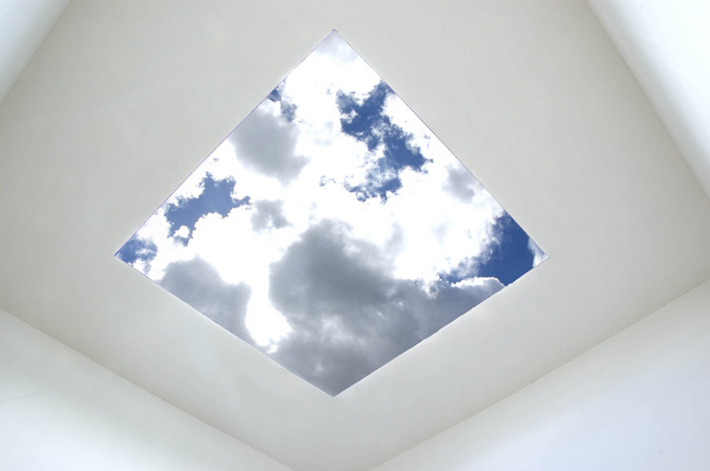
Skyspace, Live Oak Meeting House, Society of Friends -- James Turrell, Houston, TX

Slide 3
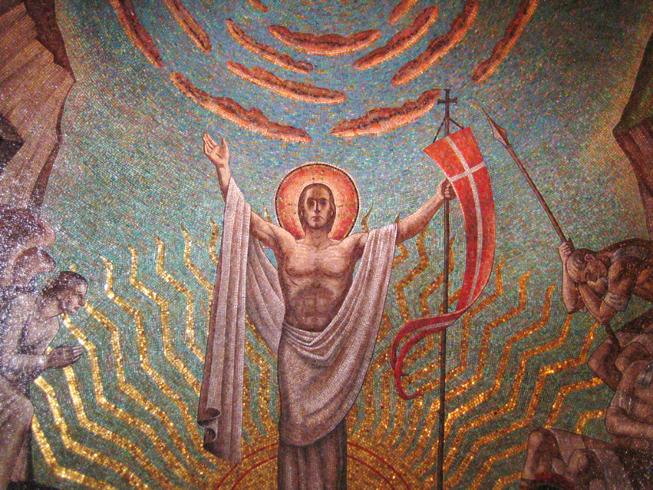
Resurrection -- Hildreth Meiere, National Cathedral, Washington, DC

Slide 4
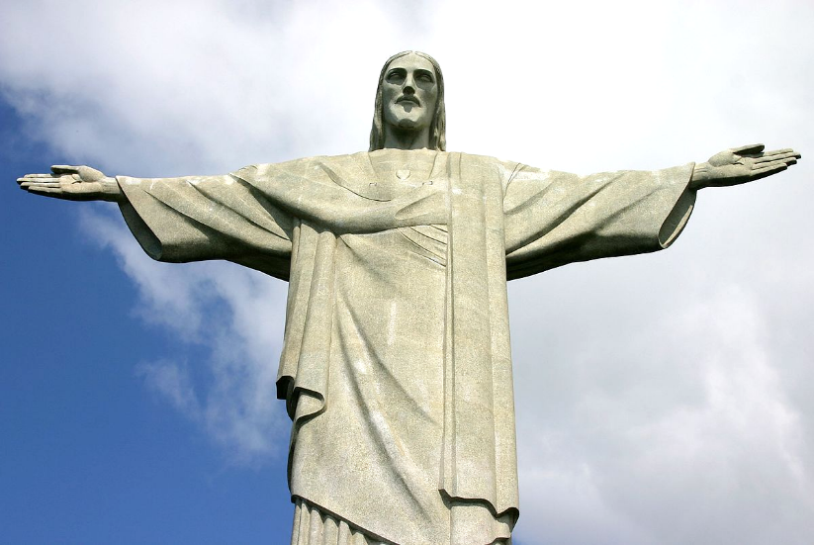
Christ the Redeemer -- Paul Landowski and Gheorghe Leonida, Rio de Janiero, Brazil

Slide 5
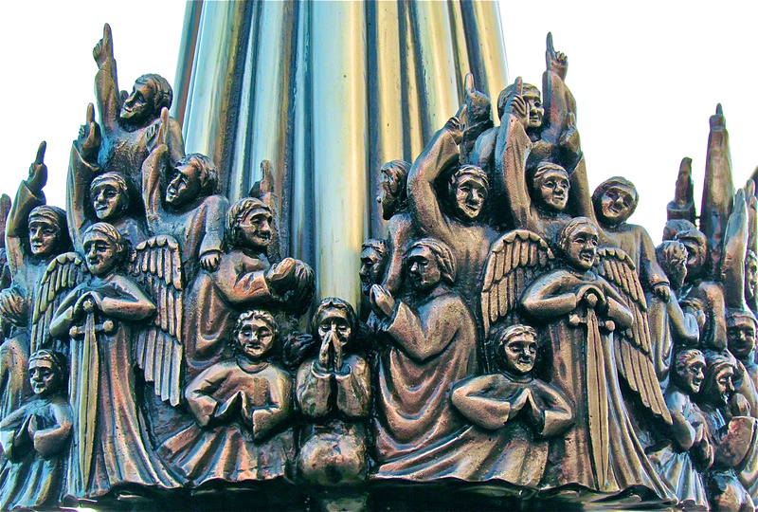
Heaven Holds a Sense of Wonder -- Famke van Wijk, Nieuwe Kerk, The Hague, Netherlands

Slide 6
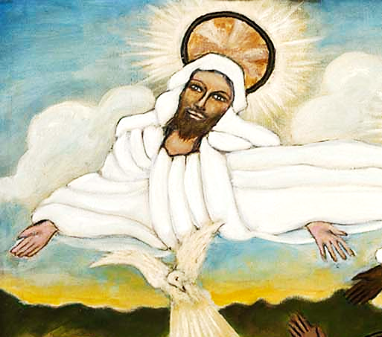
Baptism of Jesus, detail of God -- Lorenzo Scott, Smithsonian American Art Museum, DC

Slide 7
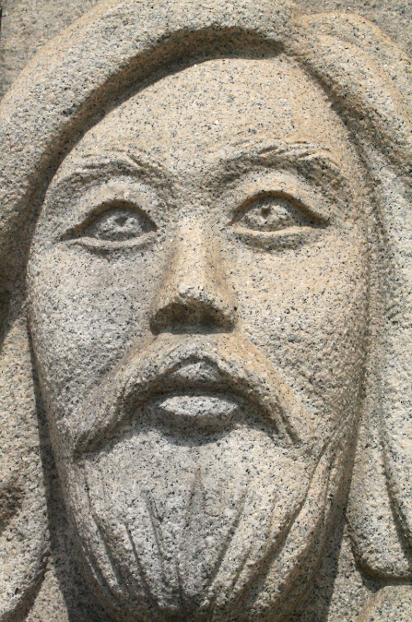
Jesus Christ
Monumental relief sculpture
Incheon, Korea

Slide 8
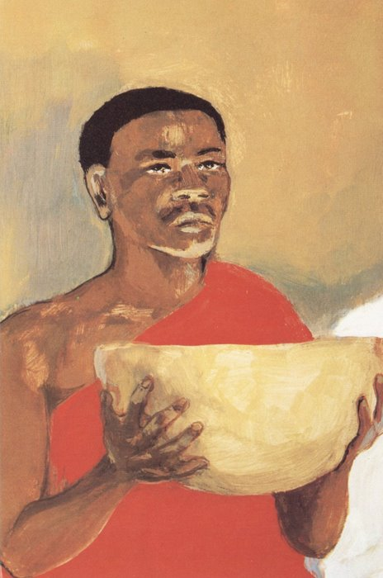
Christ
JESUS MAFA, Cameroon

Slide 9
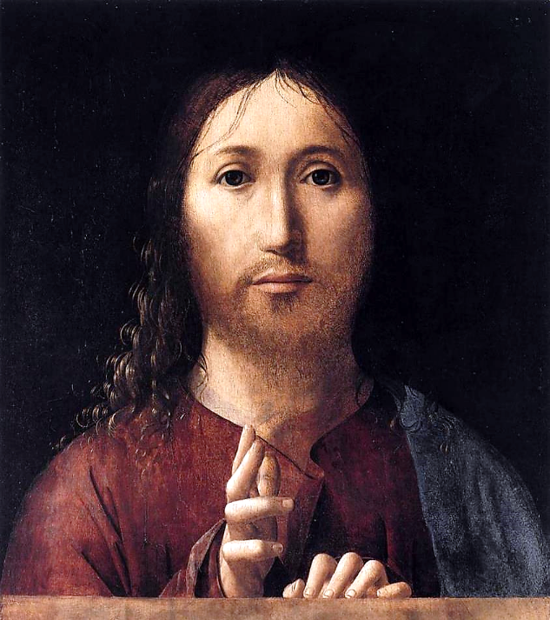
Salvator Mundi
Antonello da Messina
National Gallery London

Slide 10
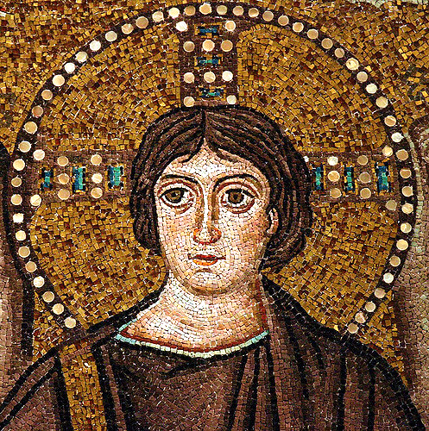
Christ -- Apse mosaic, Basilica of San Vitale, Ravenna, Italy

Slide 11
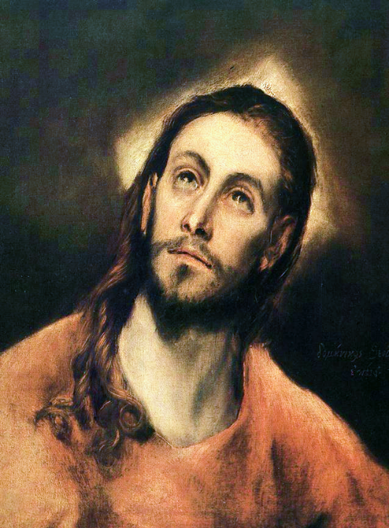
Christ
El Greco
National Gallery
Prague, Czech Republic

Slide 12
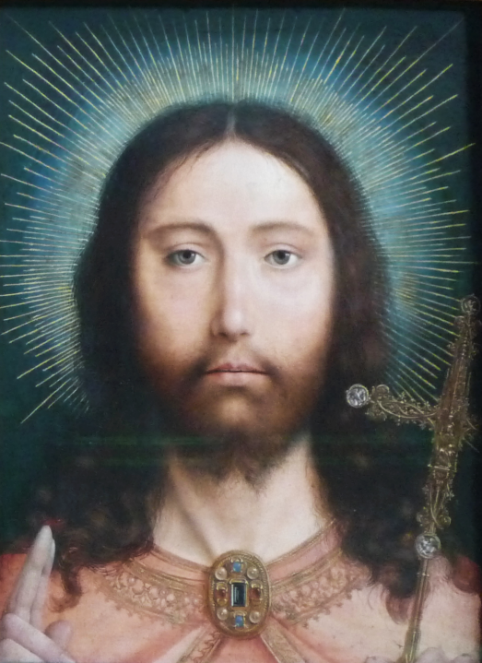
Christ Salvator Mundi
Quentin Metsys
Musée des Beaux-Arts
Antwerp, Belgium

Slide 13
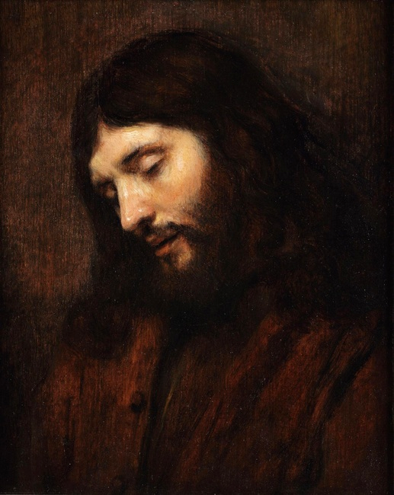
Head of Christ
Rembrandt
Louvre, Paris

Slide 14
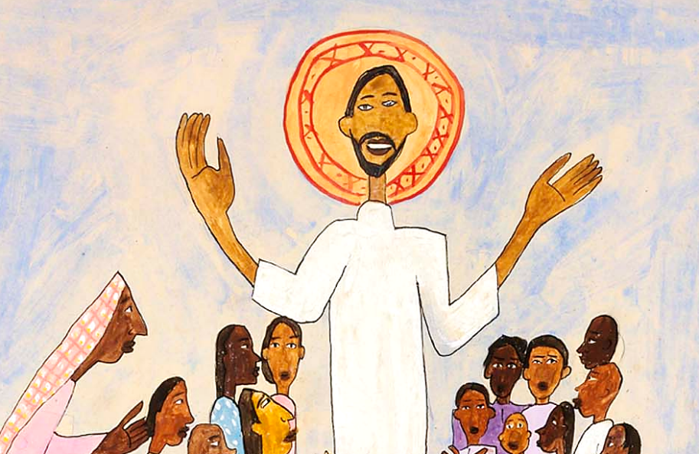
Come Unto Me, Little Children -- William H. Johnson, Smithsonian American Art Museum, DC

Slide 15
He is Risen, indeed!

Slide 16
Credits
New Revised Standard Version Bible, copyright 1989, Division of Christian Education of the National Council of the Churches of Christ in the United States of America. Used by permission. All rights reserved.
http://www.flickr.com/photos/21804434@N02/5394865139
https://www.flickr.com/photos/mcolburn/394714737
https://commons.wikimedia.org/wiki/File:Christtheredeemer.jpg
http://www.flickr.com/photos/roel1943/5414772066
http://americanart.si.edu/collections/search/artwork/?id=33953
http://diglib.library.vanderbilt.edu/act-imagelink.pl?RC=54325 – Flickr Creative Commons
http://diglib.library.vanderbilt.edu/act-imagelink.pl?RC=48298
https://commons.wikimedia.org/wiki/File:Antonello_da_Messina_-_Salvator_Mundi_-_WGA0757.jpg
https://www.flickr.com/photos/sacred_destinations/2880373399/
https://commons.wikimedia.org/wiki/File:El_Greco_-_Christ_-_WGA10501.jpg
https://commons.wikimedia.org/wiki/File:Quentin_Metsys_Christ_Antwerp.jpg
https://www.flickr.com/photos/waitingfortheword/6010350398/
http://americanart.si.edu/collections/search/artwork/?id=11621
Additional descriptions can be found at the Art in the Christian Tradition image library, a service of the Vanderbilt Divinity Library, http://diglib.library.vanderbilt.edu/. All images available via Creative Commons 3.0 License.

