Slide 1
Sixth Sunday after Pentecost
Year A
Genesis 24:34-38, 42-49, 58-67 and Psalm 45:10-17 or Song of Solomon 2:8-13 • Zechariah 9:9-12 and Psalm 145:8-14 Romans 7:15-25a • Matthew 11:16-19, 25-30

Slide 2
"Before I had finished speaking in my heart, there was Rebekah coming out with her water jar on her shoulder;"
Genesis 24:45a

Slide 3
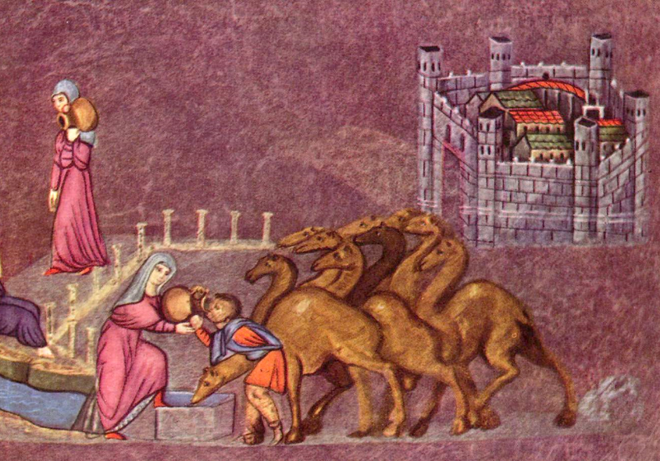
Rebecca at the Well -- Österreichische Nationalbibliothek, Vienna, Austria

Slide 4
She quickly let down her jar from her shoulder, and said, 'Drink, and I will also water your camels.'
Genesis 24:46

Slide 5
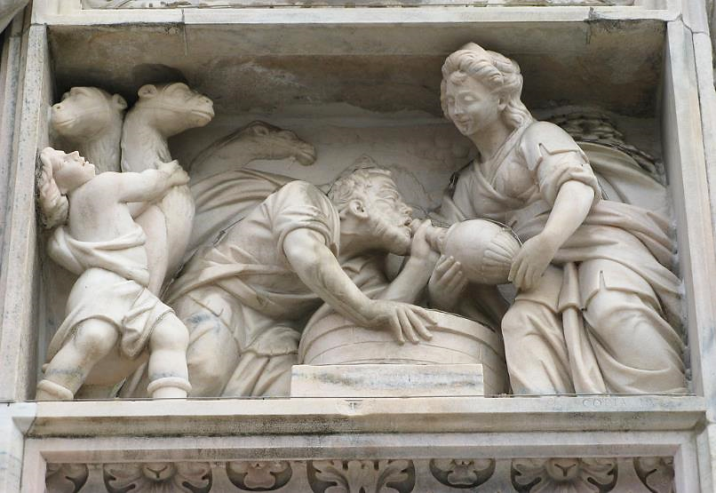
Isaac's Messenger Drinks from Rebecca's Jug -- Duomo, Milan, Italy

Slide 6
Then I asked her, 'Whose daughter are you?' She said, 'The daughter of Bethuel, Nahor's son, whom Milcah bore to him.' So I put the ring on her nose, and the bracelets on her arms.
Genesis 24:47

Slide 7
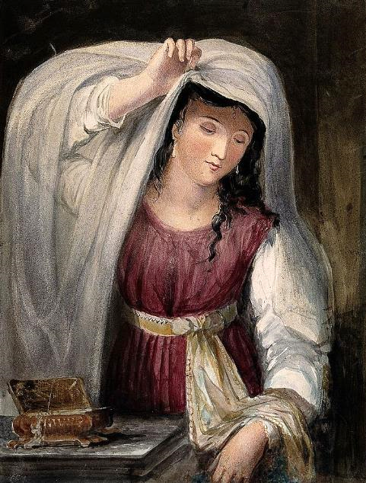
Rebecca With Her Gifts from Isaac
Juliana Howard
Iconographic Collections

Slide 8
And they called Rebekah, and said to her, "Will you go with this man?" She said, "I will."
Genesis 24:58

Slide 9
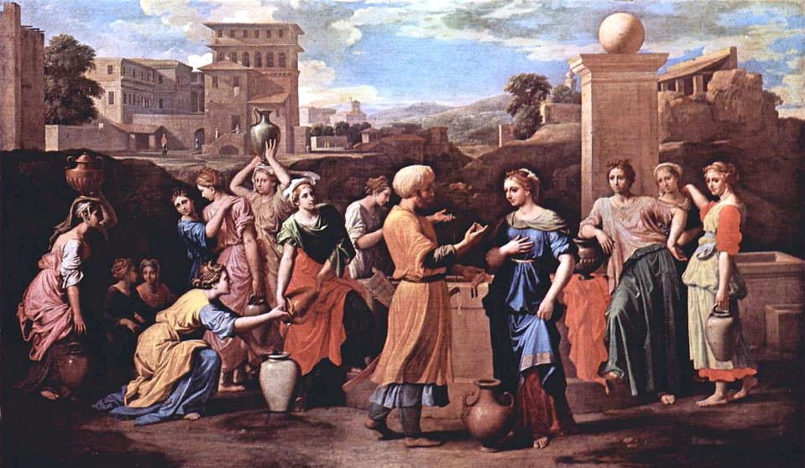
Rebecca at the Well -- Nicolas Poussin, Louvre Museum, Paris, France

Slide 10
…Isaac…took Rebekah, and she became his wife; and he loved her. So Isaac was comforted after his mother's death.
Genesis 24:67

Slide 11
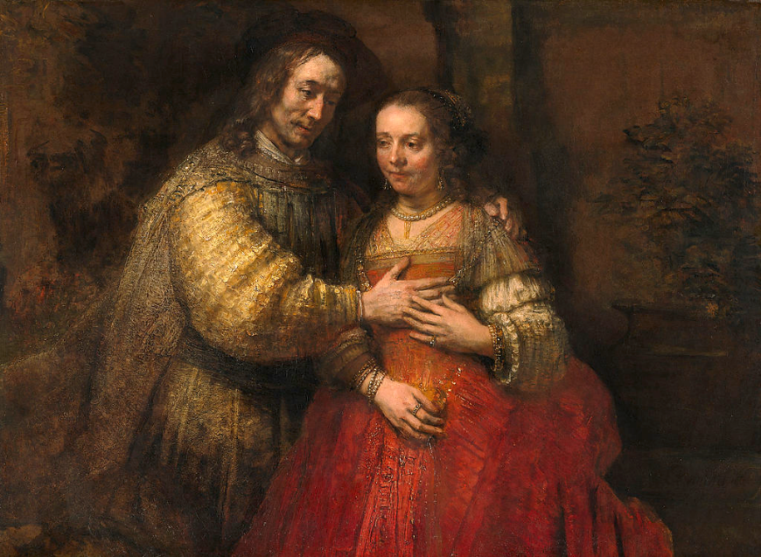
Isaac and Rebecca -- Rembrandt, Rijksmuseum, Amsterdam, Netherlands

Slide 12
Hear, O daughter, consider and incline your ear … I will cause your name to be celebrated in all generations;
Psalm 45:10a, 17a

Slide 13
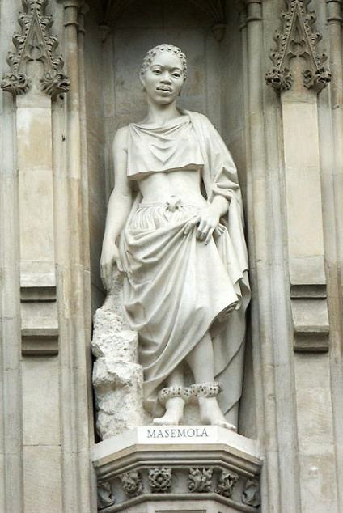
Manche Masemola,
South African Martyr
Westminster Abbey
London, England

Slide 14
My beloved speaks and says to me: "Arise, my love, my fair one, and come away … "
Song of Solomon 2:10

Slide 15
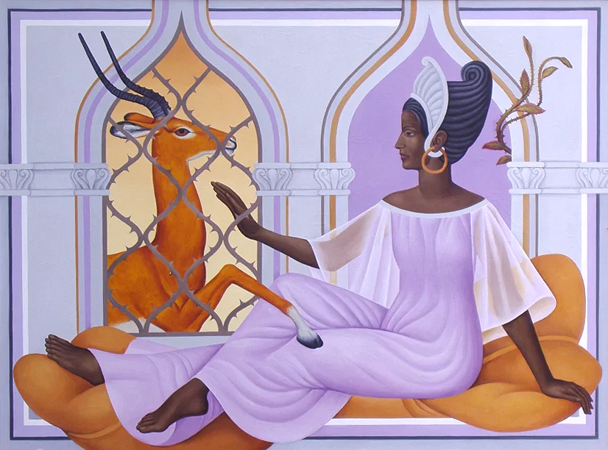
Lattice Window – Song of Solomon -- Peter Koenig

Slide 16
Rejoice greatly, O daughter Zion! … Lo, your king comes to you; triumphant and victorious is he, humble and riding on a donkey, on a colt, the foal of a donkey.
Zechariah 9:9

Slide 17
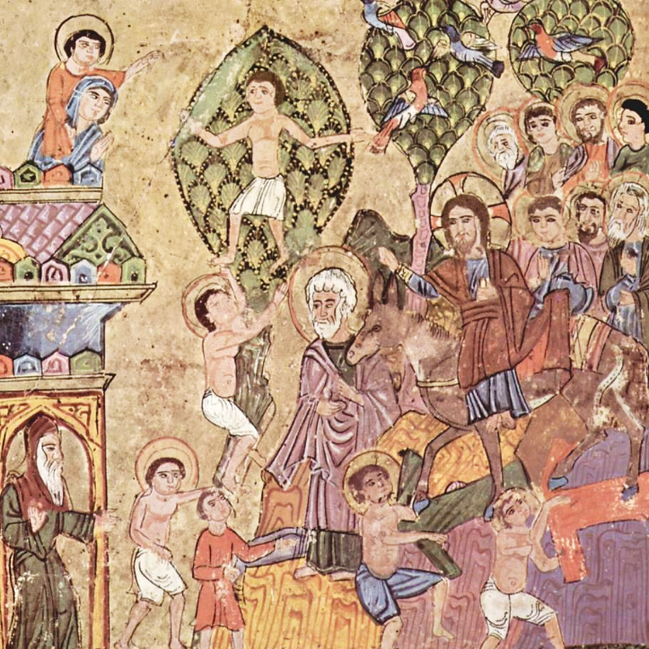
Christ Enters Jerusalem
Syrian Jacobite Church
Vatican Museum Vatican City

Slide 18
The LORD upholds all who are falling, and raises up all who are bowed down.
Psalm 145: 14

Slide 19
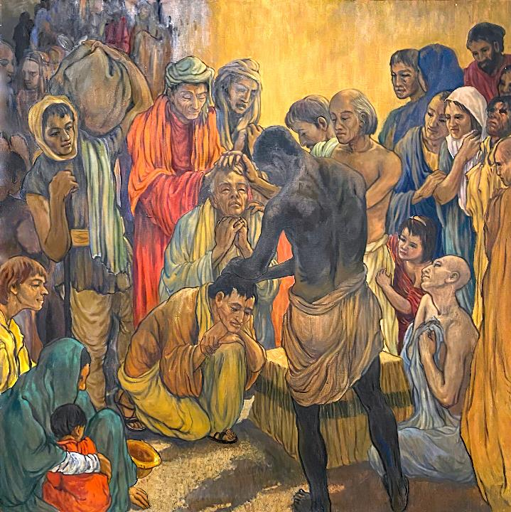
Dedication of Paul and Barnabas
Frank Wesley

Slide 20
For I delight in the law of God in my inmost self,
Romans 7:22

Slide 21
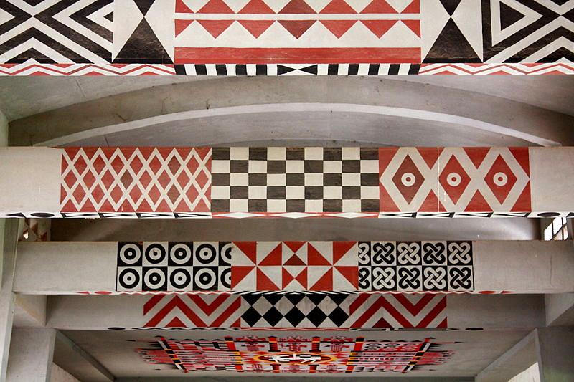
Ceiling of Keur Moussa Abbey, Senegal

Slide 22
"Come to me, all you that are weary and are carrying heavy burdens, and I will give you rest."
Matthew 11:28

Slide 23
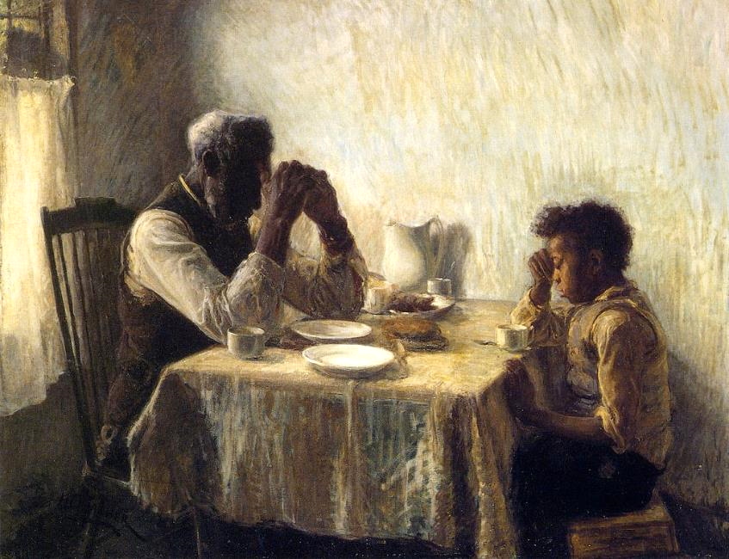
The Thankful Poor -- Henry Ossawa Tanner

Slide 24
Credits
New Revised Standard Version Bible, copyright 1989, Division of Christian Education of the National Council of the Churches of Christ in the United States of America. Used by permission. All rights reserved.
http://en.wikipedia.org/wiki/Vienna_Genesis
https://commons.wikimedia.org/wiki/File:Rebecca_at_the_well-.jpg
https://commons.wikimedia.org/wiki/File:Rebecca_admires_the_clothes_and_jewellery_given_to_her_by_Ab_Wellcome_V0034251.jpg
https://commons.wikimedia.org/wiki/File:Nicolas_Poussin_073.jpg
https://commons.wikimedia.org/wiki/File:Rembrandt_Harmensz._van_Rijn_-_Het_Joodse_bruidje.jpg
https://commons.wikimedia.org/wiki/File:WestminsterAbbey-Martyrs.jpg - Jean-Christophe BENOIST
Peter Winfried (Canisius) Koenig, https://www.pwkoenig.co.uk/
http://de.wikipedia.org/wiki/Datei:Syrischer_Maler_um_1220_001.jpg
Estate of Frank Wesley, http://www.frankwesleyart.com/main_page.htm
https://commons.m.wikimedia.org/wiki/File:KeurMoussaPlafond.jpg#mw-jump-to-license
https://www.flickr.com/photos/jimsurkamp/17339820129/
Additional descriptions can be found at the Art in the Christian Tradition image library, a service of the Vanderbilt Divinity Library, http://diglib.library.vanderbilt.edu/. All images available via Creative Commons 3.0 License.

