Slide 1
Third Sunday after Pentecost
Year A
Genesis 18:1-15, (21:1-7) and Psalm 116:1-2, 12-19 or Exodus 19:2-8a and Psalm 100
Romans 5:1-8
Matthew 9:35-10:8, (9-23)

Slide 2
Then one said … "your wife Sarah shall have a son." And Sarah was listening at the tent entrance behind him.
Genesis 18:10

Slide 3
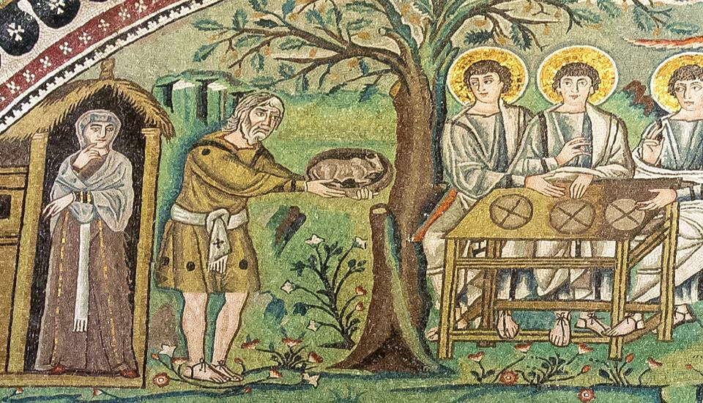
Sarah, Abraham, and the Three Visitors -- Basilica of San Vitale, Ravenna, Italy

Slide 4
What shall I return to the LORD for all his bounty to me?
Psalm 116:12

Slide 5
Handmade print

Slide 6
Then Moses went up to God; the LORD called to him … saying, "Thus you shall say to the house of Jacob … I bore you on eagles' wings and brought you to myself."
Exodus 19:3a, 4b

Slide 7
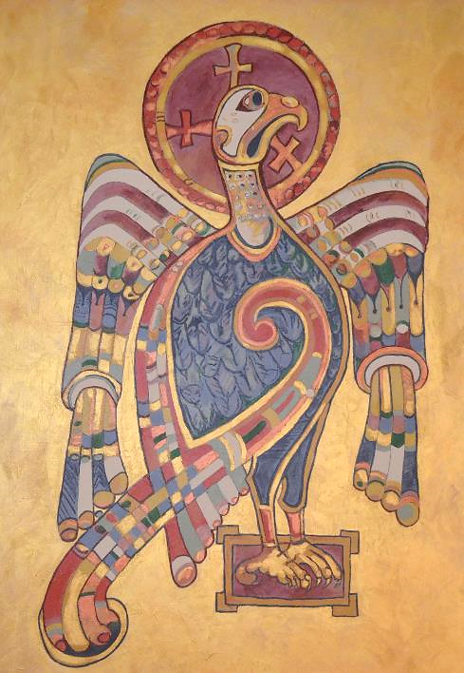
Eagle from Book of Kells
Congregational art,
Church of St. Clement of Rome, Seattle, WA

Slide 8
For the LORD is good; his steadfast love endures forever, and his faithfulness to all generations.
Psalm 100:5

Slide 9
Wooden Love Sign -- Doi Inthanon National Park, Thailand

Slide 10
God's love has been poured into our hearts through the Holy Spirit that has been given to us.
Romans 5:5b

Slide 11
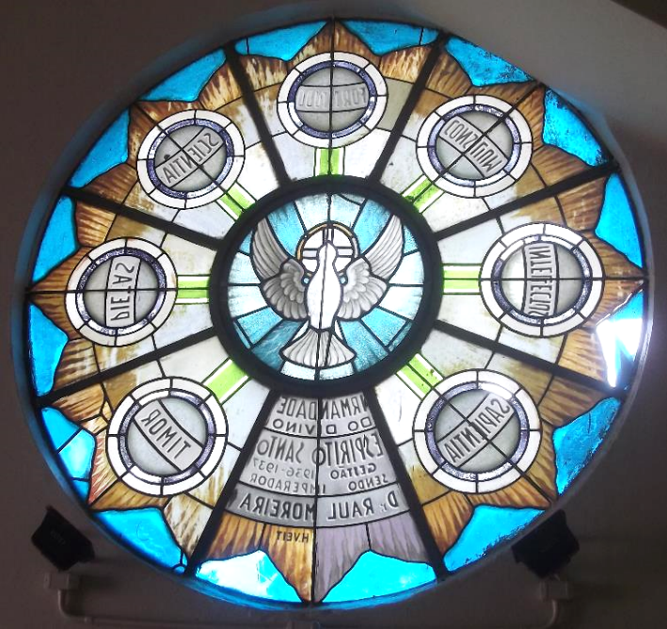
Gifts of the Holy Spirit
Chapel of the Holy Spirit
Porto Alegre,
Brazil

Slide 12
Then Jesus went about all the cities and villages, teaching in their synagogues, and proclaiming the good news of the kingdom, and curing every disease and every sickness.
Matthew 9:35

Slide 13
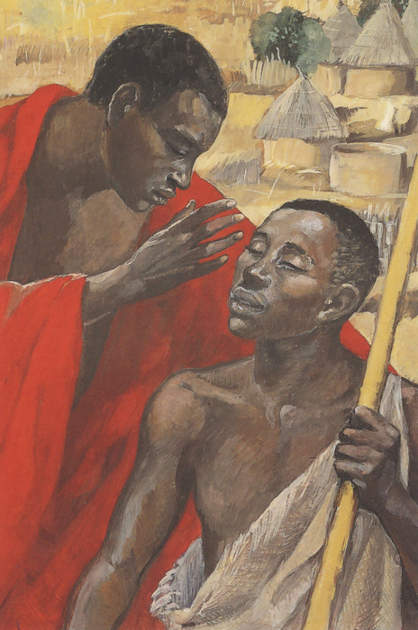
Jesus Cures the Man Born Blind
JESUS MAFA
Cameroon

Slide 14
When he saw the crowds, he had compassion for them, because they were harassed and helpless, like sheep without a shepherd.
Matthew 9:36

Slide 15
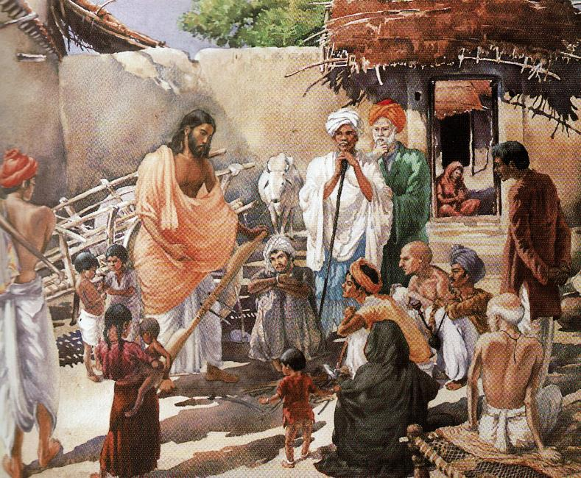
Jai Krist -- Frank Wesley

Slide 16
Then he said to his disciples, "The harvest is plentiful, but the laborers are few;
Matthew 9:37

Slide 17
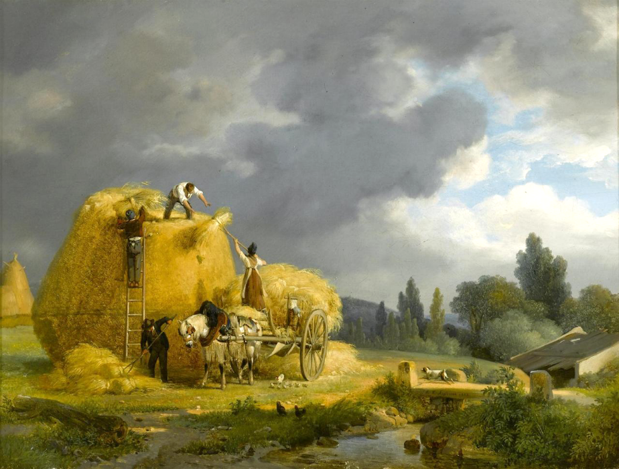
The Harvest
Auguste LePrince

Slide 18
therefore ask the Lord of the harvest to send out laborers into his harvest."
Matthew 9:38

Slide 19
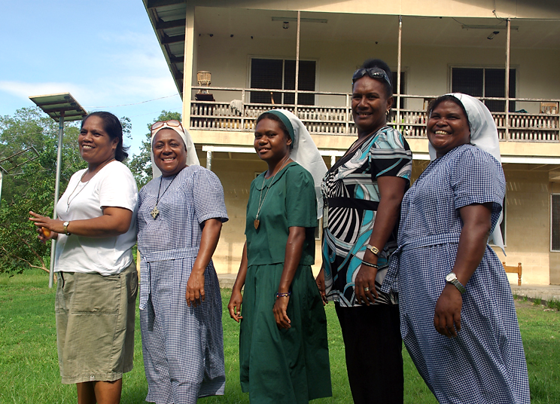
Nuns of the Christian Care Center -- Honiara, Solomon Islands

Slide 20
As you go, proclaim the good news, 'The kingdom of heaven has come near.'
Matthew 10:7

Slide 21
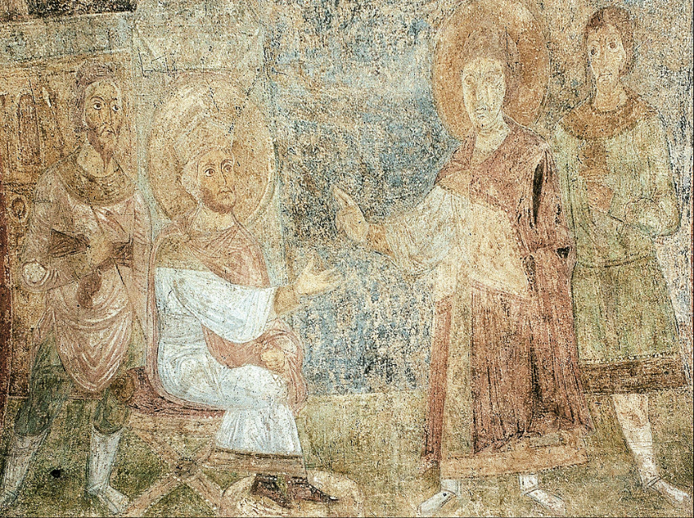
St. George Proclaims Christ to Diocletian -- Church of St. Sophia, Kiev, Ukraine

Slide 22
… do not worry about how you are to speak or what you are to say … for it is not you who speak, but the Spirit of your Father speaking through you.
Matthew 10:19b, 20

Slide 23
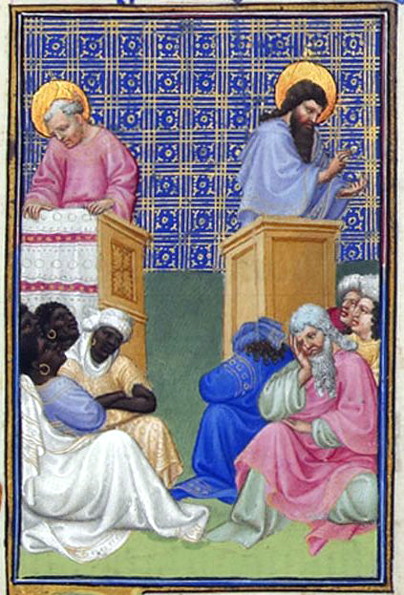
Preaching of the Apostles
Limbourg Brothers
Musée Condé
Chantilly, France

Slide 24
Credits
New Revised Standard Version Bible, copyright 1989, Division of Christian Education of the National Council of the Churches of Christ in the United States of America. Used by permission. All rights reserved.
https://commons.wikimedia.org/wiki/File:Ravenna_Basilica_of_San_Vitale_mosaic2.jpg
http://www.flickr.com/photos/yardsale/76188544/
https://www.flickr.com/photos/pahphotos/8648115268
https://www.flickr.com/photos/mastababa/2398441001/
https://commons.wikimedia.org/wiki/File:Capela_do_Divino_Esp%C3%ADrito_Santo_em_Porto_Alegre_000.JPG
http://diglib.library.vanderbilt.edu/act-imagelink.pl?RC=48383
Estate of Frank Wesley, http://www.frankwesleyart.com/main_page.htm
https://commons.wikimedia.org/wiki/File:The_Harvest_Auguste-Xavier_Leprince.jpg
https://commons.m.wikimedia.org/wiki/File:The_nuns_of_the_Christian_Care_Centre._(10729767853).jpg
https://commons.wikimedia.org/wiki/File:The_Inquisition_of_St._George_by_the_Emperor_Diocletian_-_Google_Art_Project.jpg
https://commons.wikimedia.org/wiki/File:Folio_28r_-_David_Foresees_the_Preaching_of_the_Apostles.jpg
Additional descriptions can be found at the Art in the Christian Tradition image library, a service of the Vanderbilt Divinity Library, http://diglib.library.vanderbilt.edu/. All images available via Creative Commons 3.0 License.

