Slide 1
Twenty-Fifth Sunday after Pentecost
Year A
Judges 4:1-7 and Psalm 123 • Zephaniah 1:7, 12-18 and Psalm 90:1-8, (9-11), 12
1 Thessalonians 5:1-11 • Matthew 25:14-30

Slide 2
At that time Deborah, a prophetess, … was judging Israel.
Judges 4:4ac

Slide 3
Deborah – In Tune
Lauren Wright Pittman, Sanctified Art

Slide 4
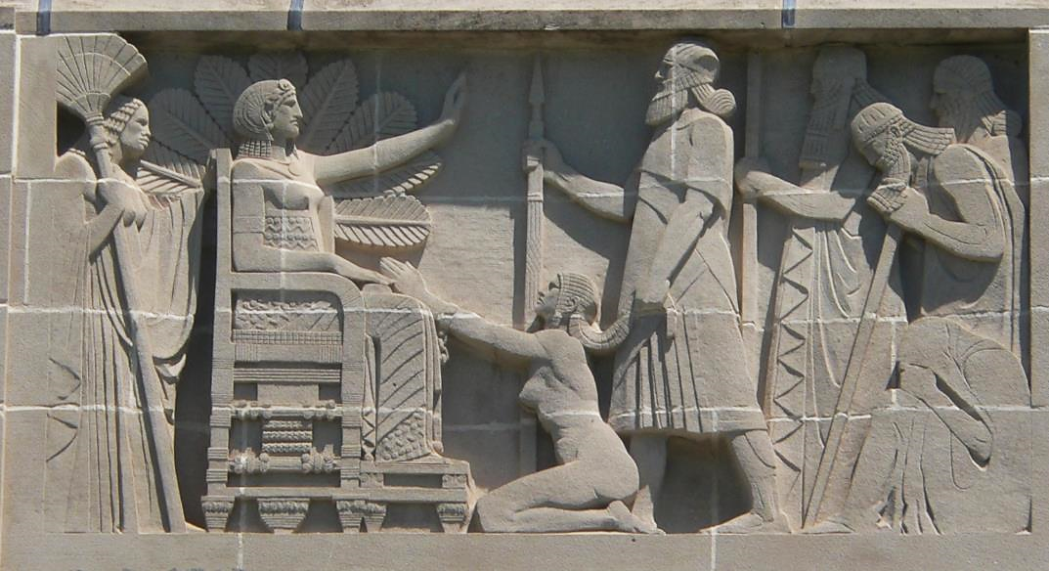
Deborah Judging Israel -- Lee Lawrie, Nebraska State Capitol, Lincoln, NE

Slide 5
She used to sit under the palm of Deborah … and the Israelites came up to her for judgment.
Judges 4:5ac

Slide 6
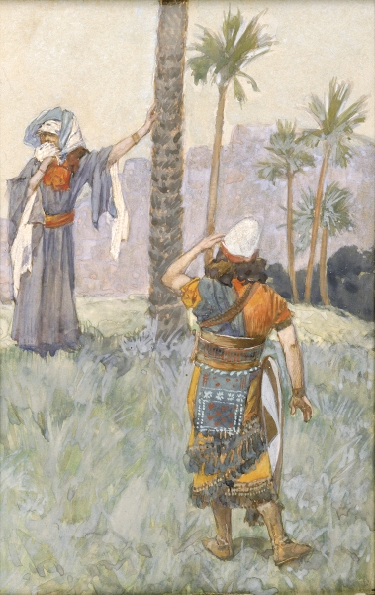
Deborah Beneath the Palm Tree
James Tissot
Jewish Museum
New York City

Slide 7
Our soul has had more than its fill of the scorn of those who are at ease, of the contempt of the proud.
Psalm 123:4

Slide 8
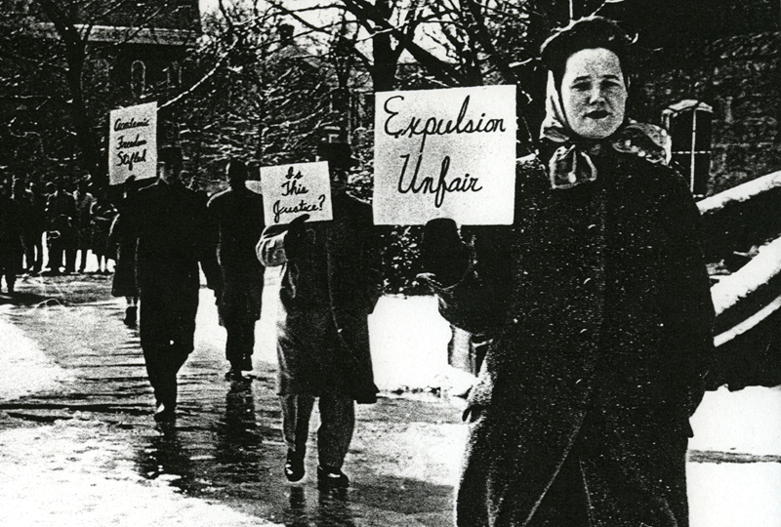
Protest Against Expulsion of James Lawson -- Vanderbilt University, Nashville, TN, 1960

Slide 9
Be silent before the Lord GOD!
For the day of the LORD is at hand …
Zephaniah 1:7a

Slide 10
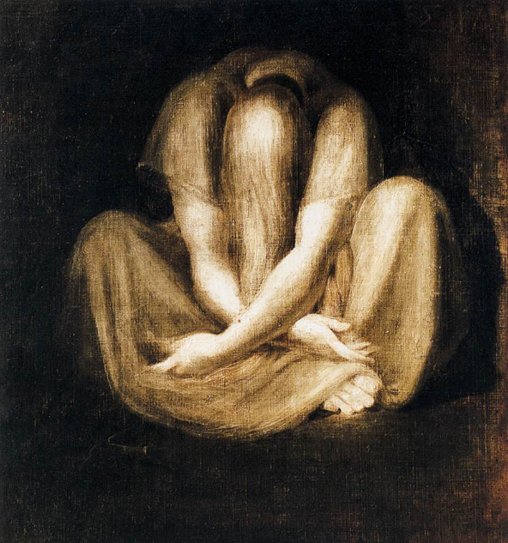
Silence -- Henry Fuseli, Kunsthaus Zurich, Zurich, Switzerland

Slide 11
Before the mountains were brought forth, or ever you had formed the earth and the world, from everlasting to everlasting you are God.
Psalm 90:2

Slide 12
Universe, 3-D map of dark matter -- Hubble Space Telescope

Slide 13
For God has destined us not for wrath but for obtaining salvation through our Lord Jesus Christ …
1 Thessalonians 5:9

Slide 14
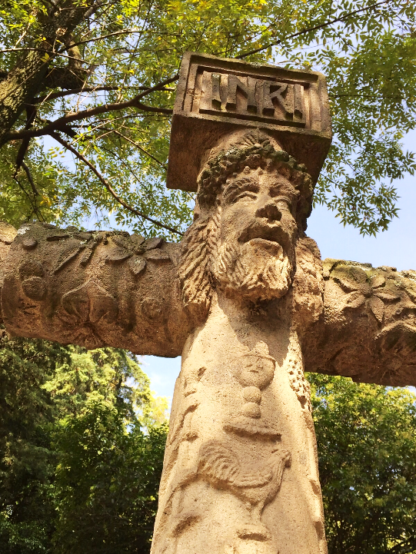
Christ on the Cross
Unidentified sculptor
Church of San Jacinto
San Angel, Mexico

Slide 15
Therefore encourage one another and build up each other, as indeed you are doing.
1 Thessalonians 5:11

Slide 16
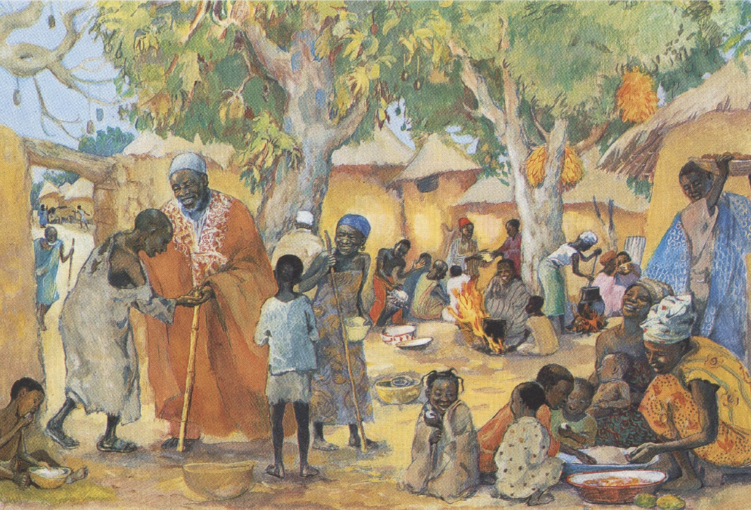
The Poor Invited to the Feast -- JESUS MAFA, Cameroon

Slide 17
"For it is as if a man … summoned his slaves and … to one he gave five talents, to another two, to another one, to each according to his ability.
Matthew 25:14a, 15a

Slide 18
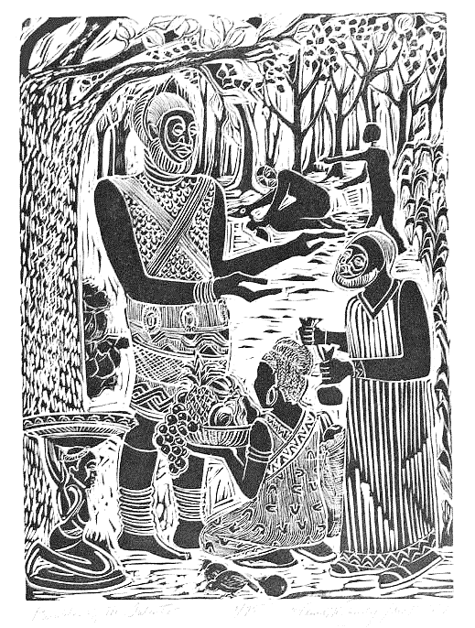
Parable of the Talents
Annette Fortt Gandy
Silver Spring, MD

Slide 19
The one who had received the five talents … traded with them, and made five more talents … the one who had the two talents made two more talents.
Matthew 25:16ac, 17b

Slide 20
Then the one who had received the one talent came forward, saying, 'Master, … I was afraid, and I went and hid your talent in the ground.'
Matthew 25:24

Slide 21
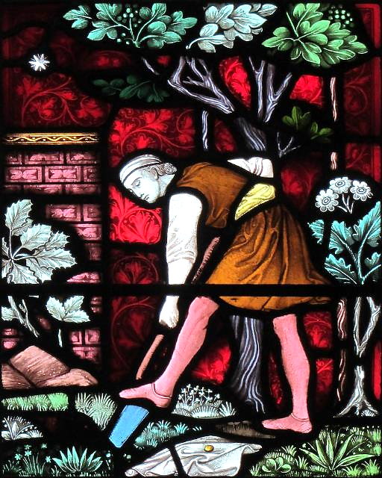
He Hid His Lord's Money
St Edward the Martyr's Church
Corfe Castle, Dorset

Slide 22
But his master replied, … take the talent from him, and give it to the one with the ten talents.
Matthew 25:26a, 28b

Slide 23
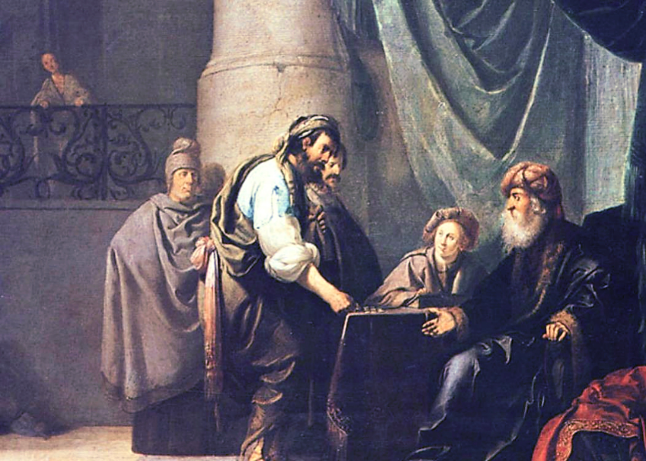
Parable of the Talents -- Willem de Poorter, Narodnie Galerie, Prague, Czech Republic

Slide 24
For to all those who have, more will be given … but from those who have nothing, even what they have will be taken away."
Matthew 25:29ac

Slide 25
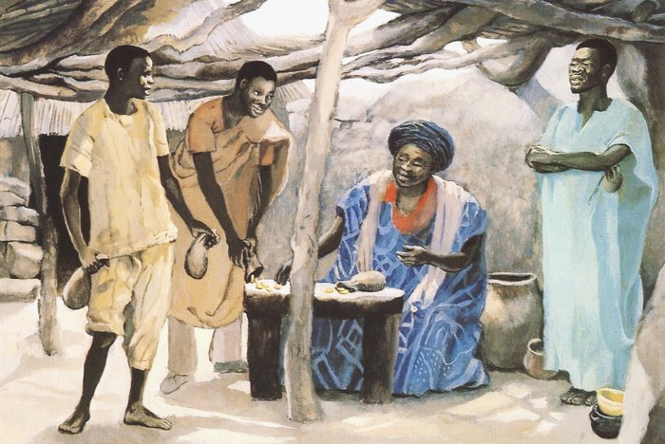
Parable of the Three Servants -- JESUS MAFA, Cameroon

Slide 26
Credits
New Revised Standard Version Bible, copyright 1989, Division of Christian Education of the National Council of the Churches of Christ in the United States of America. Used by permission. All rights reserved.
Lauren Wright Pittman, http://www.lewpstudio.com/
http://commons.wikimedia.org/wiki/File:Nebraska_State_Capitol_NW_corner_W_panel_1.JPG
http://commons.wikimedia.org/wiki/File:Tissot_Deborah_Beneath_the_Palm_Tree.jpg
http://diglib.library.vanderbilt.edu/act-imagelink.pl?RC=54244
https://commons.wikimedia.org/wiki/File:Johann_Heinrich_F%C3%BCssli_-_Silence_-_WGA08336.jpg
https://commons.wikimedia.org/wiki/File:COSMOS_3D_dark_matter_map.jpg
https://commons.wikimedia.org/wiki/File:Escultura_de_Jesucristo_crucificado_en_la_Parroquia_de_San_Jacinto.jpg
http://www.librairie-emmanuel.fr (contact page: https://www.librairie-emmanuel.fr/contact)
annettefortt.com – with permission
https://www.flickr.com/photos/hobler/14073476777 - Roman Hobler
https://commons.wikimedia.org/wiki/File:Willem_de_Poorter%27s_The_Parable_of_The_Talents_or_Minas.png
http://www.librairie-emmanuel.fr (contact page: https://www.librairie-emmanuel.fr/contact)
Additional descriptions can be found at the Art in the Christian Tradition image library, a service of the Vanderbilt Divinity Library, http://diglib.library.vanderbilt.edu/. All images available via Creative Commons 3.0 License.

