Slide 1
Twenty-Fourth Sunday after Pentecost
Year A
Joshua 24:1-3a, 14-25 and Psalm 78:1-7 • Wisdom of Solomon 6:12-16 or Amos 5:18-24 and Wisdom of Solomon 6:17-20 or Psalm 70 • 1 Thessalonians 4:13-18 • Matthew 25:1-13

Slide 2
Joshua made a covenant with the people that day, and made statutes and ordinances for them …
Joshua 24:25ab

Slide 3
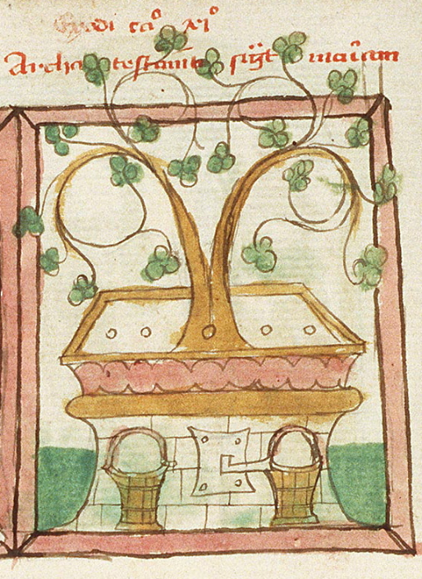
Budding Growth from the Ark of the Covenant
Museum Meermanno Westreenianum
The Hague,
Netherlands

Slide 4
We will tell to the coming generation the glorious deeds of the LORD …
so that they should set their hope in God …
Psalm 78:4b, 7a

Slide 5
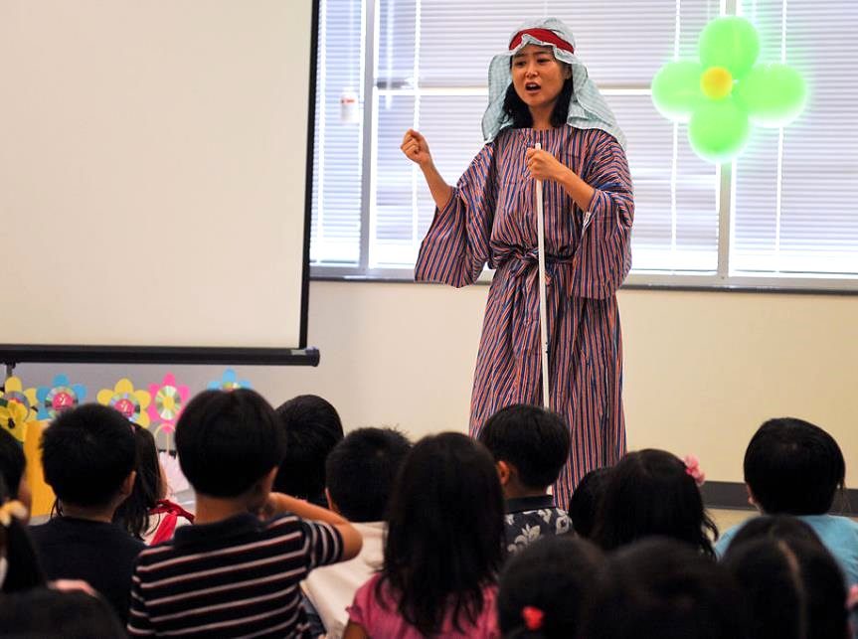
Sunday School -- Korean Central Presbyterian Church, Centreville, VA

Slide 6
But let justice roll down like waters, and righteousness like an everflowing stream.
Amos 5:24

Slide 7
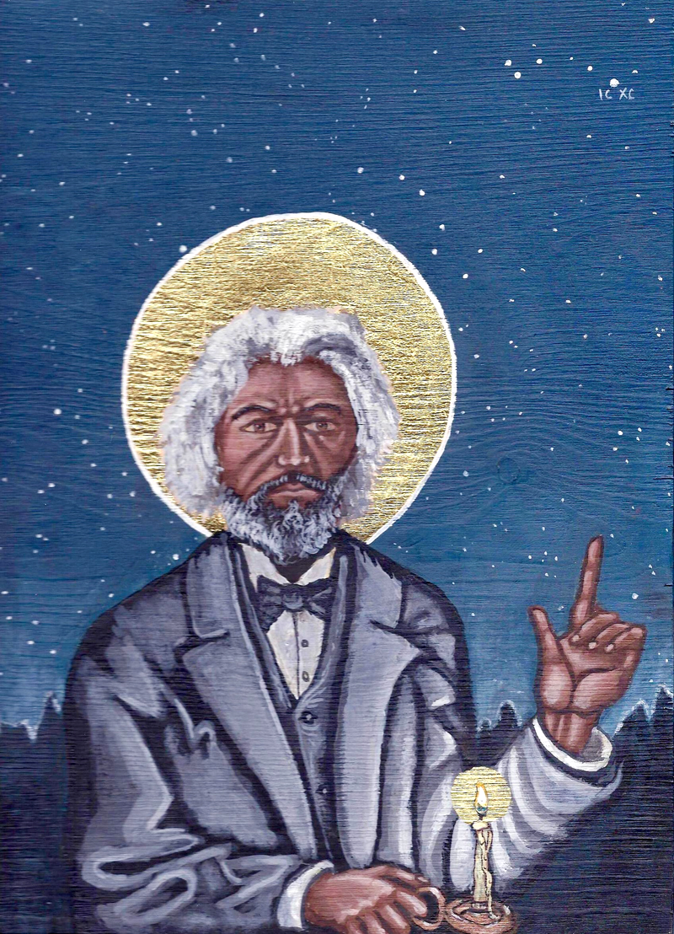
Frederick Douglass
Kelly Latimore

Slide 8
But I am poor and needy; hasten to me, O God! You are my help and my deliverer; O LORD, do not delay!
Psalm 70:5

Slide 9
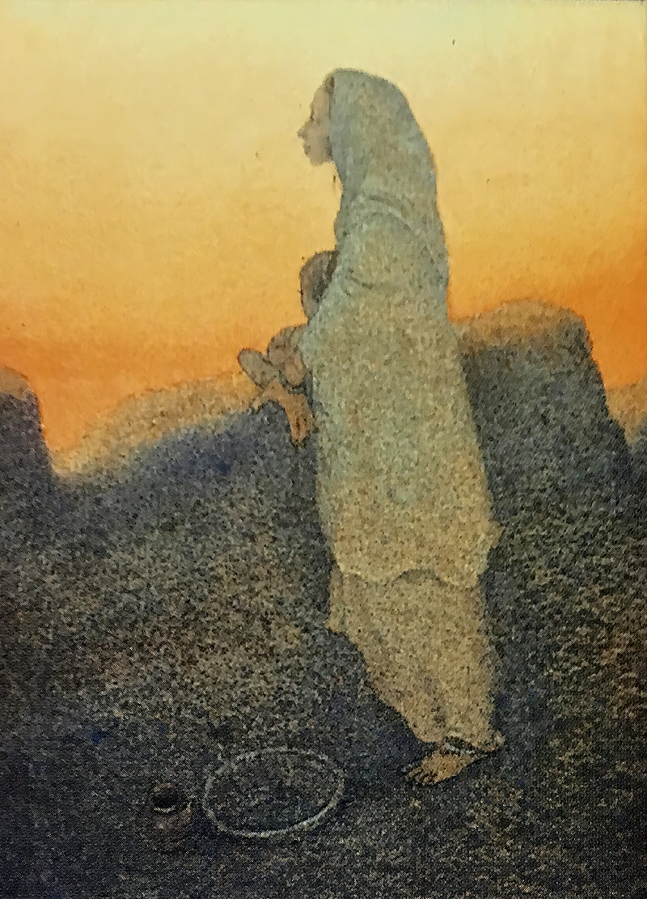
Blessed are the Poor
Frank Wesley

Slide 10
Then we … will be caught up in the clouds together with them to meet the Lord in the air; and so we will be with the Lord forever.
1 Thessalonians 4:17ac

Slide 11
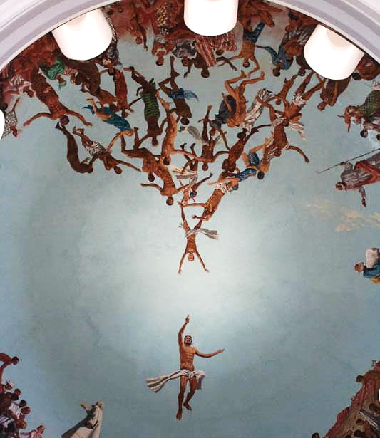
Meeting God
Mural in Dome of Cathedral
Dakar, Senegal

Slide 12
"… the kingdom of heaven will be like this. Ten bridesmaids took their lamps and went to meet the bridegroom.
Matthew 25:1

Slide 13
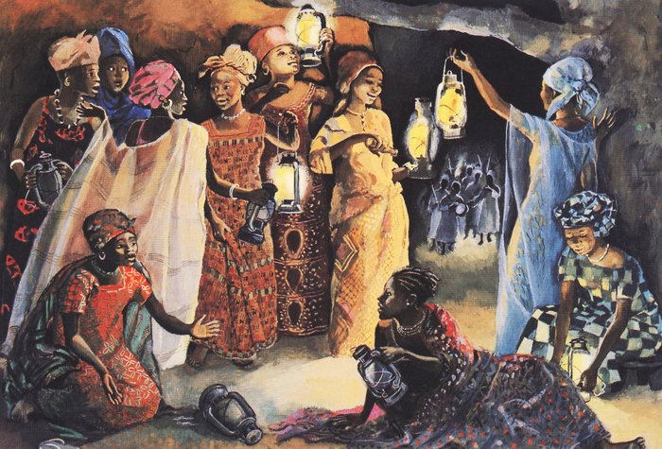
The Ten Bridesmaids -- JESUS MAFA, Cameroon

Slide 14
As the bridegroom was delayed, all of them became drowsy and slept.
Matthew 25:5

Slide 15
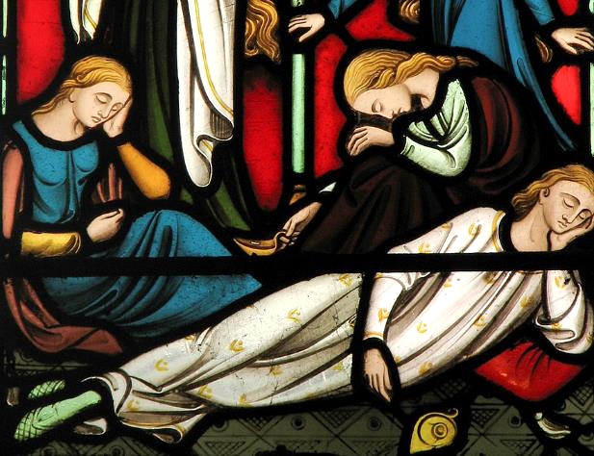
The Bridesmaids Sleeping -- Stained Glass, Church of St. Giles, Oxford, England

Slide 16
But at midnight there was a shout, 'Look! Here is the bridegroom! Come out to meet him.'
Matthew 25:6

Slide 17
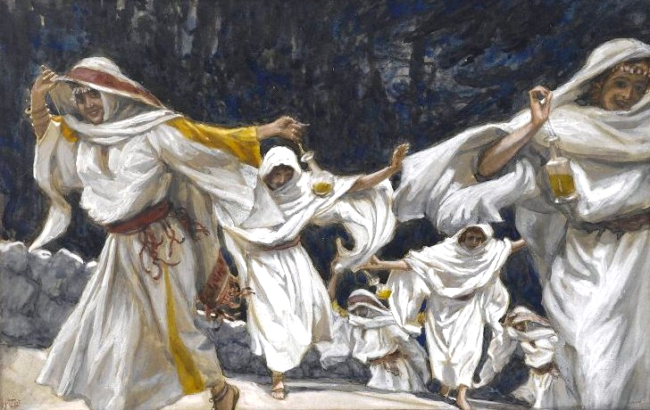
The Bridesmaids -- James Tissot, Brooklyn Museum, New York, NY

Slide 18
Keep awake therefore, for you know neither the day nor the hour."
Matthew 25:13

Slide 19
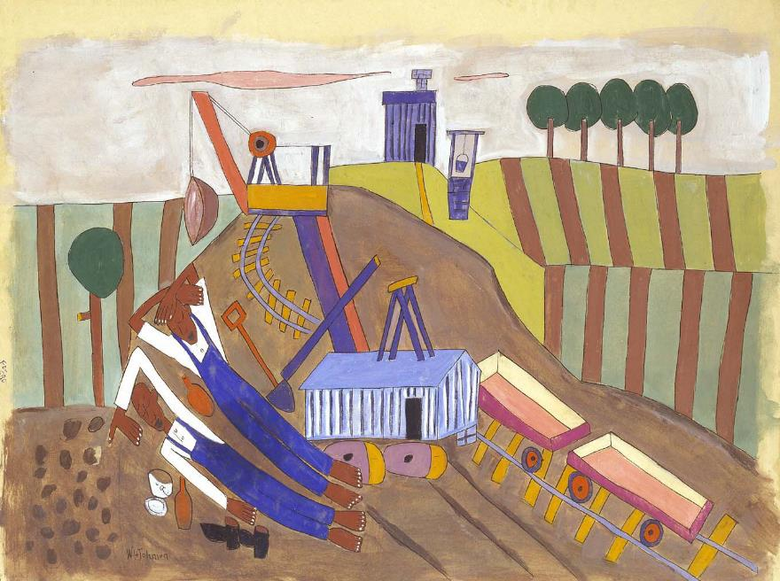
Lunchtime Rest -- William H. Johnson, Smithsonian Museum of American Art, Washington, DC

Slide 20
Credits
New Revised Standard Version Bible, copyright 1989, Division of Christian Education of the National Council of the Churches of Christ in the United States of America. Used by permission. All rights reserved.
https://commons.wikimedia.org/wiki/File:Speculum_Ark_of_the_Covenant.jpg
https://commons.wikimedia.org/wiki/File:Korean_Central_Presbyterian_Church.jpg
Kelly Latimore Icons, https://kellylatimoreicons.com/
Estate of Frank Wesley, http://www.frankwesleyart.com/main_page.htm
https://www.flickr.com/photos/carsten_tb/22260925034/ - Carsten ten Brink
http://diglib.library.vanderbilt.edu/act-imagelink.pl?RC=48394
https://www.flickr.com/photos/paullew/6317715388/ - Fr Lawrence Lew, O.P.
https://commons.wikimedia.org/wiki/File:Brooklyn_Museum_-_The_Foolish_Virgins_(Les_vierges_folles)_-_James_Tissot_(cropped).jpg
https://www.flickr.com/photos/americanartmuseum/3662422645/
Additional descriptions can be found at the Art in the Christian Tradition image library, a service of the Vanderbilt Divinity Library, http://diglib.library.vanderbilt.edu/. All images available via Creative Commons 3.0 License.

