Slide 1
Twentieth Sunday after Pentecost
Year A
Exodus 32:1-14 and Psalm 106:1-6, 19-23 • Isaiah 25:1-9 and Psalm 23 • Philippians 4:1-9 • Matthew 22:1-14

Slide 2
The LORD said to Moses, "Go down at once! Your people … have cast for themselves an image of a calf, and have worshiped it …"
Exodus 32:7a, 8b

Slide 3
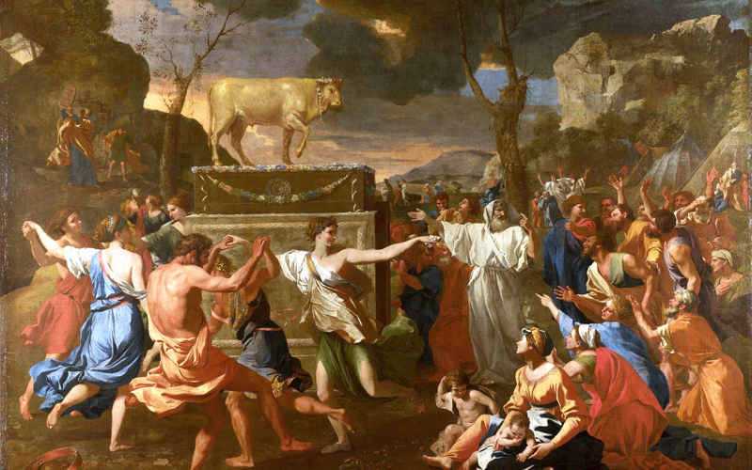
Adoration of the Golden Calf -- Nicolas Poussin, National Gallery, London, UK

Slide 4
They exchanged the glory of God for the image of an ox that eats grass. They forgot God, their Savior …
Psalm 106:20, 21a

Slide 5
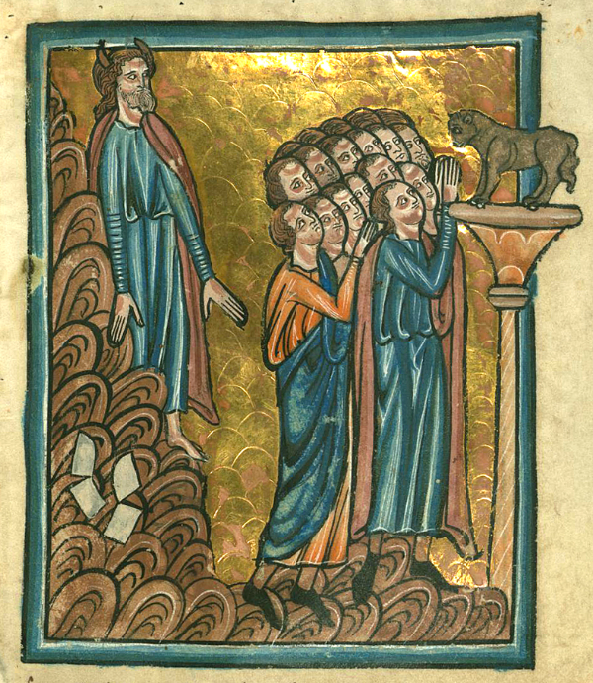
Worshipping the Golden Calf
William de Brailes
Walters Art Museum
Baltimore, MD

Slide 6
Then the Lord GOD will wipe away the tears from all faces … let us be glad and rejoice in his salvation.
Isaiah 25:8a, 9b

Slide 7
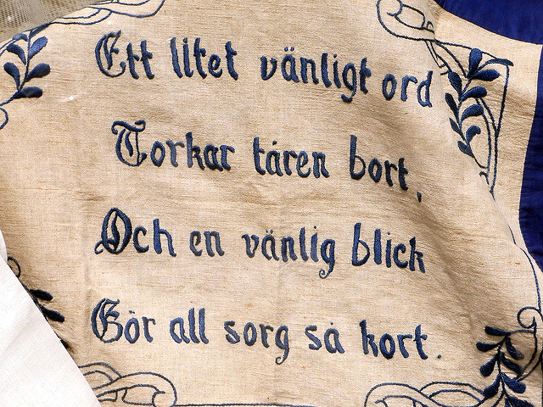
“As Single, Kind Word Wipes Away the Tears…” -- Swedish embroidery

Slide 8
The LORD is my shepherd, I shall not want.
Psalm 23:1

Slide 9
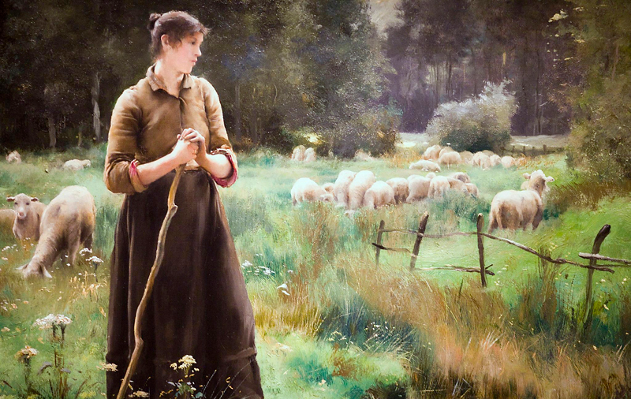
The Good Shepherd -- Julien Dupre, Legion of Honor Museum, San Francisco, CA

Slide 10
He makes me lie down in green pastures; he leads me beside still waters;
Psalm 23:2

Slide 11
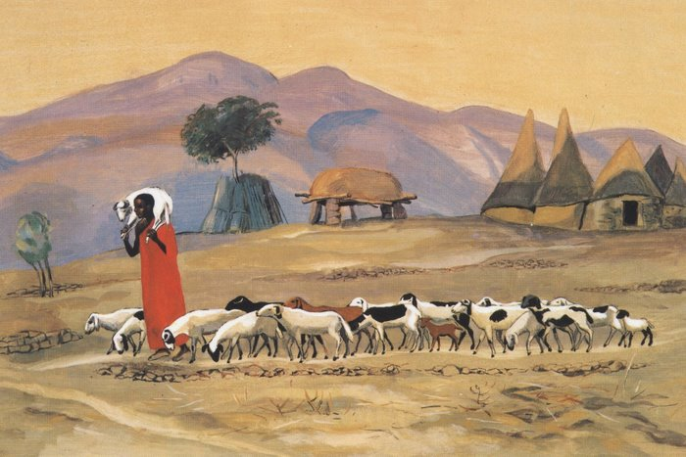
The Good Shepherd -- JESUS MAFA, Cameroon

Slide 12
He restores my soul.
He leads me in right paths for his name's sake.
Psalm 23:3

Slide 13
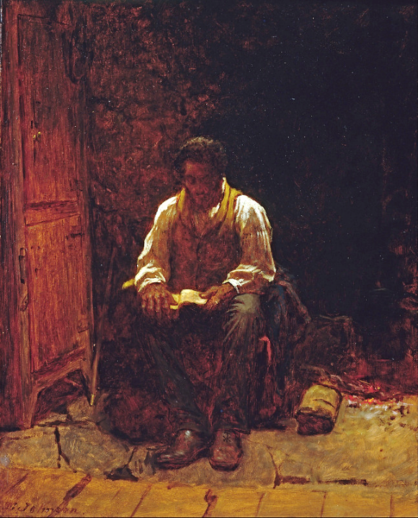
The Lord is My Shepherd
Eastman Johnson, Smithsonian Museum of American Art, DC

Slide 14
Even though I walk through the darkest valley, I fear no evil; for you are with me; your rod and your staff-- they comfort me.
Psalm 23:4

Slide 15
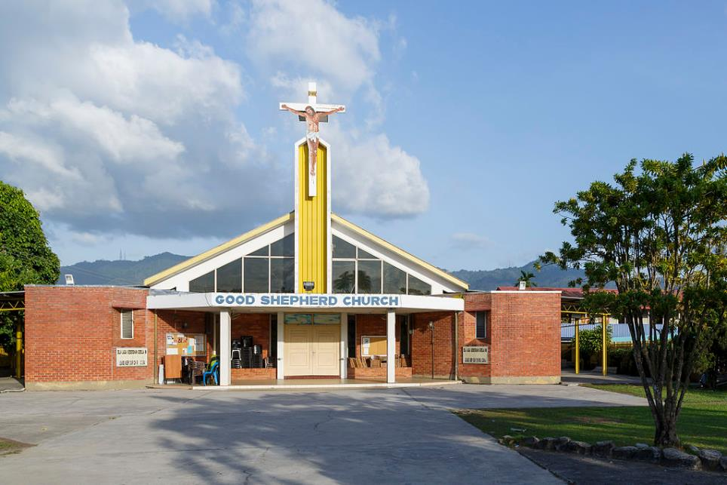
Good Shepherd Church -- Uwe Aranas, Menggatal, Malaysia

Slide 16
You prepare a table before me in the presence of my enemies; you anoint my head with oil; my cup overflows.
Psalm 23:5

Slide 17
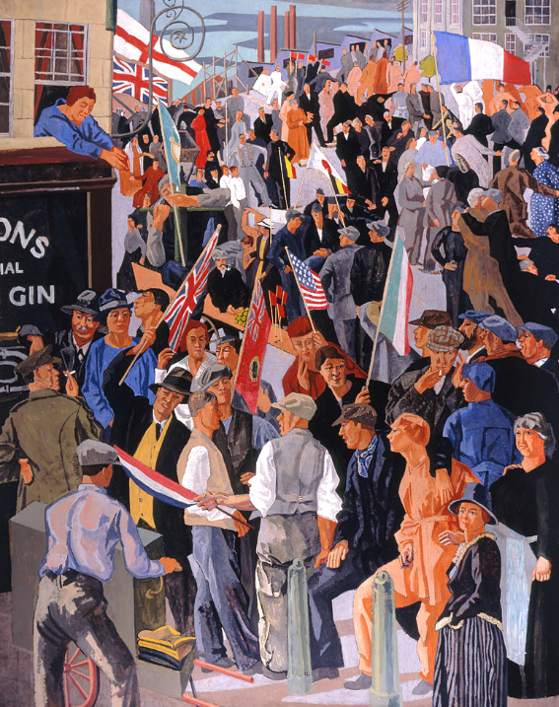
Armistice Day
Frederick Etchells
Canadian War Museum
Ottawa, Canada

Slide 18
Surely goodness and mercy shall follow me all the days of my life,
and I shall dwell in the house of the LORD my whole life long.
Psalm 23:6

Slide 19
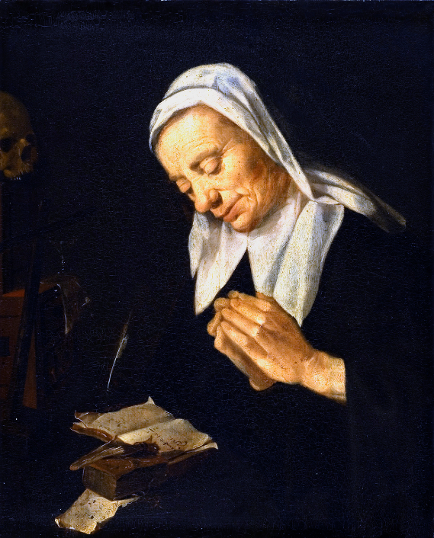
Praying Woman
Artist unknown
National Museum
Stockholm, Sweden

Slide 20
help these women, for they have struggled beside me in the work of the gospel …
Philippians 4:3b

Slide 21
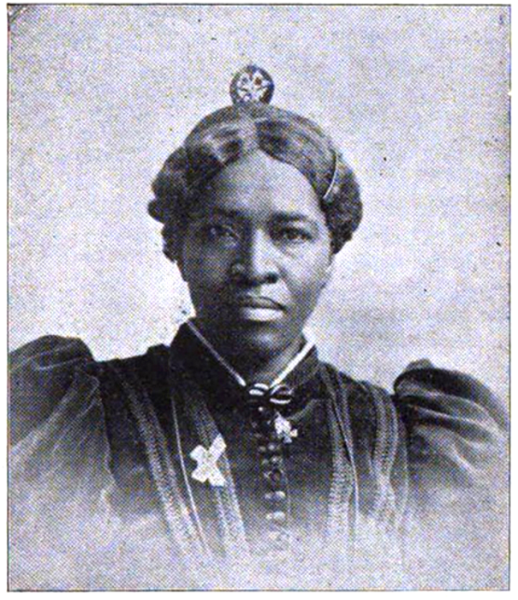
Amanda Berry Smith, Methodist Evangelist

Slide 22
'Go therefore into the main streets, and invite everyone you find to the wedding banquet.'
Matthew 22:9

Slide 23
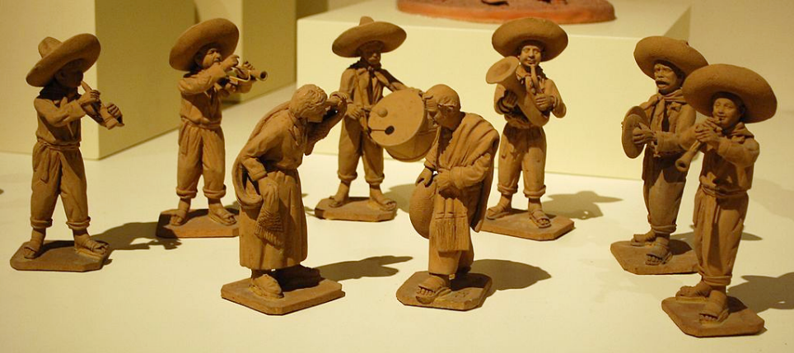
Golden Wedding Anniversary Celebration -- Zenón Martinez Garcia, Museo de Arte Popular, Mexico City

Slide 24
Credits
New Revised Standard Version Bible, copyright 1989, Division of Christian Education of the National Council of the Churches of Christ in the United States of America. Used by permission. All rights reserved.
https://commons.wikimedia.org/wiki/File:Nicolas_Poussin_-_L%27Adoration_du_Veau_d%27or.jpg
https://commons.wikimedia.org/wiki/File:William_de_Brailes_-_The_Israelites_Worship_the_Golden_Calf_and_Moses_Breaks_the_Tablets_(Exodus_32_-1-19)_-_Walters_W10613R_-_Full_Page.jpg
https://www.flickr.com/photos/brandsvig/584238966 - Christer
http://www.flickr.com/photos/thomashawk/2202377733/
http://diglib.library.vanderbilt.edu/act-imagelink.pl?RC=48288
http://commons.wikimedia.org/wiki/File:Eastman_Johnson_-_The_Lord_Is_My_Shepherd_-_Google_Art_Project.jpg
https://commons.wikimedia.org/wiki/File:Menggatal_Sabah_Good-Shepherd-Catholic-Church-Menggatal-02.jpg - Photo by CEphoto, Uwe Aranas
https://commons.wikimedia.org/wiki/File:Frederick_Etchells_-_Armistice_Day,_Munitions_Centre.jpg
https://commons.wikimedia.org/wiki/File:Praying_Woman_-_Nationalmuseum_-_23609.tif
https://commons.wikimedia.org/wiki/File:AmandaSmith1898.tif
https://commons.wikimedia.org/wiki/File:BodasOroMartinezGarcia.JPG
Additional descriptions can be found at the Art in the Christian Tradition image library, a service of the Vanderbilt Divinity Library, http://diglib.library.vanderbilt.edu/. All images available via Creative Commons 3.0 License.

