Slide 1
Seventeenth Sunday after Pentecost
Year A
Exodus 16:2-15 and Psalm 105:1-6, 37-45 • Jonah 3:10-4:11 and Psalm 145:1-8 • Philippians 1:21-30 • Matthew 20:1-16

Slide 2
The LORD spoke to Moses and said, "I have heard the complaining of the Israelites; say to them …
Exodus 16:11, 12a

Slide 3
in the morning you shall have your fill of bread" … and in the morning there was a layer of dew around the camp.
Exodus 16:12b, 13b

Slide 4
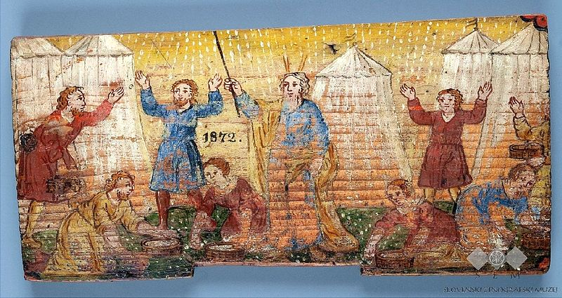
Moses and the Israelites -- Slovenia Ethnographic Museum, Ljubljana, Slovenia

Slide 5
When the Israelites saw it, they said to one another, "What is it?" Moses said to them, "It is the bread that the LORD has given you to eat.
Exodus 16:15ac

Slide 6
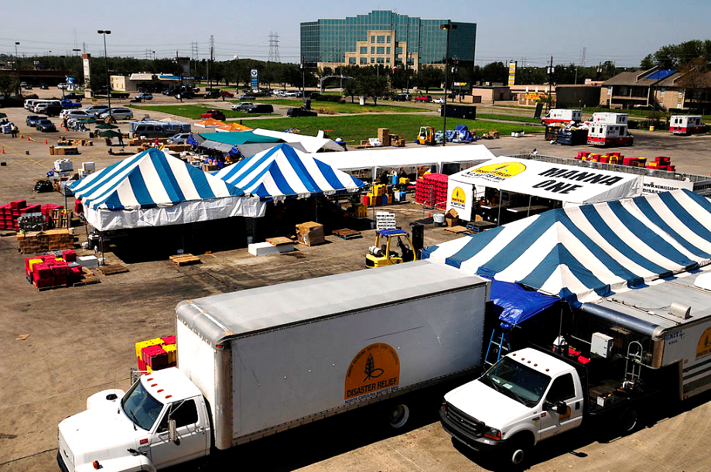
"Manna 1" -- An aerial view of the North Carolina Baptist Men's disaster kitchens, Texas floods

Slide 7
He spread a cloud for a covering, and fire to give light by night.
Psalm 105:39

Slide 8
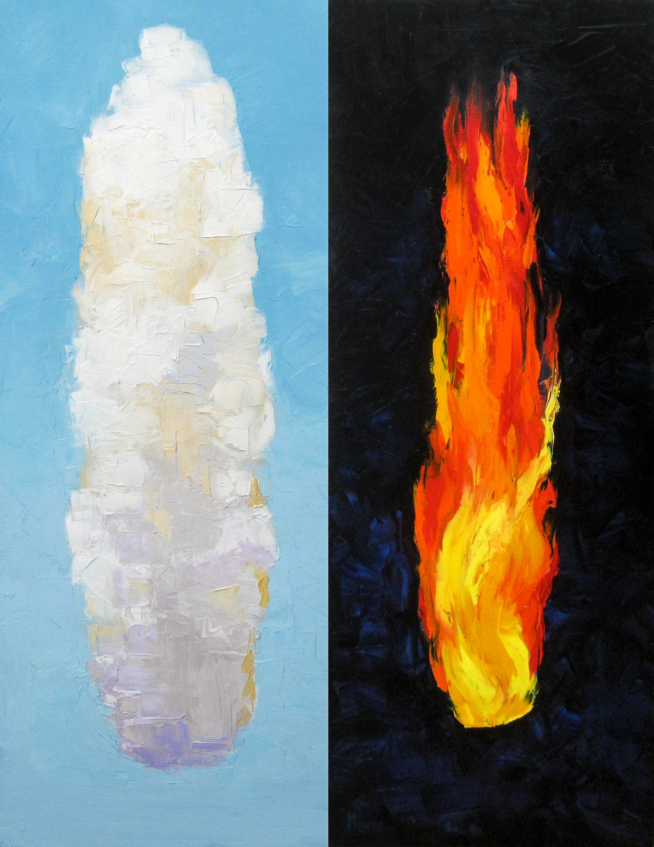
Guidance Day and Night
Mike Moyers

Slide 9
When God saw what they did, how they turned from their evil ways, God changed his mind about the calamity; and he did not do it.
Jonah 3:10ac

Slide 10
But this was very displeasing to Jonah, and he became angry.
Jonah 4:1

Slide 11
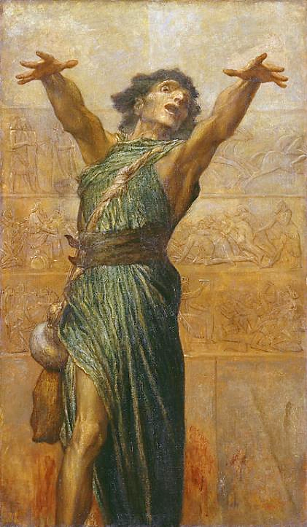
Jonah
George Frederick Watts
Tate Britain
London, England

Slide 12
"O LORD, please take my life from me, for it is better for me to die than to live."
Jonah 4:3

Slide 13
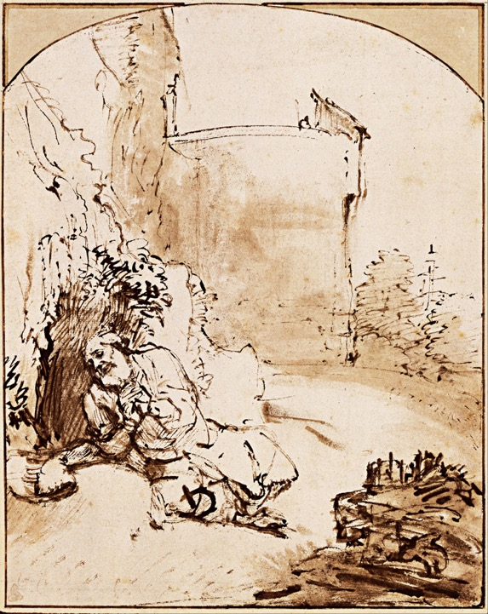
Prophet Jonah Before the Walls of Ninevah
Rembrandt
Albertina Museum
Vienna, Austria

Slide 14
The LORD is gracious and merciful, slow to anger and abounding in steadfast love.
Psalm 145:8

Slide 15
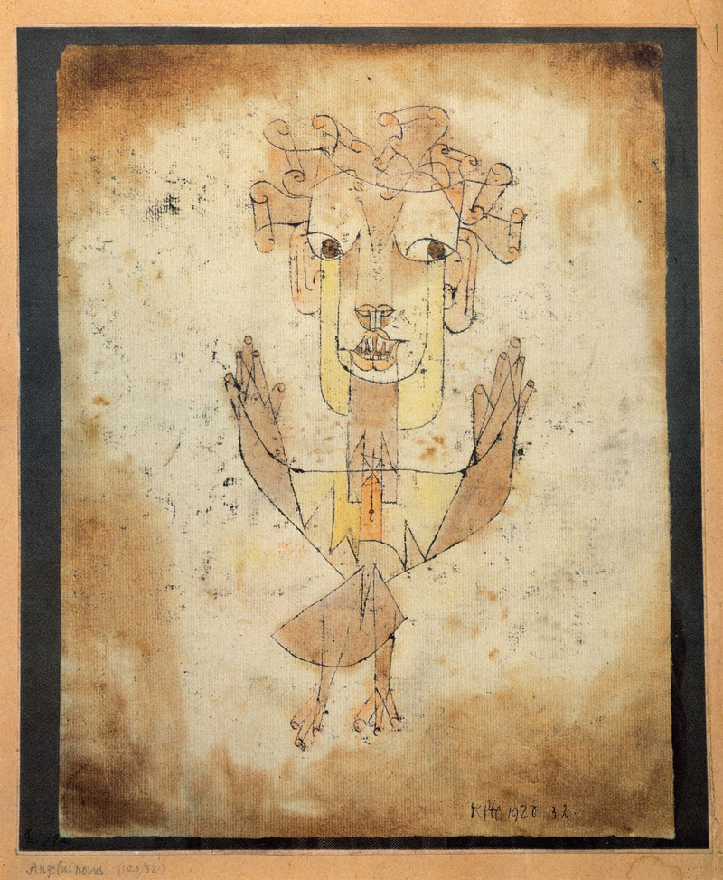
Angelus Novus
Paul Klee
Israel Museum
Jerusalem

Slide 16
… live your life in a manner worthy of the gospel of Christ, so that … I will know that you are standing firm in one spirit …
Philippians 1:27ab

Slide 17
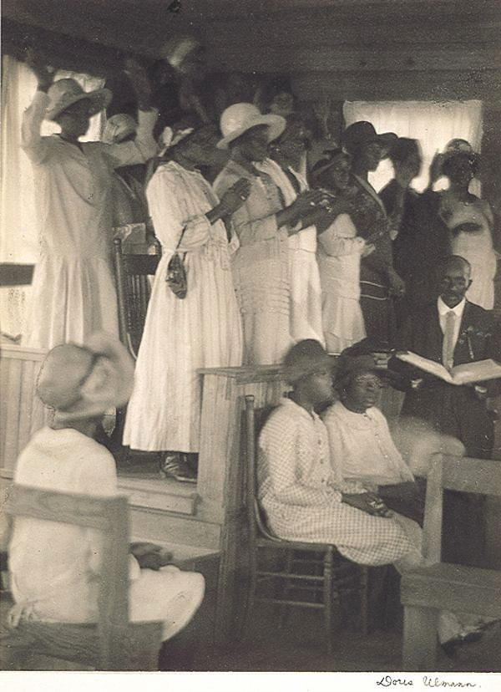
African-American Church, Rural South
Doris Ullman

Slide 18
"For the kingdom of heaven is like a landowner who went out early in the morning to hire laborers for his vineyard.
Matthew 20:1

Slide 19
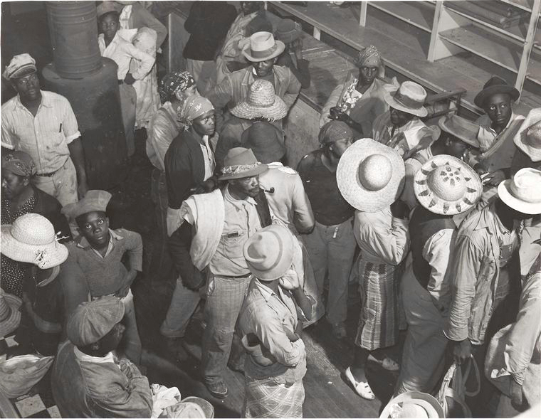
Day Laborers Brought In By Truck From Nearby Towns, 1939 -- Marion Post Wolcott

Slide 20
When those hired about five o'clock came, each of them received the usual daily wage.
Matthew 20:9

Slide 21
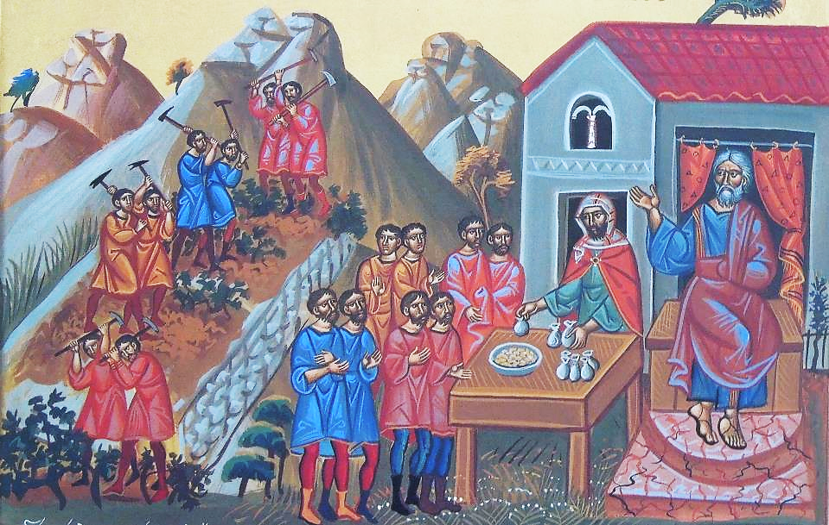
Orthodox Icon of Laborers in the Vineyard

Slide 22
Now when the first came, they thought they would receive more; but each of them also received the usual daily wage.
Matthew 20:10

Slide 23
'These last worked only one hour, and you have made them equal to us who have borne the burden of the day and the scorching heat.'
Matthew 20:12

Slide 24
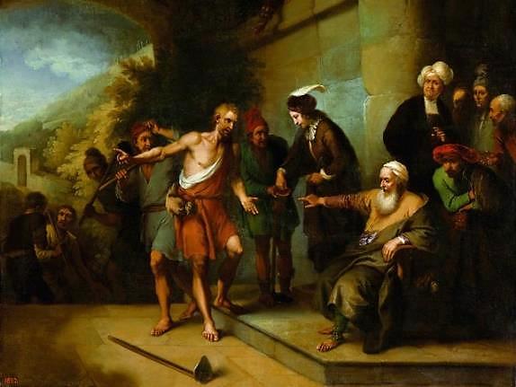
Parable of the Workers in the Vineyard -- Christian Dietrich, Baths Palace, Warsaw, Poland

Slide 25
But he replied to one of them, 'Friend, I am doing you no wrong; did you not agree with me for the usual daily wage?
Matthew 20:13

Slide 26
Am I not allowed to do what I choose with what belongs to me? Or are you envious because I am generous?'
Matthew 20:15

Slide 27
So the last will be first, and the first will be last."
Matthew 20:16

Slide 28
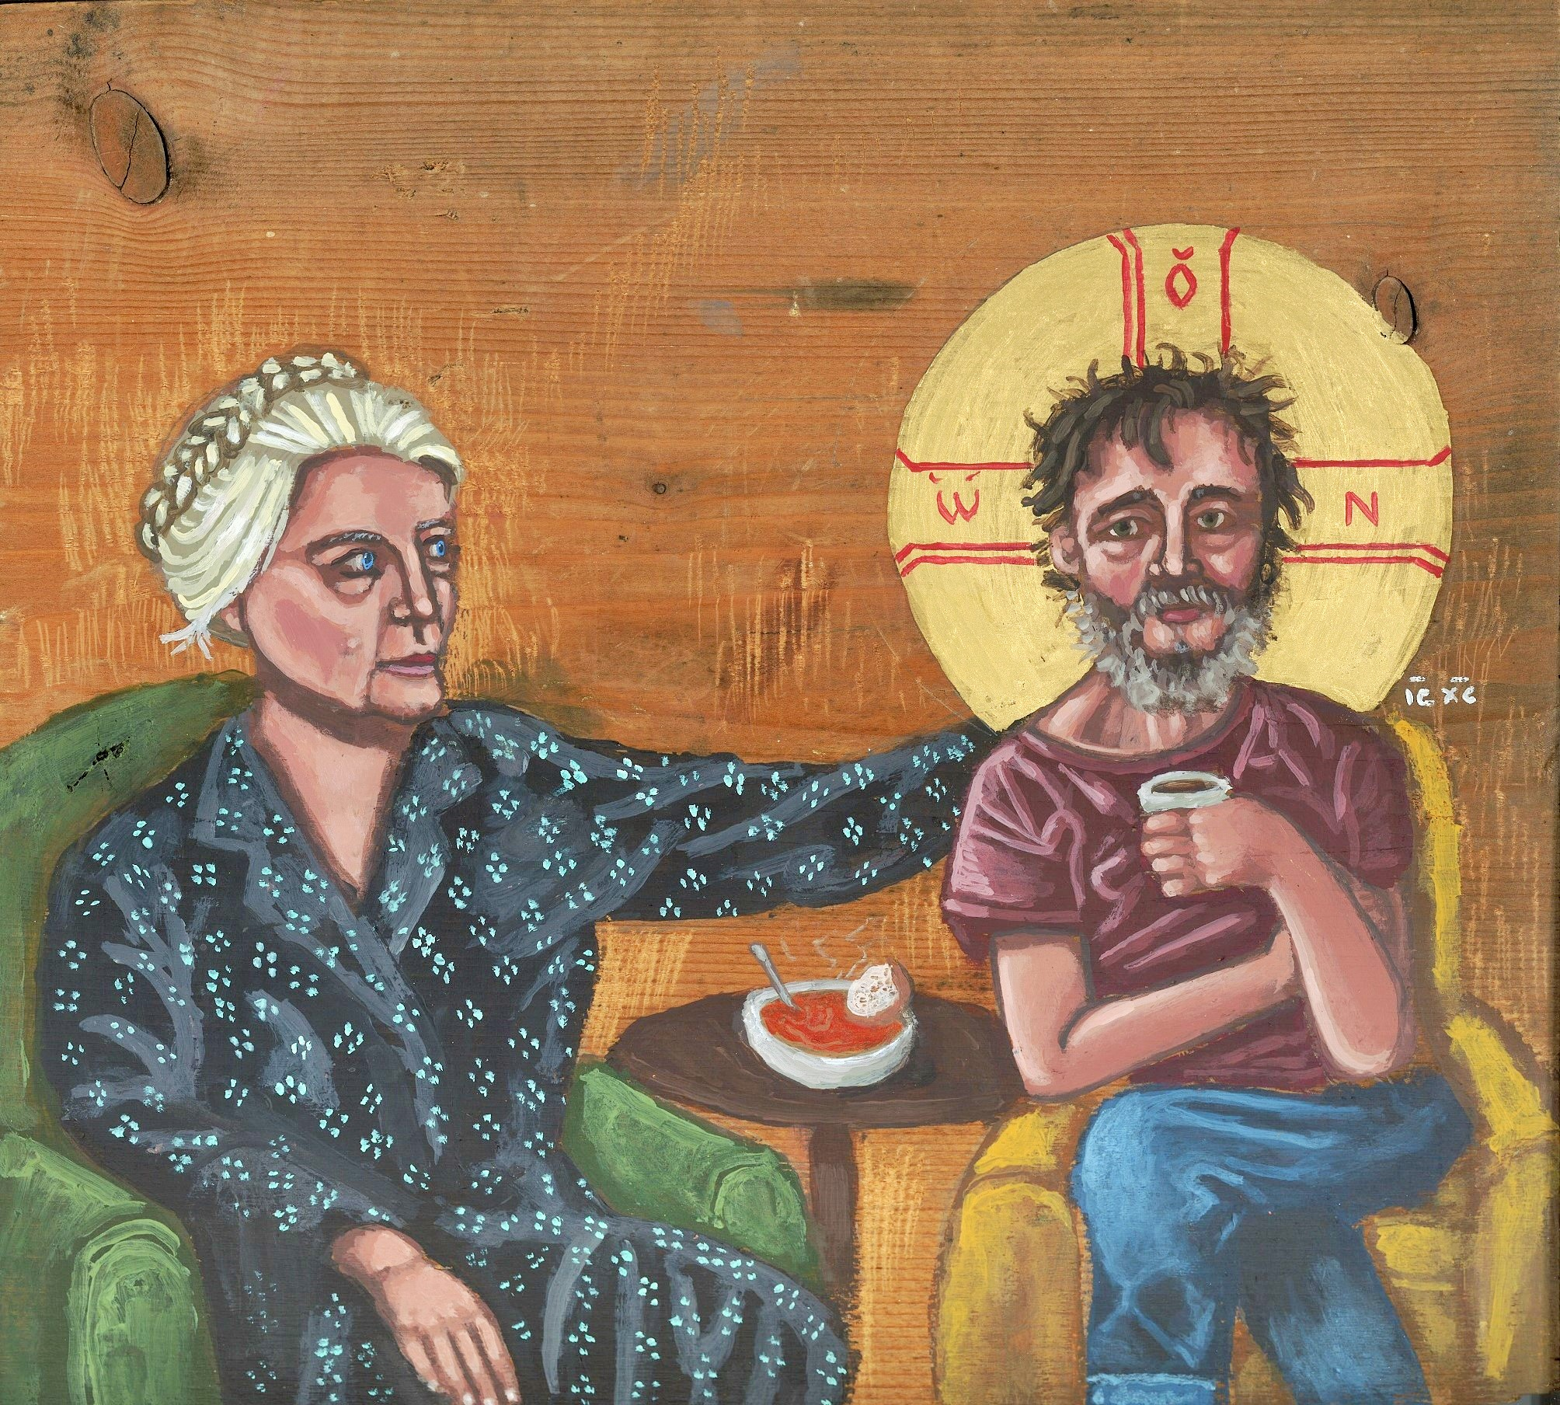
Dorothy Day with Homeless Christ -- Kelly Latimore

Slide 29
Credits
New Revised Standard Version Bible, copyright 1989, Division of Christian Education of the National Council of the Churches of Christ in the United States of America. Used by permission. All rights reserved.
https://commons.wikimedia.org/wiki/File:Leopold_Layer_-_Mana_v_pu%C5%A1%C4%8Davi.jpg
shttps://commons.wikimedia.org/wiki/File:FEMA_-_39022_-_Overview_of_Baptist_Men_mobile_kitchen_and_commodity_point_of_distribution_in_Texas.jpg
Mike Moyers, https://www.mikemoyersfineart.com/
https://commons.wikimedia.org/wiki/File:George_Frederic_Watts_-_Jonah_-_Google_Art_Project.jpg
https://commons.m.wikimedia.org/wiki/File:Rembrandt_Harmenszoon_van_Rijn_-_The_Prophet_Jonah_before_the_Walls_of_Nineveh,_c._1655_-_Google_Art_Project.jpg
https://commons.wikimedia.org/wiki/File:The_thrones_and_palaces_of_Babylon_and_Ninevah_from_sea_to_sea;_a_thousand_miles_on_horseback_(1876)_(14591339829).jpg
https://commons.wikimedia.org/wiki/File:Klee-angelus-novus.jpg
https://commons.wikimedia.org/wiki/File:Ulmann,_African-American_Church.jpg
https://commons.wikimedia.org/wiki/File:Negro_day_laborers_brought_in_by_truck_from_nearby_towns,_wa..._(3110578766).jpg
https://www.flickr.com/photos/frted/6995563197
https://commons.wikimedia.org/wiki/File:Dietrich_Workers_in_the_vineyard.jpg
Kelly Latimore Icons, https://kellylatimoreicons.com/
Additional descriptions can be found at the Art in the Christian Tradition image library, a service of the Vanderbilt Divinity Library, http://diglib.library.vanderbilt.edu/. All images available via Creative Commons 3.0 License.

