Slide 1
Thirteenth Sunday after Pentecost
Year A
Exodus 1:8-2:10 and Psalm 124 • Isaiah 51:1-6 and Psalm 138 • Romans 12:1-8
Matthew 16:13-20

Slide 2
The king of Egypt said to the Hebrew midwives … "if it is a boy, kill him" … But the midwives feared God … they let the boys live.
Exodus 1:15a, 16b, 17ac

Slide 3
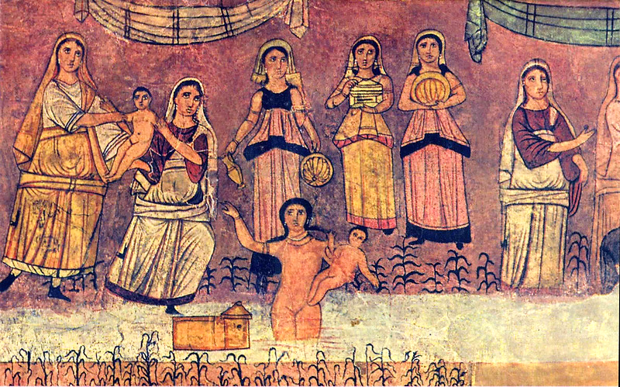
Shiphrah, Puah, Jocheved, Miriam, Pharoah's Daughter, and the infant Moses – Dura Europos

Slide 4
The woman conceived and bore a son … she got a papyrus basket for him, and put the child in it and placed it among the reeds on the bank of the river.
Exodus 2:2a, 3b

Slide 5
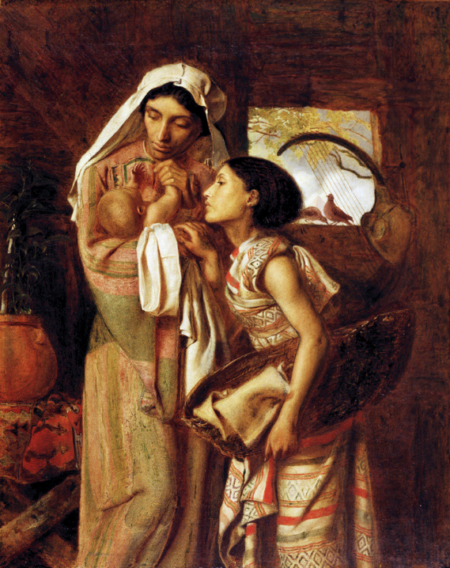
The Mother of Moses
Simeon Solomon
Delaware Art Museum
Wilmington, DE

Slide 6
Pharaoh's daughter said to her, "Take this child and nurse it for me …
She named him Moses, "because …
I drew him out of the water."
Exodus 2:9a, 2:10b

Slide 7
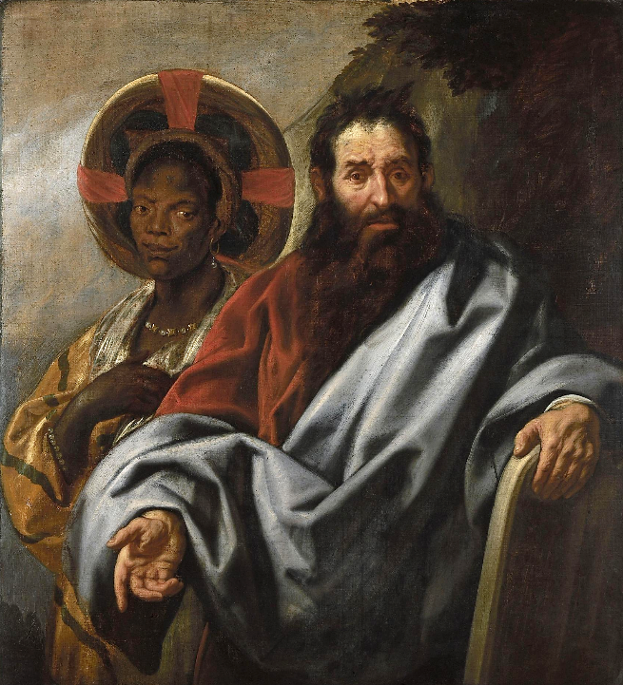
Moses and His Ethiopian Wife Sephora
Jacob Jordaens
Rubenshuis
Antwerp, Belgium

Slide 8
We have escaped like a bird from the snare of the fowlers; the snare is broken, and we have escaped.
Psalm 124:7

Slide 9
Ranganthittu Bird Sanctuary, Mysore, India

Slide 10
For the LORD will comfort Zion; he will comfort all her waste places, and will make her wilderness like Eden …
Isaiah 51:3a

Slide 11
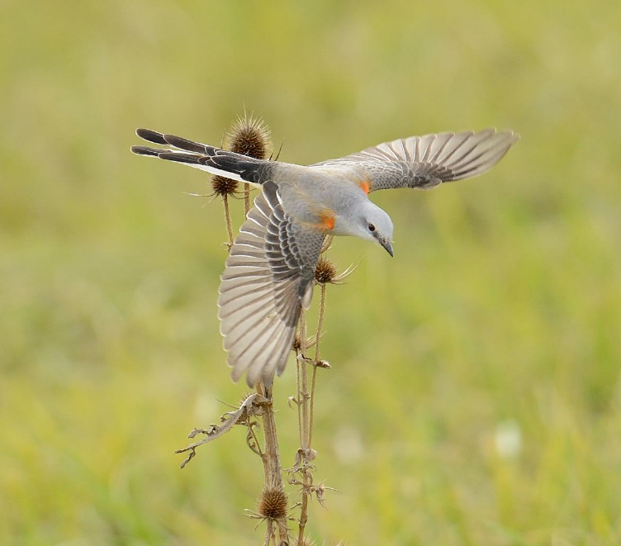
Scissor-tailed Flycatcher -- Former Landfill, Techny Overlay District, Northbrook, IL

Slide 12
The LORD will fulfill his purpose for me; your steadfast love, O LORD, endures forever.
Psalm 138:8

Slide 13
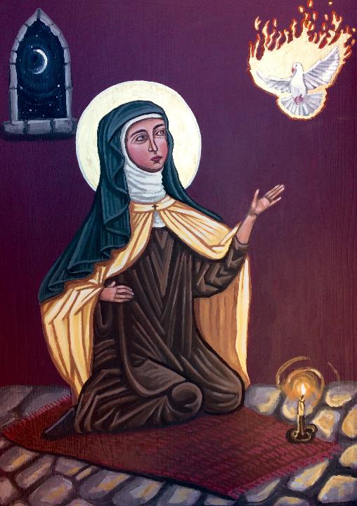
St Teresa of Avila
Kelly Latimore
St. Paul's Episcopal Church
Gallipoli, OH

Slide 14
Do not be conformed to this world, but be transformed by the renewing of your minds, so that you may discern what is the will of God.
Romans 12:2

Slide 15
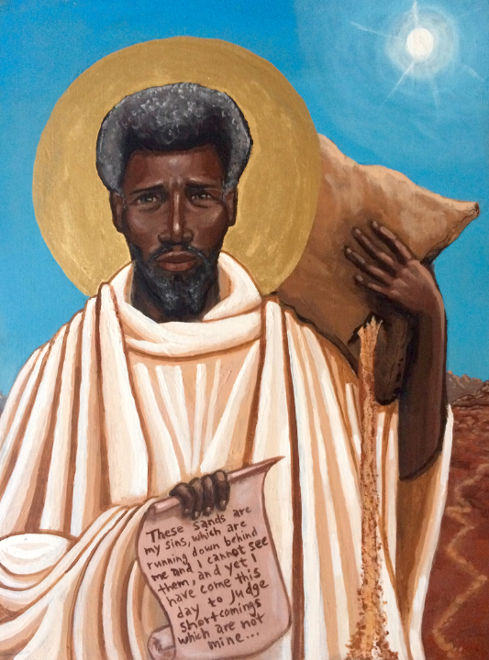
Moses the Black
(Desert Church Father)
Kelly Latimore
Kansas City, MO

Slide 16
Now when Jesus came into the district of Caesarea Philippi, he asked his disciples, "Who do people say that the Son of Man is?"
Matthew 16:13

Slide 17
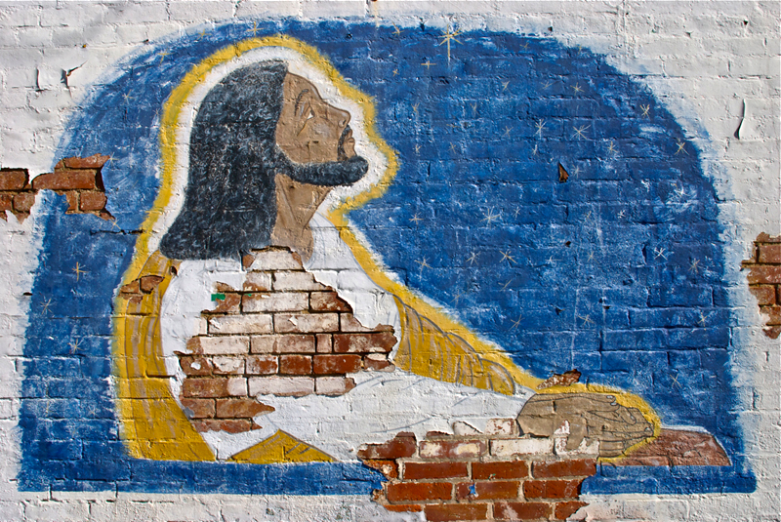
Jesus Praying -- Mural, Louisville, KY

Slide 18
And they said, "Some say John the Baptist, but others Elijah, and still others Jeremiah or one of the prophets."
Matthew 16:14

Slide 19
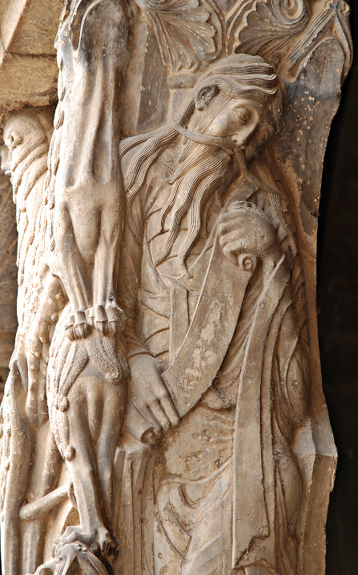
Jeremiah
Abbey of St. Pierre
Moissac, France

Slide 20
He said to them, "But who do you say that I am?" Simon Peter answered, "You are the Messiah, the Son of the living God."
Matthew 16:15-16

Slide 21
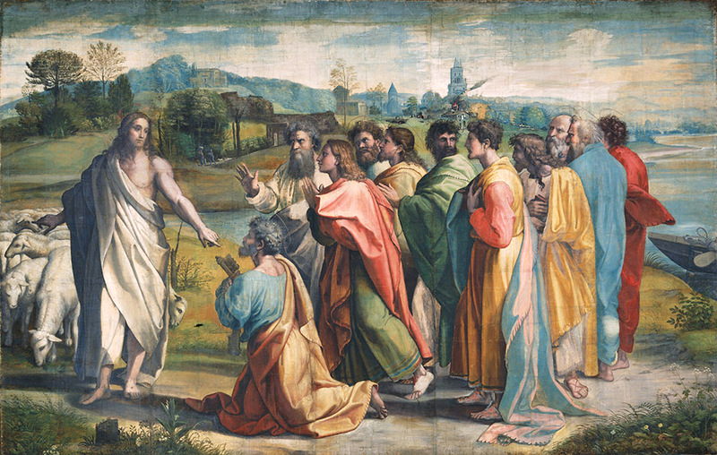
Peter Proclaims the Christ -- Raphael, Victoria and Albert Museum, London, England

Slide 22
And Jesus answered him … "And I tell you, you are Peter, and on this rock I will build my church …"
Matthew 16:17a, 18a

Slide 23
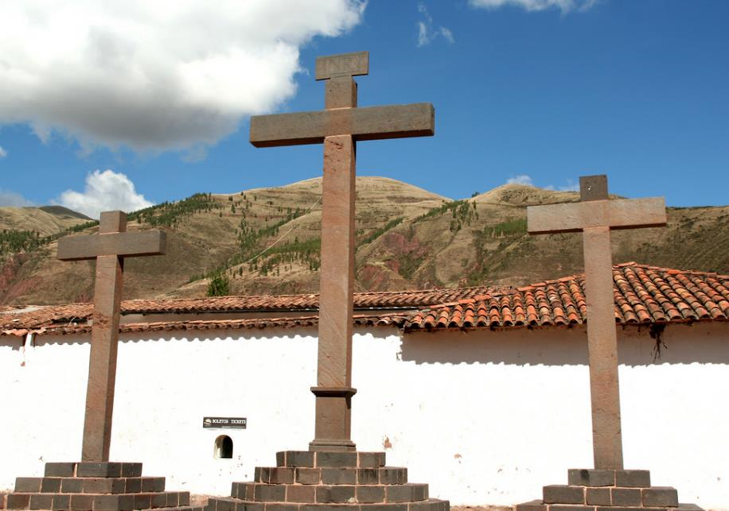
Church of St. Peter and St. Paul -- Andahuaylillas, Peru

Slide 24
"I will give you the keys of the kingdom of heaven, and whatever you bind on earth will be bound in heaven, and whatever you loose on earth will be loosed in heaven."
Matthew 16:19

Slide 25
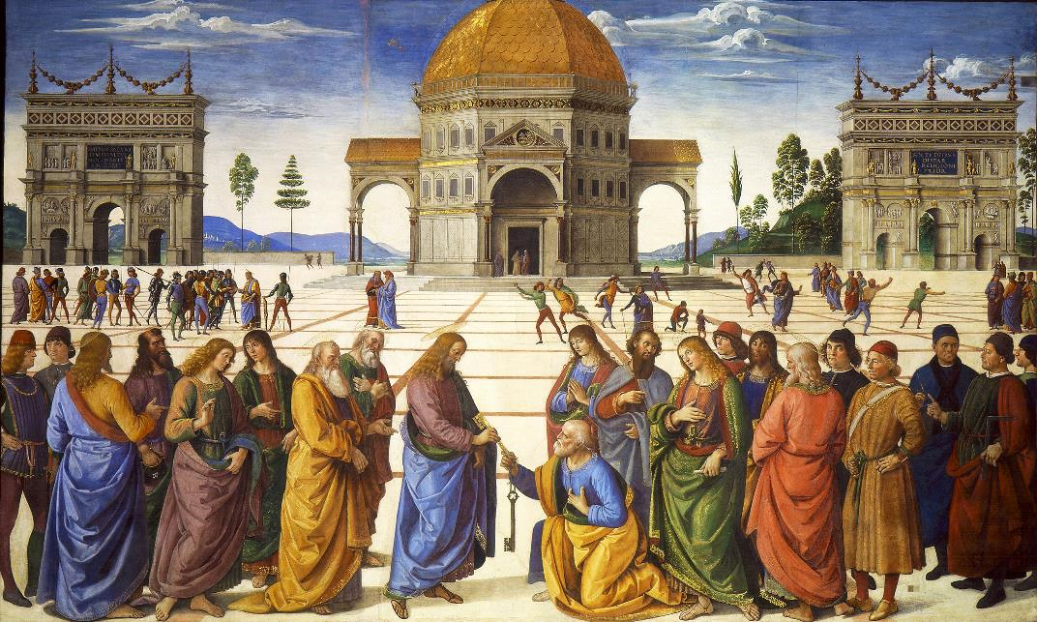
Christ Gives Keys of Kingdom to Peter -- Perugino, Sistine Chapel, Vatican City

Slide 26
Credits
New Revised Standard Version Bible, copyright 1989, Division of Christian Education of the National Council of the Churches of Christ in the United States of America. Used by permission. All rights reserved.
http://commons.wikimedia.org/wiki/File:Dura_Europos_fresco_Moses_from_river.jpg
https://commons.wikimedia.org/wiki/File:Simeon_Solomon_-_The_Mother_of_Moses.jpg
https://commons.wikimedia.org/wiki/File:Jacob_Jordaens_-_Moses_and_his_Ethiopian_wife_Sephora.jpg
https://www.flickr.com/photos/46721134@N04/6099939566/
https://www.flickr.com/photos/dharma_for_one/8111513291/ - Janetandphil
https://kellylatimoreicons.com/contact/
https://kellylatimoreicons.com/contact/
https://www.flickr.com/photos/talesoftaromeet/6867087845 - DL Duncan
http://commons.wikimedia.org/wiki/File:Moissac,_Jeremiah.JPG
http://www.vam.ac.uk/content/articles/t/raphael-cartoons/
https://www.flickr.com/photos/iheartpandas/5421843645/
http://commons.wikimedia.org/wiki/File:Entrega_de_las_llaves_a_San_Pedro_(Perugino).jpg
Additional descriptions can be found at the Art in the Christian Tradition image library, a service of the Vanderbilt Divinity Library, http://diglib.library.vanderbilt.edu/. All images available via Creative Commons 3.0 License.

