Slide 1
Eleventh Sunday after Pentecost
Year A
Genesis 37:1-4, 12-28 and Psalm 105: 1-6, 16-22, 45b
1 Kings 19:9-18 and Psalm 85:8-13 • Romans 10:5-15 Matthew 14:22-33

Slide 2
This is the story of the family of Jacob. Joseph, being seventeen years old, was shepherding the flock with his brothers…and Joseph brought a bad report of them to their father.
Genesis 37:2ac

Slide 3
But when his brothers saw that their father loved him more than all his brothers, they hated him, and could not speak peaceably to him.
Genesis 37:4

Slide 4
They said to one another, “Here comes this dreamer … let us kill him and throw him into one of the pits; … we shall say that a wild animal has devoured him … "
Genesis 37:19, 20a

Slide 5
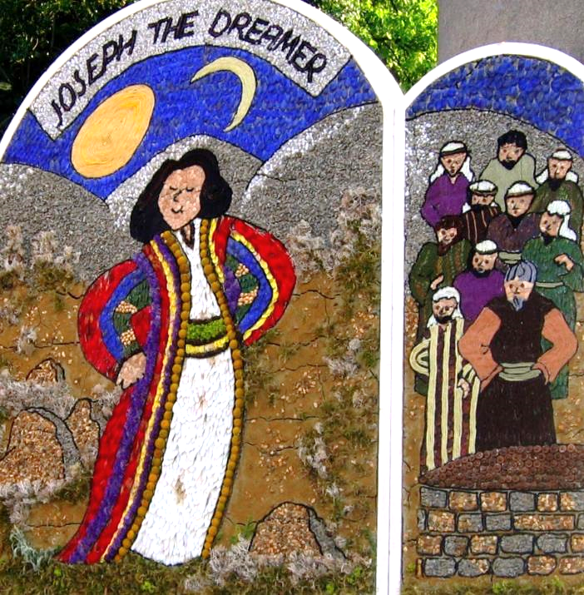
Joseph the Dreamer
Well Mural Bakewell, England

Slide 6
Reuben said to them, "Shed no blood; throw him into this pit here in the wilderness, but lay no hand on him" …
Genesis 37:22a

Slide 7
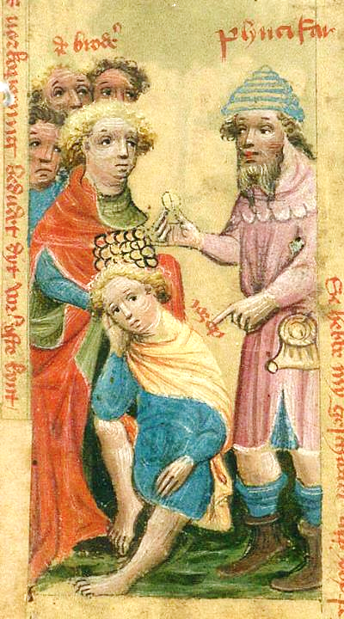
Rueben Saves Joseph
Biblia Pauperum
German, before 1700

Slide 8
Come, let us sell him to the Ishmaelites, and not lay our hands on him, for he is our brother, our own flesh." And his brothers agreed.
Genesis 37:27

Slide 9
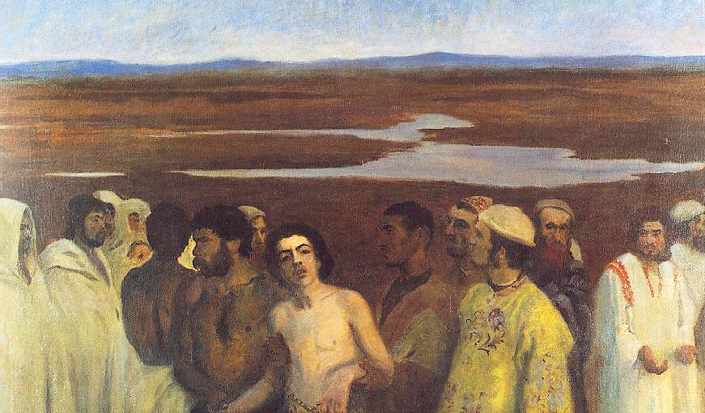
Joseph Sold into Slavery -- Karoly Ferenczy, Hungarian National Gallery, Budapest

Slide 10
He had sent a man ahead of them, Joseph, who was sold as a slave.
Psalm 105:17

Slide 11
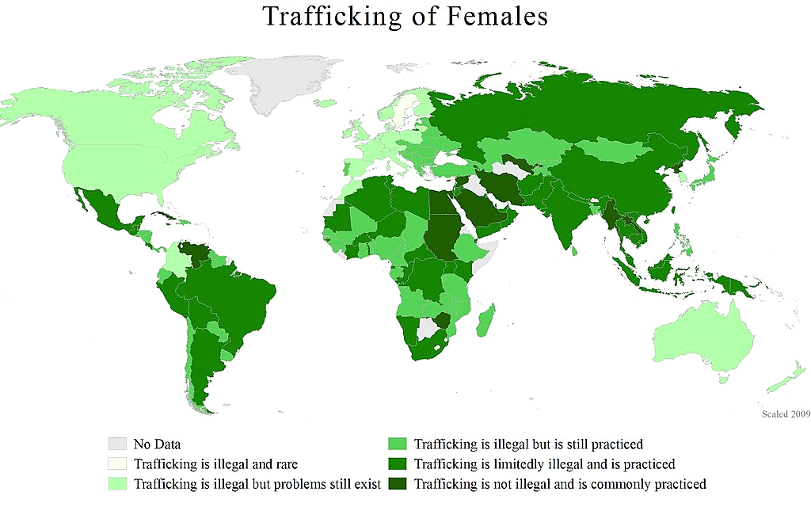
Human Trafficking Map, WomanStats Project

Slide 12
His feet were hurt with fetters, his neck was put in a collar of iron;
Psalm 105:18b

Slide 13
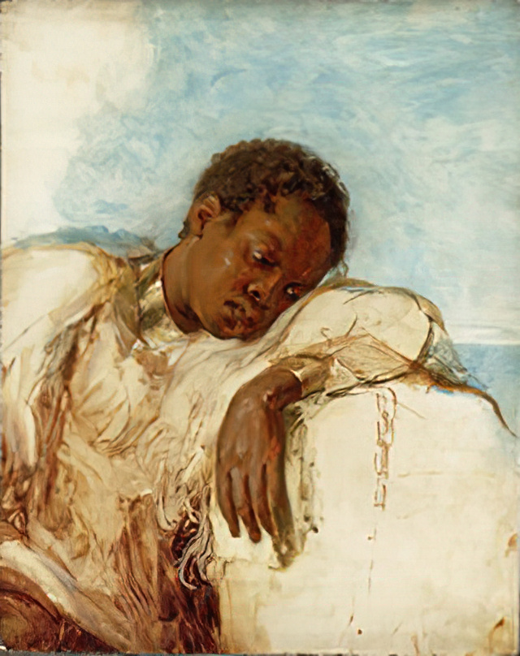
Slave in Chains
Royal Museums Greenwich, UK

Slide 14
Now there was a great wind …
but the LORD was not in the wind;
and after the wind an earthquake,
but the LORD was not in the earthquake;
1 Kings 19:11b

Slide 15
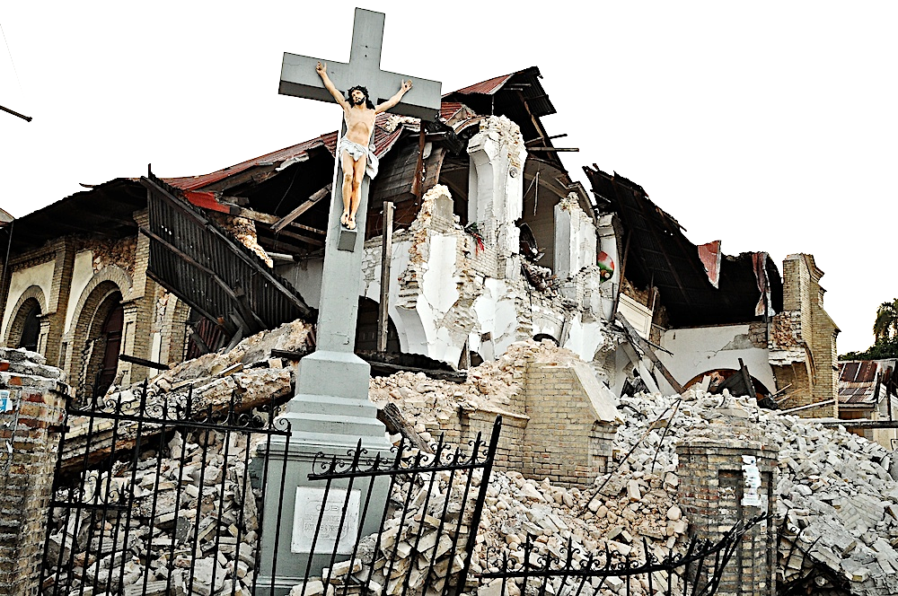
Earthquake Destruction 2010, Port-au-Prince, Haiti

Slide 16
and after the earthquake a fire,
but the LORD was not in the fire;
and after the fire a sound of sheer silence.
1 Kings 19:12

Slide 17
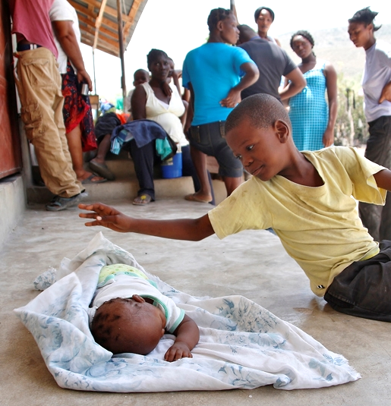
Caring for Sleeping Brother
Haitian 2010 Earthquake Refugees

Slide 18
Steadfast love and faithfulness
will meet;
righteousness and peace
will kiss each other.
Psalm 85:10

Slide 19
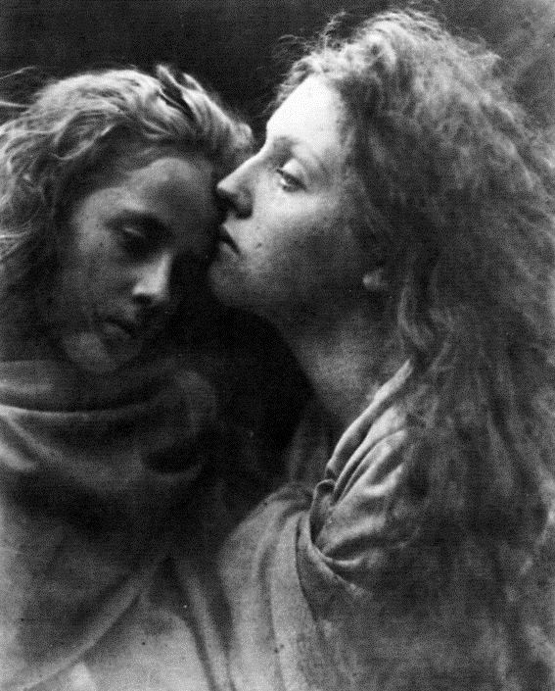
Kiss of Peace
Julia Margaret Cameron
Royal Photographic Society Bath, England

Slide 20
"The word is near you, on your lips and in your heart“ …
Romans 10:8b

Slide 21
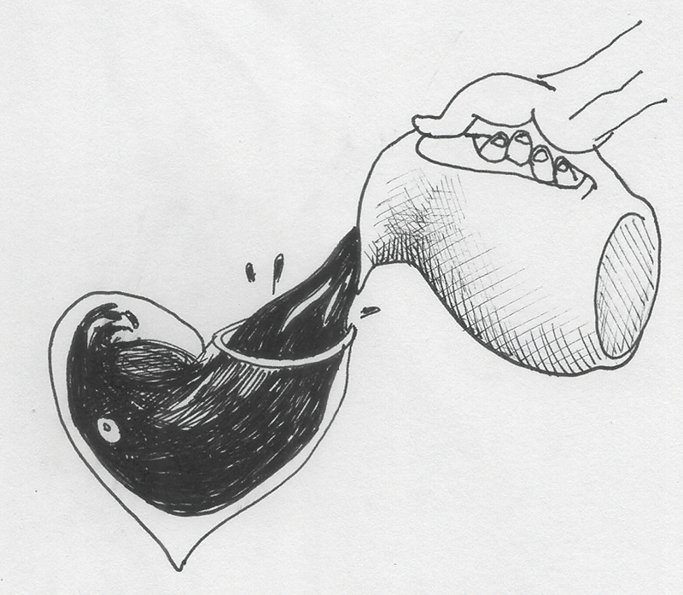
Fill Me -- Liz Valente

Slide 22
And early in the morning he came walking toward them on the sea.
Matthew 14:25

Slide 23
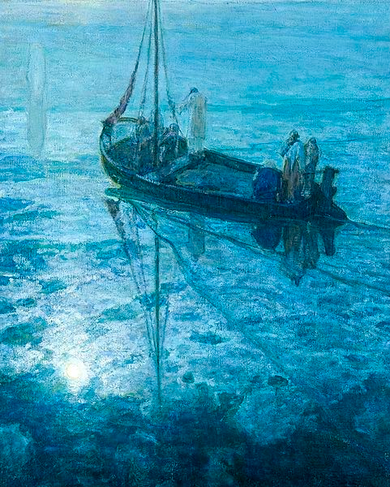
Disciples See Christ Walking on the Water
Henry Ossawa Tanner
Art Center
Des Moines, IA

Slide 24
But when the disciples saw him … they were terrified, saying, "It is a ghost!"
Matthew 14:26

Slide 25
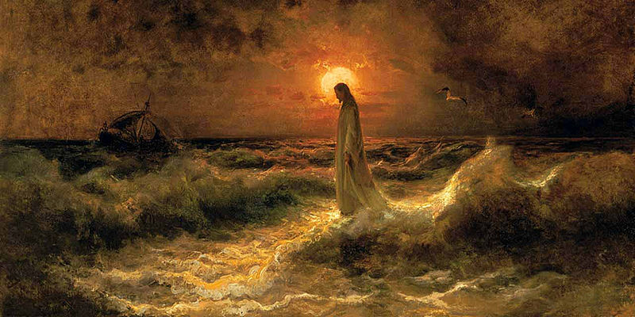
Christ Walking on the Water -- Julius Sergius Von Klever

Slide 26
But immediately Jesus spoke to them and said, "Take heart, it is I; do not be afraid."
Matthew 14:27

Slide 27
Psalm 23 -- John August Swanson

Slide 28
Peter answered him, "Lord, if it is you, command me to come to you on the water."
Matthew 14:28

Slide 29
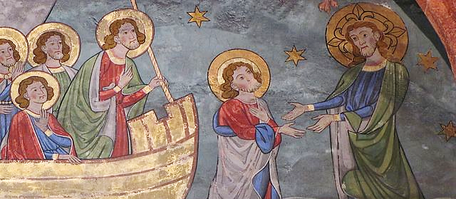
Peter on the Water -- Church of St. Peter the Younger, Strasbourg, France

Slide 30
But when he noticed the strong wind, he became frightened, and beginning to sink, he cried out, "Lord, save me!"
Matthew 14:30

Slide 31
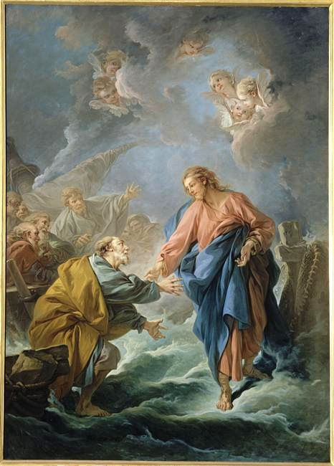
Peter Tries to Walk on Water
Francois Boucher
Cathedral of St. Louis
Versailles, france

Slide 32
Jesus immediately reached out his hand and caught him, saying to him, "You of little faith, why did you doubt?"
Matthew 14:31

Slide 33
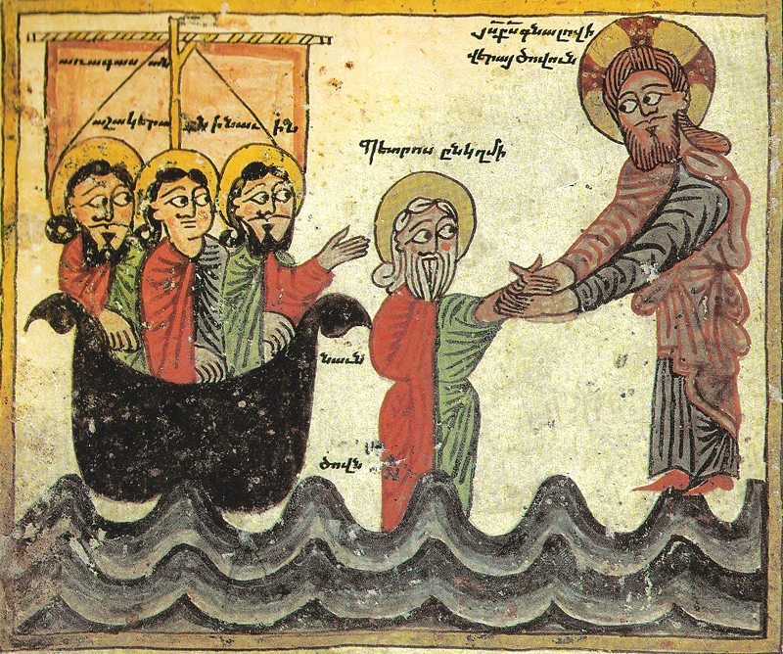
Christ Rescues Peter -- Daniel of Uranc, Mesrop Mashtots, Armenia

Slide 34
Credits
New Revised Standard Version Bible, copyright 1989, Division of Christian Education of the National Council of the Churches of Christ in the United States of America. Used by permission. All rights reserved.
https://www.flickr.com/photos/ugardener/3344020114/
https://upload.wikimedia.org/wikipedia/commons/8/82/Biblia_Pauperum_Det_Kongelige_Bibliotek.jpg
https://commons.wikimedia.org/wiki/File:Ferenczy,_K%C3%A1roly_-_Joseph_Sold_into_Slavery_by_his_Brothers_(1900).jpg
https://commons.wikimedia.org/wiki/Category:Human_trafficking#/media/File:Map3.3Trafficking_compressed.jpg
https://commons.wikimedia.org/wiki/File:Slave_in_chains_RMG_E9148.tiff
https://www.flickr.com/photos/newbeatphoto/4293703467 - Colin Crowley
https://www.flickr.com/photos/iom-migration/19847754796
http://commons.wikimedia.org/wiki/File:Cameron_Kuss_des_Friedens_1869.jpg
Liz Valente, https://www.instagram.com/donalizvalente/
https://commons.m.wikimedia.org/wiki/File:Henry_Ossawa_Tanner,_The_Disciples_See_Christ_Walking_on_the_Water,_c._1907.jpg
https://commons.m.wikimedia.org/wiki/File:Christ_Walking_on_the_Waters,_Julius_Sergius_Von_Klever.jpg
Estate of John August Swanson, https://www.johnaugustswanson.com/
https://commons.m.wikimedia.org/wiki/File:StPierreJeuneP232.JPG
http://commons.wikimedia.org/wiki/File:Saint_Pierre_tentant_de_marcher_sur_les_eaux_by_Fran%C3%A7ois_Boucher.jpg
https://commons.wikimedia.org/wiki/File:Jesus_walking_on_water._Daniel_of_Uranc,_1433.jpg
Additional descriptions can be found at the Art in the Christian Tradition image library, a service of the Vanderbilt Divinity Library, http://diglib.library.vanderbilt.edu/. All images available via Creative Commons 3.0 License.

