Slide 1
Tenth Sunday after Pentecost
Year A
Genesis 32:22-31 and Psalm 17:1-7, 15
Isaiah 55:1-5 and Psalm 145:8-9, 14-21
Romans 9:1-5 • Matthew 14:13-21

Slide 2
Then the man said, "You shall no longer be called Jacob, but Israel, for you have striven with God and with humans, and have prevailed."
Genesis 32:28

Slide 3
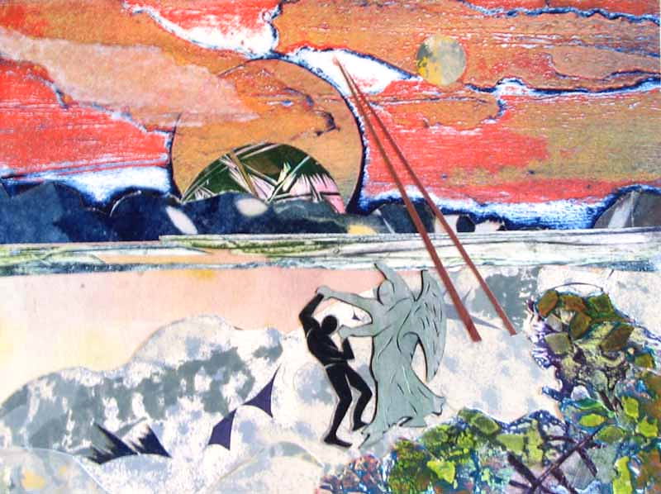
Jacob and the Angel -- Annette Gandy Fortt, Silver Spring, MD

Slide 4
Wondrously show your steadfast love, O savior of those who seek refuge.
Psalm 17:7

Slide 5
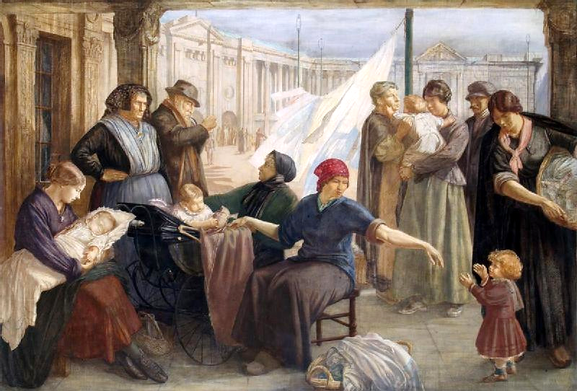
War Refugee's Camp -- Henry Rushbury, Imperial War Museum, London, England

Slide 6
Ho, everyone who thirsts, come to the waters … Come, buy wine and milk without money and without price.
Isaiah 55:1ac

Slide 7
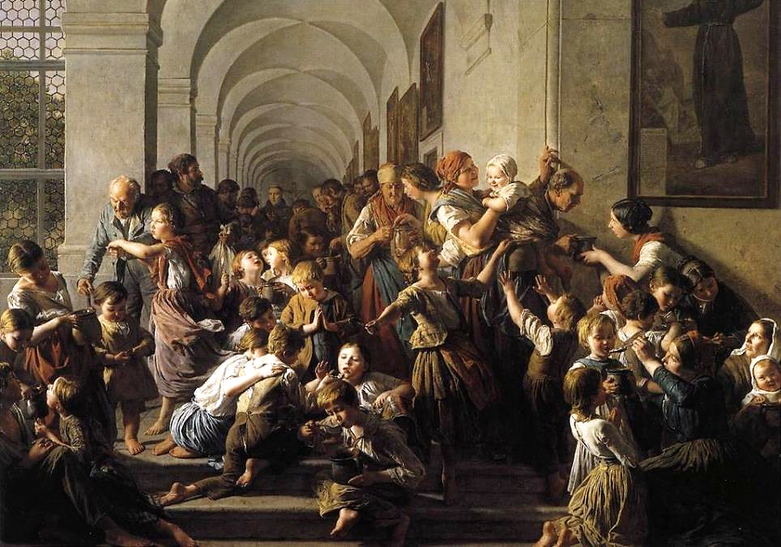
The Soup Kitchen -- Ferdinand Waldmuller, Palace Belvedere, Vienna, Austria

Slide 8
The LORD is good to all, and his compassion is over all that he has made.
Psalm 145:9

Slide 9
Refugee Boy
William H. Johnson Smithsonian American Art Museum Washington, DC

Slide 10
They are Israelites, and to them belong the covenants, the giving of the law, the worship, and the promises.
Romans 9:4

Slide 11
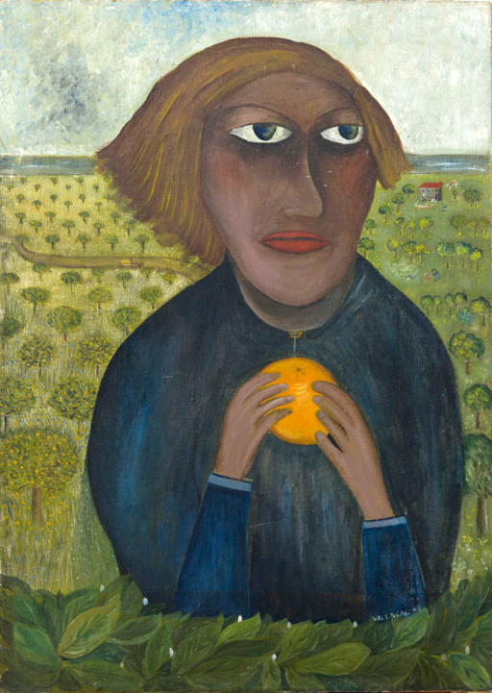
The Promised Land
Lette Valeska

Slide 12
When he went ashore, he saw a great crowd; and he had compassion for them and cured their sick.
Matthew 14:14

Slide 13
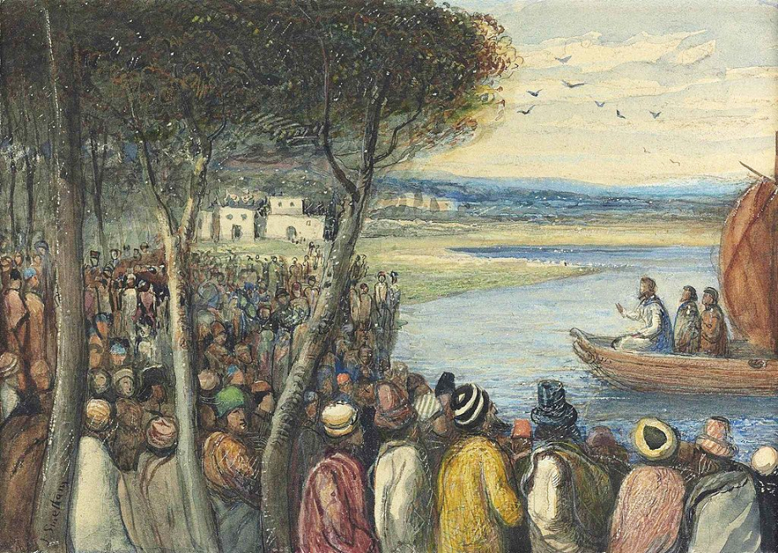
Christ Preaching to the Multitudes -- James Smetham, Fine Art Society, London, England

Slide 14
When it was evening, the disciples said, "This is a deserted place, and the hour is now late; send the crowds away so that they may go into the villages and buy food for themselves."
Matthew 14:15

Slide 15
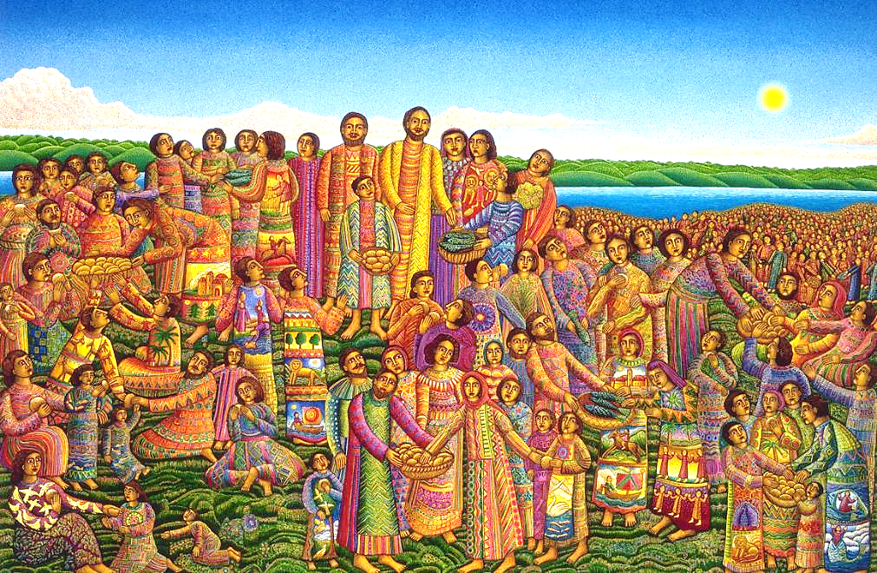
Loaves and Fishes -- John August Swanson

Slide 16
Jesus said to them, "They need not go away; you give them something to eat.
Matthew 14:16

Slide 17
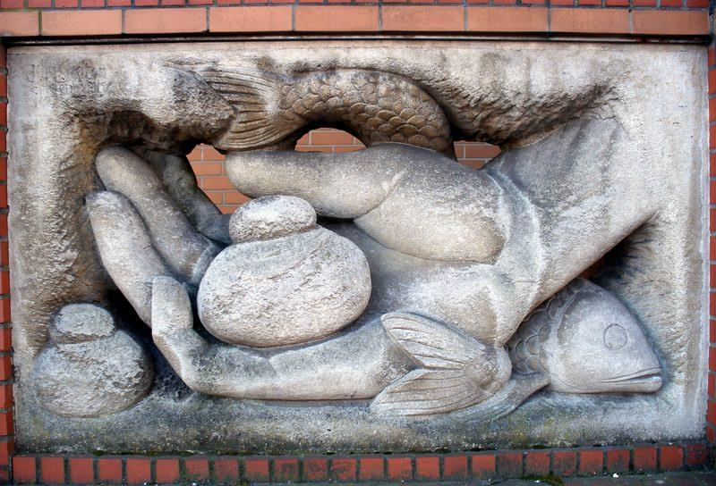
Offering of Loaves and Fish -- United Reformed Church, Brighton, England

Slide 18
They replied, "We have nothing here but five loaves and two fish."
Matthew 14:17

Slide 19
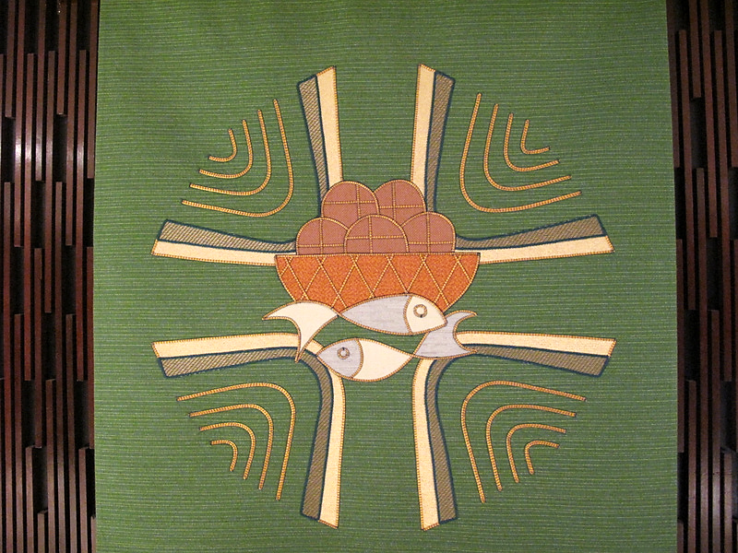
Altar Cloth -- Air Force Academy Chapel, Colorado Springs, CO

Slide 20
Taking the five loaves and the two fish, he looked up to heaven, and blessed and broke the loaves,
Matthew 14:19b

Slide 21
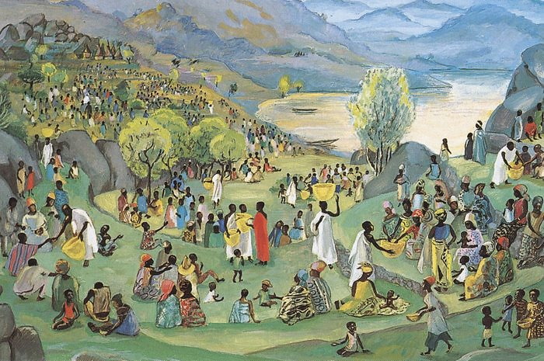
Jesus Multiplies the Loaves and Fish -- JESUS MAFA, Cameroon

Slide 22
and gave them to the disciples, and the disciples gave them to the crowds.
Matthew 14:19c

Slide 23
Words Can’t Feed the Hungry
Michal Pawlicki
United Nations Millenium Goal to End Hunger

Slide 24
And all ate and were filled; and they took up what was left over of the broken pieces, twelve baskets full.
Matthew 14:20

Slide 25
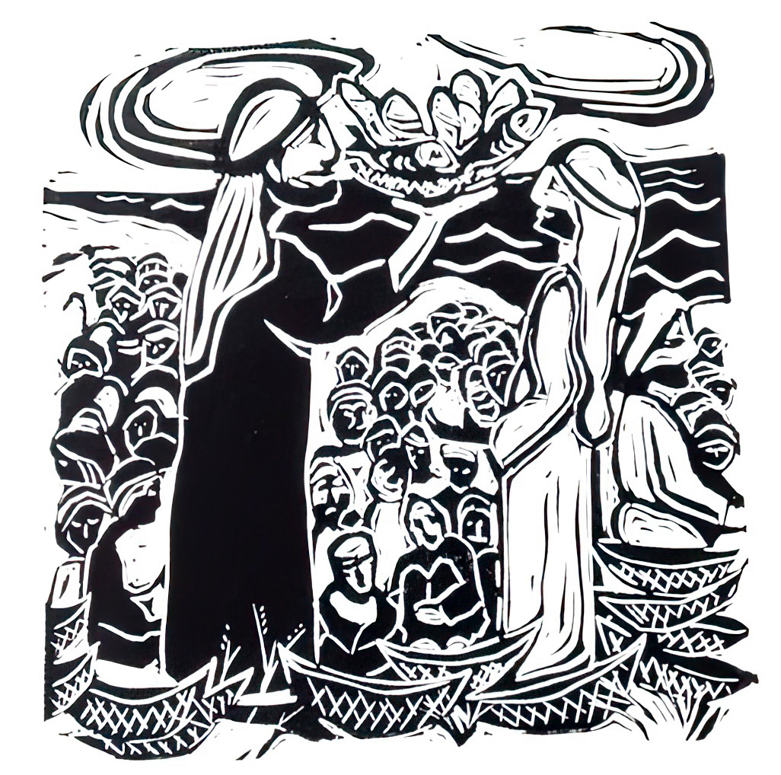
Feeding the Multitudes -- Cara Hochhalter

Slide 26
Credits
New Revised Standard Version Bible, copyright 1989, Division of Christian Education of the National Council of the Churches of Christ in the United States of America. Used by permission. All rights reserved.
annettefortt.com with permission
http://commons.wikimedia.org/wiki/File:The_War_Refugees%27_Camp,_Earl%27s_Court_1918_Art.IWMART2449.jpg
https://commons.wikimedia.org/wiki/File:Ferdinand_Georg_Waldm%C3%BCller_-_The_Soup_Kitchen_-_WGA25425.jpg
https://commons.wikimedia.org/wiki/File:Refugee_Boy,_by_William_H._Johnson.jpg
https://www.flickr.com/photos/ugardener/33111682964
https://commons.wikimedia.org/wiki/File:James_Smetham_-_Christ_preaching_to_the_multitudes.jpg
Estate of John August Swanson, https://www.johnaugustswanson.com/
https://www.flickr.com/photos/arenamontanus/2313539134
https://www.flickr.com/photos/aemalkin/4328702855
http://diglib.library.vanderbilt.edu/act-imagelink.pl?RC=48287
http://www.flickr.com/photos/undpeuropeandcis/5269051224/
Cara B. Hochhalter - The artist has granted permission for the non-commercial use of this image with attribution.
https://www.flickr.com/photos/zenmama/9595059022/ - Lorianne DiSabato
Additional descriptions can be found at the Art in the Christian Tradition image library, a service of the Vanderbilt Divinity Library, http://diglib.library.vanderbilt.edu/. All images available via Creative Commons 3.0 License.

