Slide 1
Nativity of the Lord II
Year A
Isaiah 62:6-12
Psalm 97
Titus 3:4-7
Luke 2:(1-7), 8-20

Slide 2
In those days a decree went out from Emperor Augustus that all the world should be registered.
Luke 2:1

Slide 3
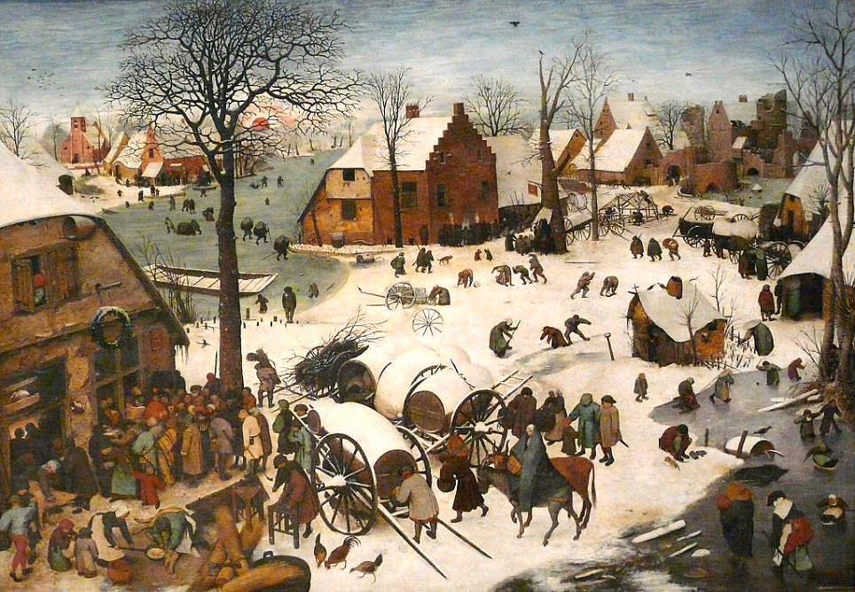
The Census at Bethlehem -- Pieter Brueghel the Elder, Brussels Museum of Fine Arts, Brussels, Belgium

Slide 4
Joseph went … to the city of David called Bethlehem, because he was descended from the house and family of David.
Luke 2:4ac

Slide 5
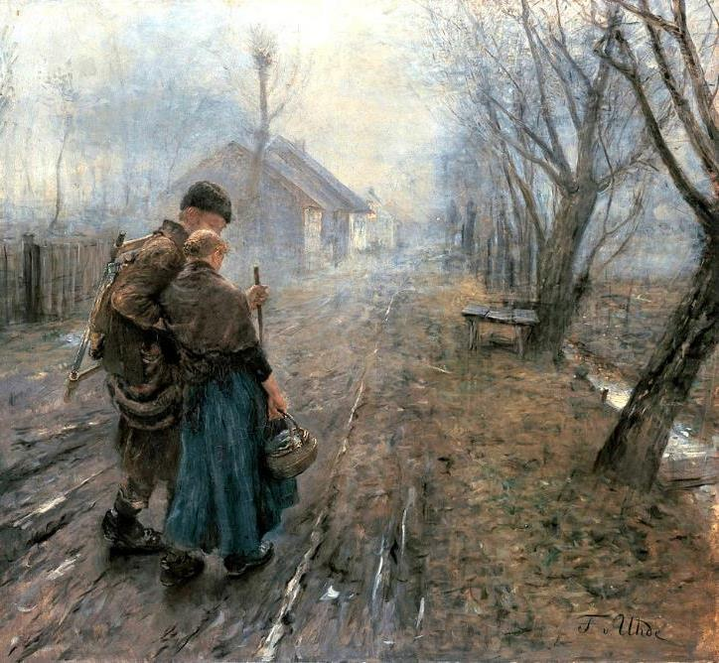
Difficult Journey – Transition to Bethelehem – Fritz von Uhde, Neue Pinakothek, Munich, Germany

Slide 6
He went to be registered with Mary, to whom he was engaged and who was expecting a child.
Luke 2:5

Slide 7
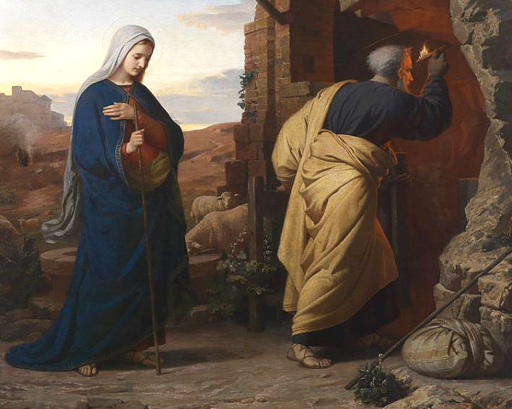
On the Eve of the Birth of Christ -- Michael Reiser, Austrian, 1869

Slide 8
While they were there, the time came for her to deliver her child.
Luke 2:6

Slide 9
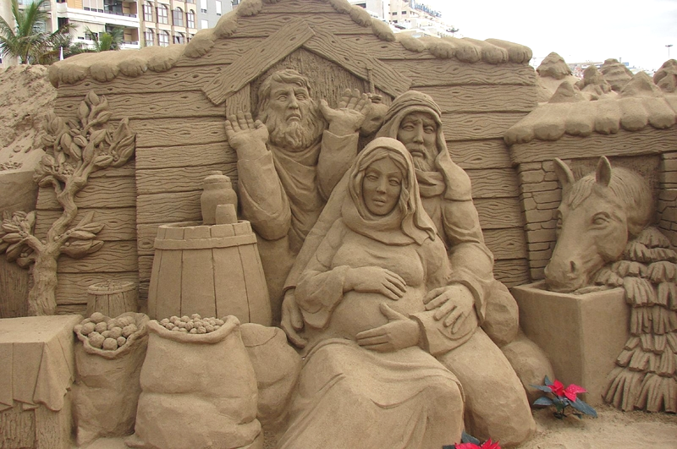
No Room in the Inn -- Peter Busch, Sand sculpture, Canary Islands, Spain

Slide 10
And she gave birth to her firstborn son and wrapped him in bands of cloth, and laid him in a manger, because there was no place for them in the inn.
Luke 2:7

Slide 11
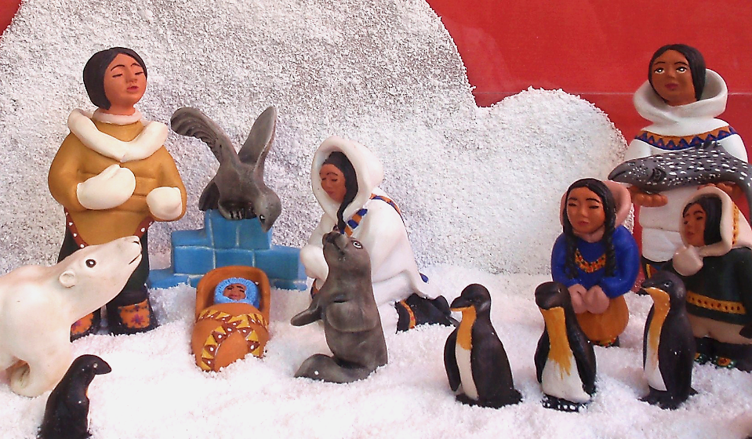
Inuit Nativity -- Padron House Museum, Galdar, Spain

Slide 12
In that region there were shepherds living in the fields, keeping watch over their flock by night.
Luke 2:8

Slide 13
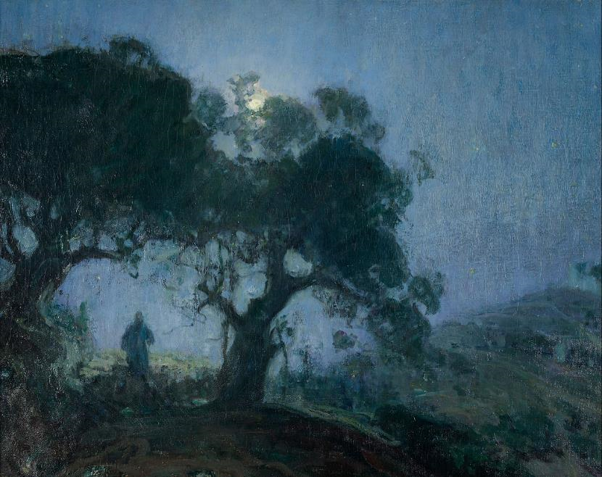
The Good Shepherd -- Henry Ossawa Tanner, Zimmerli Art Museum, Rutgers, NJ

Slide 14
Then an angel of the Lord stood before them, and the glory of the Lord shone around them, and they were terrified.
Luke 2:9

Slide 15
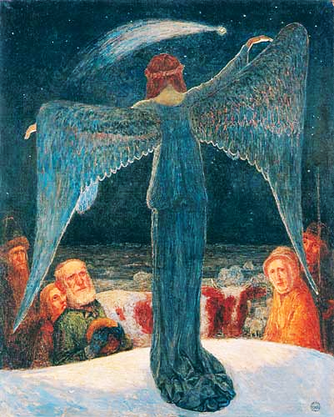
Annunciation to the Shepherds
Heinrich Vogeler

Slide 16
But the angel said to them, "Do not be afraid; for see--I am bringing you good news of great joy for all the people:
Luke 2:10

Slide 17
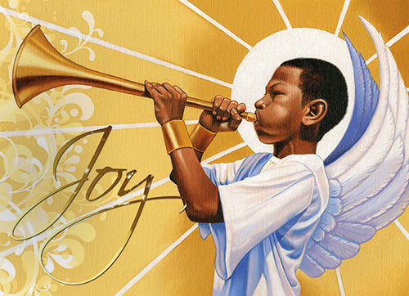
Joy to the World, the Lord is Come -- Illustration from Dem. Republic of Congo

Slide 18
to you is born this day in the city of David a Savior, who is the Messiah, the Lord.
Luke 2:11

Slide 19
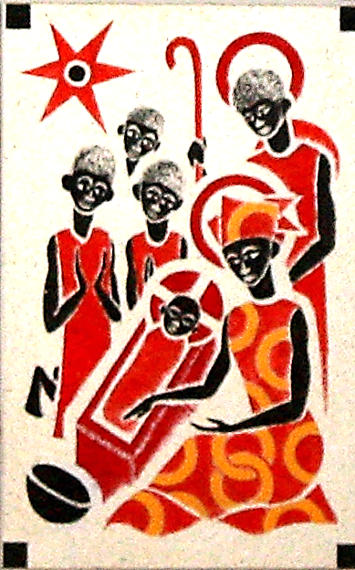
Christ is Born
Father Georges Saget
Keur Moussa Abbey
Keur Moussa, Senegal

Slide 20
This will be a sign for you: you will find a child wrapped in bands of cloth and lying in a manger."
Luke 2:12

Slide 21
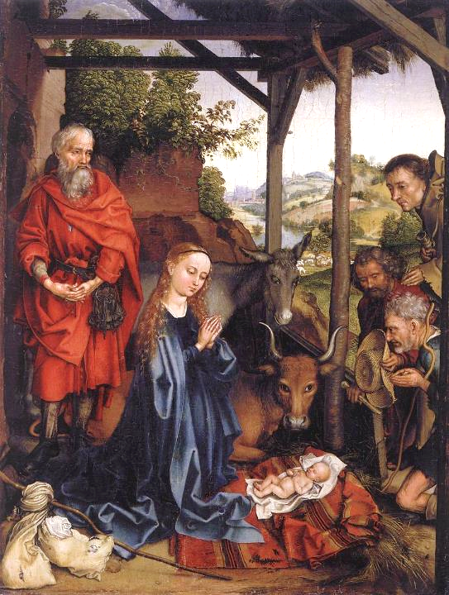
Birth of Christ
Martin Schongauer
Gemaldegalerie
Berlin, Germany

Slide 22
And suddenly there was with the angel a multitude of the heavenly host, praising God and saying,
Luke 2:13

Slide 23
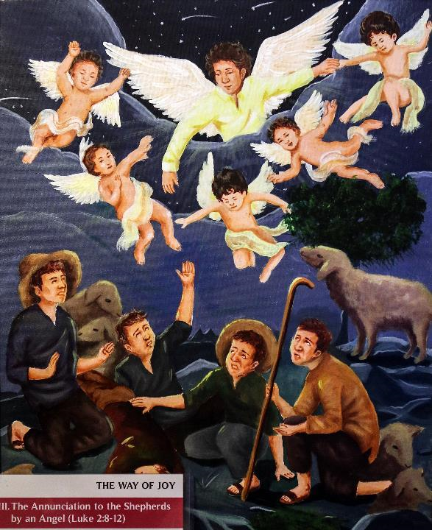
Filipino painting from display of enculturated sacred art
Manila Cathedral
Manila, Philippines

Slide 24
"Glory to God in the highest heaven, and on earth peace among those whom he favors!"
Luke 2:14

Slide 25
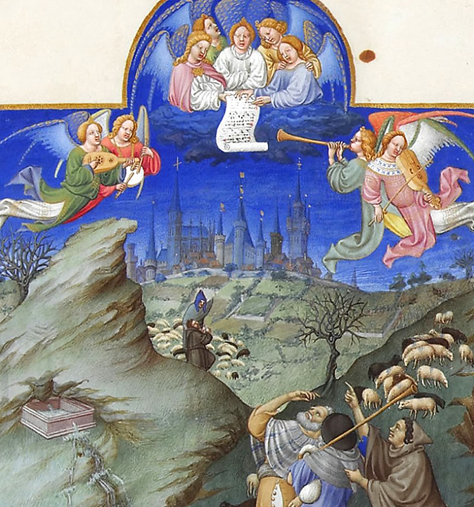
Annunciation to the Shepherds
Les Tres Riches Heures du duc de Berry
Musée Condé
Chantilly, France

Slide 26
… the shepherds said to one another, "Let us go now to Bethlehem and see this thing that has taken place, which the Lord has made known to us."
Luke 2:15b

Slide 27
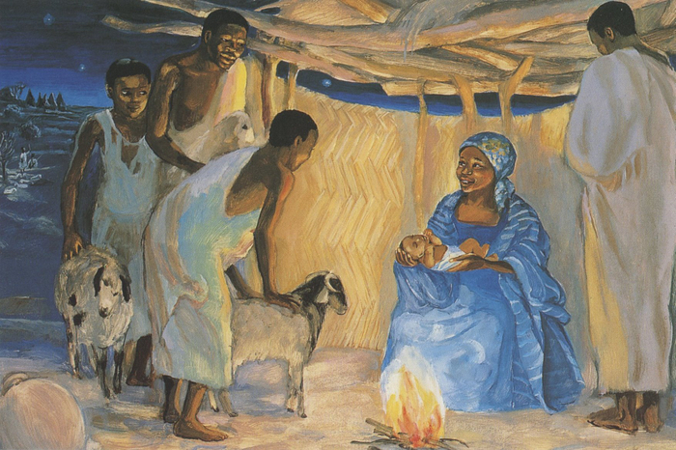
Birth of Jesus with the Shepherds -- JESUS MAFA, Cameroon

Slide 28
So they went with haste and found Mary and Joseph, and the child lying in the manger.
Luke 2:16

Slide 29
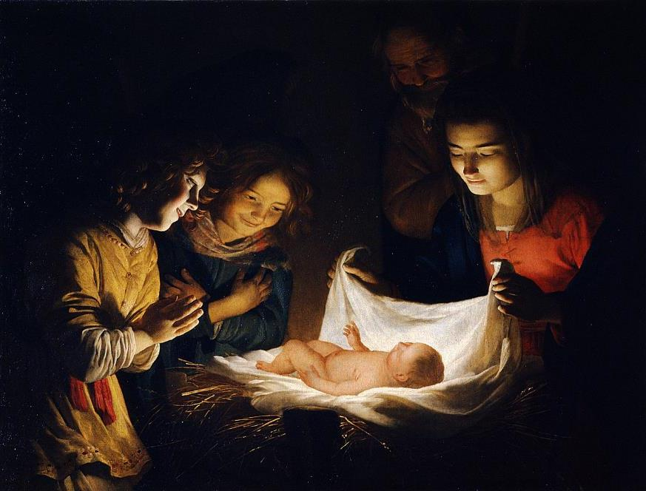
Adoration of the Child -- Gerard van Honthorst, Uffizi Gallery, Florence, Italy

Slide 30
When they saw this, they made known what had been told them about this child; and all who heard it were amazed …
Luke 2:17, 18a

Slide 31
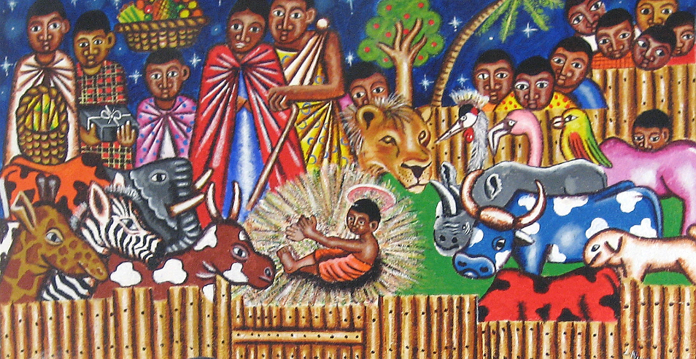
Nativity from a church in Kenya

Slide 32
But Mary treasured all these words and pondered them in her heart.
Luke 2:19

Slide 33
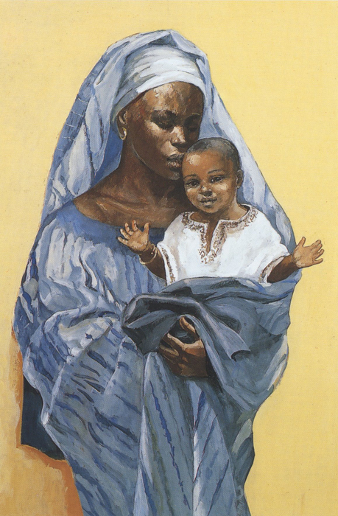
Madonna and Child
JESUS MAFA, Cameroon

Slide 34
Credits
New Revised Standard Version Bible, copyright 1989, Division of Christian Education of the National Council of the Churches of Christ in the United States of America. Used by permission. All rights reserved.
https://www.flickr.com/photos/snarfel/3713215932 - Frans Vandewalle
https://commons.wikimedia.org/wiki/File:Fritz_v_Uhde_Schwerer_Gang_(1).jpg
https://commons.wikimedia.org/wiki/File:Michael_Rieser_Am_Abend_vor_Christi_Geburt_1869.jpg – Dorotheum
http://www.flickr.com/photos/mercywatch/2095491207/
https://www.flickr.com/photos/azuaje/5321600328
https://commons.wikimedia.org/wiki/File:Henry_Ossawa_Tanner_-_The_Good_Shepherd_-_Google_Art_Project.jpg
https://commons.wikimedia.org/wiki/File:Heinrich_Vogeler_Verk%C3%BCndigung_an_die_Hirten_1902.jpg
https://www.flickr.com/photos/babasteve/31844535845 - Steve Evans
https://commons.wikimedia.org/wiki/File:KeurMoussaAutel.jpg
https://commons.wikimedia.org/wiki/File:Martin_Schongauer_-_Nativity_-_WGA21041.jpg
https://www.flickr.com/photos/paullew/31817765076 - Fr Lawrence Lew, O.P.
https://commons.wikimedia.org/wiki/File:Folio_48r_-_The_Annunciation_to_the_Shepherds.jpg
http://www.librairie-emmanuel.fr
https://commons.wikimedia.org/wiki/File:Gerard_van_Honthorst_-_Adoration_of_the_Child_-_WGA11655.jpg
https://www.flickr.com/photos/genvessel/537858093 - klndonnelly
http://www.librairie-emmanuel.fr
Additional descriptions can be found at the Art in the Christian Tradition image library, a service of the Vanderbilt Divinity Library, http://diglib.library.vanderbilt.edu/. All images available via Creative Commons 3.0 License.

