Slide 1
Holy Name of Jesus
Year A
Numbers 6:22-27
Psalm 8
Galatians 4:4-7 or Philippians 2:5-11 Luke 2:15-21

Slide 2
The LORD bless you and keep you;
Numbers 6:24

Slide 3
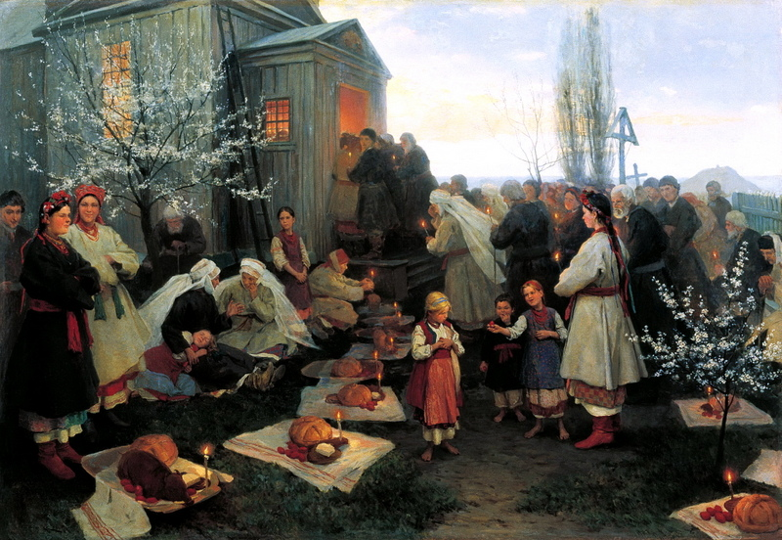
Waiting for the Blessing -- Mykola Pymonenko, Rybinsk Museum, Rybinsk, Russia

Slide 4
the LORD make his face to shine upon you, and be gracious to you;
Numbers 6:25

Slide 5
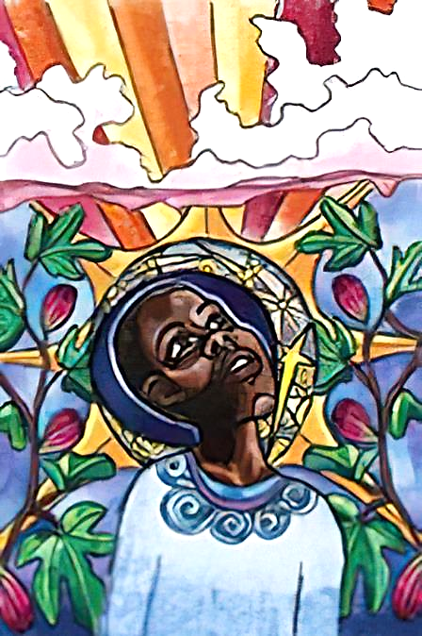
Raise Your Head
Lauren Wright Pittman

Slide 6
the LORD lift up his countenance upon you, and give you peace.
Numbers 6:26

Slide 7
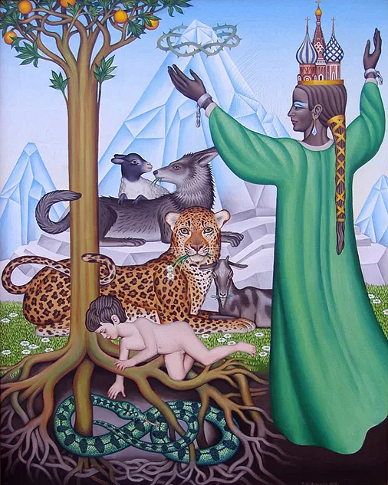
Great Peace
Peter Koenig

Slide 8
When I look at your heavens, the work of your fingers, the moon and the stars that you have established…
Psalm 8:3

Slide 9
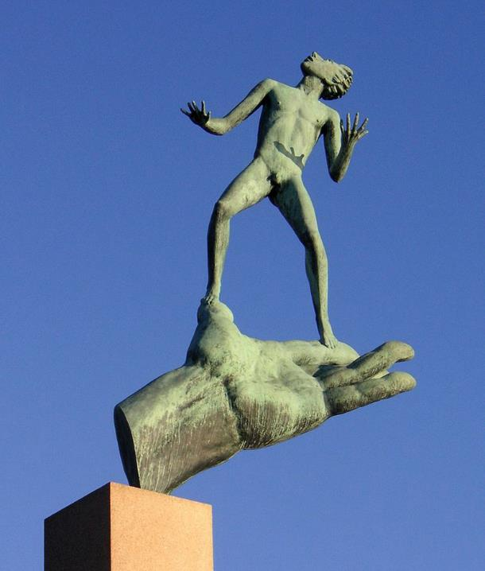
God’s Hand
Carl Milles Millesgarden, Stockholm, Sweden

Slide 10
…what are human beings that you are mindful of them, mortals that you care for them?
Psalm 8:4

Slide 11
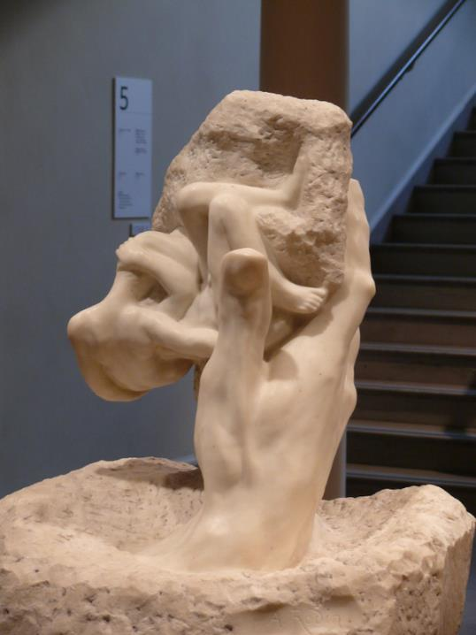
Hand of God
Auguste Rodin
Rhode Island School of Design Museum, Providence, RI

Slide 12
And because you are children, God has sent the Spirit of his Son into our hearts, crying, "Abba! Father!"
Galatians 4:6

Slide 13
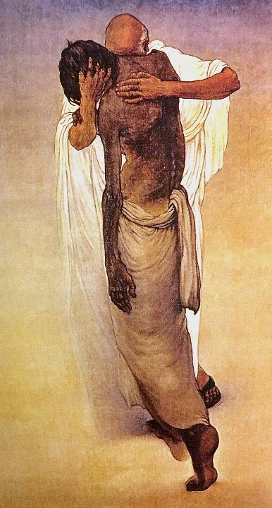
Forgiving Father
Frank Wesley

Slide 14
he humbled himself and became obedient to the point of death-- even death on a cross.
Philippians 2:8

Slide 15
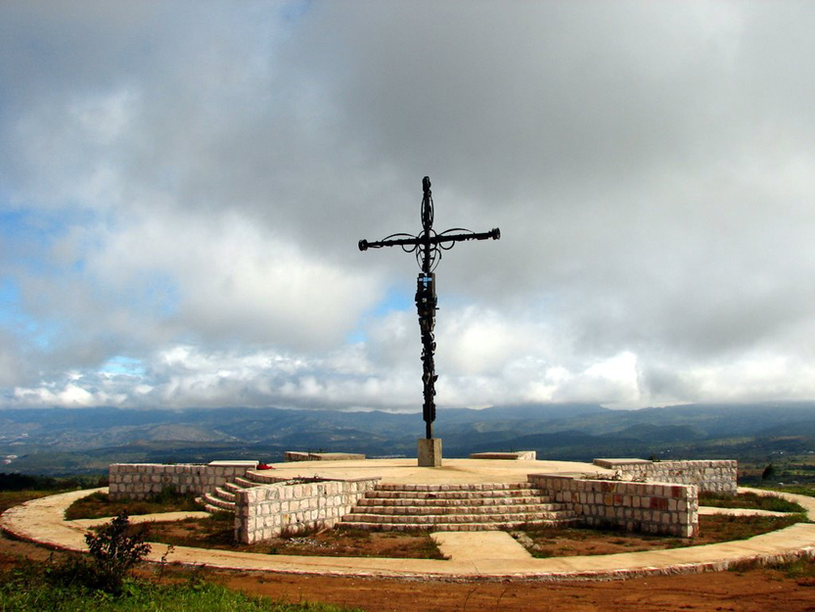
Scrap metal Cross -- Santa Ana, Honduras

Slide 16
After eight days had passed, it was time to circumcise the child; and he was called Jesus, the name given by the angel before he was conceived in the womb.
Luke 2:21

Slide 17
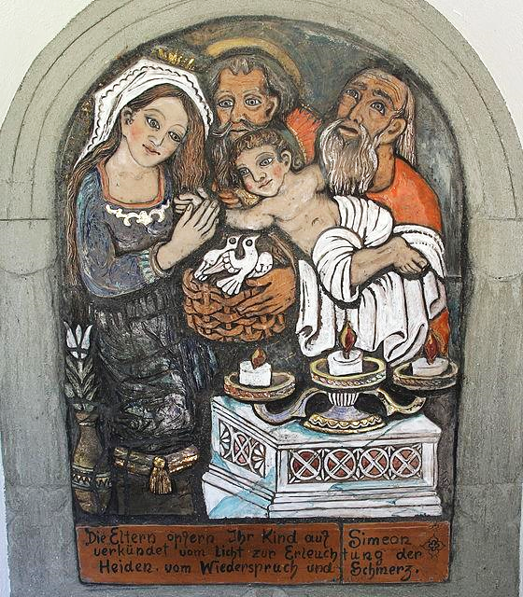
Roadside Shrine
Karl Obelitner, Jr.
Kalvarienberg, Austria

Slide 18
Credits
New Revised Standard Version Bible, copyright 1989, Division of Christian Education of the National Council of the Churches of Christ in the United States of America. Used by permission. All rights reserved.
http://commons.wikimedia.org/wiki/File:PimonenkoNK_PashalZautrRYB.jpg
Lauren Wright Pittman, http://www.lewpstudio.com/
Peter Winfried (Canisius) Koenig, https://www.pwkoenig.co.uk/
http://commons.wikimedia.org/wiki/File:Guds_hand_2007.jpg?uselang=enhands%20painting
http://commons.wikimedia.org/wiki/File:RISD_Rodin_Hand_of_God.JPG
http://www.mfa.org/
http://www.flickr.com/photos/aeortiz/307851438/
https://commons.wikimedia.org/wiki/File:Kalvarienberg,_Jerzens_08.JPG
Additional descriptions can be found at the Art in the Christian Tradition image library, a service of the Vanderbilt Divinity Library, http://diglib.library.vanderbilt.edu/. All images available via Creative Commons 3.0 License.

