Slide 1
Fourth Sunday after Epiphany
Year A
Micah 6:1-8 • Psalm 15 • 1 Corinthians 1:18-31
Matthew 5:1-12

Slide 2
For I brought you up from the land of Egypt, and redeemed you from the house of slavery…
Micah 6:4a

Slide 3
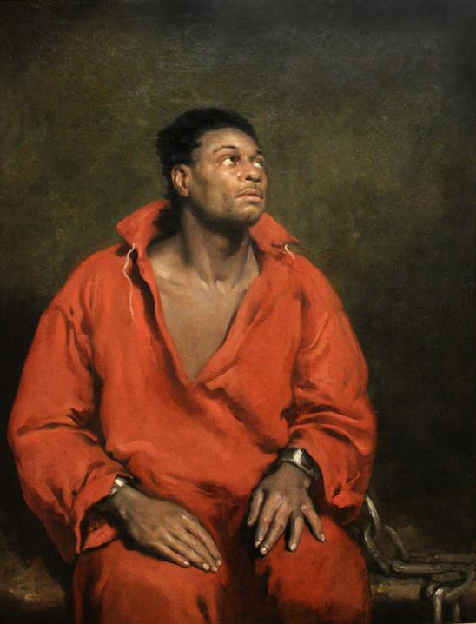
Captive Slave
John Simpson
Art Institute of Chicago

Slide 4
and I sent before you Moses, Aaron, and Miriam.
Micah 6:4b

Slide 5
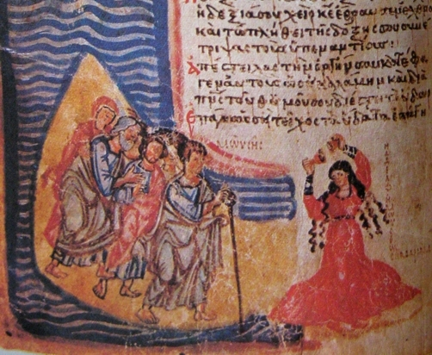
Dance of Miriam upon Crossing the Red Sea -- Chludov Psalter, State Hist. Museum, Moscow

Slide 6
and what does the LORD require of you, but to do justice…
Micah 6:8a

Slide 7
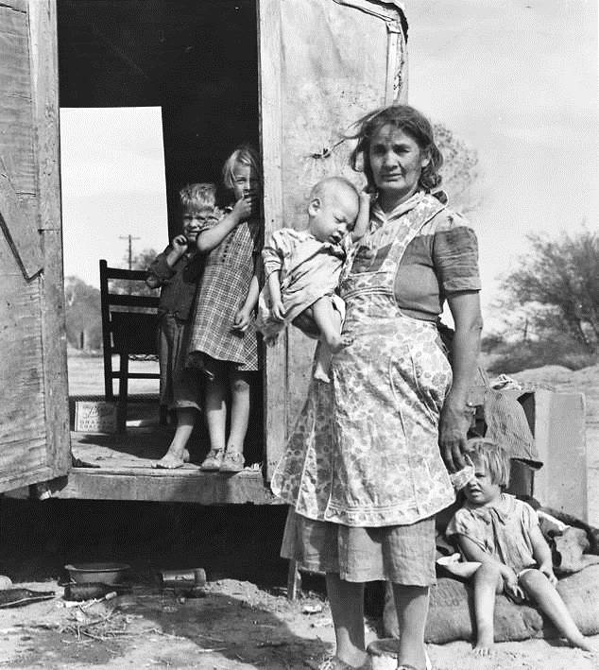
Children in a Democracy
Dorothea Lange
National Archives
College Park, MD

Slide 8
…and to love kindness…
Micah 6:8c

Slide 9
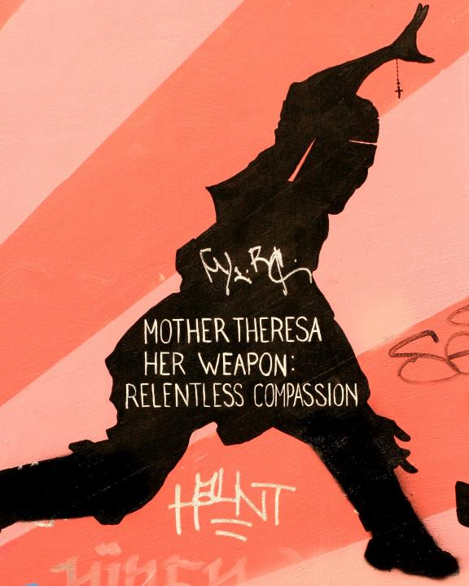
Relentless Compassion
Mission District mural San Francisco, CA

Slide 10
and to walk humbly with your God?
Micah 6:8d

Slide 11
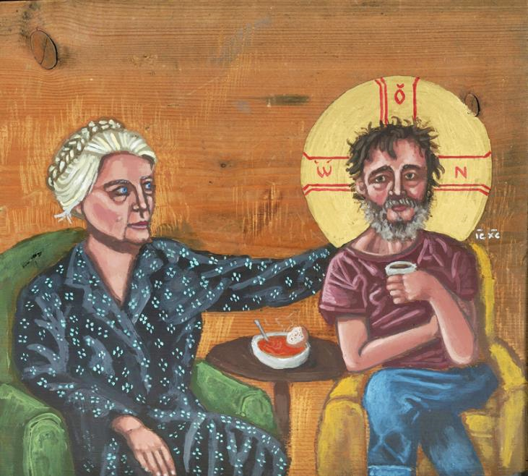
Dorothy Day with Homeless Christ -- Kelly Latimore

Slide 12
O LORD, who may abide in your tent?
Those who…speak the truth from their heart…
Psalm 15:1a-2b

Slide 13
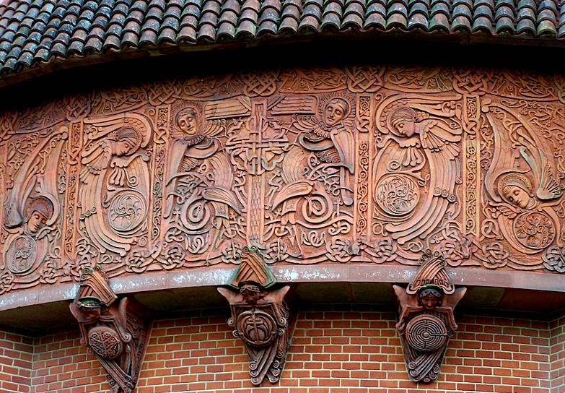
Spirit of Truth -- Mary S. Watts, Watts Chapel, Compton, England

Slide 14
Christ …the power of God and the wisdom of God.
1 Corinthians: 1:24b

Slide 15
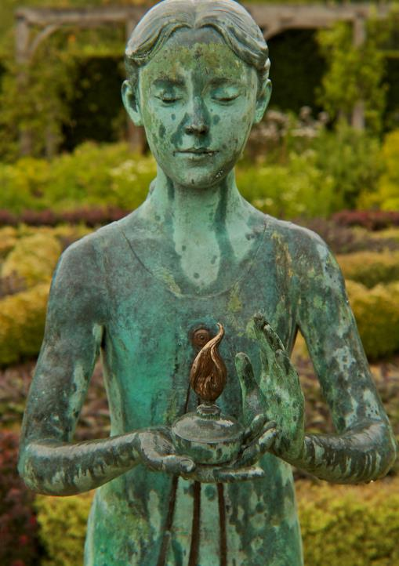
Lamp of Wisdom
Waterperry Gardens, Oxfordshire, England

Slide 16
God chose what is low and despised in the world...
1 Corinthians 1:28a

Slide 17
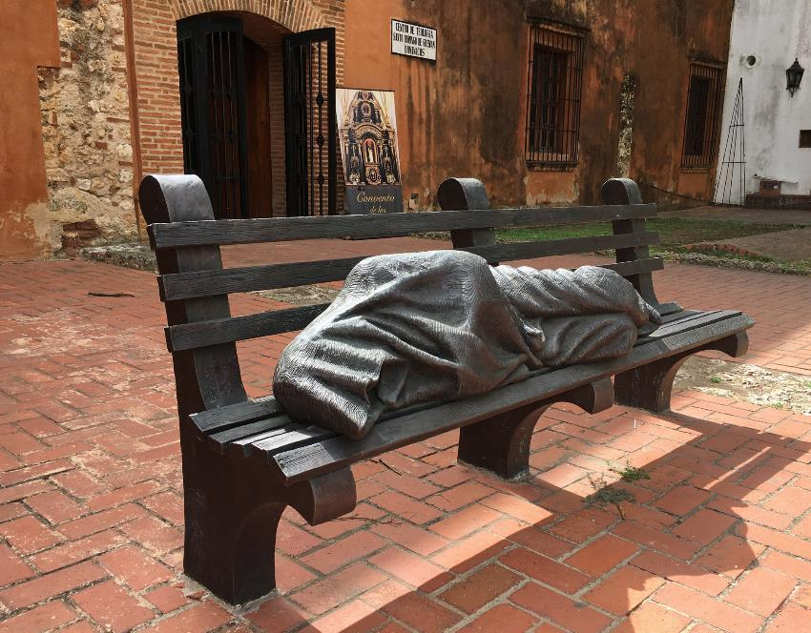
Homeless Jesus -- Timothy Schmaltz, Dominican Convent, Santo Domingo, Dominican Republic

Slide 18
Then he began to speak,
and taught them, saying:
Matthew 5:2

Slide 19
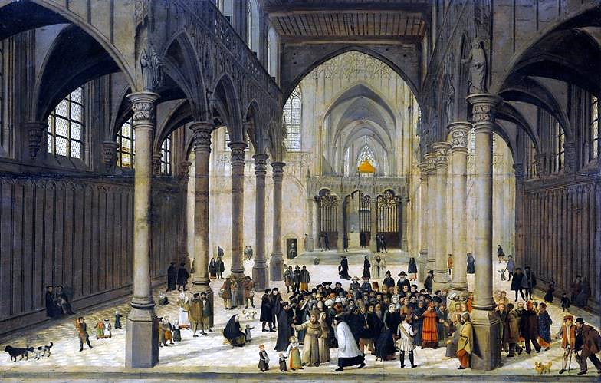
Christ Preaching to a Crowd -- Cornelis van Dalem and Jan van Wechelen, Rijksmuseum, Amsterdam

Slide 20
Blessed are the poor in spirit, for theirs is the kingdom of heaven.
Matthew 5:3

Slide 21
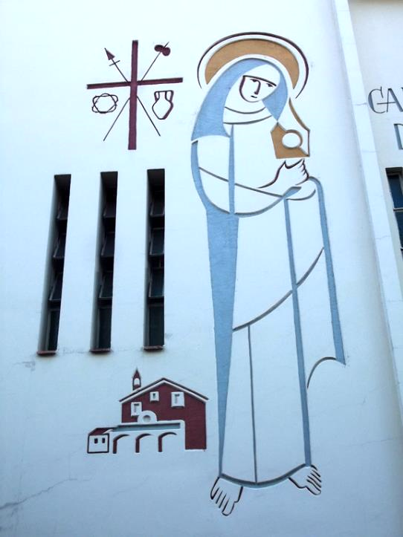
Sister Claire
Monastery of St. Damiano and Sister Clare
Porto Alegre, Brazil

Slide 22
Blessed are those who mourn,
for they will be comforted.
Matthew 5:4

Slide 23
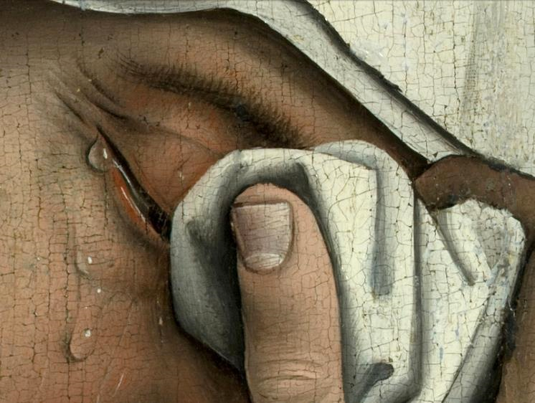
Mary's Tears, detail from Descent from the Cross-- Rogier van der Weyden, Prado, Madrid

Slide 24
Blessed are the meek,
for they will inherit the earth.
Matthew 5:5

Slide 25
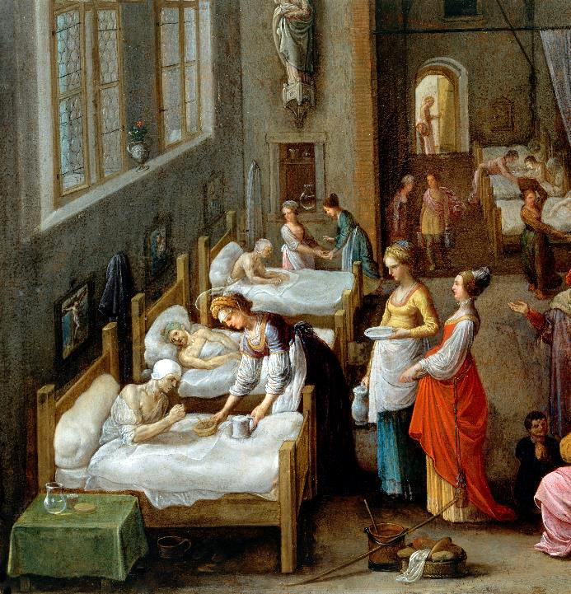
Elizabeth of Hungary Visiting a Hospital
Adam Elsheimer
Wellcome Collection

Slide 26
Blessed are those who hunger and thirst for righteousness,
for they will be filled.
Matthew 5:6

Slide 27
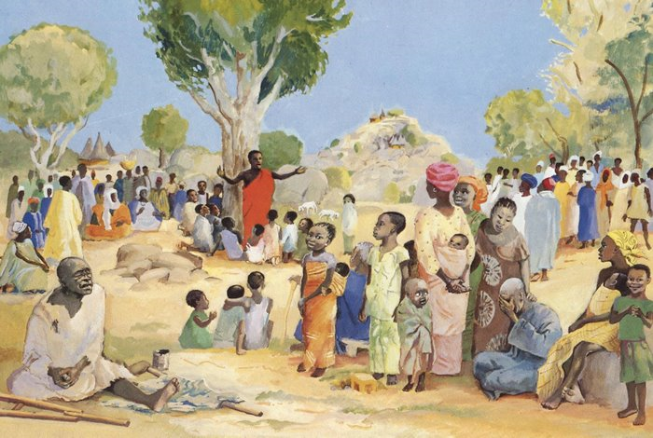
Sermon on the Mount -- JESUS MAFA, Cameroon

Slide 28
Blessed are the merciful,
for they will receive mercy.
Matthew 5:7

Slide 29
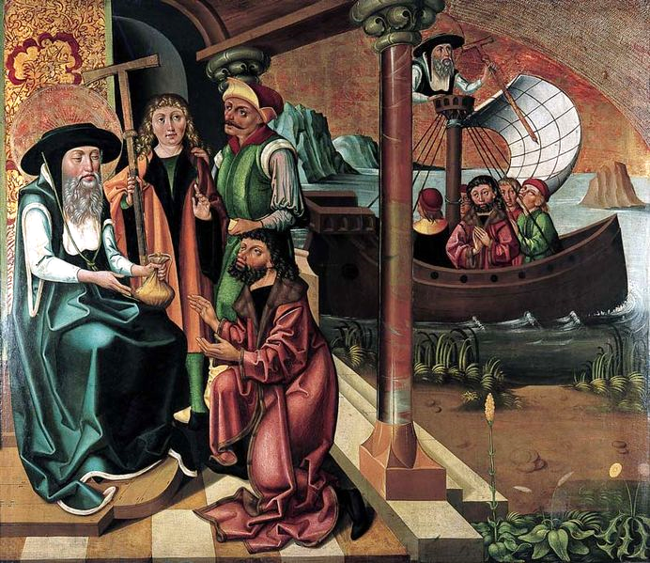
Support
to an Impover-ished Merchant
Master of the Legend of John the Merciful
Krakow, Poland

Slide 30
Blessed are the pure in heart,
for they will see God.
Matthew 5:8

Slide 31
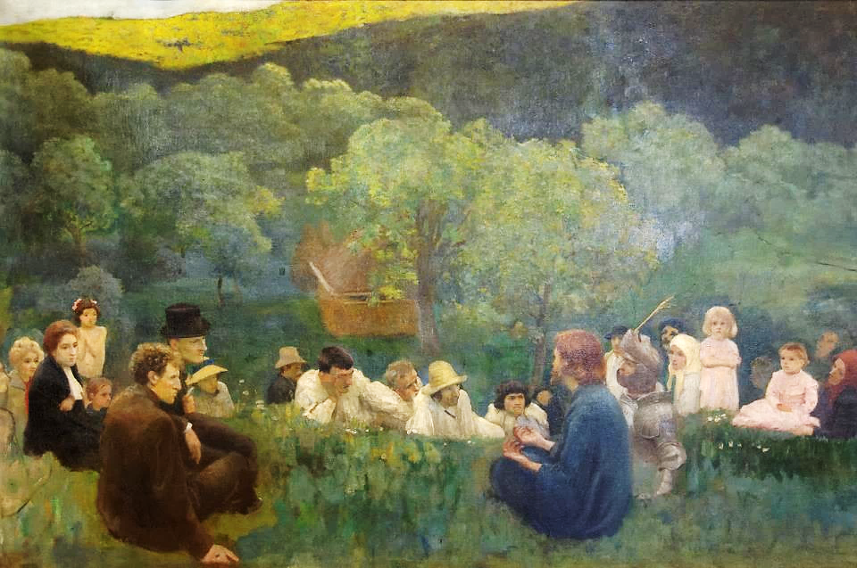
Sermon on the Mountain -- Karoly Ferenczy, Hungarian National Gallery, Budapest, Hungary

Slide 32
Blessed are the peacemakers, for they will be called children of God.
Matthew 5:9

Slide 33
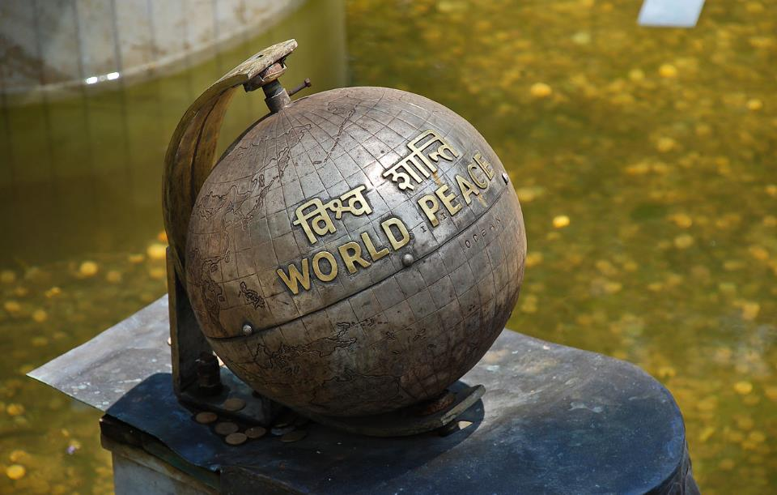
World Peace Monument -- Swayambhunath Temple Garden, Kathmandu, Nepal

Slide 34
Blessed are those who are persecuted for righteousness' sake, for theirs is the kingdom of heaven.
Matthew 5:10

Slide 35
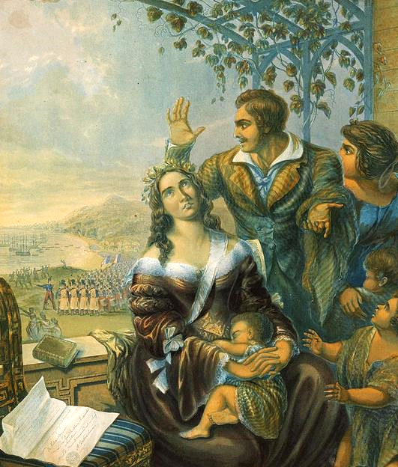
Pomare, Queen of Tahiti, Persecuted for her Faith
Tinted engraving

Slide 36
Blessed are you when people revile you and persecute you and utter all kinds of evil against you falsely on my account.
Matthew 5:11

Slide 37
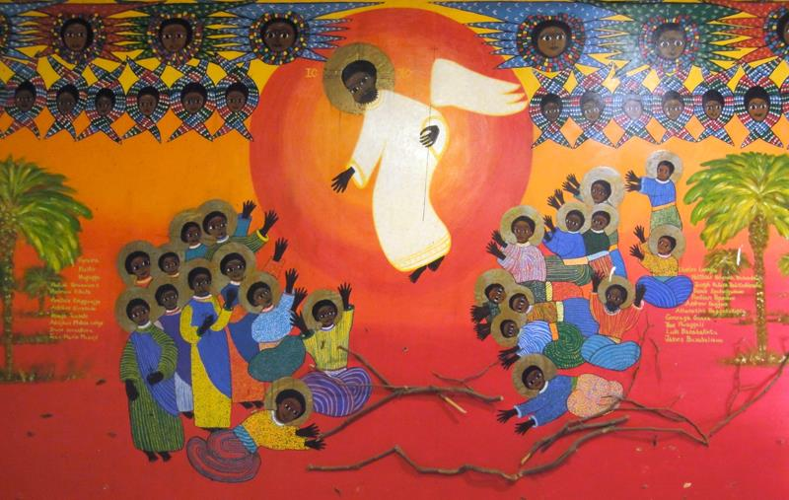
Martyrs of Uganda -- Emmaus House, Kampala, Uganda

Slide 38
Rejoice and be glad, for your reward is great in heaven …
Matthew 5:12a

Slide 39
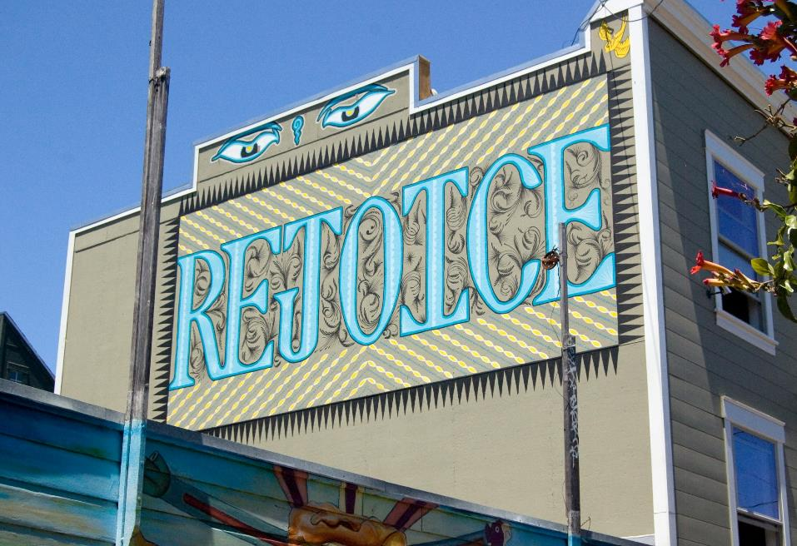
Rejoice! -- Mural in Mission District, San Francisco, CA

Slide 40
Credits
New Revised Standard Version Bible, copyright 1989, Division of Christian Education of the National Council of the Churches of Christ in the United States of America. Used by permission. All rights reserved.
http://commons.wikimedia.org/wiki/File:Captive_Slave.jpg
http://commons.wikimedia.org/wiki/File:Chludov_Miriam.jpg
http://commons.wikimedia.org/wiki/File:On_Arizona_Highway_87,_south_of_Chandler._Maricopa_County,_Arizona._Children_in_a_democracy._A_migra_._._._-_NARA_-_522527.jpg
https://www.flickr.com/photos/ladymissmarquise/4534743419
https://kellylatimoreicons.com/contact/
http://www.flickr.com/photos/nouveau/1871908002/
http://www.flickr.com/photos/rowanbank/5815103193/
https://commons.wikimedia.org/wiki/File:Homeless_Jesus_CCSD_07_2018_9749.jpg
https://commons.wikimedia.org/wiki/File:Cornelis_van_Dalem_(attr.)_and_Jan_van_Wechelen_(attr.)_-_Church_interior_with_Christ_preaching_to_a_crowd.jpg
https://commons.wikimedia.org/wiki/File:Mosteiro_S%C3%A3o_Dami%C3%A3o_em_Porto_Alegre_03.JPG – Eugenio Hansen
http://commons.wikimedia.org/wiki/File:Weyden,_Rogier_van_der_-_Descent_from_the_Cross_-_Detail_women_(left).jpg
https://commons.wikimedia.org/wiki/File:St_Elizabeth_visiting_a_hospital._Wellcome_V0017201.jpg
http://diglib.library.vanderbilt.edu/act-imagelink.pl?RC=48284

Slide 41
Credits
https://commons.wikimedia.org/wiki/File:Polyptych_of_John_the_Merciful_01.jpg
http://commons.wikimedia.org/wiki/File:The_Sermon_on_the_Mount_K%C3%A1roly_Ferenczy.jpg#
https://commons.wikimedia.org/wiki/File:Swayambhunath_world_peace_monument.jpg
http://commons.wikimedia.org/wiki/File:Pomare,_Queen_of_Tahiti,_the_persecuted_Christian,_by_George_Baxter,_1845.jpg
https://www.flickr.com/photos/jimforest/5710252358
https://www.flickr.com/photos/micromero/4739497551
Additional descriptions can be found at the Art in the Christian Tradition image library, a service of the Vanderbilt Divinity Library, http://diglib.library.vanderbilt.edu/. All images available via Creative Commons 3.0 License.

