Slide 1
First Sunday after Christmas Day
Year A
Isaiah 63:7-9
Psalm 148
Hebrews 2:10-18 Matthew 2:13-23

Slide 2
I will recount the gracious deeds of the LORD, the praiseworthy acts of the LORD, because of all that the LORD has done for us.
Isaiah 63:7

Slide 3
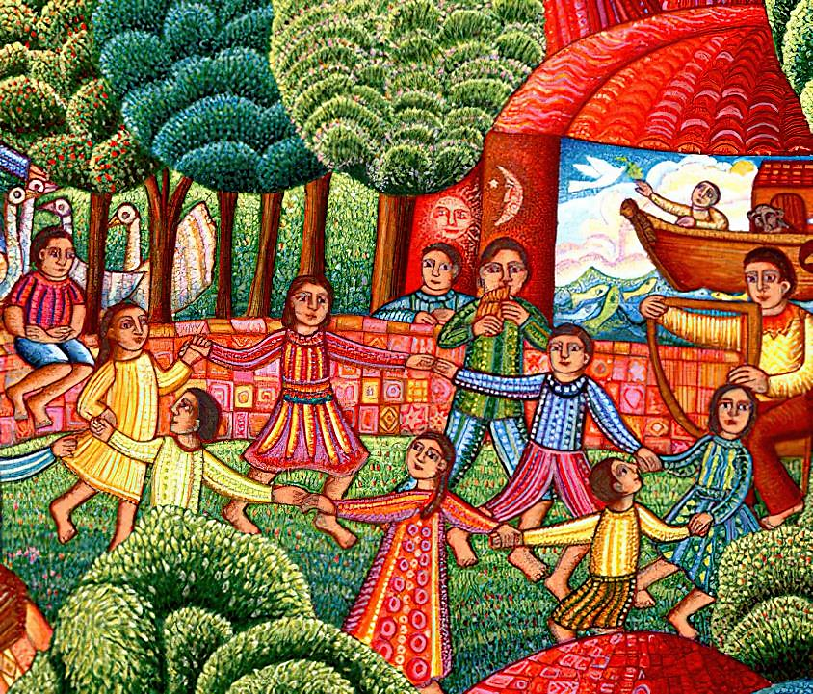
A Visit
John August Swanson

Slide 4
Praise the LORD! ...Praise him, sun and moon; praise him, all you shining stars!
Psalm 148:1a, 3a

Slide 5
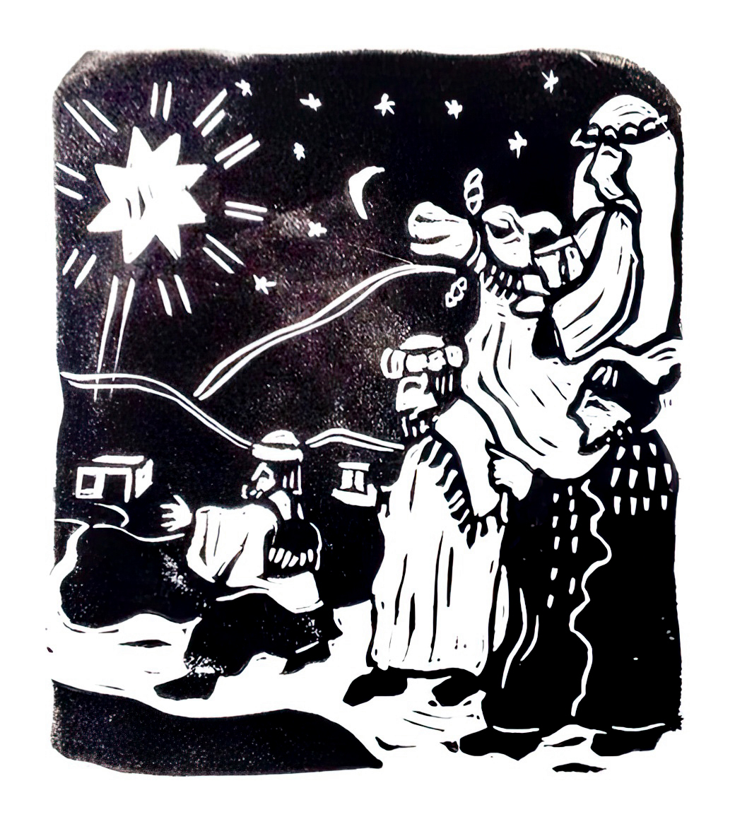
The Magi
Cara Hochhalter

Slide 6
Praise the LORD from the earth, you sea monsters and all deeps,
Psalm 148:7

Slide 7
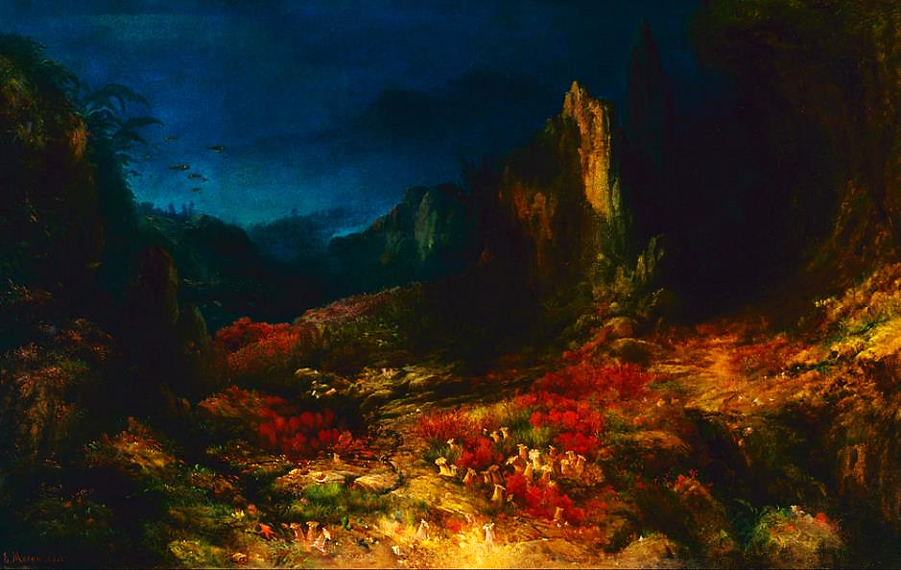
The Valley in the Sea (1862) -- Edward Moran, Indianapolis Museum of Art

Slide 8
Wild animals and all cattle, creeping things and flying birds! … Praise the Lord!
Psalm 148:10, 14c

Slide 9
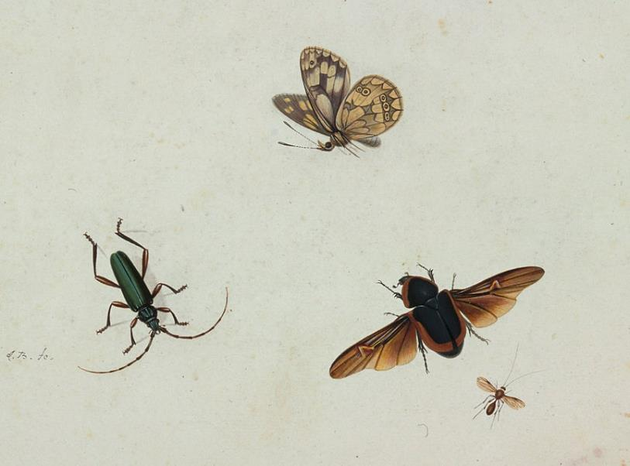
Four Insects -- Johannes Bronkhorst, Centraal Museum, Utrecht, Netherlands

Slide 10
Because he himself was tested by what he suffered, he is able to help those who are being tested.
Hebrews 2:18

Slide 11
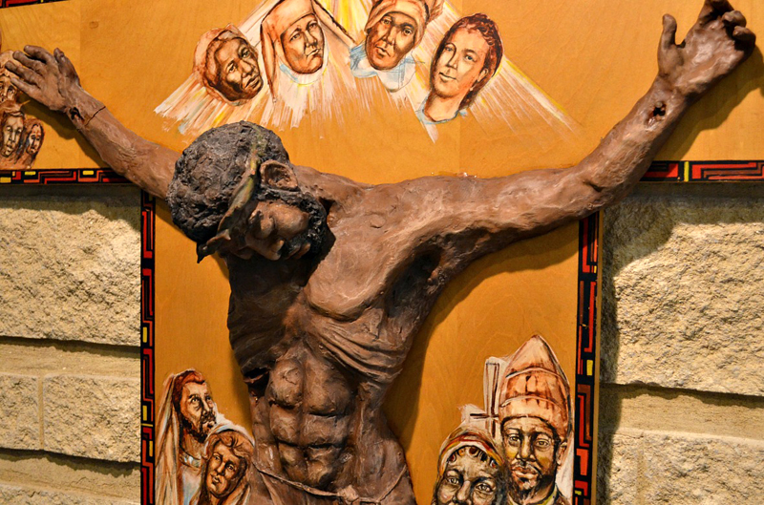
Crucifixion -- St. Benedict the African Church, Chicago, IL

Slide 12
saying, … "Here am I and the children whom God has given me."
Hebrews 2:12, 13c

Slide 13
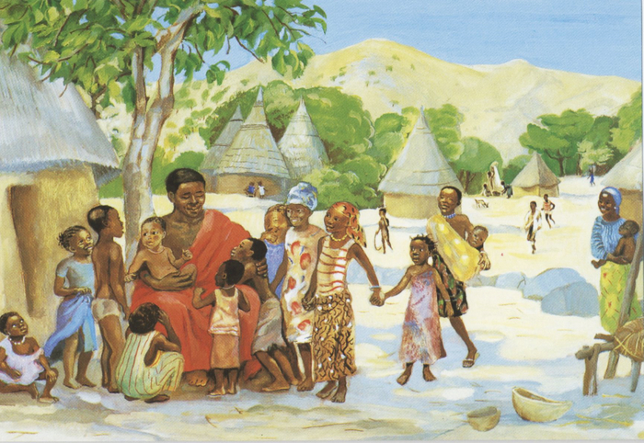
Jesus Welcomes the Children -- JESUS MAFA, Cameroon

Slide 14
… an angel of the Lord appeared to Joseph in a dream and said, "Get up, take the child and his mother, and flee to Egypt…”
Matthew 2:13b

Slide 15
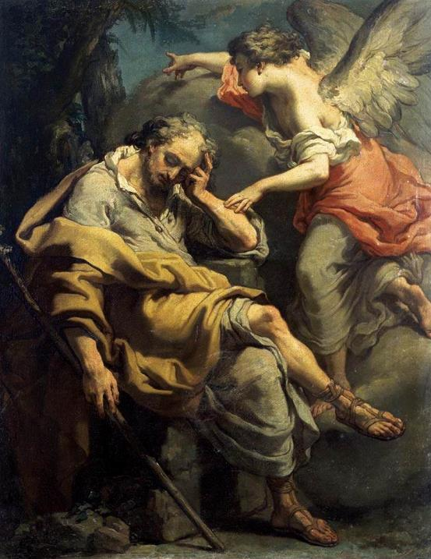
Joseph’s Dream
Gaetano Gandolfi

Slide 16
Herod… sent and killed all the children in and around Bethlehem who were two years old or under…
Matthew 2:16b

Slide 17
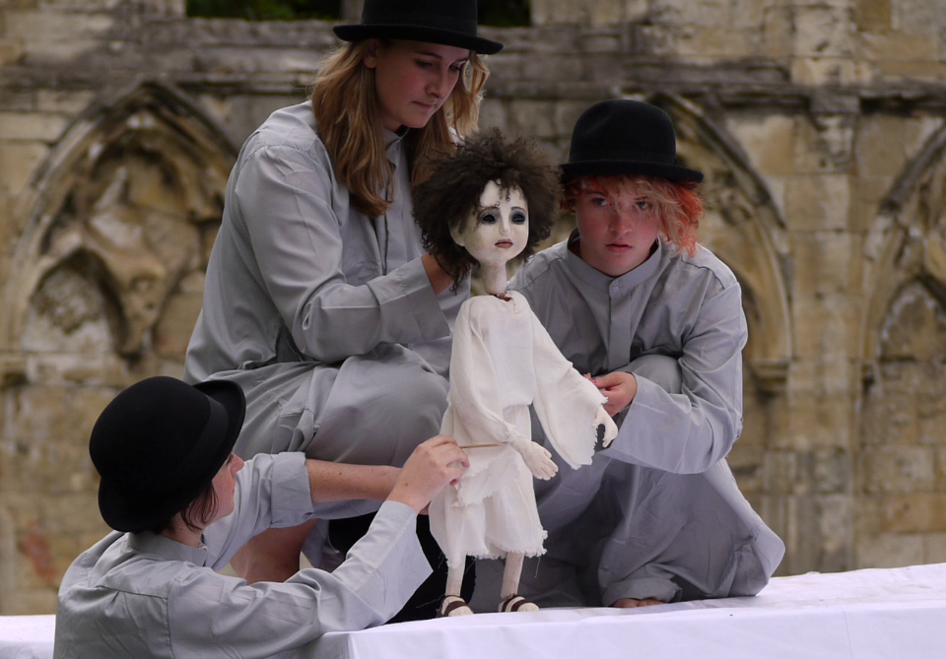
Massacre of the Innocents, a Mystery Play -- York Cathedral, York, England

Slide 18
"A voice was heard in Ramah, wailing and loud lamentation, Rachel weeping for her children; she refused to be consoled, because they are no more."
Matthew 2:18

Slide 19
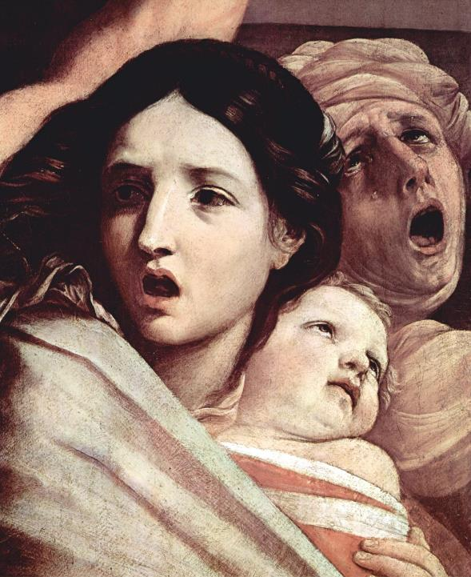
Massacre of the Innocents
Guido Reni
Pinacoteca Nazionale Bologna, Italy

Slide 20
"Get up, take the child and his mother, and go to the land of Israel, for those who were seeking the child's life are dead."
Matthew 2:20

Slide 21
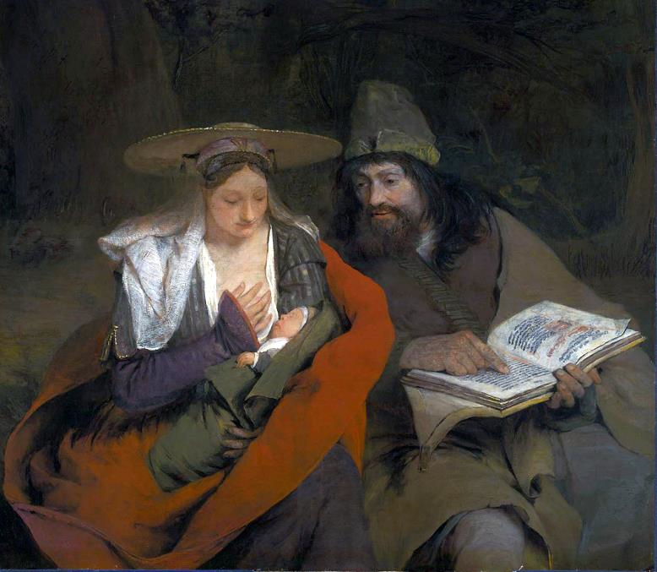
Rest on the Flight into Egypt -- Aert de Gelder, MFA, Boston

Slide 22
There he made his home in a town called Nazareth, so that what had been spoken through the prophets might be fulfilled, "He will be called a Nazorean."
Matthew 2:23

Slide 23
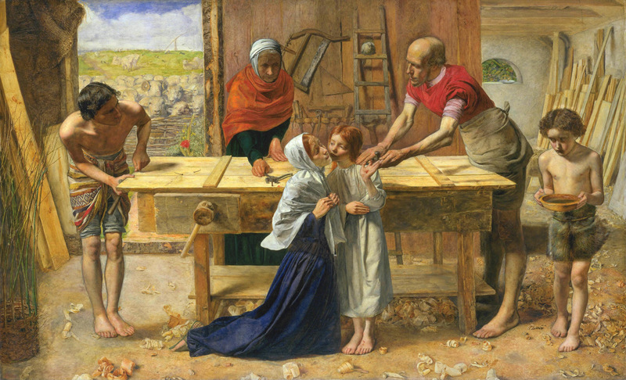
Christ in the House of His Parents -- John Everett Millais, Tate Britain, London

Slide 24
Credits
New Revised Standard Version Bible, copyright 1989, Division of Christian Education of the National Council of the Churches of Christ in the United States of America. Used by permission. All rights reserved.
Estate of John August Swanson, https://johnaugustswanson.com
Cara Hochhalter - The artist has granted permission for the non-commercial use of this image with attribution.
https://commons.wikimedia.org/wiki/File:Moran,_Edward_-_The_Valley_in_the_Sea_-_Google_Art_Project.jpg
https://commons.wikimedia.org/wiki/File:Johannes_Bronkhorst_-_Four_insects_-_Google_Art_Project.jpg
https://www.flickr.com/photos/seanbirm/31589314255 - Sean Birmingham
http://diglib.library.vanderbilt.edu/act-imagelink.pl?RC=48395
http://commons.wikimedia.org/wiki/File:'Joseph's_Dream',_painting_by_Gaetano_Gandolfi,_c._1790.jpg
https://www.flickr.com/photos/robbophotos/4810474650/
https://commons.wikimedia.org/wiki/File:Guido_Reni_-_Massacre_of_the_Innocents_detail2_-_Pinacoteca_Nazionale_Bologna.jpg
https://commons.wikimedia.org/wiki/File:The_Rest_on_The_Flight_into_Egypt_-_Arent_de_Gelder_-_Q20536897.jpg
http://commons.wikimedia.org/wiki/File:John_Everett_Millais_-_Christ_in_the_House_of_His_Parents_(%60The_Carpenter%27s_Shop%27)_-_Google_Art_Project.jpg
Additional descriptions can be found at the Art in the Christian Tradition image library, a service of the Vanderbilt Divinity Library, http://diglib.library.vanderbilt.edu/. All images available via Creative Commons 3.0 License.

