Slide 1
Fifth Sunday of Easter
Year A
Acts 7:55-60 • Psalm 31:1-5, 15-16 • 1 Peter 2:2-10
John 14:1-14

Slide 2
Then he knelt down and cried out in a loud voice, "Lord, do not hold this sin against them." When he had said this, he died.
Acts 7:60

Slide 3
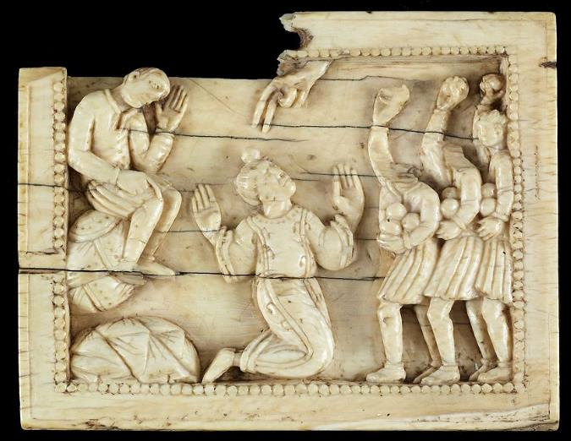
The Stoning of Stephen -- Mosan Workshop, Walters Art Museum, Baltimore, MD

Slide 4
Let your face shine upon your servant; save me in your steadfast love.
Psalm 31:16

Slide 5
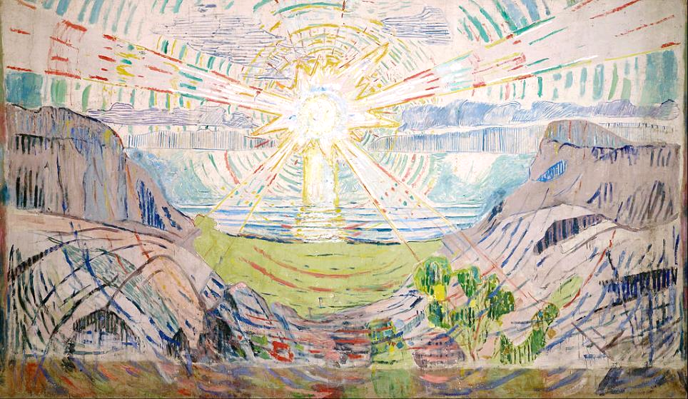
The Sun -- Edvard Munch, Munch Museum, Oslo, Norway

Slide 6
Like newborn infants, long for the pure, spiritual milk … indeed you have tasted that the Lord is good.
1 Peter 1:2a, 3

Slide 7
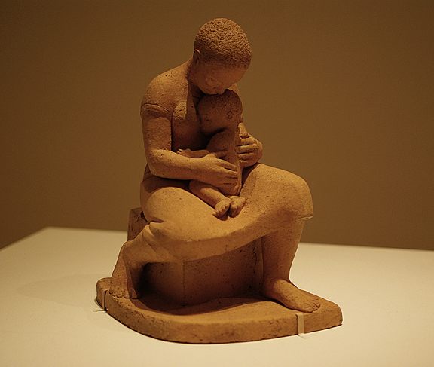
Mother and Child -- Elizabeth Catlett, Museum of Modern Art, New York

Slide 8
"The stone that the builders rejected has become the very head of the corner."
1 Peter 2:7b

Slide 9
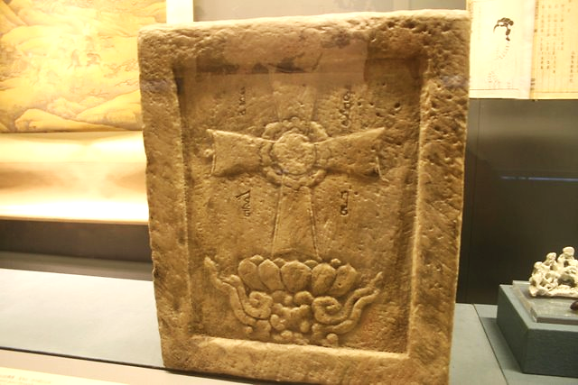
Nestorian Stone Cross from location of ancient monastery, Beijing, China, 1271-1368

Slide 10
"Do not let your hearts be troubled. Believe in God, believe also in me.”
John 14:1

Slide 11
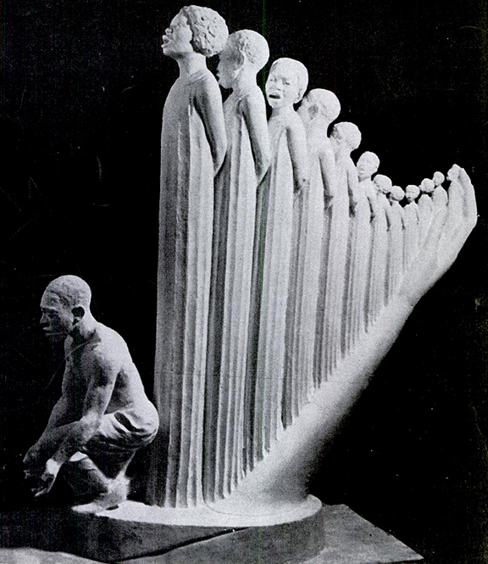
Lift Every Voice and Sing
Augusta Savage
1939 New York World’s Fair

Slide 12
“I will come again and will take you to myself, so that where I am, there you may be also.”
John 14:3b

Slide 13
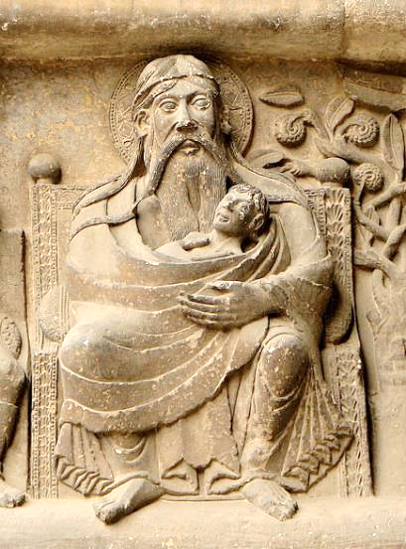
Abraham in Heaven, holding the soul of Lazarus
Abbey of St. Pierre Moissac, France

Slide 14
Thomas said to him, "Lord, we do not know where you are going. How can we know the way?"
John 14:5

Slide 15
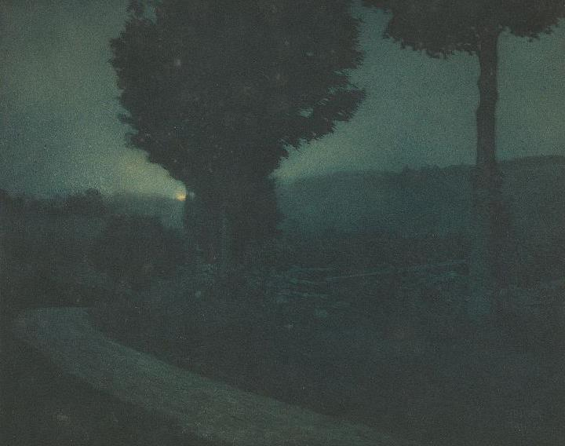
Road Into the Valley – Moonrise -- Edward Steichen, photo gravure

Slide 16
Jesus said to him, "I am the way, and the truth, and the life.”
John 14:6

Slide 17
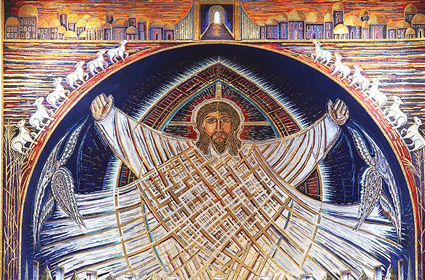
Christ in Glory -- Church of the Transfiguration, Community of Jesus, Orleans, MA

Slide 18
“If you know me, you will know my Father also.”
John 14:7

Slide 19
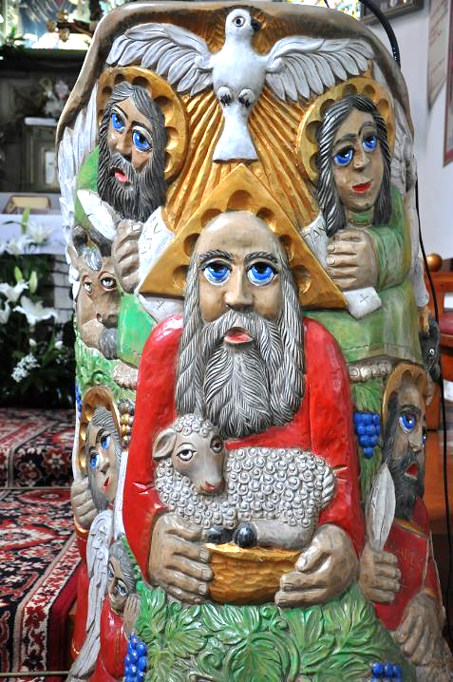
Holy Trinity
Church wood carving
Poland

Slide 20
Credits
New Revised Standard Version Bible, copyright 1989, Division of Christian Education of the National Council of the Churches of Christ in the United States of America. Used by permission. All rights reserved.
https://commons.wikimedia.org/wiki/File:Mosan_Workshop_-_The_Stoning_of_St_Stephen_-_Walters_71140_(2).jpg
https://commons.wikimedia.org/wiki/File:Edvard_Munch_-_The_Sun_-_Google_Art_Project.jpg
https://www.flickr.com/photos/sajith/7910599088/
https://commons.wikimedia.org/wiki/File:Yuan_stone_Nestorian_inscription_(rep).JPG
https://books.google.com/books?id=5VoEAAAAMBAJ&printsec=frontcover&dq=the+crisis+magazine+1939&hl=en&sa=X&ved=0ahUKEwiy8rT1_d_QAhVL8WMKHWw1AKA4ChDoAQgZMAA#v=onepage&q&f=false
http://www.flickr.com/photos/pelegrino/561258331/
https://commons.wikimedia.org/wiki/File:Edward_Steichen_(American)_-_(Road_into_the_Valley_--_Moonrise)_-_Google_Art_Project.jpg
https://commons.wikimedia.org/wiki/File:Apse_mosaic_Christ_in_Glory.jpg
http://www.flickr.com/photos/feargal/5096160543/
Additional descriptions can be found at the Art in the Christian Tradition image library, a service of the Vanderbilt Divinity Library, http://diglib.library.vanderbilt.edu/. All images available via Creative Commons 3.0 License.

