Slide 1
Fifth Sunday in Lent
Year A
Ezekiel 37:1-14
Psalm 130
Romans 8:6-11
John 11:1-45

Slide 2
The hand of the LORD came upon me … and set me down in the middle of a valley; it was full of bones.
Ezekiel 37:1a, 1c

Slide 3
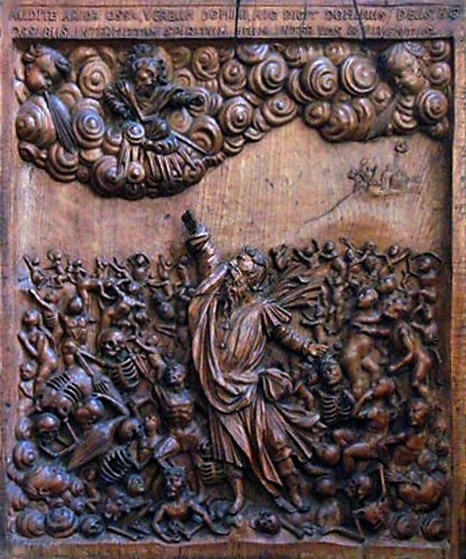
Ezekiel in Valley of Bones
St Nicholas Church
Deptford Green, England

Slide 4
Then he said to me, "Prophesy to these bones, and say to them: I will…cause flesh to come upon you…and put breath in you, and you shall live…”
Ezekiel 37:4a, 6a

Slide 5
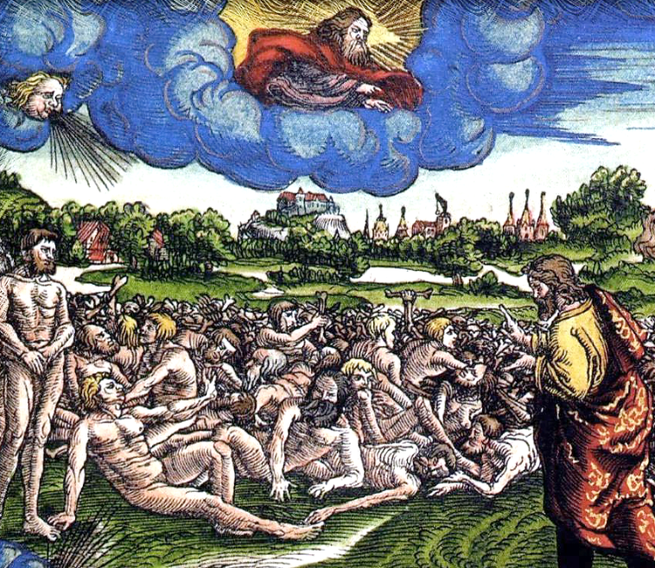
“You Shall Live”
The Luther Bible of 1534

Slide 6
Out of the depths I cry to you, O Lord. Lord, hear my voice!
Psalm 130:1, 2a

Slide 7
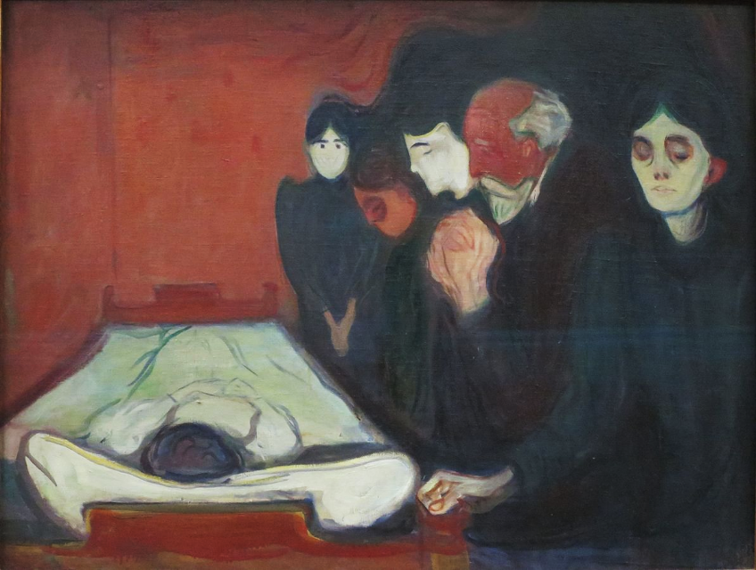
At the Deathbed -- Edvard Munch, Bergen Kunstmuseum, Bergen, Norway

Slide 8
he who raised Christ from the dead will give life to your mortal bodies also through his Spirit that dwells in you.
Romans 8:11b

Slide 9
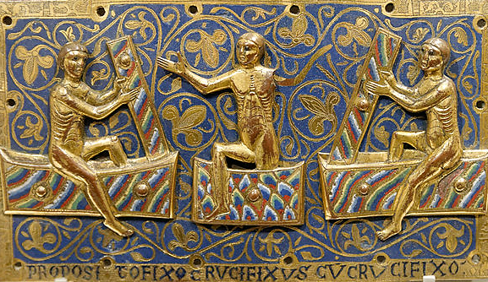
Resurrection of the Dead -- Limoges, Victoria and Albert Museum, London

Slide 10
Now a certain man was ill, Lazarus of Bethany, the village of Mary and her sister Martha.
John 11:1

Slide 11
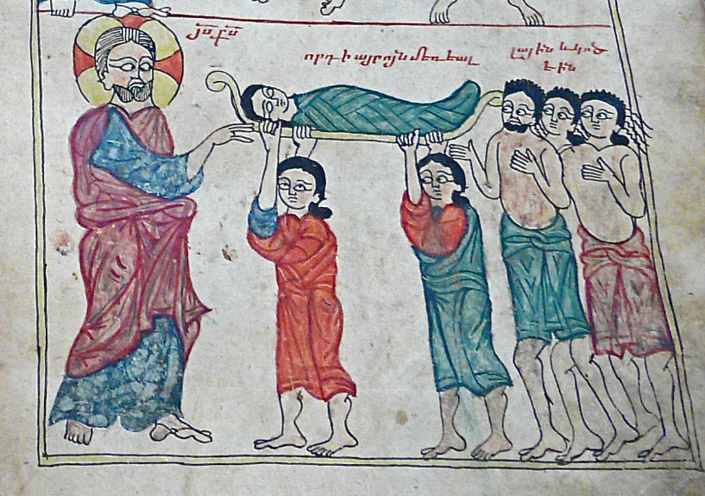
Gospel of Lazarus, 887 AD -- Mesrops Mashtots Institute of Ancient Manuscripts, Yerevan, Armenia

Slide 12
When Jesus arrived, he found that Lazarus had already been in the tomb four days.
John 11:17

Slide 13
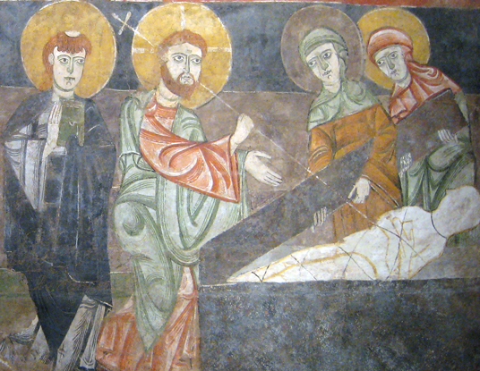
Raising of Lazarus -- Spanish, Cloisters Museum, New York City

Slide 14
Jesus said to her, "I am the resurrection and the life… Do you believe this?"
John 11:25

Slide 15
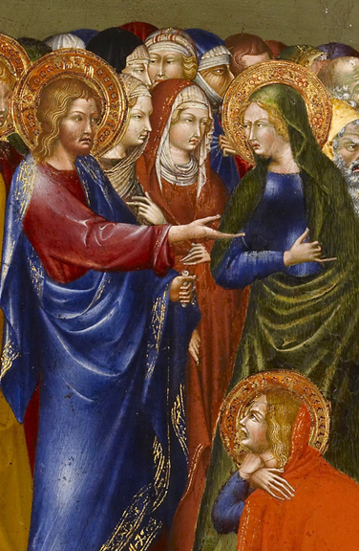
Raising of Lazarus
Giovanni di Paolo
Walters Art Museum, Baltimore, MD

Slide 16
She said to him, "Yes, Lord, I believe that you are the Messiah, the Son of God…"
John 11:27a

Slide 17
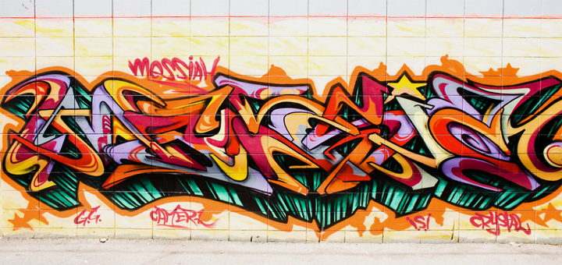
Messiah! -- Mural, San Jose, CA

Slide 18
When Jesus saw her weeping, and the Jews who came with her also weeping, he was greatly disturbed in spirit and deeply moved.
John 11:33

Slide 19
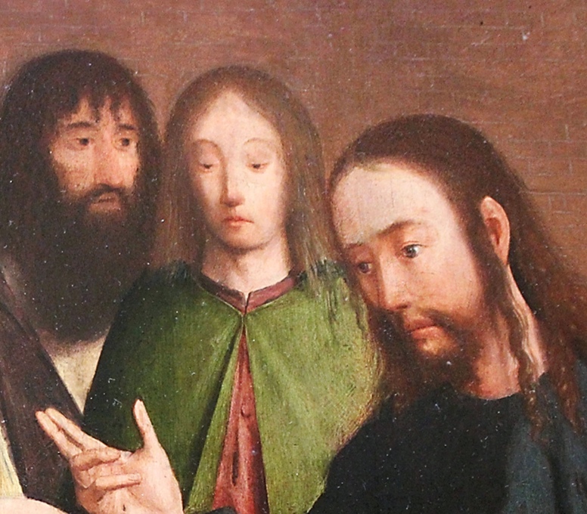
Resurrection of Lazarus, detail
Geertgen tot Sint Jans Louvre, Paris

Slide 20
Jesus said, "Take away the stone." Martha…said to him, "Lord, already there is a stench because he has been dead four days."
John 11:39

Slide 21
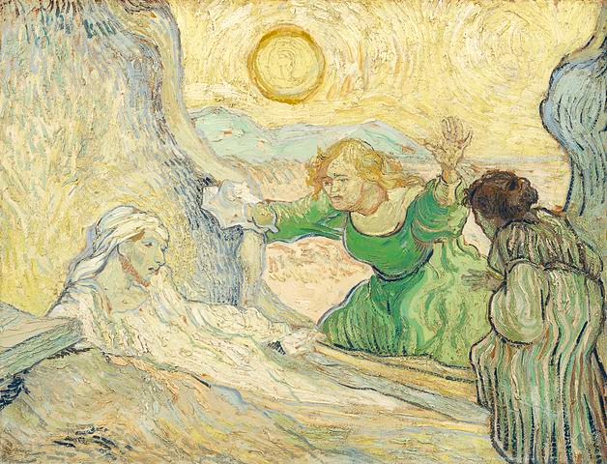
Resurrection of Lazarus -- Vincent van Gogh, Van Gogh Museum, Amsterdam

Slide 22
The dead man came out, his hands and feet bound with strips of cloth, and his face wrapped in a cloth. Jesus said to them, "Unbind him, and let him go."
John 11:44

Slide 23
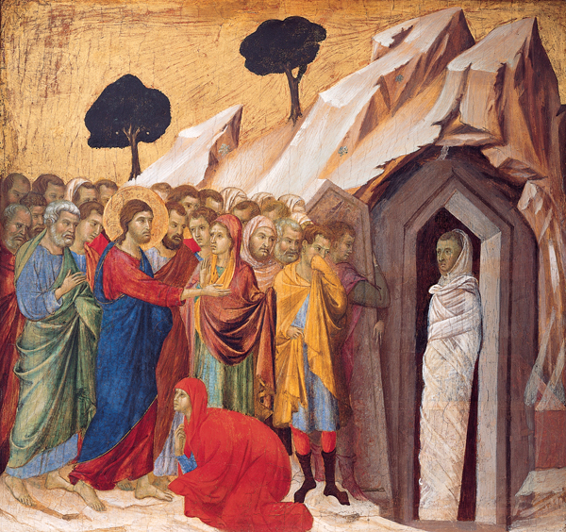
Raising of Lazarus
Duccio
Kimbell Art Museum
Fort Worth, TX

Slide 24
Credits
New Revised Standard Version Bible, copyright 1989, Division of Christian Education of the National Council of the Churches of Christ in the United States of America. Used by permission. All rights reserved.
http://commons.wikimedia.org/wiki/File:St._Nicholas%27_Church,_Deptford_Green,_SE8_-_carved_panel_representing_Ezekiel_in_the_Valley_of_the_Dry_Bones_-_geograph.org.uk_-_1501992.jpghttps://commons.wikimedia.org/wiki/File:Lutherbibel_1534_Hesekiel_37.jpg
https://commons.wikimedia.org/wiki/File:%27At_the_Deathbed%27_by_Edvard_Munch,_1895,_Bergen_Kunstmuseum.JPG
https://commons.wikimedia.org/wiki/File:Plaque_resurrection_dead_VandA_M.104-1945.jpg
https://www.flickr.com/photos/medmss/8510932740/
https://www.flickr.com/photos/artanonymous/3674205928/
https://www.flickr.com/photos/rietje/2882338471/ - Rita Willaert
https://www.flickr.com/photos/clairity/3220269616/ - Sharon Mollerus
https://commons.m.wikimedia.org/wiki/File:Giovanni_di_Paolo_-_The_Resurrection_of_Lazarus_-_Walters_37489A.jpg
https://www.flickr.com/photos/thomashawk/4834469760/ - Thomas Hawk
https://commons.wikimedia.org/wiki/File:Geertgen_Louvre_02.JPG
https://commons.wikimedia.org/wiki/File:De_opwekking_van_Lazarus_(naar_Rembrandt)_-_s0169V1962_-_Van_Gogh_Museum.jpg
https://commons.wikimedia.org/wiki/File:%27The_Raising_of_Lazarus%27,_tempera_and_gold_on_panel_by_Duccio_di_Buoninsegna,_1310%E2%80%9311,_Kimbell_Art_Museum.jpg
Additional descriptions can be found at the Art in the Christian Tradition image library, a service of the Vanderbilt Divinity Library, http://diglib.library.vanderbilt.edu/. All images available via Creative Commons 3.0 License.

