Slide 1
Fifth Sunday after Epiphany
Year A
Isaiah 58:1-9a (9b-12) • Psalm 112:1-9 (10)
1 Corinthians 2:1-12 (13-16) • Matthew 5:13-20

Slide 2
…the fast that I choose:
to loose the bonds of injustice…
Isaiah 58:6a

Slide 3
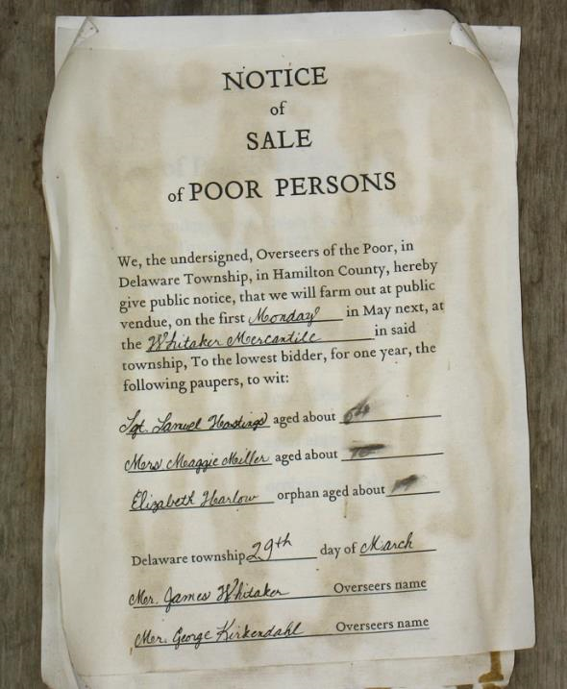
Notice of Sale of Poor Persons
Mid-19th c. handbill from Prairietown
Butler, OH

Slide 4
…to let the oppressed go free..
Isaiah 58:6b

Slide 5
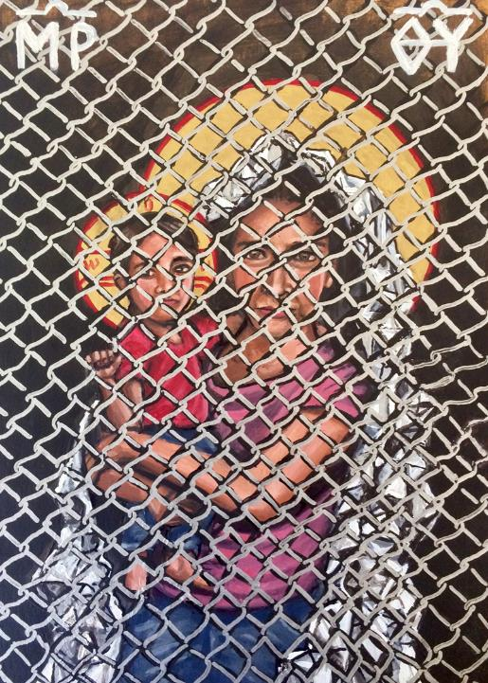
Mother of God: Protectress of the Oppressed
Kelly Latimore
St. Louis, MO

Slide 6
…to share your bread with the hungry…
Isaiah 58:7a

Slide 7
Words Can’t Feed the Hungry
Michal Pawlicki

Slide 8
and bring the homeless poor into your house…
Isaiah 58:7b

Slide 9
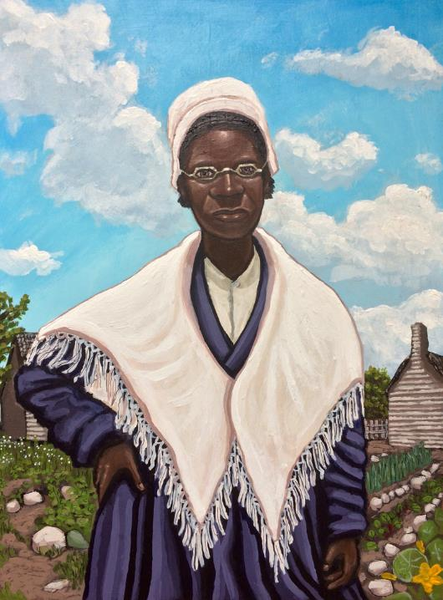
Sojourner Truth
Kelly Latimore

Slide 10
The LORD will guide you continually…
and you shall be like a watered garden…
Isaiah 58:11

Slide 11
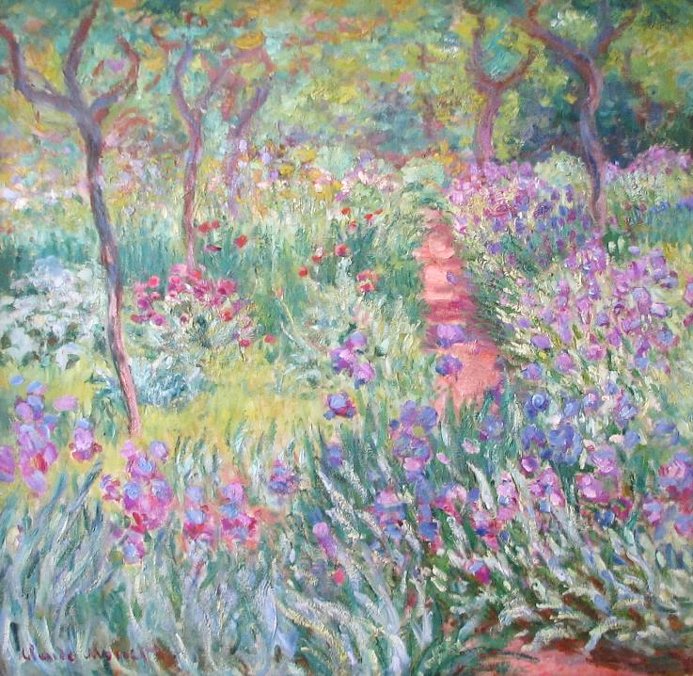
Artist’s Garden at Giverny
Claude Monet
Yale Univ. Art Gallery

Slide 12
It is well with those who deal generously and lend, who conduct their affairs with justice.
Psalm 112:5

Slide 13
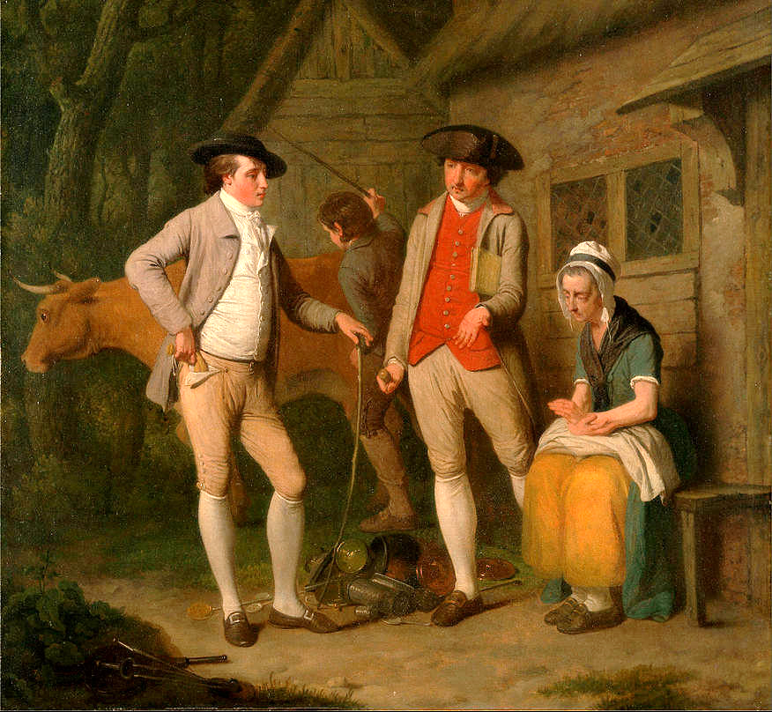
Widow Costard's Cow, redeemed by the generosity of Johnny Pearmain
Edward Penny
Yale Center for British Art

Slide 14
these things God has revealed to us through the Spirit…
1 Corinthians 2:10a

Slide 15
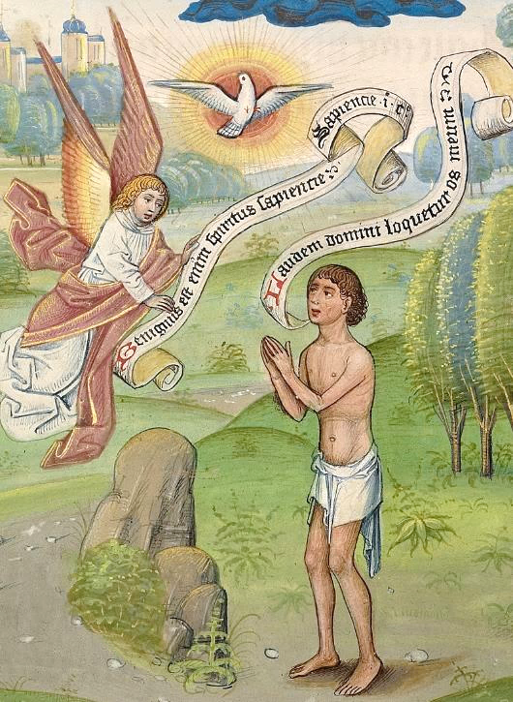
Man Praying to the Holy Spirit
Guillaume Vrelant
J. Paul Getty Museum, Los Angeles

Slide 16
…so that we may understand the gifts bestowed on us by God.
1 Corinthians 2:12b

Slide 17
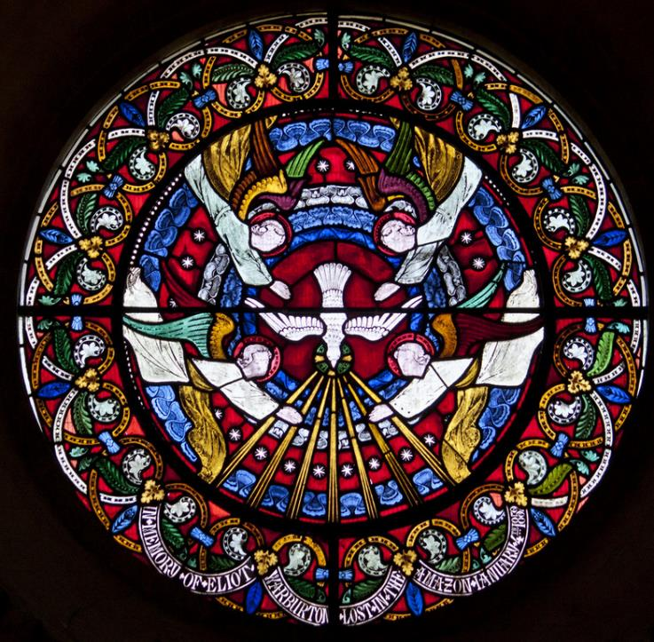
The Spirit with Sevenfold Gifts
St. Mary’s Iffley
Oxford, England

Slide 18
“You are the salt of the earth…”
Matthew 5:13a

Slide 19
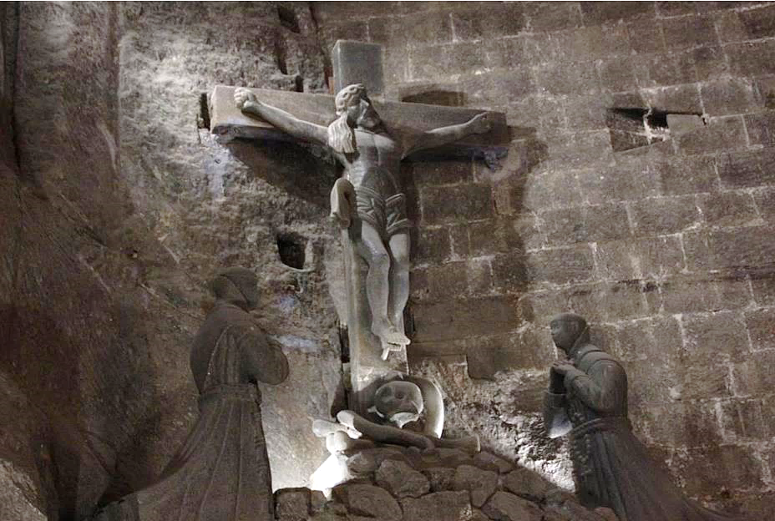
Christ on the Cross – a sculpture in rock salt -- Jozef Markowski, Wieliczka Salt Mine, Poland

Slide 20
“You are the light of the world.
A city built on a hill cannot be hid.”
Matthew 5:14

Slide 21
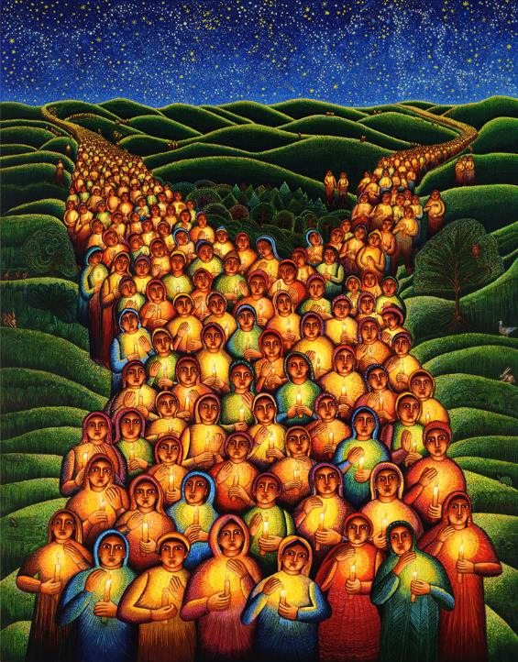
Festival of Lights
John August Swanson

Slide 22
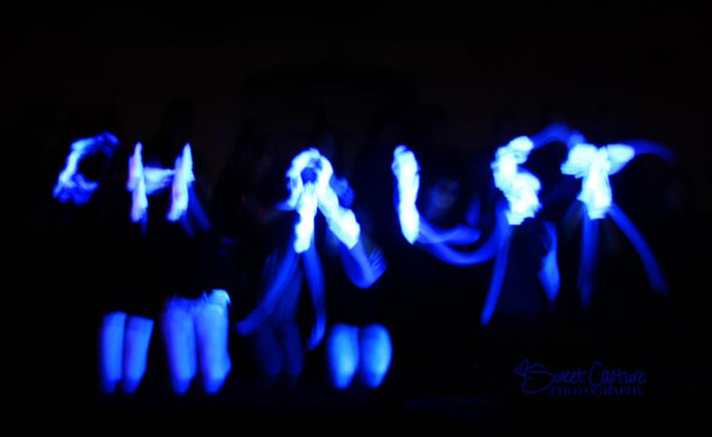
Light of the World -- Presentation by church youth with gloves in dark space

Slide 23
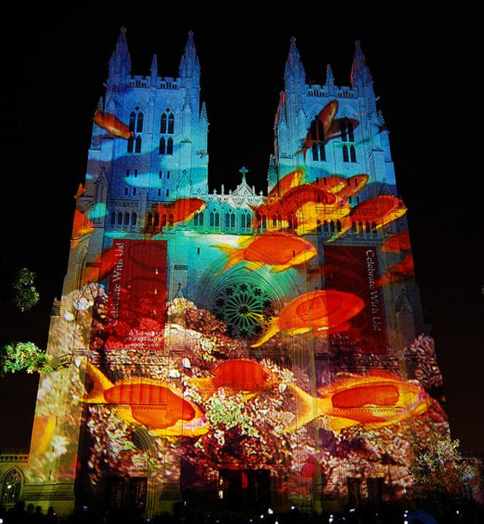
Light on the Cathedral
Gerry Hofstetter
Washington Cathedral Washington, DC

Slide 24
“No one after lighting a lamp puts it under the bushel basket, but on the lampstand…”
Matthew 5:15a

Slide 25
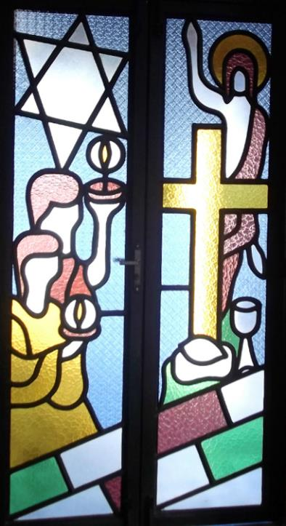
Saint Anthony Convent
Caninde, Brazil

Slide 26
“…let your light shine before others, so that they may see your good works and give glory to your Father in heaven.”
Matthew 5:16

Slide 27
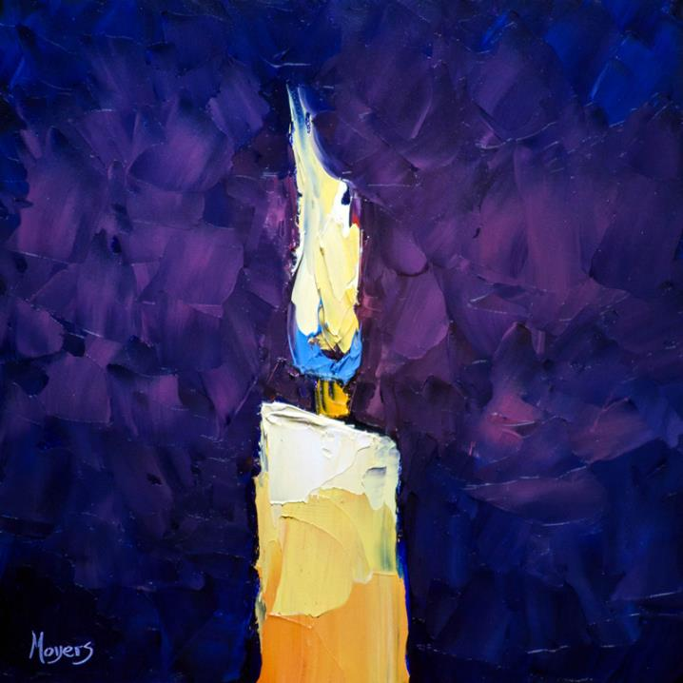
Shine -
A reminder for us to be the Light of the World
Mike Moyers

Slide 28
Credits
New Revised Standard Version Bible, copyright 1989, Division of Christian Education of the National Council of the Churches of Christ in the United States of America. Used by permission. All rights reserved.
http://diglib.library.vanderbilt.edu/act-imagelink.pl?RC=54203 – Craig Stephen
https://kellylatimoreicons.com/contact/
http://www.flickr.com/photos/undpeuropeandcis/5269051224/
https://kellylatimoreicons.com/contact/
https://commons.wikimedia.org/wiki/File:The_Artist%27s_Garden_at_Giverny_by_Claude_Monet_1900.jpeg
http://commons.wikimedia.org/wiki/File:Edward_Penny_-_Widow_Costard%27s_cow_and_goods,_distrained_for_taxes,_are_redeemed_by_the_generosity_of_Johnny_Pearma..._-_Google_Art_Project.jpg
https://commons.wikimedia.org/wiki/File:Willem_Vrelant_(Flemish,_died_1481,_active_1454_-_1481)_-_A_Man_Praying_to_the_Holy_Spirit_-_Google_Art_Project.jpg
http://www.flickr.com/photos/paullew/5827717752/ - Lawrence OP
https://commons.wikimedia.org/wiki/File:Christ_on_the_Cross_(3869589690).jpg
www.JohnAugustSwanson.com - copyright 2000 by John August Swanson
http://www.flickr.com/photos/cuonhigh/3398636812/
http://www.flickr.com/photos/prsphoto/3035138704/
http://commons.wikimedia.org/wiki/File:Saint_Anthony_Convent,_Canind%C3%A9,_Cear%C3%A1,_Brazil_(Franciscans)_-_Eucharistic_Chapel_03.JPG?uselang=enlamps%20museum – Eugenio Hansen
Mike Moyers, https://www.mikemoyersfineart.com/
Additional descriptions can be found at the Art in the Christian Tradition image library, a service of the Vanderbilt Divinity Library, http://diglib.library.vanderbilt.edu/. All images available via Creative Commons 3.0 License.

