Slide 1
Epiphany of the Lord
Year A
Isaiah 60:1-6
Psalm 72:1-7, 10-14
Ephesians 3:1-12
Matthew 2:1-12

Slide 2
A multitude of camels shall cover you, the young camels of Midian and Ephah… They shall bring gold and frankincense, and shall proclaim the praise of the LORD.
Isaiah 60:6

Slide 3
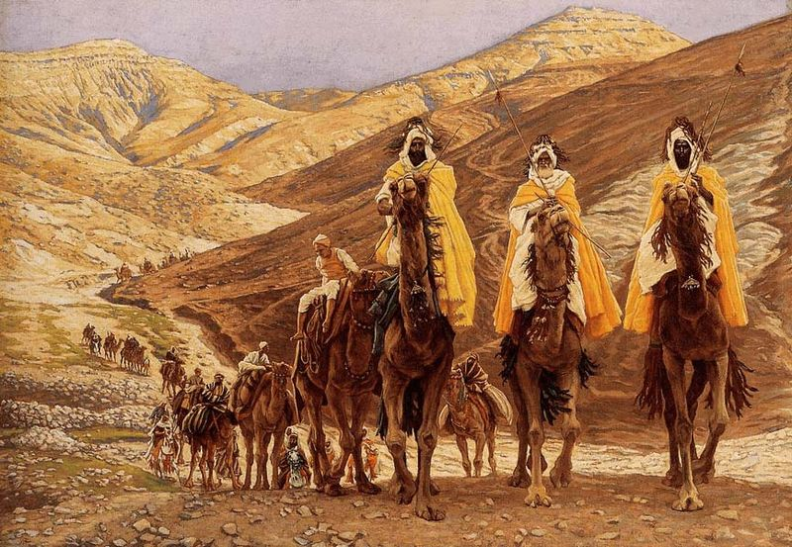
Journey of the Magi -- James Tissot, Minneapolis Institute of Art

Slide 4
May all kings fall down before him, all nations give him service.
Psalm 72:11

Slide 5
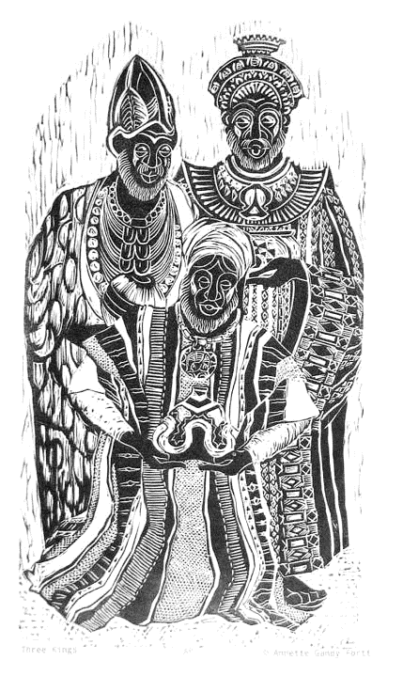
Three Kings
Annette Gandy Fortt
Silver Spring, MD

Slide 6
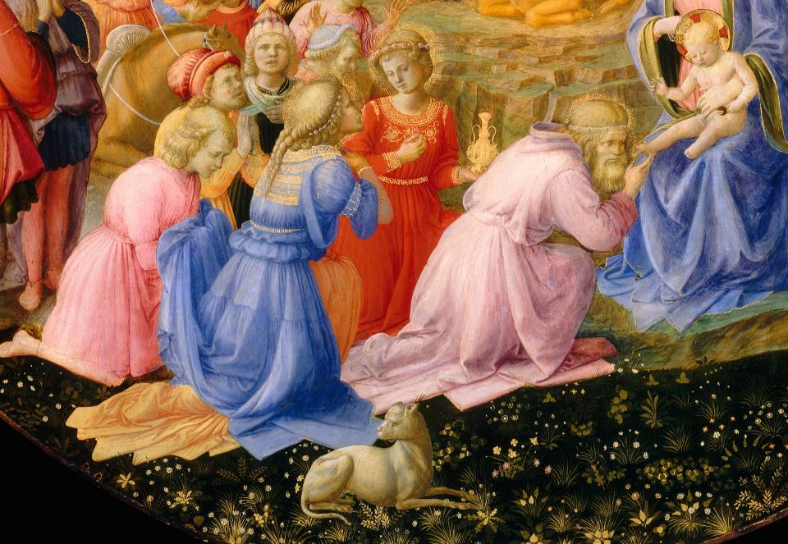
Adoration of the Magi -- Fra Angelico and Filippo Lippi, National Gallery of Art, Washington, DC

Slide 7
This is the reason that I Paul am a prisoner for Christ Jesus for the sake of you Gentiles--
Ephesians 3:1

Slide 8
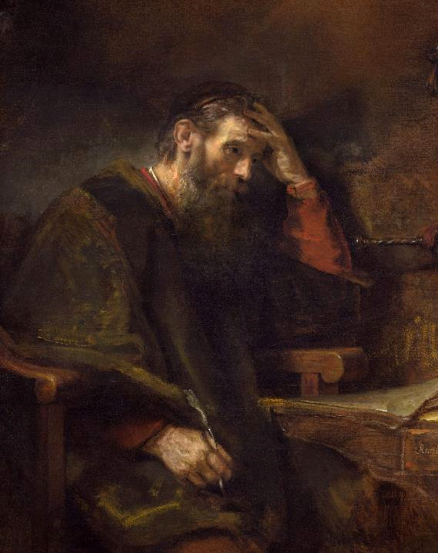
The Apostle Paul
Rembrandt
National Gallery of Art Washington, DC

Slide 9
In the time of King Herod, after Jesus was born in Bethlehem of Judea, wise men from the East came to Jerusalem…
Matthew 2:1

Slide 10
…asking, "Where is the child who has been born king of the Jews? For we observed his star at its rising, and have come to pay him homage."
Matthew 2:2

Slide 11
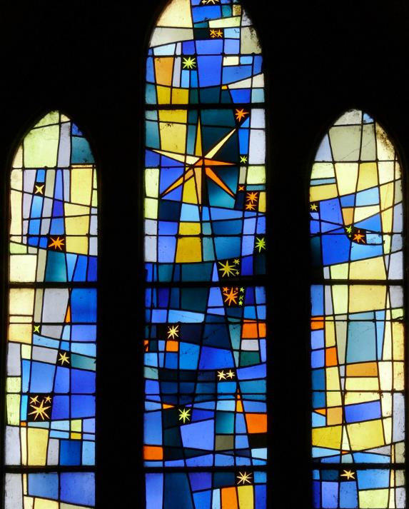
Heavenly Star
Chapelle Notre Dame de Grace
Villeneuve-sur-Lot, France

Slide 12
When King Herod heard this, he was frightened, and all Jerusalem with him …
Matthew 2:3

Slide 13
and calling together all the chief priests and scribes of the people, he inquired of them where the Messiah was to be born.
Matthew 2:4

Slide 14
They told him, "In Bethlehem of Judea; for so it has been written by the prophet:
Matthew 2:5

Slide 15
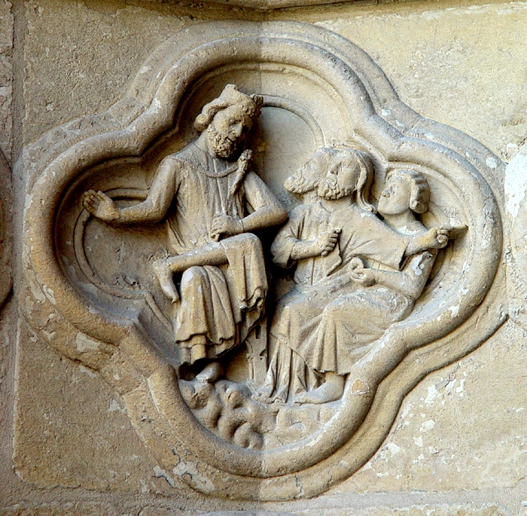
Herod Questions Chief Priests and Scribe
Amiens Cathedral
Amiens, France

Slide 16
Then Herod secretly called for the wise men and learned from them the exact time when the star had appeared.
Matthew 2:7

Slide 17
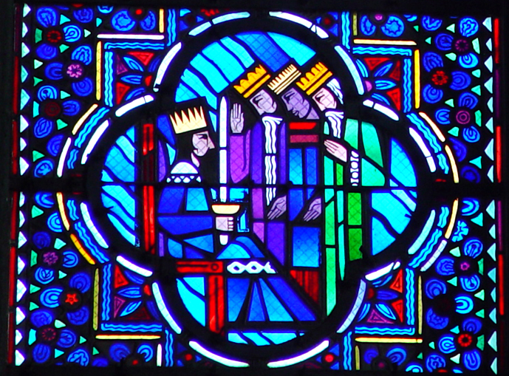
Wise Men Visit Herod -- Le Breton/Gaudin, Amiens Cathedral

Slide 18
Then he sent them to Bethlehem, saying, "Go and search diligently for the child; and when you have found him, bring me word so that I may also go and pay him homage."
Matthew 2:8

Slide 19
When they had heard the king, they set out; and there, ahead of them, went the star that they had seen at its rising, until it stopped over the place where the child was.
Matthew 2:9

Slide 20
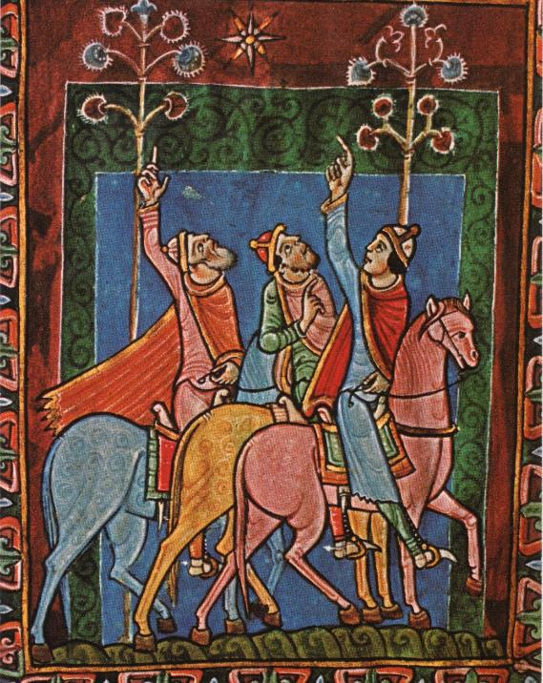
Three Magi Following the Star
St. Alban’s Psalter
University of Aberdeen, Scotland

Slide 21
When they saw that the star had stopped, they were overwhelmed with joy.
Matthew 2:10

Slide 22
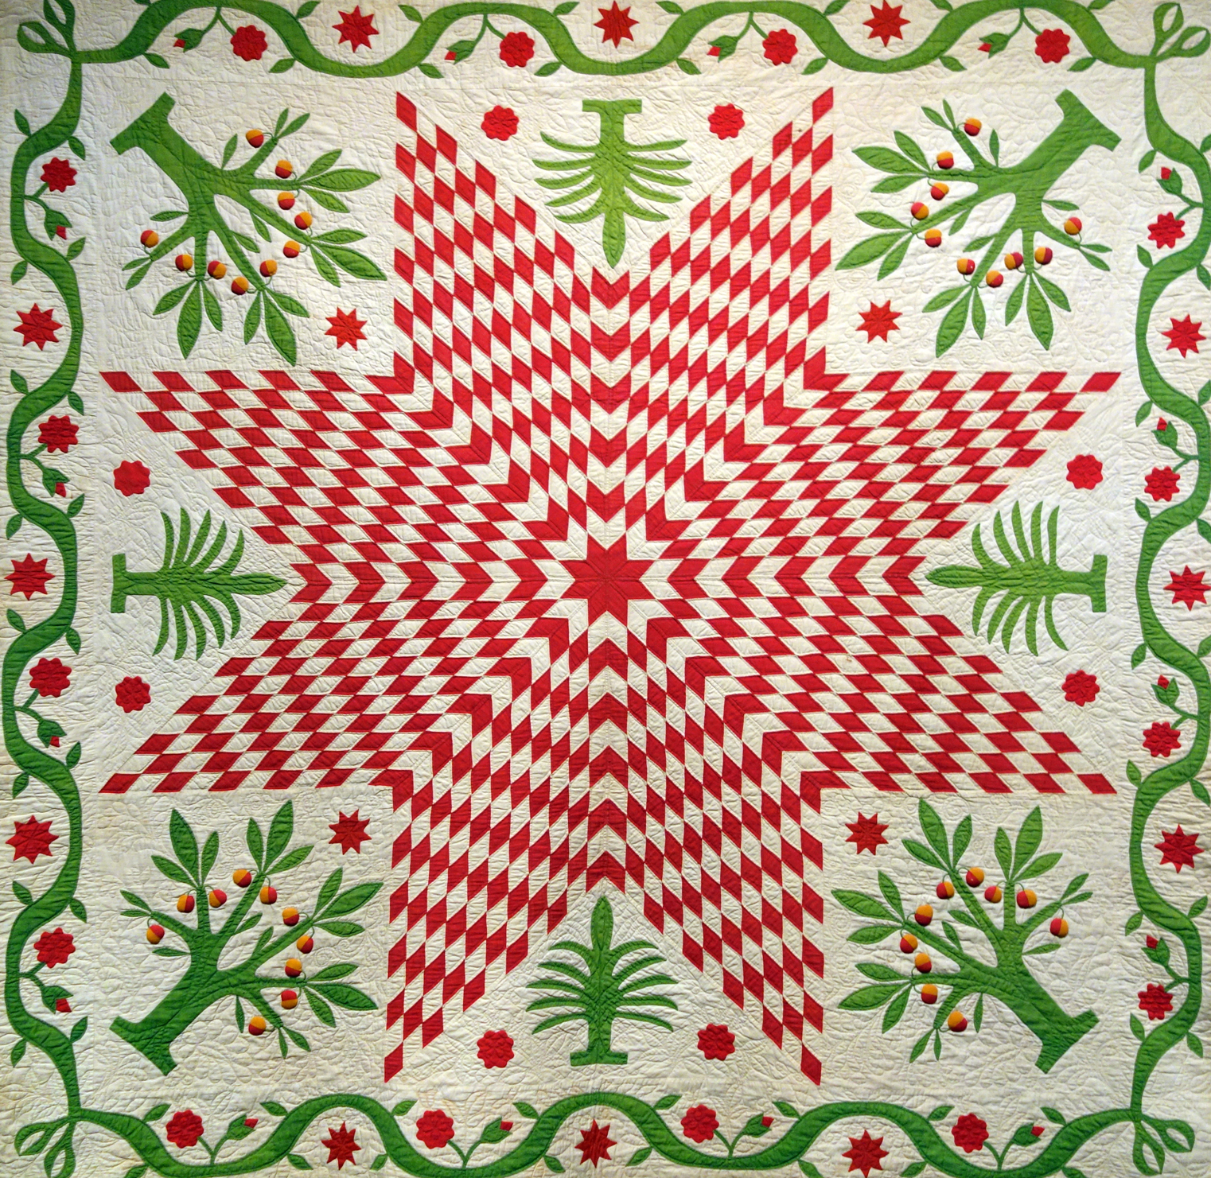
Star of Bethlehem Quilt
Museum of Fine Arts
Boston, MA

Slide 23
On entering the house, they saw the child with Mary his mother; and they knelt down and paid him homage.
Matthew 2:11a

Slide 24
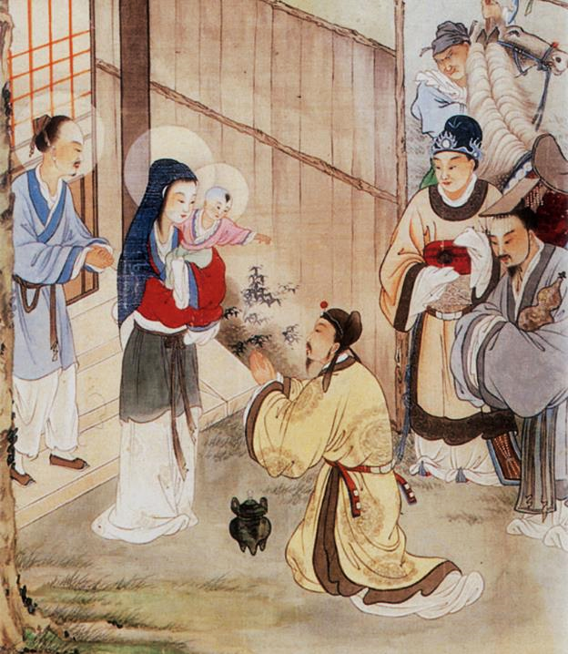
Three Wise Men Visit the Baby Jesus
Chinese Painting

Slide 25
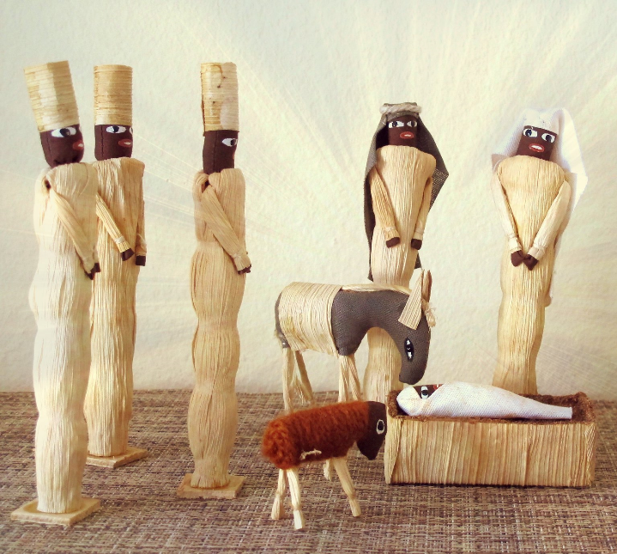
Krismasi Njema! -- Kenyan Nativity

Slide 26
Credits
New Revised Standard Version Bible, copyright 1989, Division of Christian Education of the National Council of the Churches of Christ in the United States of America. Used by permission. All rights reserved.
https://commons.wikimedia.org/wiki/File:Magi_tissot.jpg
annettefortt.com
https://commons.wikimedia.org/wiki/File:Fra_Angelico_Adoration.jpg
https://commons.wikimedia.org/wiki/File:Saint_Paul,_Rembrandt_van_Rijn_(and_Workshop%3F),_c._1657.jpg
http://commons.wikimedia.org/wiki/File:Villeneuve-sur-Lot_-_Chapelle_du_Bout-du-Pont_-090.jpg
http://diglib.library.vanderbilt.edu/act-imagelink.pl?RC=29210
https://diglib.library.vanderbilt.edu/act-imagelink.pl?RC=29380
https://commons.wikimedia.org/wiki/File:Albanipsalter_DreiKoenige.jpg
https://commons.wikimedia.org/wiki/File:Star_of_Bethlehem_with_Pomegranate_Trees,_New_York,_c._1850_-_Museum_of_Fine_Arts,_Boston_-_DSC02710.JPG
http://www.flickr.com/photos/olaer/56844310/
https://www.flickr.com/photos/75885098@N05/45457546285
Additional descriptions can be found at the Art in the Christian Tradition image library, a service of the Vanderbilt Divinity Library, http://diglib.library.vanderbilt.edu/. All images available via Creative Commons 3.0 License.

