Slide 1
Eighth Sunday after Epiphany
Year A
Isaiah 49:8-16a
Psalm 131
1 Corinthians 4:1-5
Matthew 6:24-34

Slide 2
Can a woman forget her nursing child, or show no compassion for the child of her womb?
Isaiah 49:15a

Slide 3
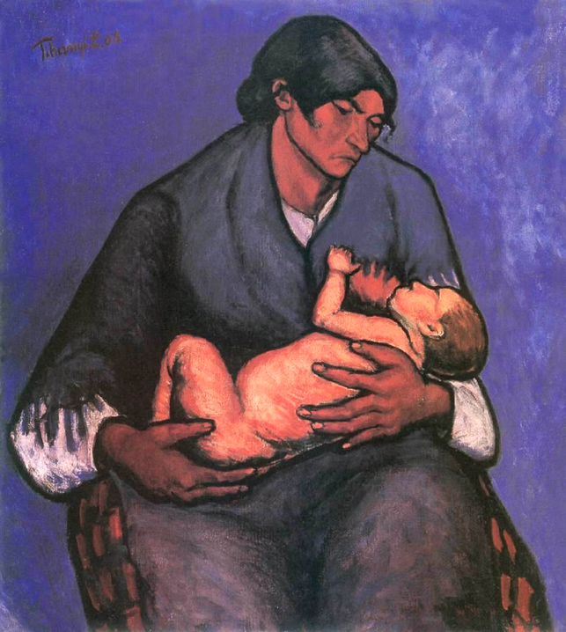
Gipsy Woman with Child
Lajos Tihanyi, Modern Hungarian Gallery, Pecs, Hungary

Slide 4
…yet I will not forget you. See, I have inscribed you on the palms of my hands.
Isaiah 49:15b, 16a

Slide 5
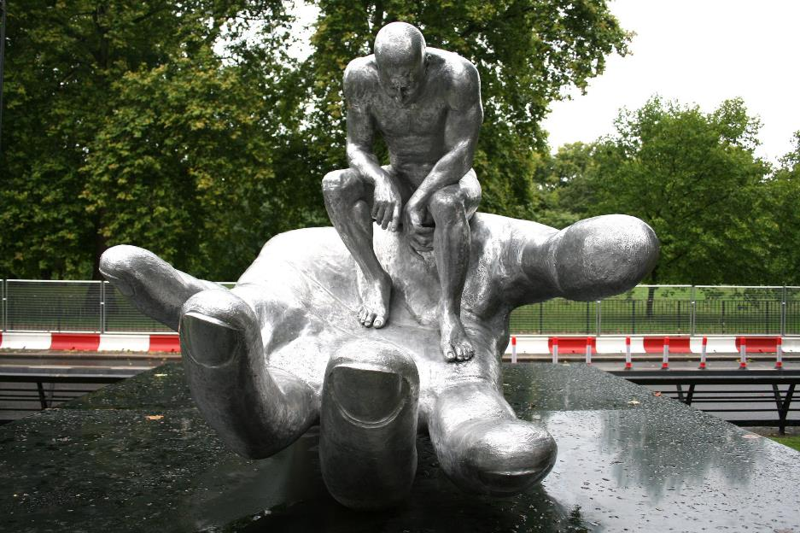
Hand of God -- Lorenzo Quinn, Royal Exchange, London, UK

Slide 6
I have calmed and quieted my soul, like a weaned child with its mother; my soul is like the weaned child that is with me.
Psalm 131:2

Slide 7
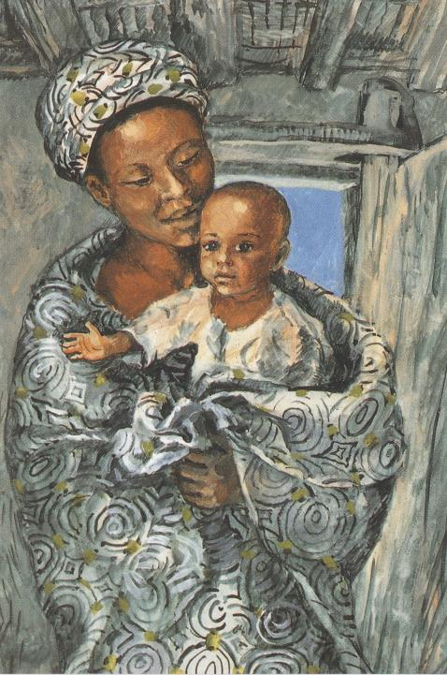
Mary and the Child Jesus
Jesus MAFA
Cameroon

Slide 8
Think of us in this way, as servants of Christ and stewards of God's mysteries.
1 Corinthians 4:1-5

Slide 9
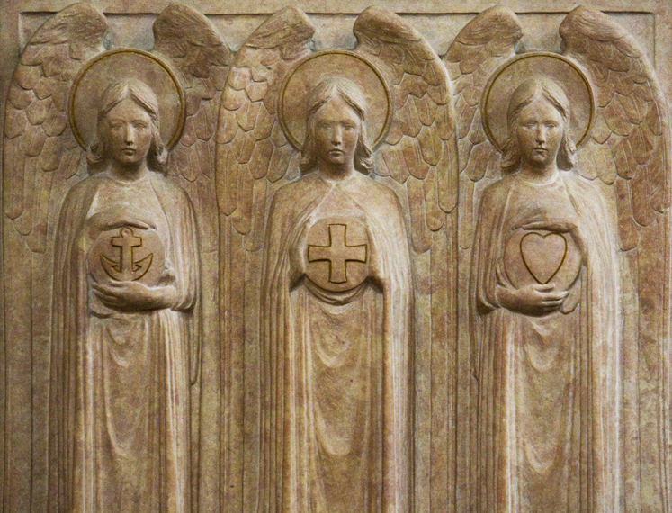
Faith, Hope, Charity -- St. Giles Cathedral, Edinburgh, Scotland

Slide 10
"No one can serve two masters; …You cannot serve God and wealth.”
Matthew 6:24a, 24c

Slide 11
A Choice -- Lauren Wright Pittman

Slide 12
“…do not worry about your life, what you will eat or what you will drink, or about your body, what you will wear.
Matthew 6:25a

Slide 13
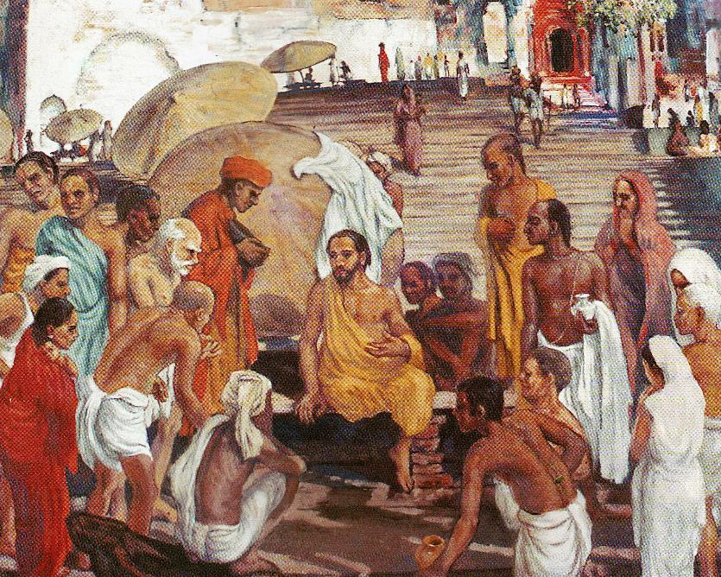
Jesus in Benares -- Frank Wesley

Slide 14
“Is not life more than food, and the body more than clothing?”
Matthew 6:25b

Slide 15
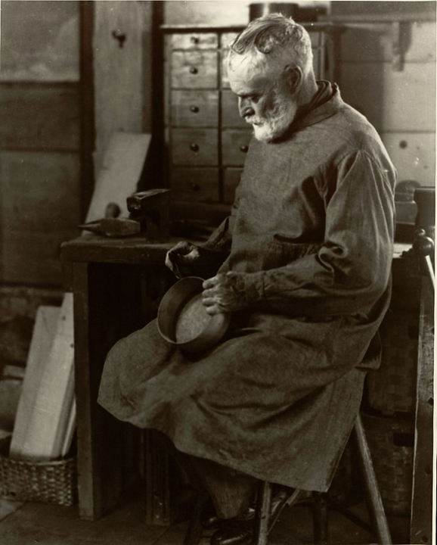
Shaker Box Maker
Samuel Kravitt
Library of Congress, Washington, DC

Slide 16
“Look at the birds of the air; they neither sow nor reap nor gather into barns, and yet your heavenly Father feeds them.”
Matthew 6:26a

Slide 17
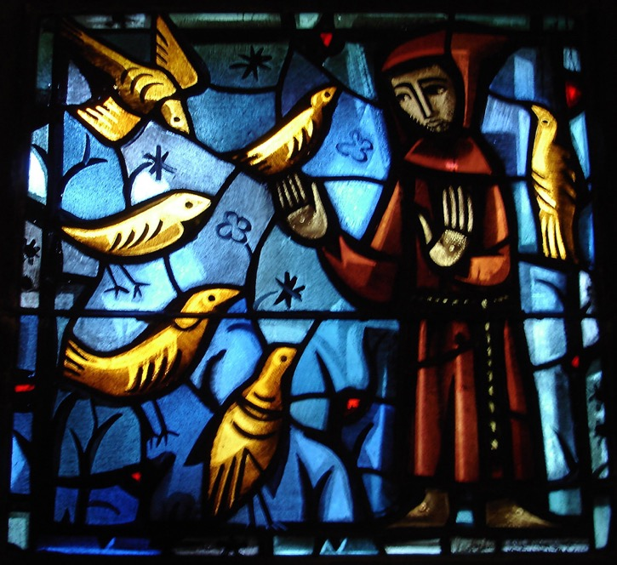
St. Francis with Birds
Brother Eric
Church of the Reconciliation, Taize, France

Slide 18
“Consider the lilies of the field, how they grow; they neither toil nor spin… even Solomon in all his glory was not clothed like one of these.”
Matthew 6:28b, 29

Slide 19
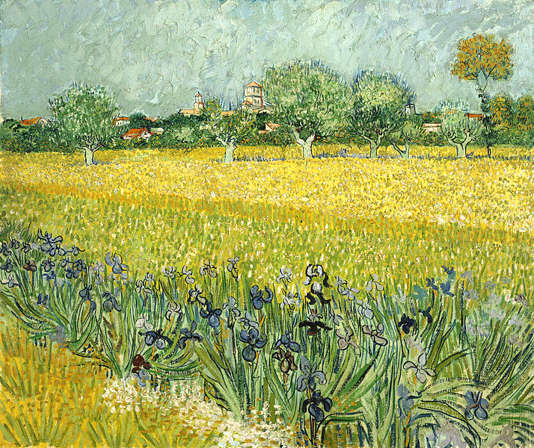
Field With Flowers Near Arles -- Vincent Van Gogh, Van Gogh Museum, Amsterdam

Slide 20
Credits
New Revised Standard Version Bible, copyright 1989, Division of Christian Education of the National Council of the Churches of Christ in the United States of America. Used by permission. All rights reserved.
http://commons.wikimedia.org/wiki/File:Tihanyi_Gipsy_Woman_with_Child.jpg
https://www.flickr.com/photos/korephotos/6350476010
http://www.librairie-emmanuel.fr (contact page: https://www.librairie-emmanuel.fr/contact)
http://www.flickr.com/photos/paullew/5709533172/
Lauren Wright Pittman, http://www.lewpstudio.com/
Estate of Frank Wesley, http://www.frankwesleyart.com/main_page.htm
https://commons.wikimedia.org/wiki/File:Shaker_box_maker.jpg
http://www.flickr.com/photos/swperman/221008978/
https://commons.wikimedia.org/wiki/File:Vincent_van_Gogh_-_Veld_met_bloemen_bij_Arles_-_Google_Art_Project.jpg
Additional descriptions can be found at the Art in the Christian Tradition image library, a service of the Vanderbilt Divinity Library, http://diglib.library.vanderbilt.edu/. All images available via Creative Commons 3.0 License.

