Slide 1
Day of Pentecost
Year A
Acts 2:1-21 or Numbers 11:24-30 • Psalm 104:24-34, 35b
1 Corinthians 12:3b-13 or Acts 2:1-21
John 20:19-23 or John 7:37-39

Slide 2
When the day of Pentecost had come, they were all together in one place.
Acts 2:1

Slide 3
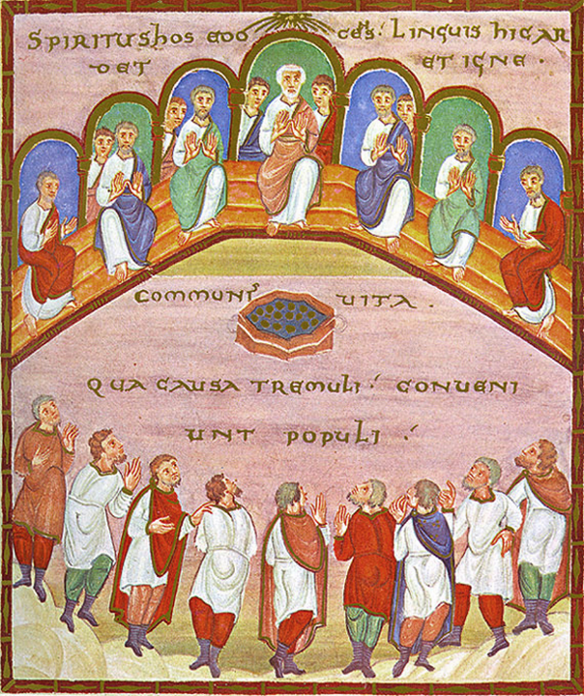
The Spirit as Wind, Pentecost
Codex Egberti
Late 10th century
Trier, Germany

Slide 4
And suddenly from heaven there came a sound like the rush of a violent wind, and it filled the entire house where they were sitting.
Acts 2:2

Slide 5
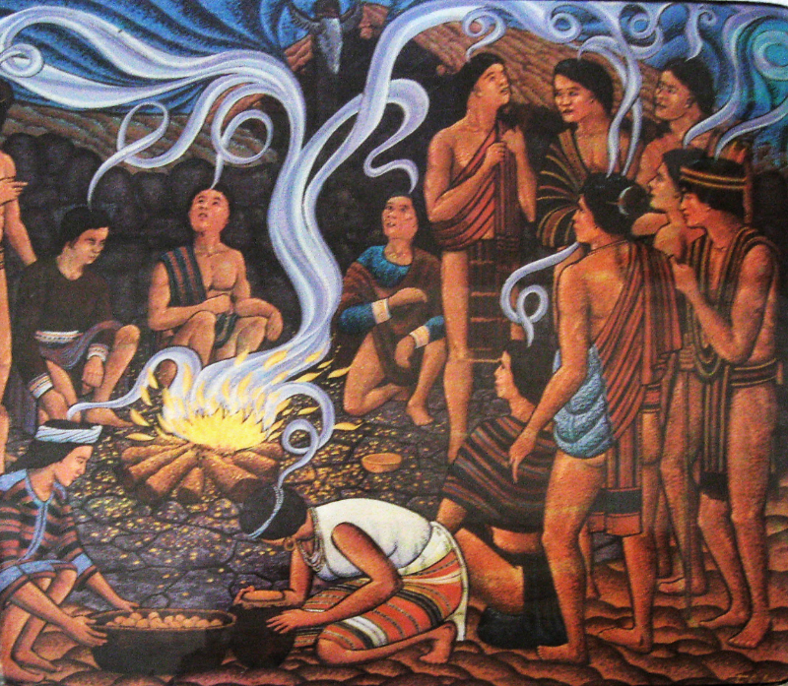
Pentecost
Bontoc Museum
Bontoc, Philippines

Slide 6
Divided tongues, as of fire, appeared among them, and a tongue rested on each of them.
Acts 2:3

Slide 7
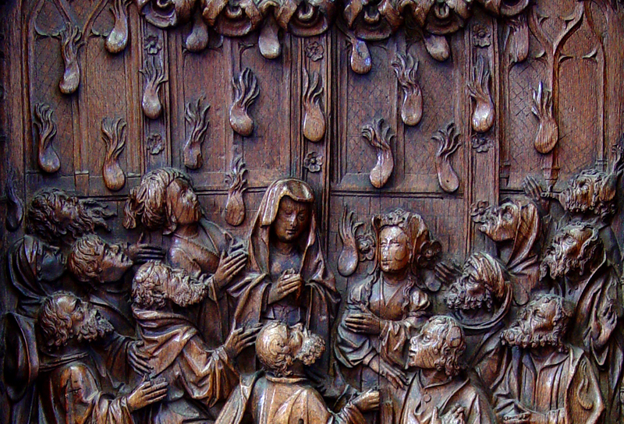
Pentecost -- Early 16th century Choirstall, Amiens Cathedral, Amiens, France

Slide 8
All of them were filled with the Holy Spirit and began to speak in other languages, as the Spirit gave them ability.
Acts 2:4

Slide 9
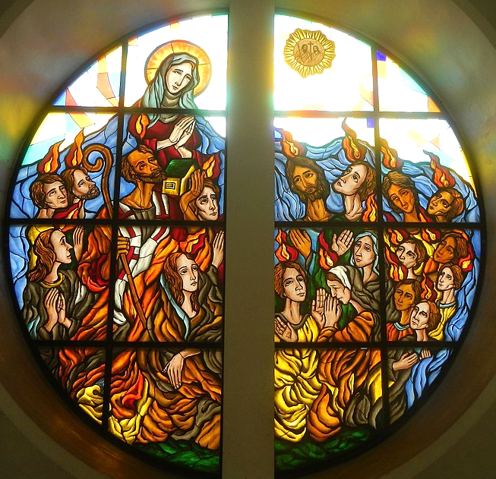
Pentecost
Our Lady of Pentecost Catholic Church
Quezon City, Philippines

Slide 10
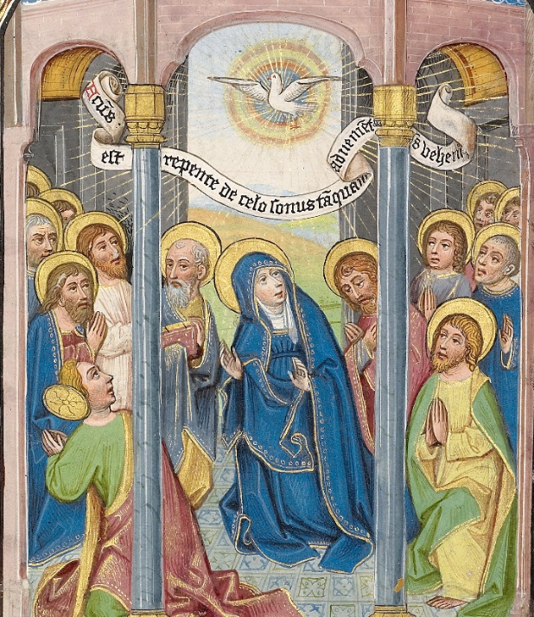
Pentecost
William Vrelant
Getty Center
Los Angeles, CA

Slide 11
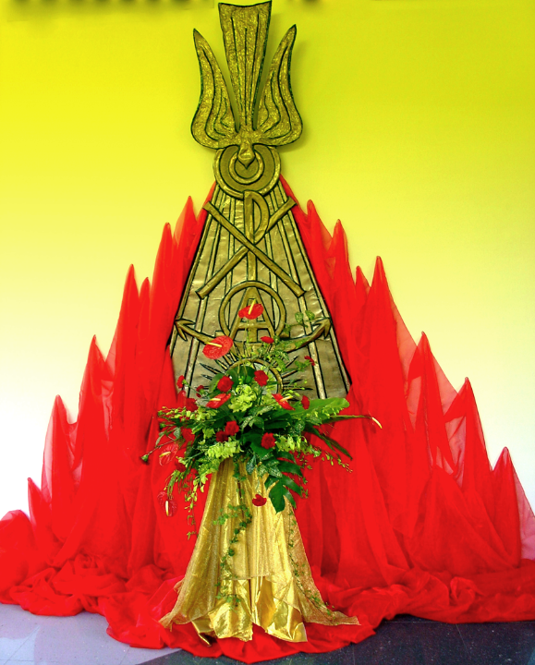
Happy Pentecost
Church of the Holy Spirit Singapore

Slide 12
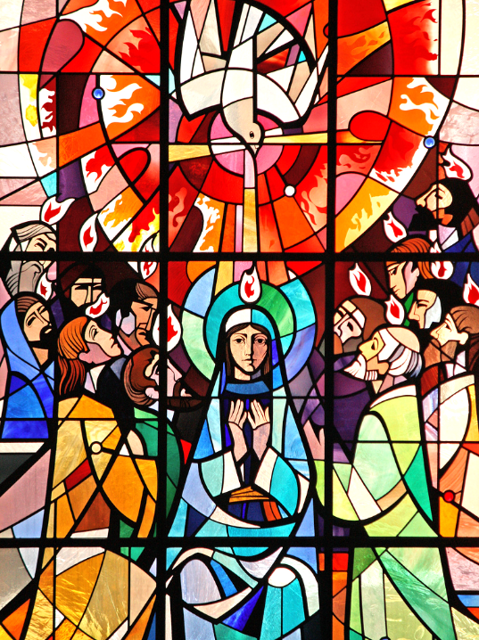
Pentecost
St. Aloyius Somers Town London, England

Slide 13
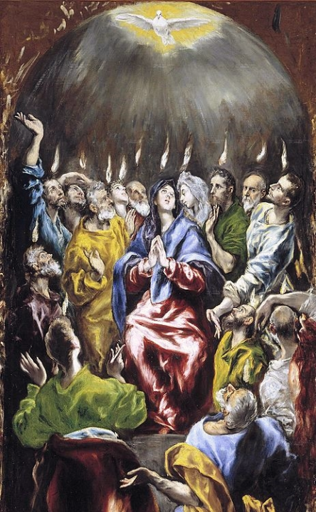
Pentecost, (detail)
El Greco
Prado Museum
Madrid, Spain

Slide 14
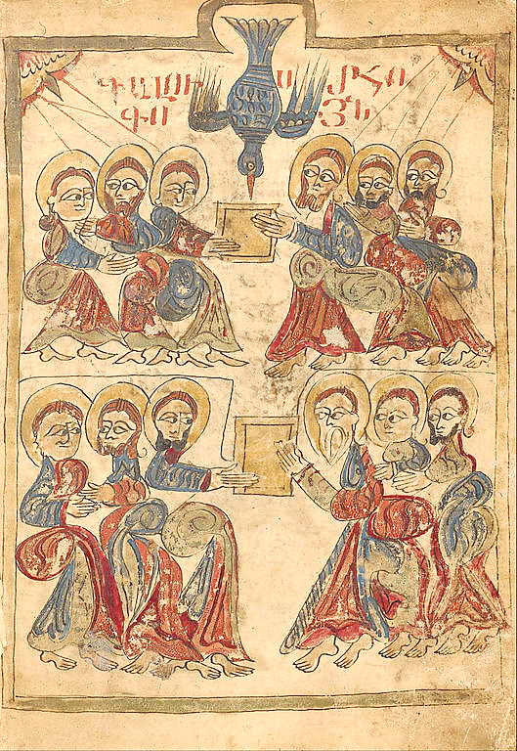
Pentecost
Turkish, Late 14th century
Getty Center, Los Angeles, CA

Slide 15
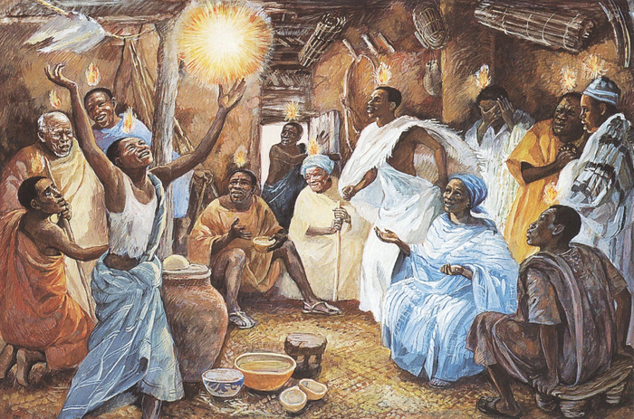
Pentecost -- JESUS MAFA, Cameroon

Slide 16
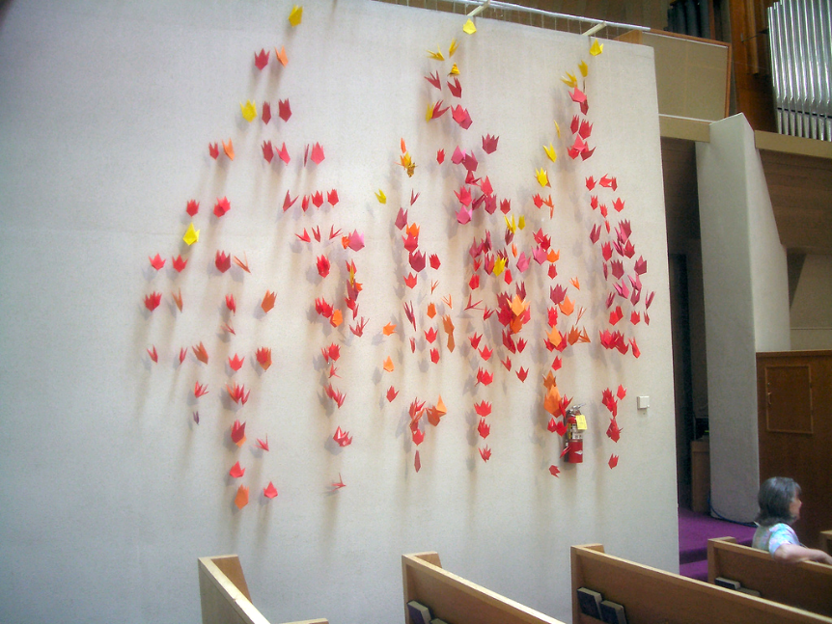
Pentecost -- First Presbyterian Church, Berkeley, CA

Slide 17
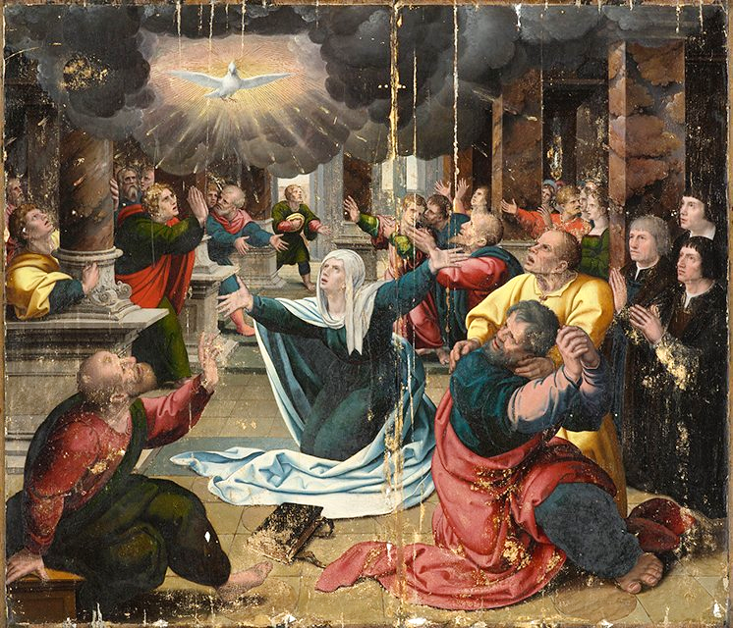
Pentecost
Follower of Bernard van Orley
North Carolina Museum of Art
Raleigh, NC

Slide 18
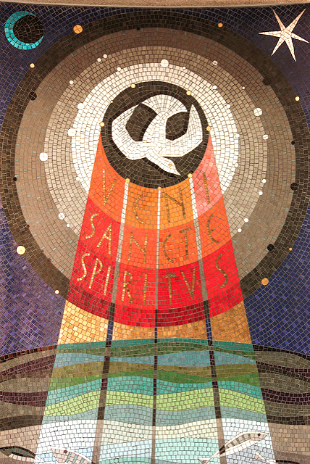
?
Veni Sancti Spiritus
St. Aloysius Somers Town London, England

Slide 19
Credits
New Revised Standard Version Bible, copyright 1989, Division of Christian Education of the National Council of the Churches of Christ in the United States of America. Used by permission. All rights reserved.
http://commons.wikimedia.org/wiki/File:CodexEgberti-Fol103-Pentecost.jpg
https://www.flickr.com/photos/onbangladesh/4786279620
http://diglib.library.vanderbilt.edu/act-imagelink.pl?RC=51555
https://commons.wikimedia.org/wiki/File:0329jfOur_Lady_of_Pentecost_Parish_Church_Quezon_City_Loyola_Heightsfvf_25.jpg
https://commons.wikimedia.org/wiki/File:Willem_Vrelant_(Flemish,_died_1481,_active_1454_-_1481)_-_Pentecost_-_Google_Art_Project.jpg
http://www.flickr.com/photos/eustaquio/3580213825/
https://www.flickr.com/photos/paullew/3580235485
https://commons.wikimedia.org/wiki/File:Pentecost%C3%A9s_(El_Greco,_1597).jpg
https://commons.wikimedia.org/wiki/File:Pentecost_-_Google_Art_Project_(6793511).jpg
http://diglib.library.vanderbilt.edu/act-imagelink.pl?RC=48388
http://www.flickr.com/photos/raymondyee/160345434/
ttps://commons.wikimedia.org/wiki/File:%27The_Pentecost%27_by_a_follower_of_Bernard_van_Orley,_c_1530.jpg
https://www.flickr.com/photos/paullew/8750321716
Additional descriptions can be found at the Art in the Christian Tradition image library, a service of the Vanderbilt Divinity Library, http://diglib.library.vanderbilt.edu/. All images available via Creative Commons 3.0 License.

