Slide 1
Baptism of the Lord
Year A
Isaiah 42:1-9
Psalm 29
Acts 10:34-43
Matthew 3:13-17

Slide 2
Here is my servant…a bruised reed he will not break, and a dimly burning wick he will not quench; he will faithfully bring forth justice.
Isaiah 42:1a, 3

Slide 3
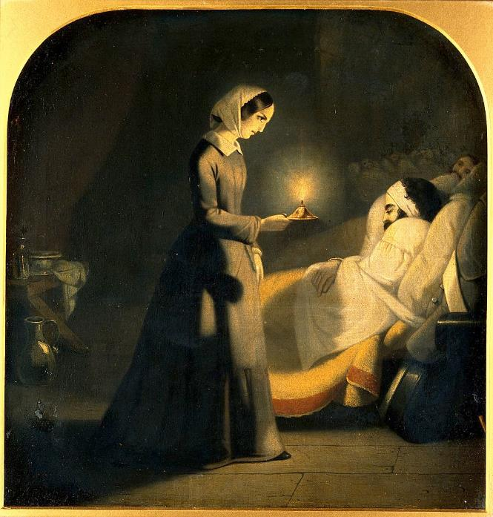
Angel of Mercy (Florence Nightingale)
James Butterworth

Slide 4
I have taken you by the hand and kept you;
Isaiah 42:6b

Slide 5
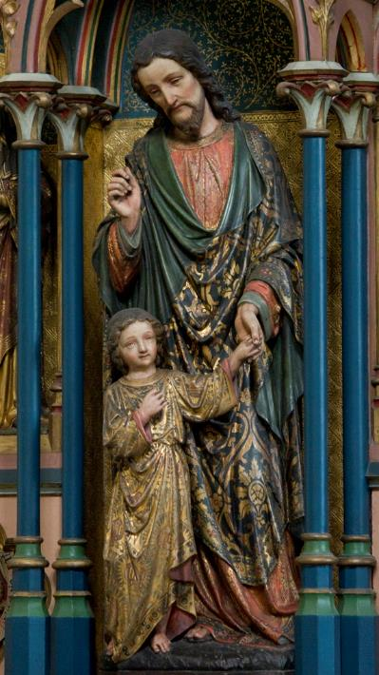
Joseph, the Foster Parent
Church of Corpus Christi
Brixton, England

Slide 6
I have given you as a covenant to the people, a light to the nations …
Isaiah 42:6c

Slide 7
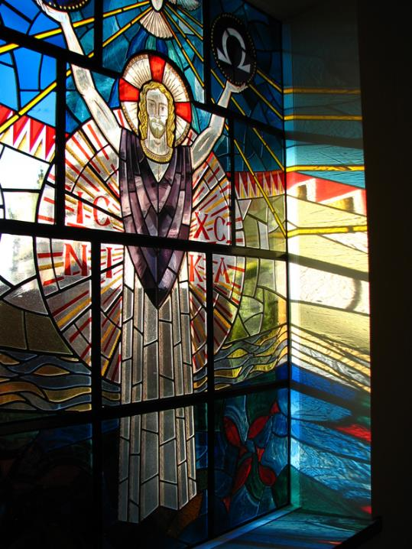
Christ Our Light
Holy Rosary Priory
Bushey, Great Britain

Slide 8
…to open the eyes that are blind,
Isaiah 42:7a

Slide 9
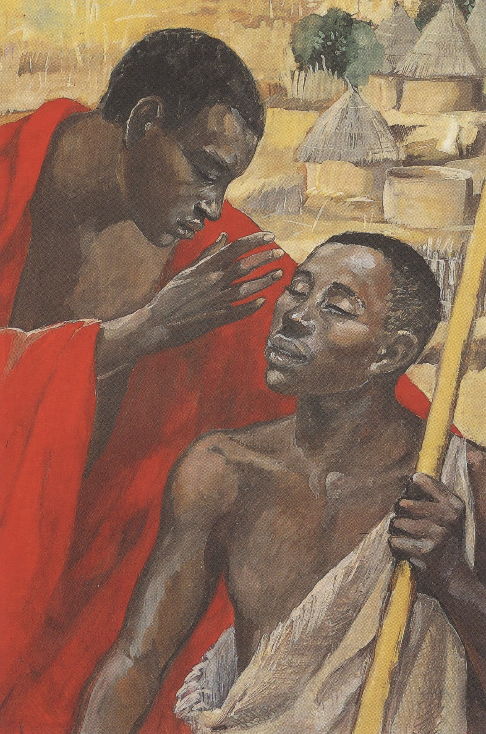
Jesus Cures the Man Born Blind
Jesus MAFA
Cameroon

Slide 10
…to bring out the prisoners from the dungeon, from the prison those who sit in darkness.
Isaiah 42:7b

Slide 11
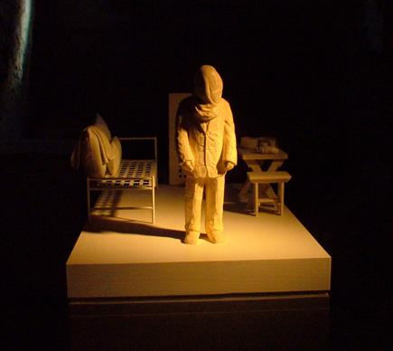
Inmate Shortly after Processing -- Susan Hagen, State Penitentiary (inactive), Philadelphia, PA

Slide 12
You know the message he sent to the people of Israel, preaching peace by Jesus Christ--he is Lord of all.
Acts 10:36

Slide 13
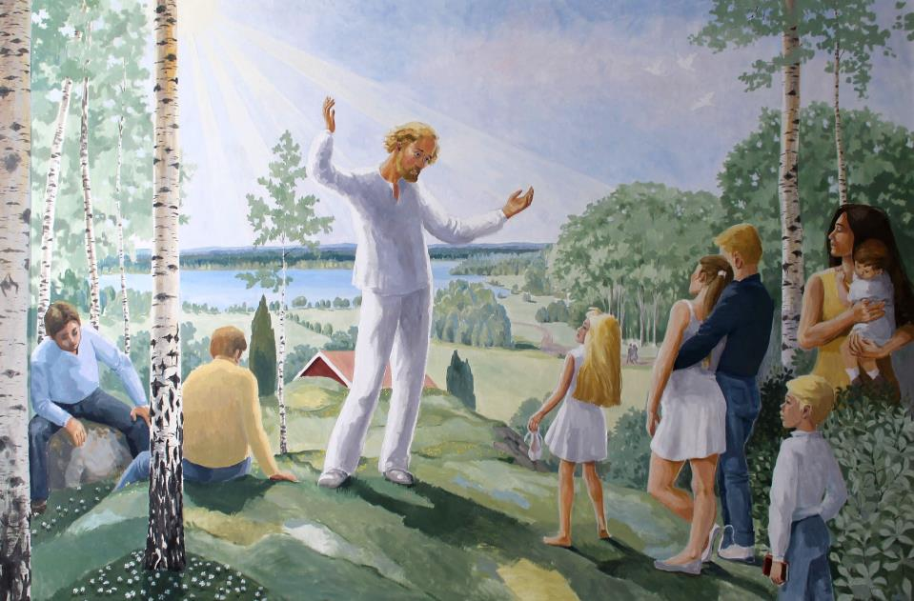
Jesus Preaching in the Present -- Soraby Church, Vaxjo, Sweden

Slide 14
…he went about doing good and healing all who were oppressed.
Acts 10:38b

Slide 15
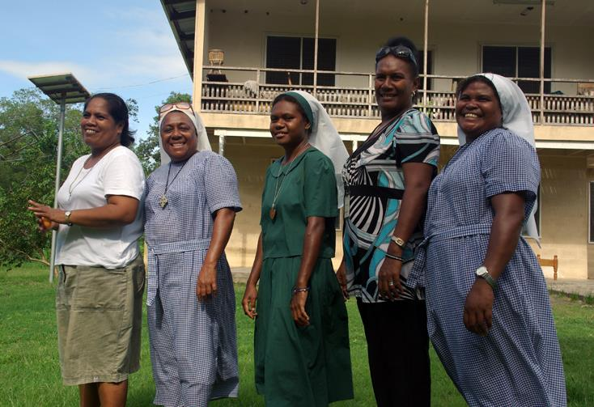
Nuns of the Christian Care Centre
Community of Sisters of the Church, Honiara, Solomon Islands

Slide 16
Then Jesus came from Galilee to John at the Jordan, to be baptized by him.
Matthew 3:13

Slide 17
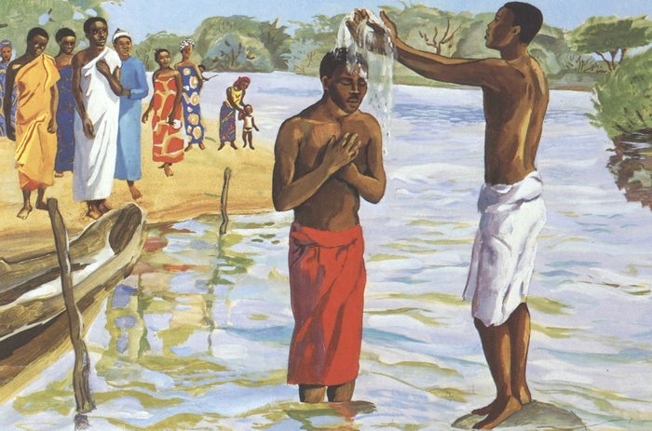
John Baptizes Jesus -- JESUS MAFA, Cameroon

Slide 18
John would have prevented him, saying, "I need to be baptized by you, and do you come to me?"
Matthew 3:14

Slide 19
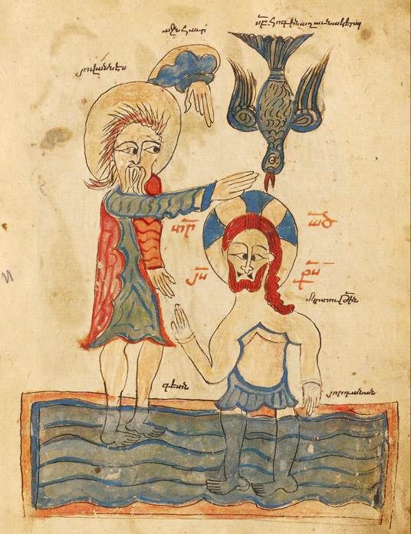
Baptism of Christ
14th century Turkey
J. Paul Getty Museum
Los Angeles, CA

Slide 20
But Jesus answered him, “Let it be so now; for it is proper for us in this way to fulfill all righteousness.”
Then he consented.
Matthew 3:15

Slide 21
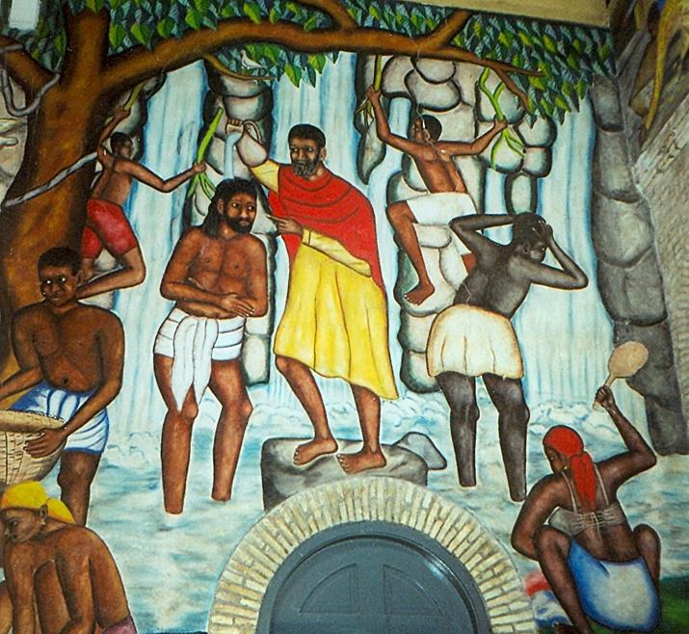
Baptism of Jesus
Castera Bazile Cathedral of the Holy Trinity
Port-au-Prince, Haiti

Slide 22
And when Jesus had been baptized, just as he came up from the water…
Matthew 3:16a

Slide 23
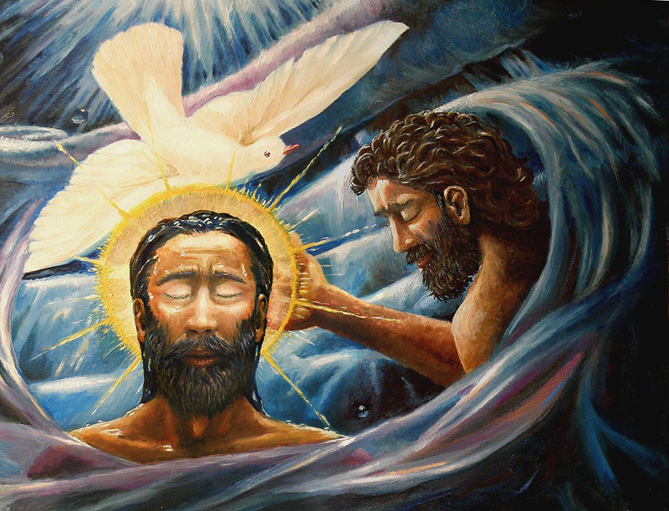
Baptism of Christ -- Dave Zelenka

Slide 24
…suddenly the heavens were opened to him and he saw the Spirit of God descending like a dove and alighting on him.
Matthew 3:16b

Slide 25
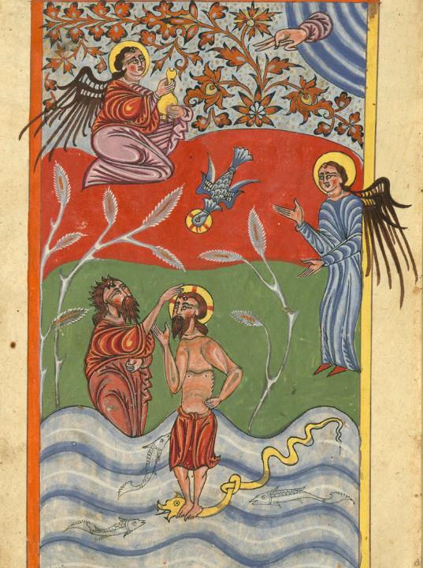
Baptism of Christ
15th c. Armenian
Walters Art Museum
Baltimore, MD

Slide 26
And a voice from heaven said, "This is my Son, the Beloved, with whom I am well pleased."
Matthew 3:17

Slide 27
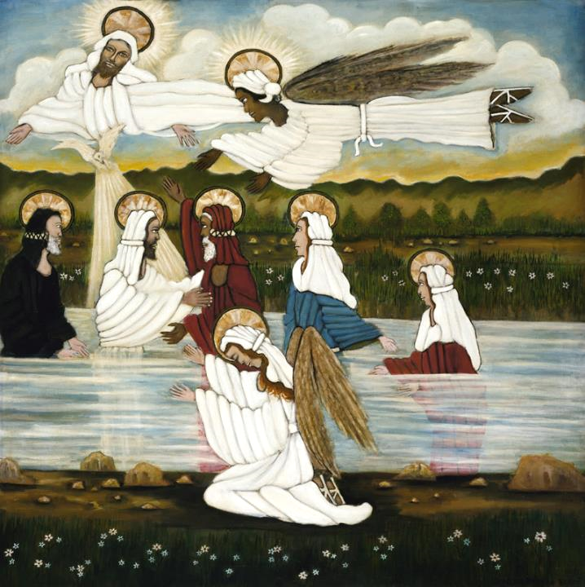
Baptism of Christ
Lorenzo Scott
Smithsonian American Art Museum
Washington, DC

Slide 28
Credits
New Revised Standard Version Bible, copyright 1989, Division of Christian Education of the National Council of the Churches of Christ in the United States of America. Used by permission. All rights reserved.
https://commons.wikimedia.org/wiki/File:Florence_Nightingale_as_the_lady_with_the_lamp._Oil_painting_Wellcome_V0017994.jpg
http://www.flickr.com/photos/paullew/5538869359/
http://www.flickr.com/photos/35409814@N00/2105918430/ - Brother Lawrence
http://www.librairie-emmanuel.fr (contact page: https://www.librairie-emmanuel.fr/contact)
http://diglib.library.vanderbilt.edu/act-imagelink.pl?RC=54279 - Ingorr
http://www.mfa.org/
https://commons.wikimedia.org/wiki/File:S%C3%B6raby_kyrka_Tavla_021.JPG – Bernt Fransson
https://commons.m.wikimedia.org/wiki/File:The_nuns_of_the_Christian_Care_Centre._(10729767853).jpg
http://diglib.library.vanderbilt.edu/act-imagelink.pl?RC=48290
https://commons.m.wikimedia.org/wiki/File:The_Baptism_of_Christ_-_Google_Art_Project.jpg
http://commons.wikimedia.org/wiki/File:PortAuPrinceMural.jpg
https://commons.wikimedia.org/wiki/File:Baptism-of-Christ.jpg
https://commons.wikimedia.org/wiki/File:Relieftafel_Szenen_aus_dem_Leben_Christi.jpg
https://commons.wikimedia.org/wiki/File:Folio_109v_-_The_Baptism_of_Christ.jpg
Additional descriptions can be found at the Art in the Christian Tradition image library, a service of the Vanderbilt Divinity Library, http://diglib.library.vanderbilt.edu/. All images available via Creative Commons 3.0 License.

