Slide 1
Ash Wednesday
Year A
Joel 2:1-2, 12-17 or Isaiah 58:1-12
Psalm 51:1-17
2 Corinthians 5:20b-6:10
Matthew 6:1-6, 16-21

Slide 2
Return to the LORD, your God,
for he is gracious and merciful,
slow to anger,
and abounding in steadfast love.
Joel 2:13b

Slide 3
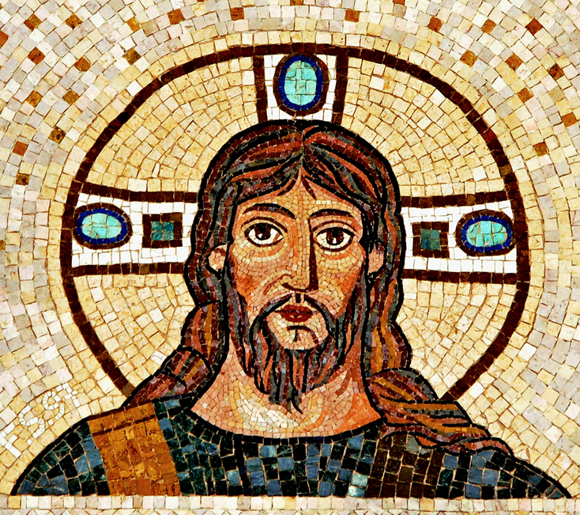
Mosaic of God
Jerusalem,
Israel

Slide 4
Blow the trumpet in Zion;
sanctify a fast;
call a solemn assembly;
gather the people.
Joel 2:15-16a

Slide 5
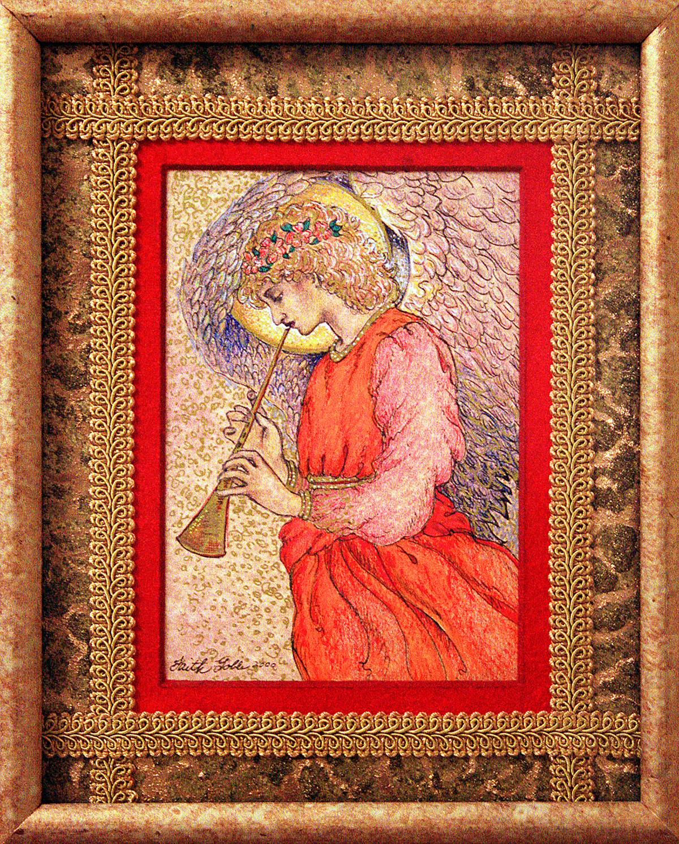
Angel Playing a Flageolet
Faith Goble

Slide 6
Is not this the fast that I choose:
to loose the bonds of injustice,
to undo the thongs of the yoke,
to let the oppressed go free…
Isaiah 58:6

Slide 7
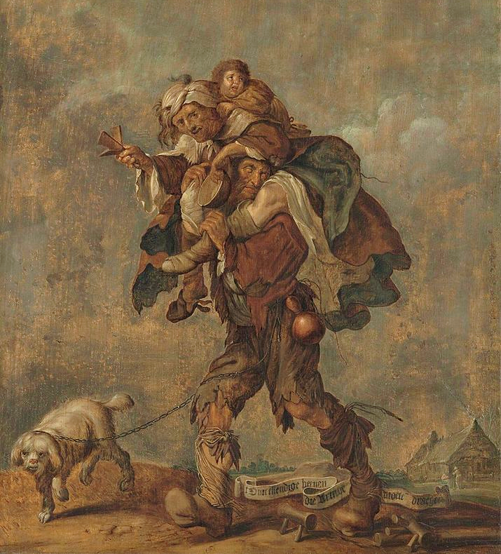
Wretched are the Legs That Must Bear the Burden of Poverty
Adrien van de Venne
Museum Boijmans Van Beuningen Rotterdam, Netherlands

Slide 8
Is it not to share your bread with the hungry, and bring the homeless poor into your house?
Isaiah 58:7

Slide 9
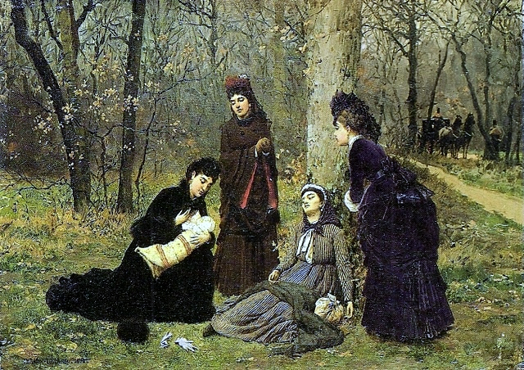
Charity -- Marie-Francois Firmin-Girard, Museu Nacional de Belas Artes, Rio de Janiero, Brazil

Slide 10
Have mercy on me, O God,
according to your steadfast love; according to your abundant mercy
blot out my transgressions.
Psalm 51:1

Slide 11
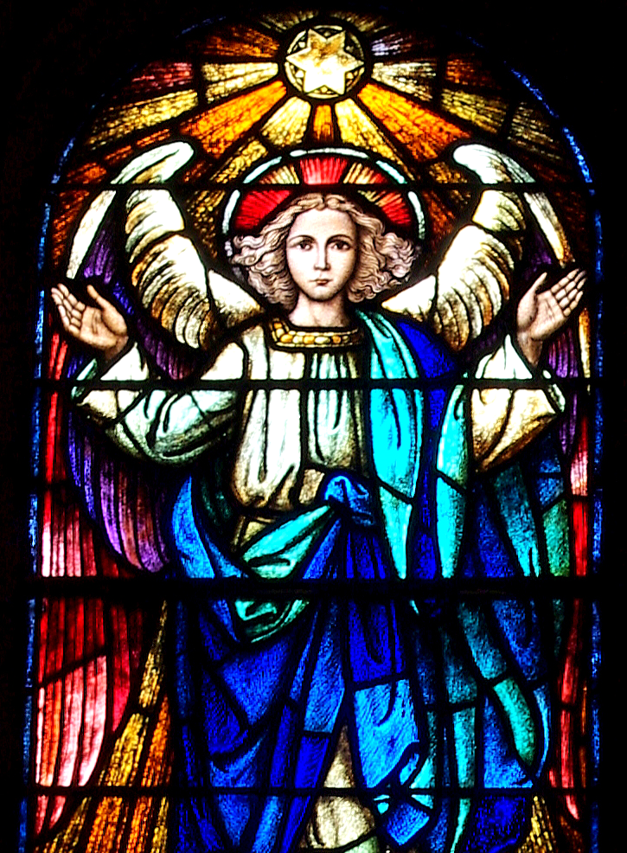
Remissionem, detail
St. Aloysius Church
Columbus, Ohio

Slide 12
Create in me a clean heart, O God, and put a new and right spirit within me.
Psalm 51:10

Slide 13
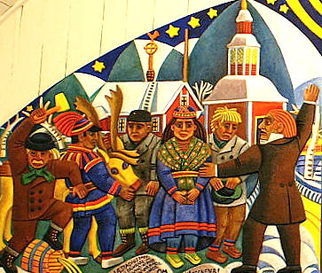
Repentance Altarpiece -- Bror Hjorth, Jukkasjarvi Church, Jukkasjarvi, Sweden

Slide 14
We are treated…as dying,
and see--we are alive;
as sorrowful,
yet always rejoicing;
2 Corinthians 5:28b, 9a, 10a

Slide 15
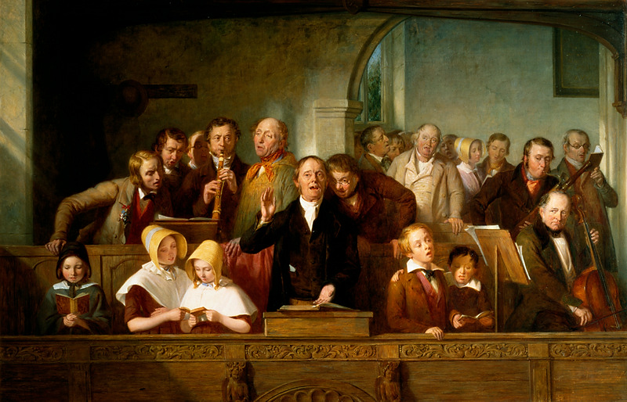
A Village Choir -- Thomas Webster, Victoria and Albert Museum, London

Slide 16
…as poor, yet making many rich;
as having nothing,
and yet possessing everything
2 Corinthians 5:10b

Slide 17
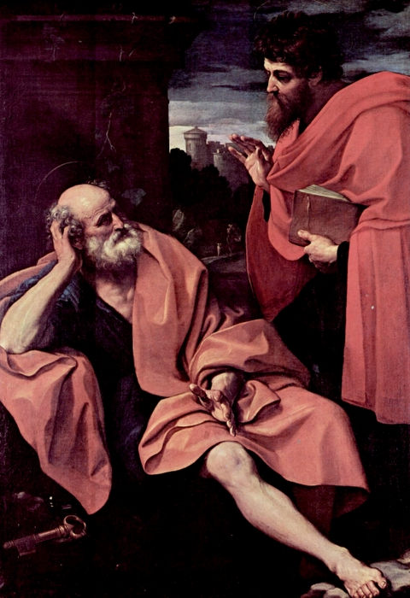
Peter and Paul
Guido Reni
Pinacoteca di Brera
Milan, Italy

Slide 18
"And whenever you pray, do not be like the hypocrites;
for they love to stand and pray…
so that they may be seen by others.”
Matthew 6:5a,c

Slide 19
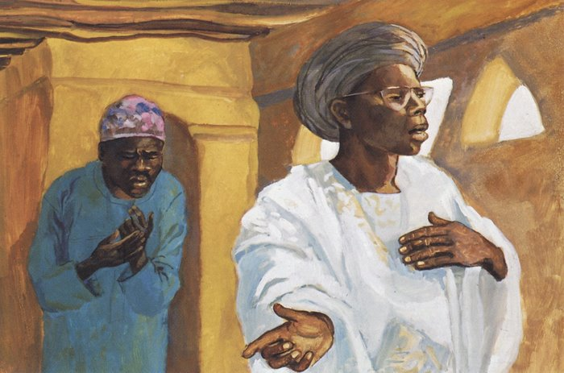
The Pharisee and the Publican -- JESUS MAFA, Cameroon

Slide 20
"Do not store up for yourselves treasures on earth…
but store up for yourselves treasures in heaven…”
Matthew 6:19a-20a

Slide 21
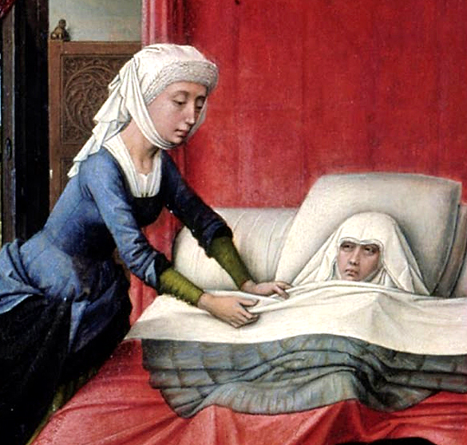
Detail, Altar of St. John
Rogier van der Weyden Gemaldegalerie
Berlin, Germany

Slide 22
“For where your treasure is, there your heart will be also.”
Matthew 6:21

Slide 23
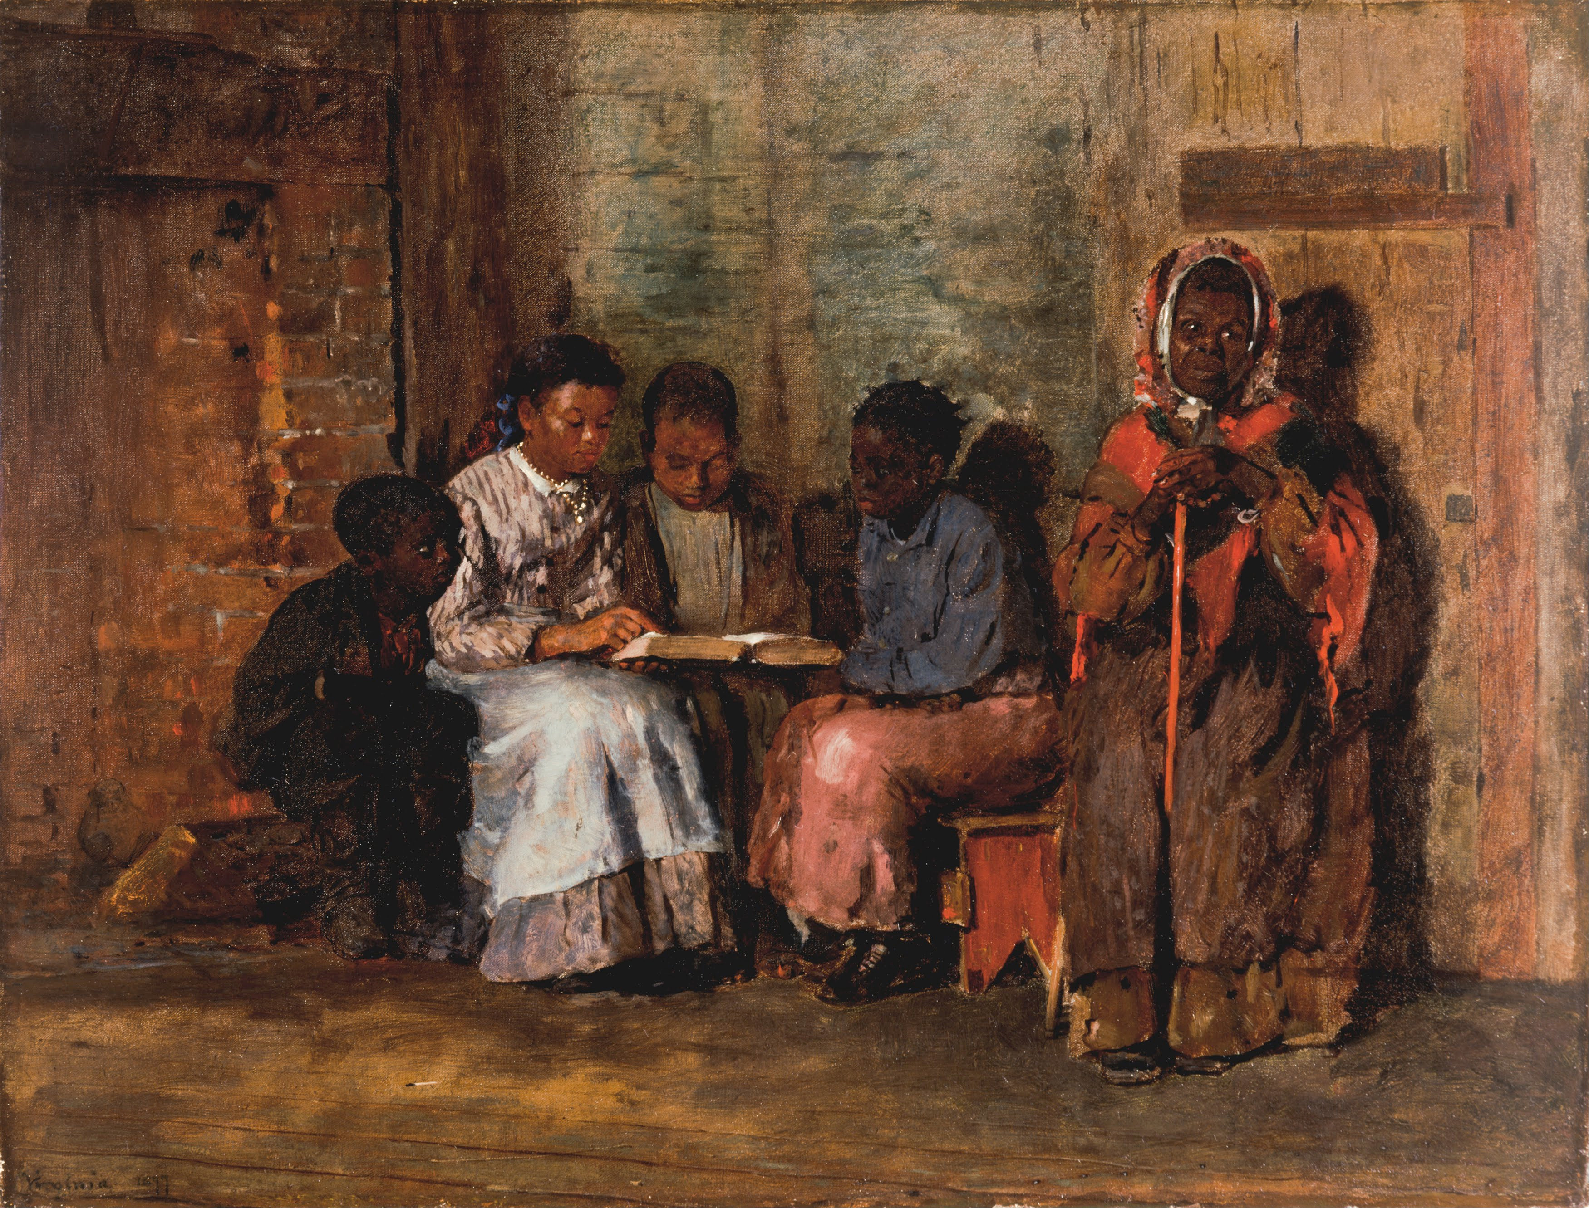
Sunday Morning in Virginia -- Winslow Homer, Cincinnati Art Museum

Slide 24
Credits
New Revised Standard Version Bible, copyright 1989, Division of Christian Education of the National Council of the Churches of Christ in the United States of America. Used by permission. All rights reserved.
http://www.flickr.com/photos/37122972@N06/3913846520/
http://www.flickr.com/photos/grafixer/2375947713/
https://commons.wikimedia.org/wiki/File:Adriaen_Pietersz._van_de_Venne_003.jpg
http://commons.wikimedia.org/wiki/File:Marie-Fran%C3%A7ois_Firmin-Girard_-_A_Caridade.jpg
https://commons.wikimedia.org/wiki/File:Saint_Aloysius_Church_(Columbus,_Ohio)_-_stained_glass,_The_forgiveness_of_Sins.jpg - Nhehob
http://commons.wikimedia.org/wiki/File:Laestadius_Hjorth1.jpg
http://commons.wikimedia.org/wiki/File:Thomas_Webster_-_A_Village_Choir.jpg
http://www.yorckproject.de
http://diglib.library.vanderbilt.edu/act-imagelink.pl?RC=48268
https://commons.wikimedia.org/wiki/File:Rogier_van_der_Weyden_-_The_Altar_of_St._John_-_Google_Art_Project.jpg
https://commons.wikimedia.org/wiki/File:Winslow_Homer_-_Sunday_Morning_in_Virginia_-_Google_Art_Project.jpg
Additional descriptions can be found at the Art in the Christian Tradition image library, a service of the Vanderbilt Divinity Library, http://diglib.library.vanderbilt.edu/. All images available via Creative Commons 3.0 License.

