Slide 1
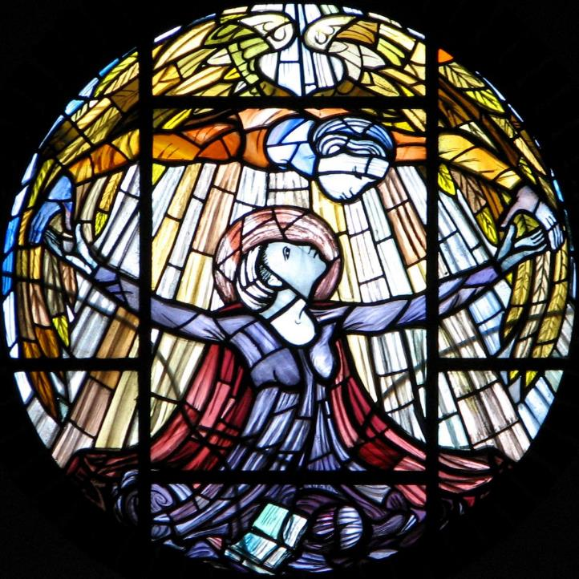
Advent Daily Prayer for Reflection
Week 4
Revised Common Lectionary Year B
The Prayers that follow are written by the RCL specifically for the Advent Lectionary scripture texts:
2 Samuel 7:1-11, 16 • Luke 1:46b-55 or Psalm 89:1-4, 19-26 • Romans 16:25-27 • Luke 1:26-38
Image information may be found at the end.

Slide 2
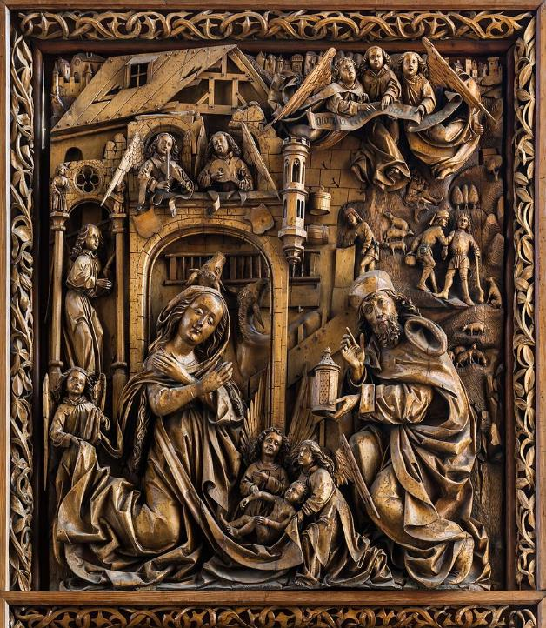
God of all ages,
in the birth of Christ
your boundless love for your people
shattered the power of darkness.
Be born in us with that same love and light,
that our song may blend with all the choirs of heaven and earth
to the glory of your holy name.
Fourth Sunday of Advent, Year B

Slide 3
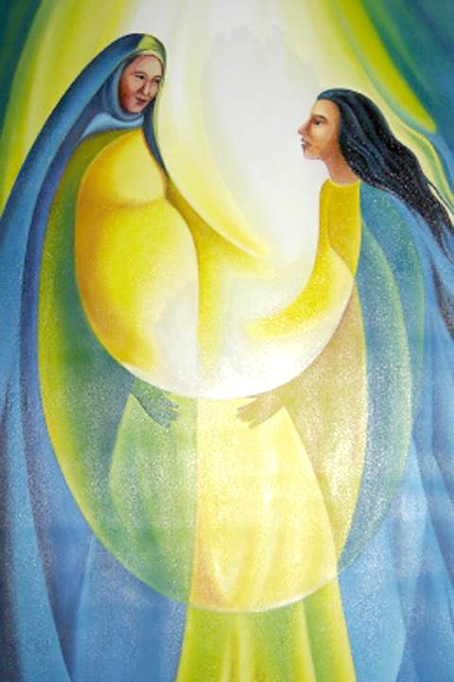
O God of Elizabeth and Mary,
you visited your servants with news of the world's redemption
in the coming of the Savior.
Fourth Monday of Advent, Year B

Slide 4
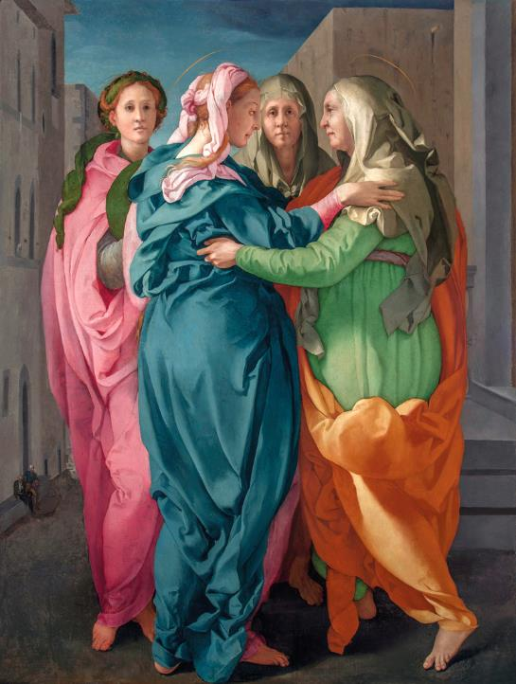
Make our hearts leap with joy,
and fill our mouths with songs of praise,
that we may announce glad tidings of peace,
and welcome the Christ in our midst.
Fourth Tuesday of Advent, Year B

Slide 5
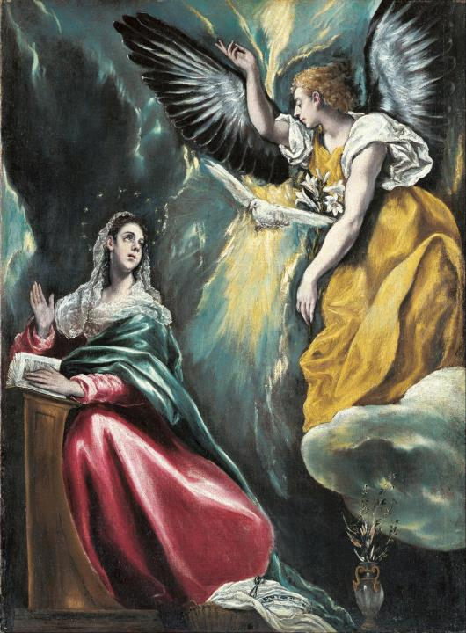
God of promise,
you have given us a sign of your love
through the gift of Jesus Christ, our Savior,
who was promised from ages past.
Fourth Wednesday of Advent, Year B

Slide 6
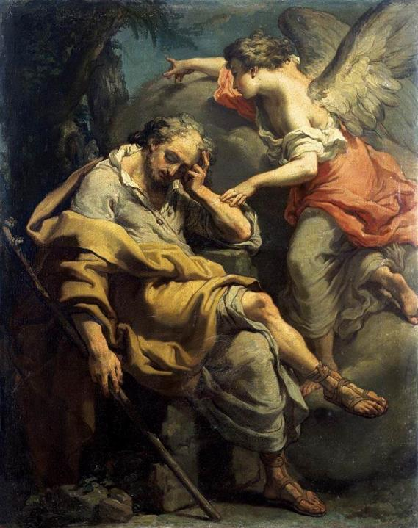
We believe as Joseph did
the message of your presence
whispered by an angel,
and offer our prayers for your world,
confident of your care and mercy for all creation.
Fourth Thursday of Advent, Year B

Slide 7
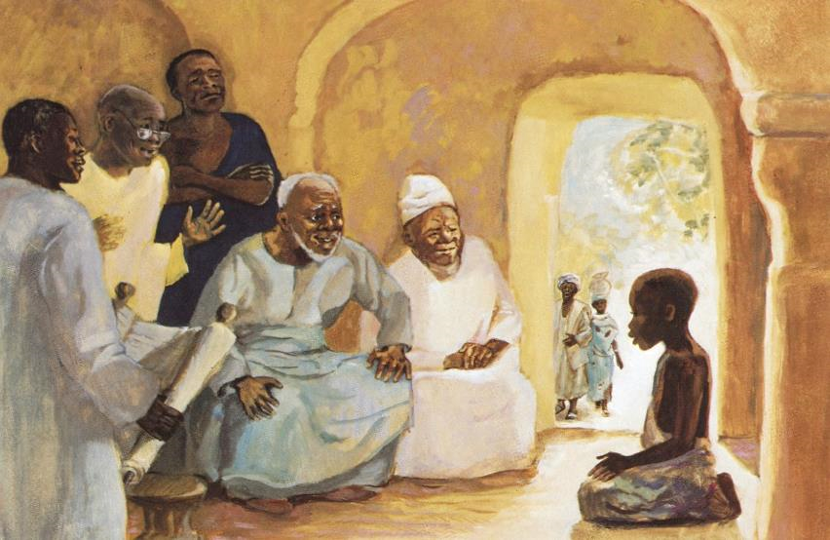
Ever faithful God,
through prophets and angels,
you promised to raise up a holy child
who would establish a household of peace and justice.
Fourth Friday of Advent, Year B

Slide 8
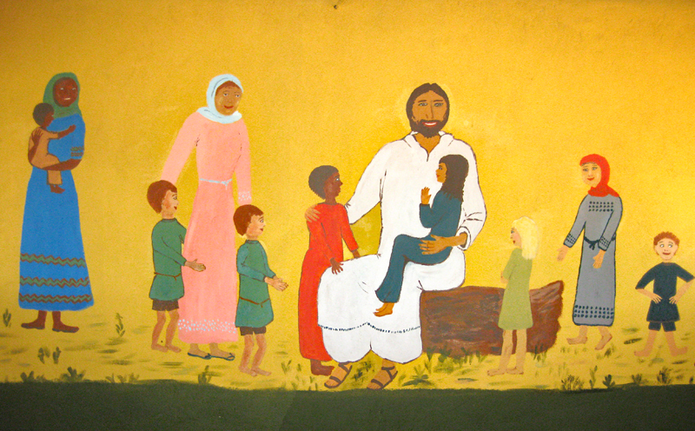
Open our hearts to receive your Son,
that we may open our doors
to welcome all people as sisters and brothers,
and establish your household in our time.
Fourth Saturday of Advent, Year B

Slide 9
Prayers are reproduced from Revised Common Lectionary Prayers, copyright © 2002 Consultation on Common Texts. Augsburg Fortress. Used by permission. Art image descriptions can be found at the Art in the Christian Tradition image library, a service of the Vanderbilt Divinity Library, http://diglib.library.vanderbilt.edu/. All images available via Creative Commons 3.0 License.
Nativity, Master of the Kefermarkt Altarpiece -- https://commons.wikimedia.org/wiki/File:Kefermarkt_Kirche_Fl%C3%BCgelaltar_Geburt_01.jpg
The Visitation, Church of St. Elizabeth El Sitio -- https://www.flickr.com/photos/johndonaghy/22885862/ - John Donaghy
The Visitation, Jacopo Pontormo -- https://commons.wikimedia.org/wiki/File:Pontormo-visitation-after-restorationRGB.jpg
Annunciation, El Greco -- https://commons.wikimedia.org/wiki/File:El_GRECO_(Domenikos_Theotokopoulos)_-_Annunciation_-_Google_Art_Project.jpg
Joseph’s Dream, Joseph Gandolphi -- http://commons.wikimedia.org/wiki/File:'Joseph's_Dream',_painting_by_Gaetano_Gandolfi,_c._1790.jpg
Teaching in the Temple, JESUS MAFA -- http://www.librairie-emmanuel.fr
Jesus Welcomes All, Sudanese Muralist -- https://www.flickr.com/photos/amyashcraft/13885591354/

