Slide 1
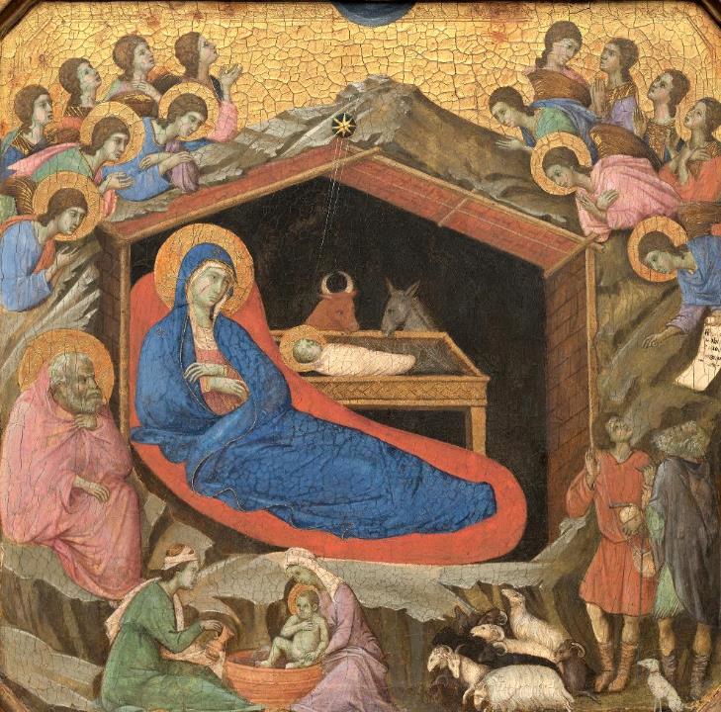
Advent Daily Prayer for Reflection
Week 2
Revised Common Lectionary Year B
The Prayers that follow are written by the RCL specifically for the Advent Lectionary scripture texts:
Isaiah 40:1-11 • Psalm 85:1-2, 8-13
2 Peter 3:8-15a • Mark 1:1-8
Image information may be found at the end.

Slide 2
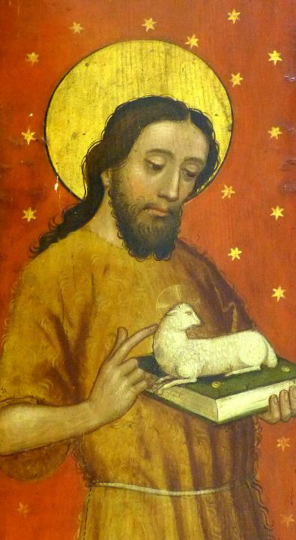
God of timeless grace,
you fill us with joyful expectation.
Make us ready for the message that prepares the way…
Second Sunday of Advent, Year B

Slide 3
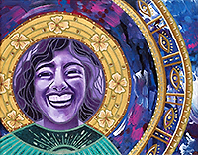
Make us ready … that with uprightness of heart and holy joy
we may eagerly await the kingdom of your Son, Jesus Christ,
who reigns with you and the Holy Spirit, now and for ever. Amen.
Second Monday of Advent, Year B

Slide 4
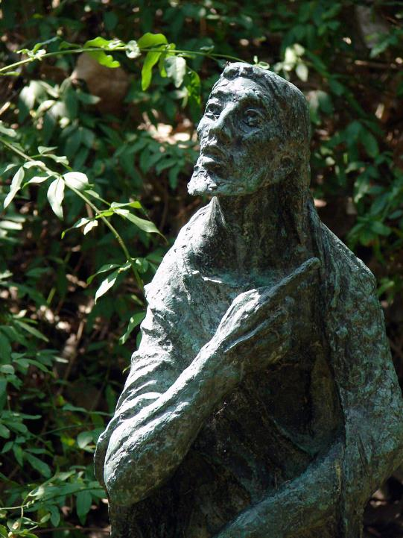
God of hope,
you raised up John the baptizer
as a herald who calls us to conversion. As we joyfully await the glorious coming of Christ,
we pray to you for the needs of … the world.
Second Tuesday of Advent, Year B

Slide 5
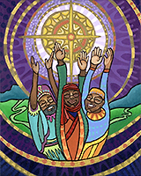
God of hope…you come to us and bring us home.
Comfort us with the expectation of your saving power,
made known to us in Jesus Christ our Lord.
Second Wednesday of Advent, Year B

Slide 6
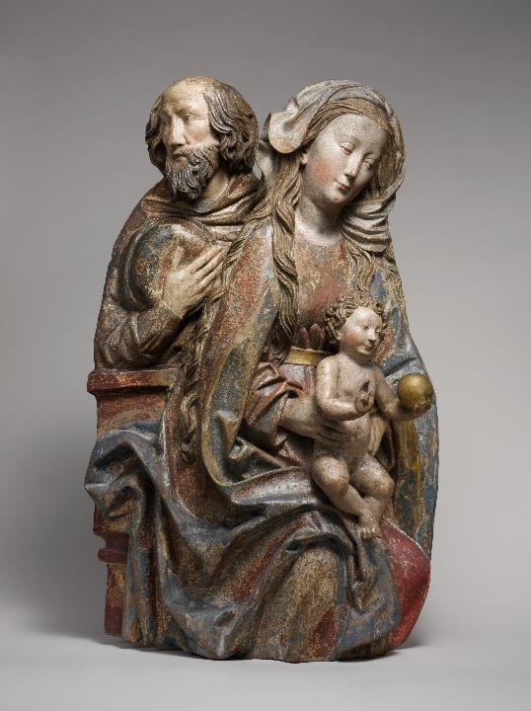
Hear our humble prayer
that we may serve you in holiness and faith
and give voice to your presence among us
until the day of the coming of your Son, Jesus Christ,
who lives and reigns for ever and ever.
Second Thursday of Advent, Year B

Slide 7
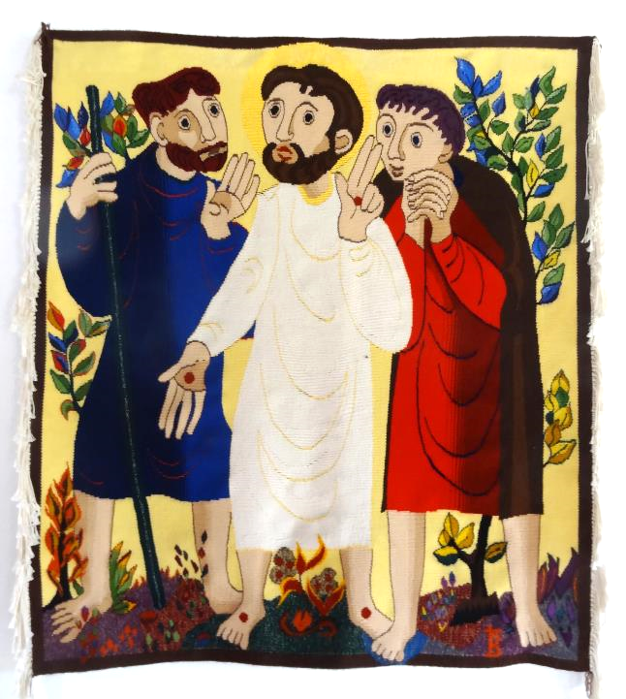
God of hope,
you call us from the exile of our sin
with the good news of restoration;
you build a highway through the wilderness;
Second Friday of Advent, Year B

Slide 8
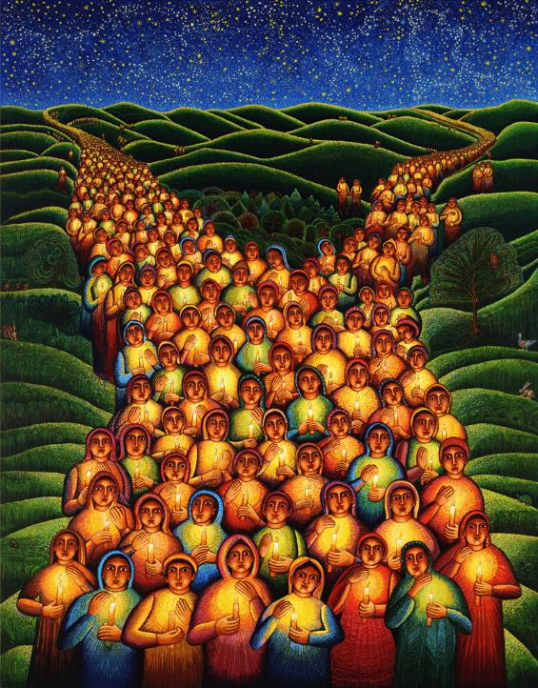
By your grace, transform our prayers from words to deeds,
that we may live as a holy people
in the dawn of your peace,
redeemed from all that divides us.
Second Saturday of Advent, Year B

Slide 9
Prayers are reproduced from Revised Common Lectionary Prayers, copyright © 2002 Consultation on Common Texts. Augsburg Fortress. Used by permission. Art image descriptions can be found at the Art in the Christian Tradition image library, a service of the Vanderbilt Divinity Library, http://diglib.library.vanderbilt.edu/. All images available via Creative Commons 3.0 License.
Nativity, Duccio di Buoninsegna -- https://commons.wikimedia.org/wiki/File:Duccio_di_Buoninsegna,_The_Nativity_with_the_Prophets_Isaiah_and_Ezekiel,_1308-1311,_NGA_10.jpg
John the Baptist, Schwabach Stadtkirche -- https://commons.wikimedia.org/wiki/File:Schwabach_Stadtkirche_-_Katharinenaltar_Fl%C3%BCgel_4a.jpg
Complete Joy, Lauren Wright Pittman -- http://www.lewpstudio.com - copyright by Lauren Wright Pittman
John the Baptist, Charles Umaluf -- https://www.flickr.com/photos/herlanieship/1429424839/ - Lanie
Shining Hope, Lauren Wright Pittman -- http://www.lewpstudio.com - copyright by Lauren Wright Pittman
Holy Family, Niclaus Weckmann -- https://www.metmuseum.org/art/collection/search/468257
Road to Emmaus, Bose Monastery -- https://www.flickr.com/photos/jimforest/15277775371
Festival of Lights, John August Swanson -- www.JohnAugustSwanson.com - copyright 2000 by John August Swanson

