Slide 1
TRANSFIGURATION SUNDAY
Year C
Exodus 34:29-35 • Psalm 99
2 Corinthians 3:12-4:2 • Luke 9:28-36, (37-43a)

Slide 2
the LORD had spoken with him on Mount Sinai … the skin of his face was shining; and Moses would put the veil on his face …
Exodus 34:32b, 35a

Slide 3
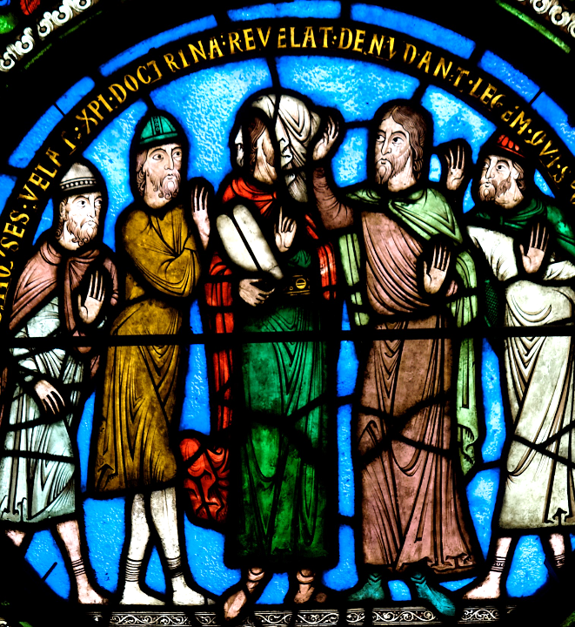
Moses with the Law and the Veil
Abbey of St. Denis
Paris, France

Slide 4
He spoke to them in the pillar of cloud; they kept his decrees … Extol the LORD our God, and worship at his holy mountain;
Psalm 99:7a, 9a

Slide 5
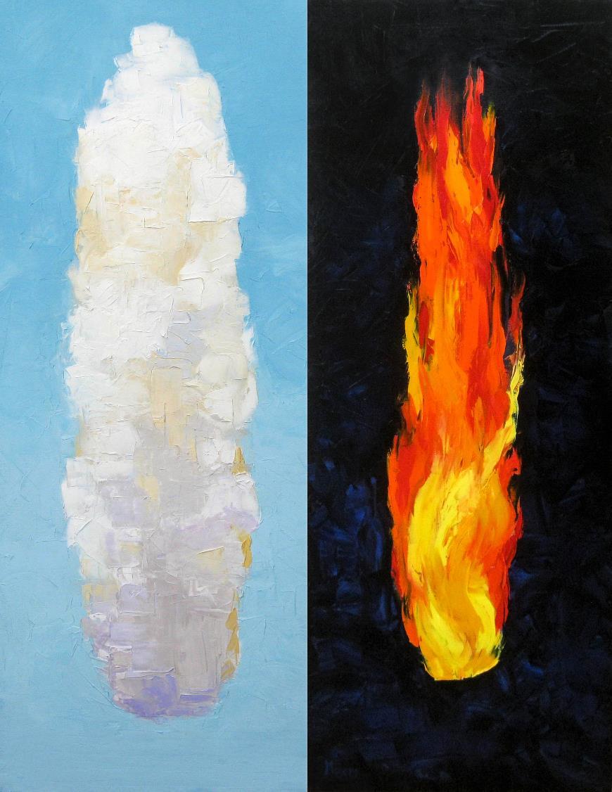
Guidance Day and Night
Mike Moyers

Slide 6
And all of us, with unveiled faces, seeing the glory of the Lord as though reflected in a mirror, are being transformed …
2 Corinthians 3:18a

Slide 7
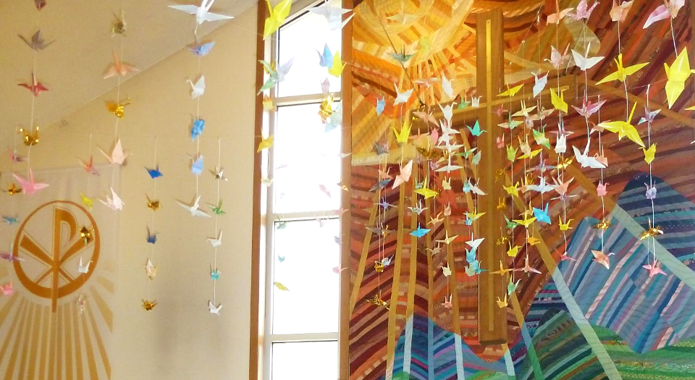
1200 Cranes, Korean Tradition -- King of Kings Lutheran Church, Ann Arbor, MI

Slide 8
Now about eight days after these sayings Jesus took with him Peter and John and James, and went up on the mountain to pray.
Luke 9:28

Slide 9
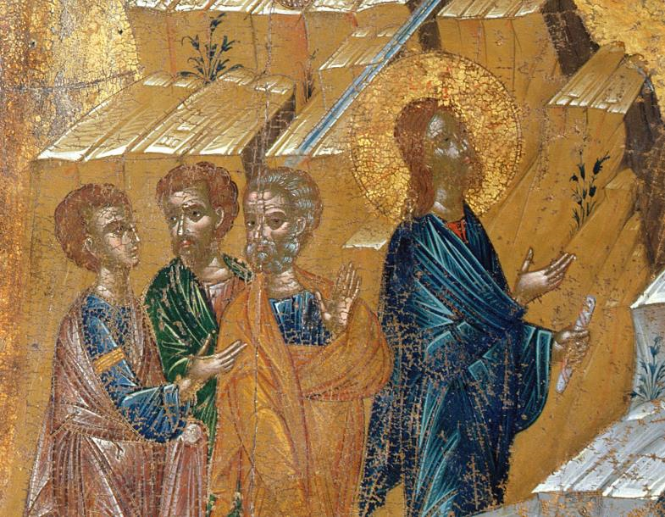
Transfiguration of Christ, detail -- Early 17th c. Icon, Benaki Museum, Athens, Greece

Slide 10
And while he was praying, the appearance of his face changed, and his clothes became dazzling white.
Luke 9:29

Slide 11
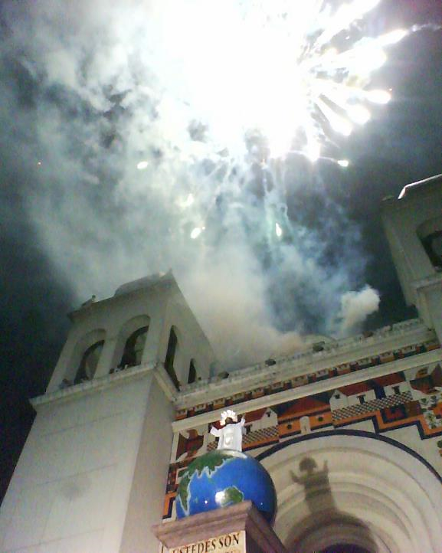
Transfiguration
Metropolitan Cathedral
San Salvador,
El Salvador

Slide 12
Suddenly they saw two men, Moses and Elijah, talking to him.
Luke 9:30

Slide 13
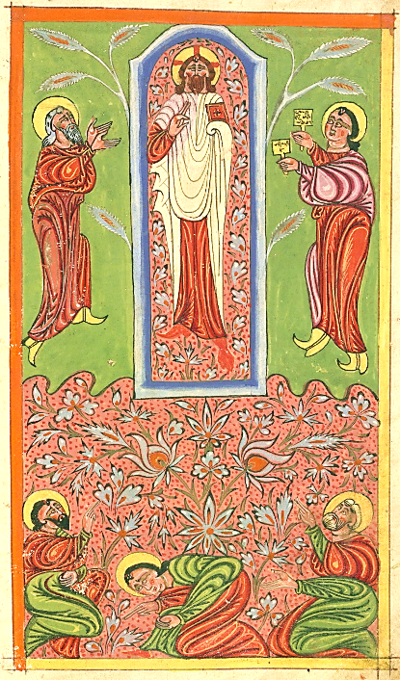
Transfiguration from Syrian Manuscript
Yohannes Vardapet
Walters Art Museum
Baltimore, MD

Slide 14
… Peter said to Jesus, "Master, it is good for us to be here; let us make three dwellings, one for you, one for Moses, and one for Elijah" …
Luke 9:33b

Slide 15
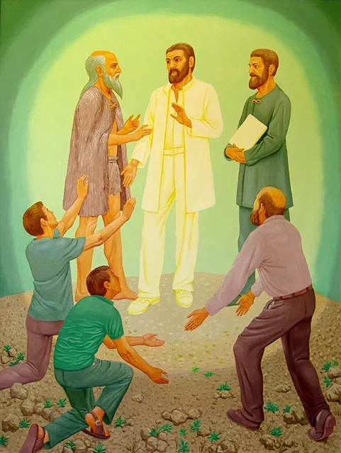
Transfiguration
Peter Koenig

Slide 16
While he was saying this, a cloud came and overshadowed them; and they were terrified as they entered the cloud.
Luke 9:34

Slide 17
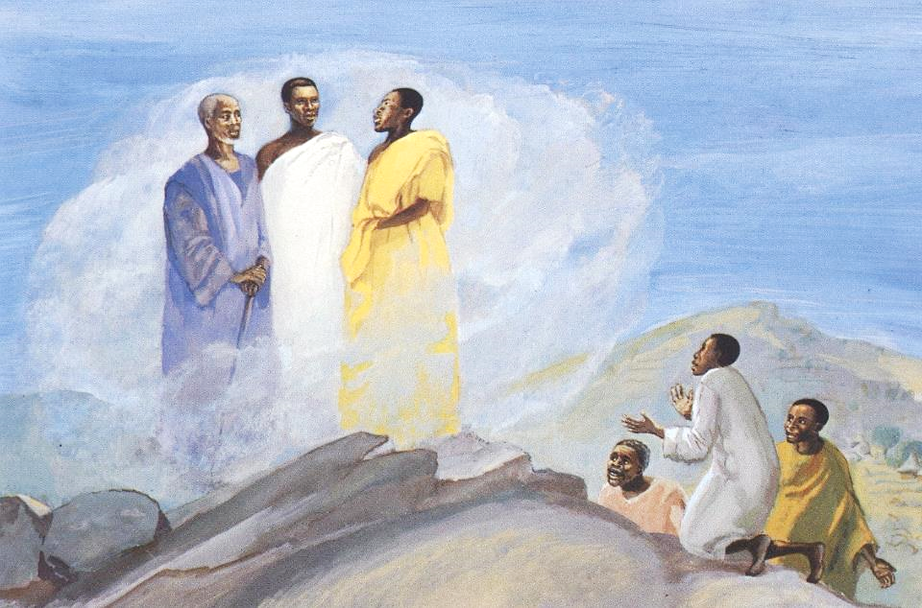
Transfiguration -- JESUS MAFA, Cameroon

Slide 18
Then from the cloud came a voice that said, "This is my Son, my Chosen; listen to him!"
Luke 9:35

Slide 19
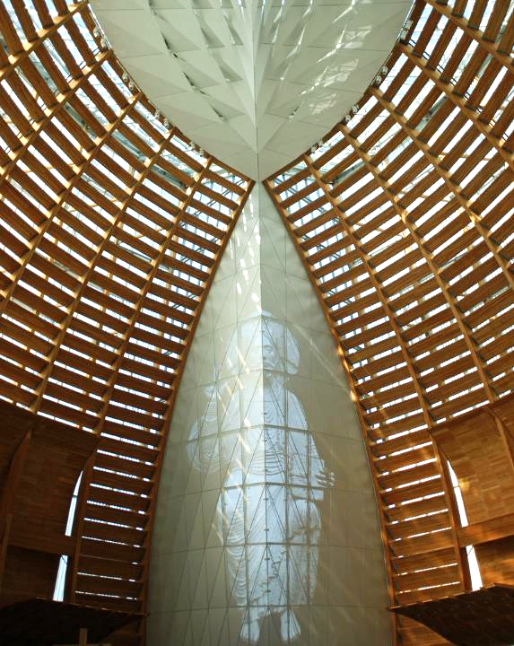
Cathedral of
Christ the Light
Craig Hartman
Oakland, CA

Slide 20
… when they had come down from the mountain … a man from the crowd shouted, "Teacher, I beg you to look at my son; he is my only child.
Luke 9:37b, 38b

Slide 21
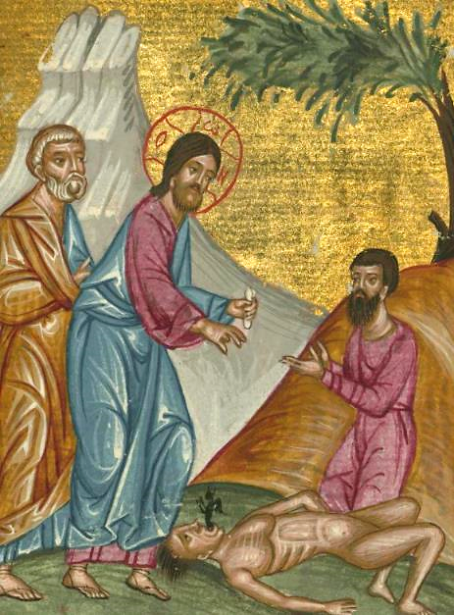
Christ Heals the Possessed Boy
Ilyas Basim Khuri
Bazzi Rahib,
Walters Art Museum, Baltimore, MD

Slide 22
Suddenly a spirit seizes him, and all at once he shrieks. It convulses him until he foams at the mouth; it mauls him and will scarcely leave him."
Luke 9:39

Slide 23
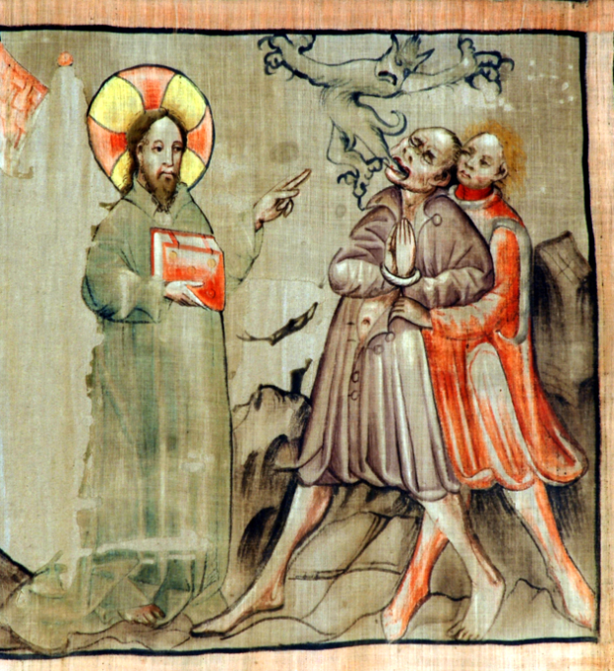
Jesus Casts Out the Unclean Spirit
Liturgical cloth
Konrad von Friesach Cathedral of Gurk
Gurk, Austria

Slide 24
Jesus rebuked the unclean spirit, healed the boy, and gave him back to his father. And all were astounded at the greatness of God.
Luke 9:42b-43a

Slide 25
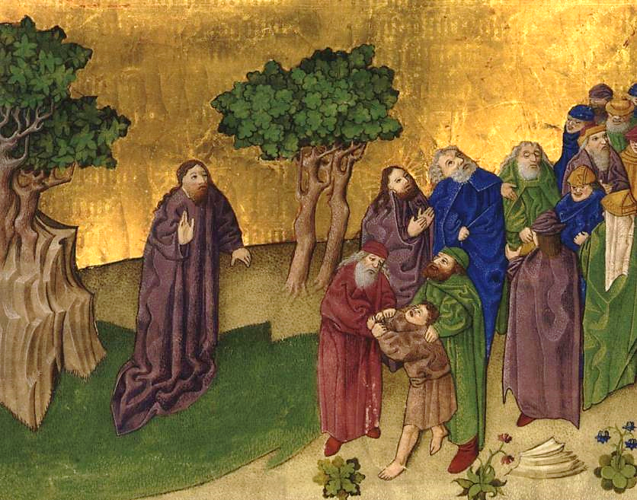
The Healing of the Demon-possessed Boy -- Ottheinrich Bible, Bavarian State Library, Munich, Germany

Slide 26
Credits
New Revised Standard Version Bible, copyright 1989, Division of Christian Education of the National Council of the Churches of Christ in the United States of America. Used by permission. All rights reserved.
https://www.flickr.com/photos/pelegrino/3725320216/ - Nick Thompson
https://www.mikemoyersfineart.com/
https://www.flickr.com/photos/stella12/13953939274
https://commons.wikimedia.org/wiki/File:The_Transfiguration_-_Google_Art_Project_(715792).jpg
http://commons.wikimedia.org/wiki/File:Transfiguracion_del_Divino_Salvador_del_Mundo.jpg
https://www.flickr.com/photos/medmss/8614785144/
Peter Winfried (Canisius) Koenig, https://www.pwkoenig.co.uk/
http://diglib.library.vanderbilt.edu/act-imagelink.pl?RC=48307
http://www.flickr.com/photos/sicarr/3251258111/
https://commons.wikimedia.org/wiki/File:Ilyas_Basim_Khuri_Bazzi_Rahib_-_Jesus_Heals_a_Demon-possessed_Boy_-_Walters_W59248B_-_Full_Page.jpg
https://commons.wikimedia.org/wiki/File:Fastentuch_Gurker_Dom_Daemonenaustreibung_30032007.jpg - Padre Josef at the Cathedral of Gurk, Carinthia, Austria
https://commons.wikimedia.org/wiki/File:Ottheinrich_Folio058r_Mc9B.jpg
Additional descriptions can be found at the Art in the Christian Tradition image library, a service of the Vanderbilt Divinity Library, http://diglib.library.vanderbilt.edu/. All images available via Creative Commons 3.0 License.

