Slide 1
SECOND SUNDAY OF EASTER
Year C
Acts 5:27-32 • Psalm 118:14-29 or Psalm 150
Revelation 1:4-8 • John 20:19-31

Slide 2
The high priest questioned them, saying, "We gave you strict orders not to teach in this name" … But Peter and the apostles answered, "We must obey God rather than any human authority."
Acts 5:27b-28a, 29

Slide 3
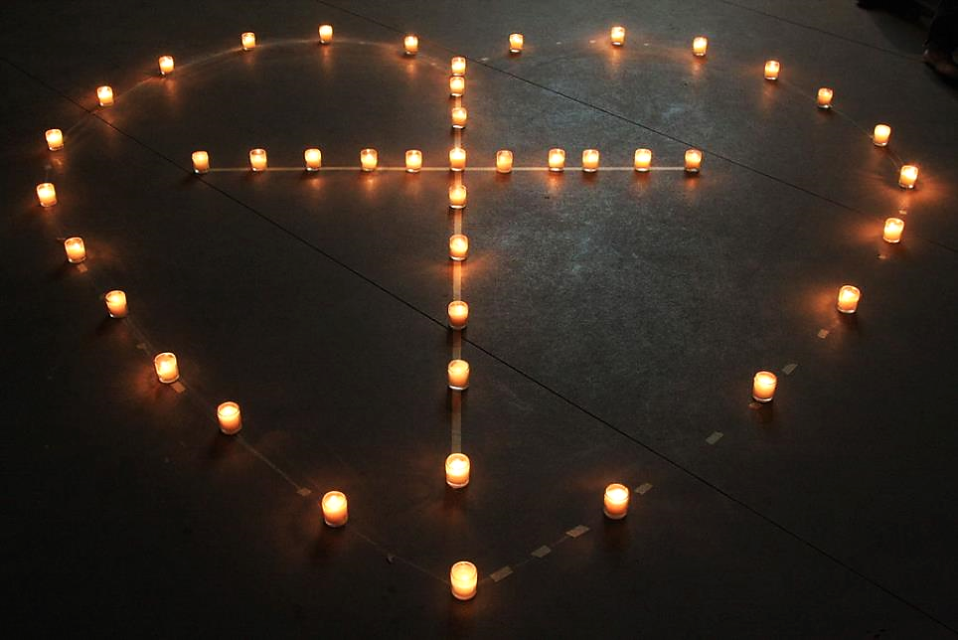
God is Love -- Camp Tejas, Giddings, Texas

Slide 4
Praise the LORD! Praise God in his sanctuary; praise him in his mighty firmament! … Let everything that breathes praise the LORD!
Psalm 150:1, 150:6a

Slide 5
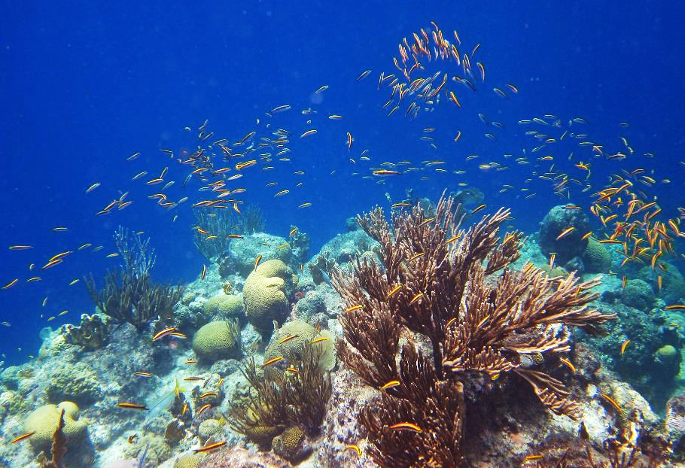
Coral Reef near Curacao

Slide 6
"I am the Alpha and the Omega," says the Lord God, who is and who was and who is to come, the Almighty.
Revelation 1:8

Slide 7
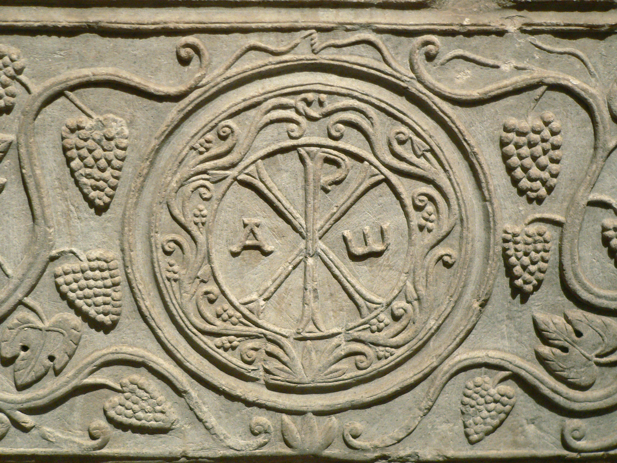
Sarcophagus of Drausin -- Louvre, Paris, France

Slide 8
When it was evening on that day, the first day of the week, … Jesus came and stood among them and said, "Peace be with you."
John 20:19ac

Slide 9
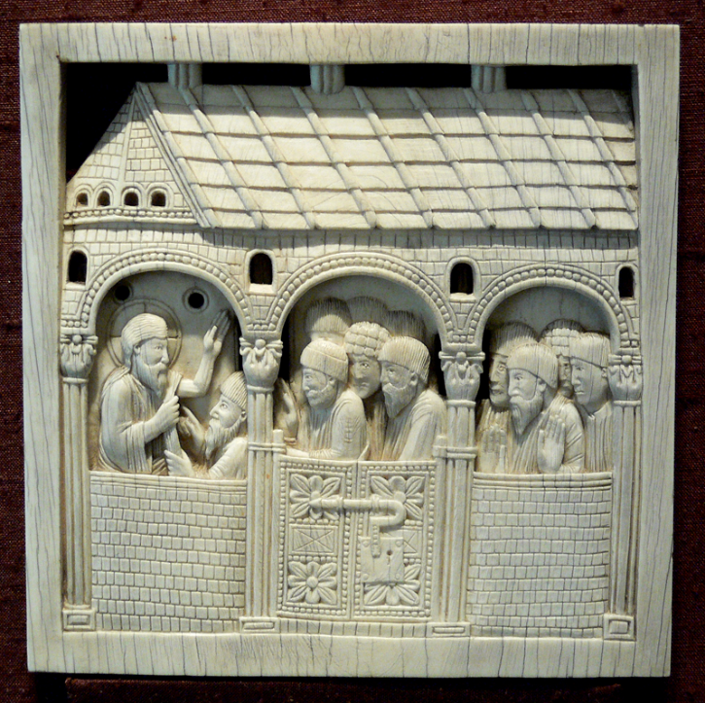
Christ Appearing to His Disciples
Bavarian National Museum, Munich, Germany

Slide 10
… he breathed on them and said to them, "Receive the Holy Spirit.”
John 20:22b

Slide 11
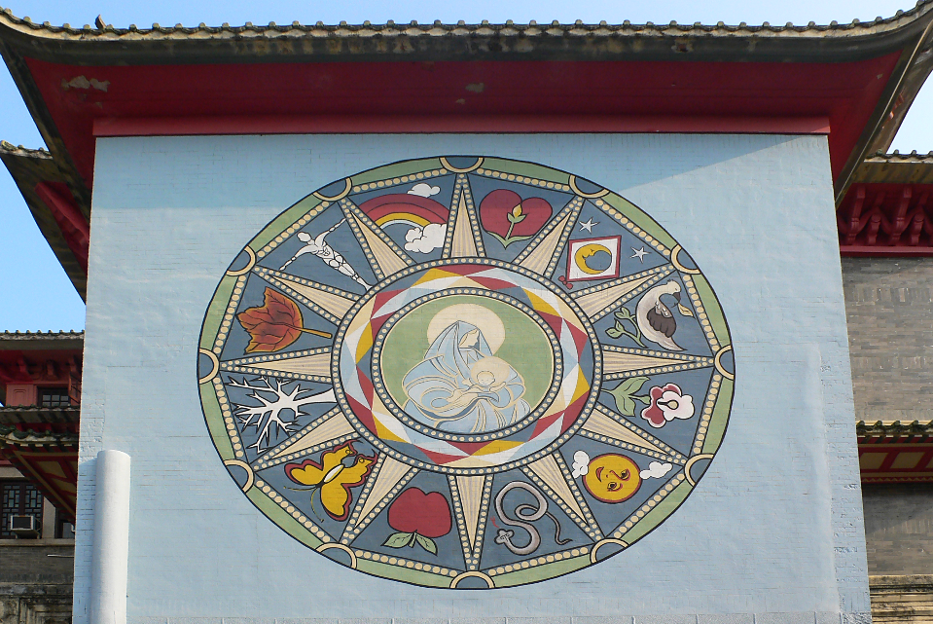
Holy Spirit -- Holy Spirit Seminary, Hong Kong, China

Slide 12
But Thomas…was not with them when Jesus came. So the other disciples told him, "We have seen the Lord."
John 20:24ac, 25a

Slide 13
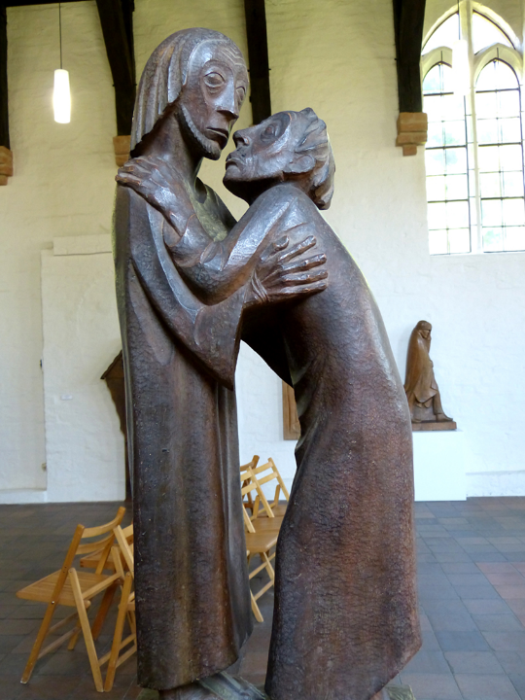
Reunion
Ernst Barlach
St. Gertrude’s Chapel, Gustrow, Germany

Slide 14
But he said to them, "Unless I see the mark of the nails in his hands, and put my finger in the mark of the nails and my hand in his side, I will not believe."
John 20:25b

Slide 15
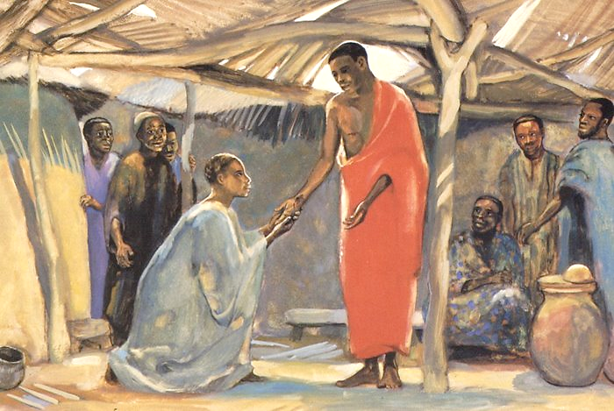
Christ with Thomas -- JESUS MAFA, Cameroon

Slide 16
A week later his disciples were again in the house, and Thomas was with them … Jesus came and stood among them and said, "Peace be with you."
John 20:26ac

Slide 17
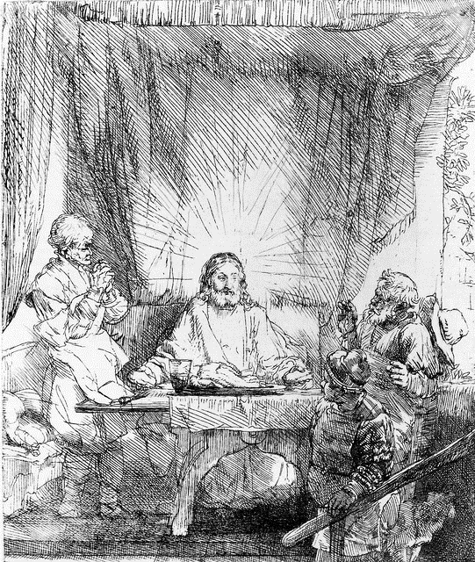
Supper at Emmaus
Rembrandt, etching

Slide 18
Then he said to Thomas, "Put your finger here and see my hands. Reach out your hand and put it in my side.
John 20:27

Slide 19
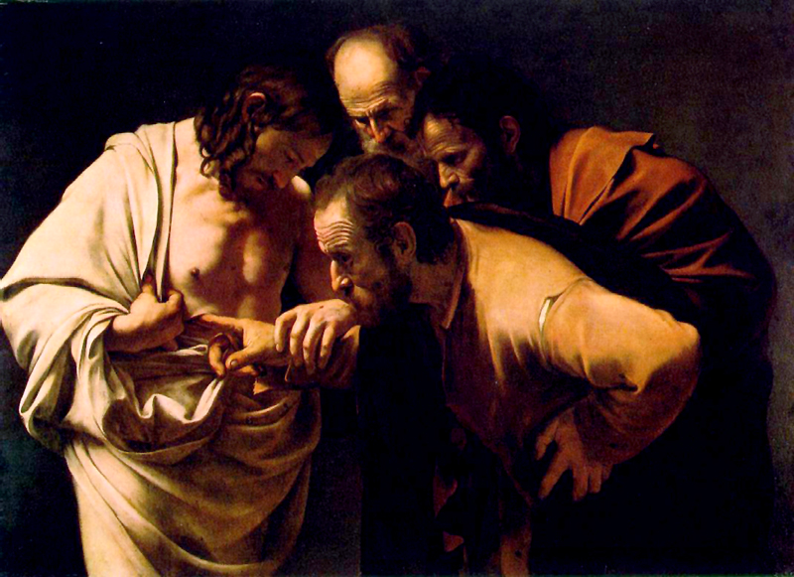
The Incredulity of Thomas -- Caravaggio, Sanssouci, Potsdam, Germany

Slide 20
Thomas answered him, "My Lord and my God!"
John 20:28

Slide 21
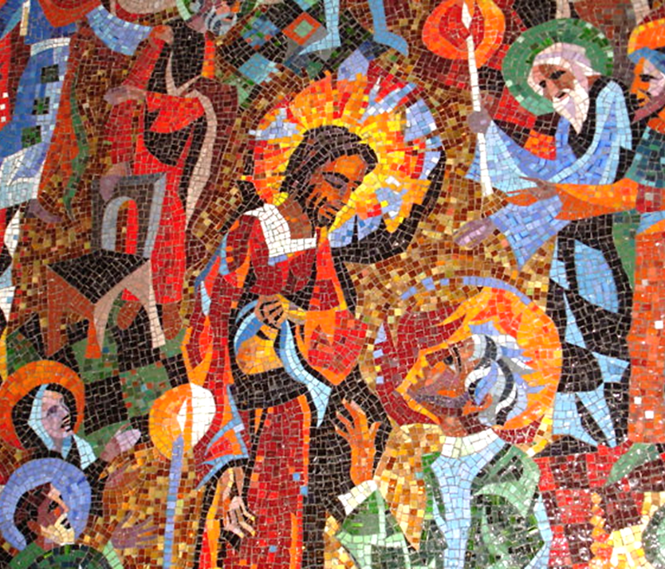
Christ with Thomas
Rowan and Irene LeCompte, Washington Cathedral, DC

Slide 22
Credits
New Revised Standard Version Bible, copyright 1989, Division of Christian Education of the National Council of the Churches of Christ in the United States of America. Used by permission. All rights reserved.
https://commons.wikimedia.org/wiki/File:God_is_Love.JPG
https://www.flickr.com/photos/dfinney23/9721975358/ - Doug Finney
https://commons.wikimedia.org/wiki/File:Sarcophage_de_Drausin_03.JPG
http://commons.wikimedia.org/wiki/File:Elfenbein_Christus_erscheint_seinen_J%C3%BCngern_BNM.jpg
https://commons.wikimedia.org/wiki/File:The_Wall_Painting_in_Holy_Spirit_Seminary.JPG
https://commons.wikimedia.org/wiki/File:G%C3%BCstrow_Gertrudenkapelle_-_Barlachsammlung_Wiedersehen_1.jpg
https://www.flickr.com/photos/jimforest/4562776090/
http://commons.wikimedia.org/wiki/File:The_Incredulity_of_Saint_Thomas_by_Caravaggio.jpg
http://www.flickr.com/photos/maryannsolari/5119341372/
http://diglib.library.vanderbilt.edu/act-imagelink.pl?RC=48302
Additional descriptions can be found at the Art in the Christian Tradition image library, a service of the Vanderbilt Divinity Library, http://diglib.library.vanderbilt.edu/. All images available via Creative Commons 3.0 License.

