Slide 1
SECOND SUNDAY AFTER CHRISTMAS DAY
Year C
Jeremiah 31:7-14 or Sirach 24:1-12 • Psalm 147:12-20 or Wisdom of Solomon 10:15-21 • Ephesians 1:3-14
John 1:(1-9), 10-18

Slide 2
In the beginning was the Word, and the Word was with God, and the Word was God.
John 1:1

Slide 3
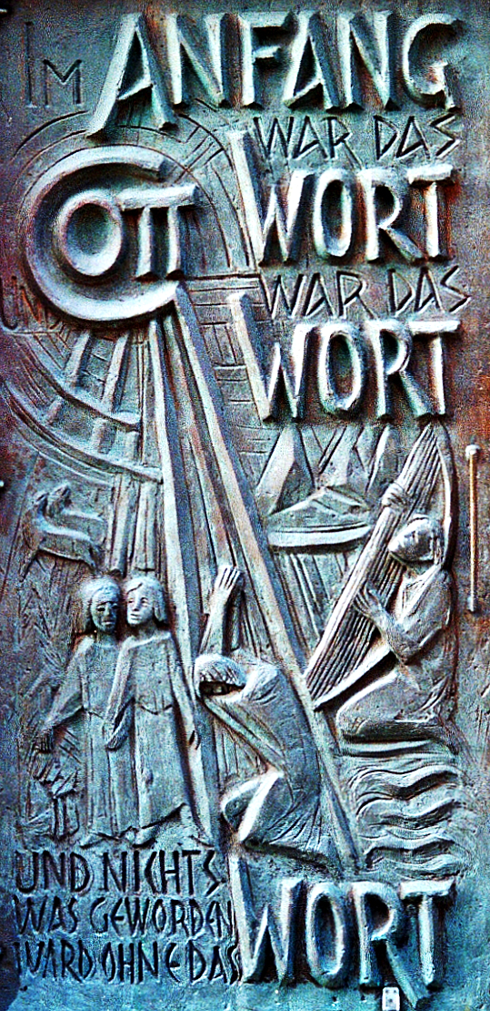
In the Beginning Was the Word
Josef Krautwald
St. Dionysius Parish Church, Recht, Germany

Slide 4
He was in the beginning with God. All things came into being through him, and without him not one thing came into being.
John 1:2-3a

Slide 5
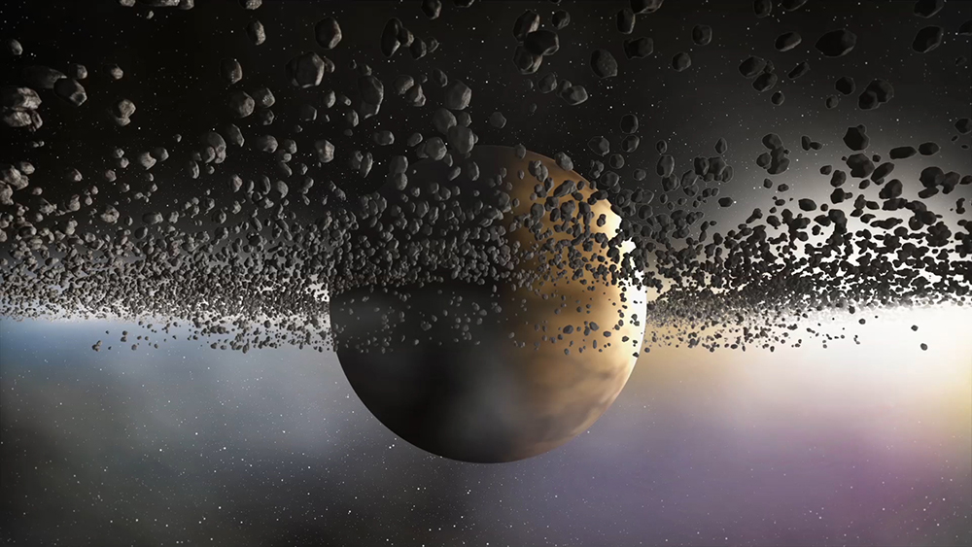
God’s Authority – “In the beginning …” – Seth Drum, graphic art

Slide 6
What has come into being in him was life, and the life was the light of all people.
John 1:3b-4

Slide 7
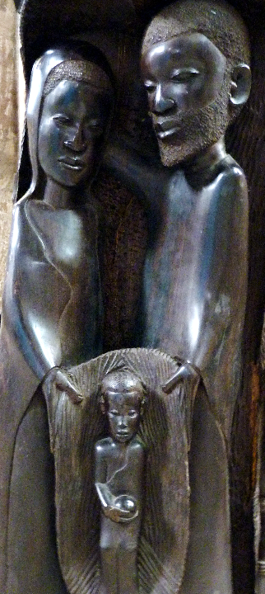
African Nativity
St. Sebaldus
Nuremburg, Germany

Slide 8
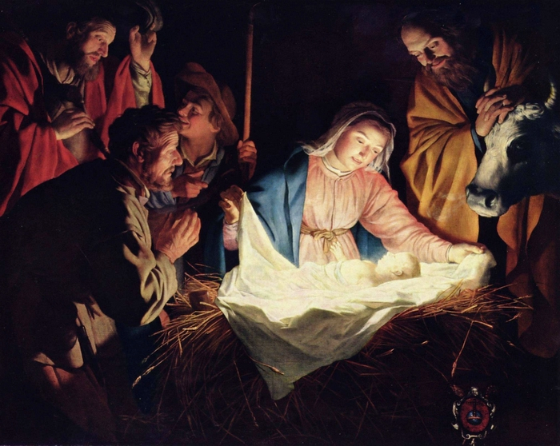
Adoration of the Shepherds -- Gerrit van Honthorst, Wallraf-Richartz Museum, Cologne, GDR

Slide 9
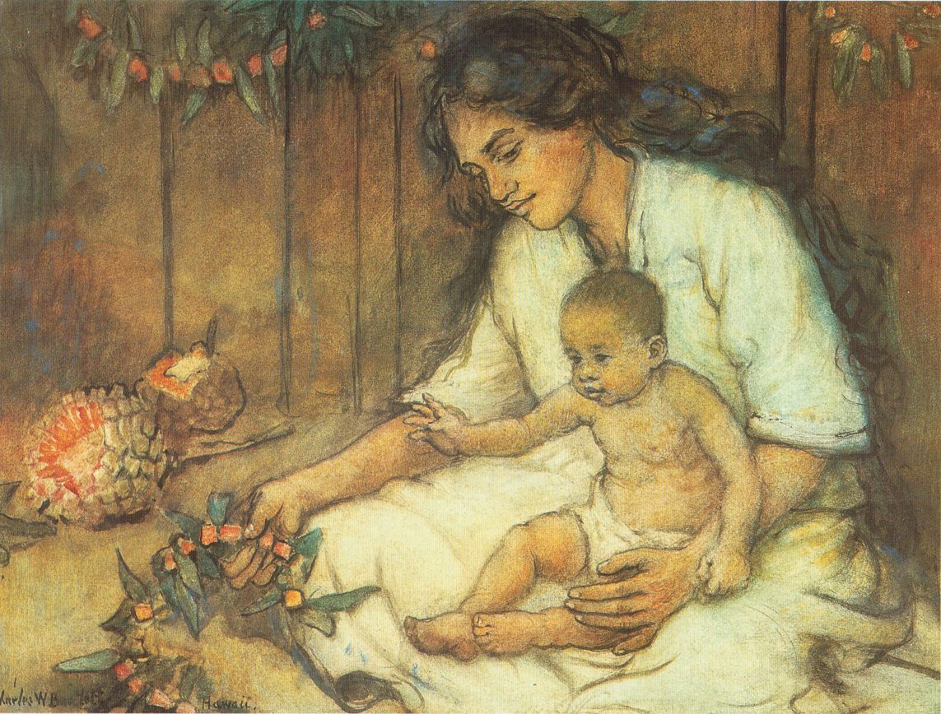
Mother and Child -- Charles Bartlett

Slide 10
The light shines in the darkness, and the darkness did not overcome it.
John 1:5

Slide 11
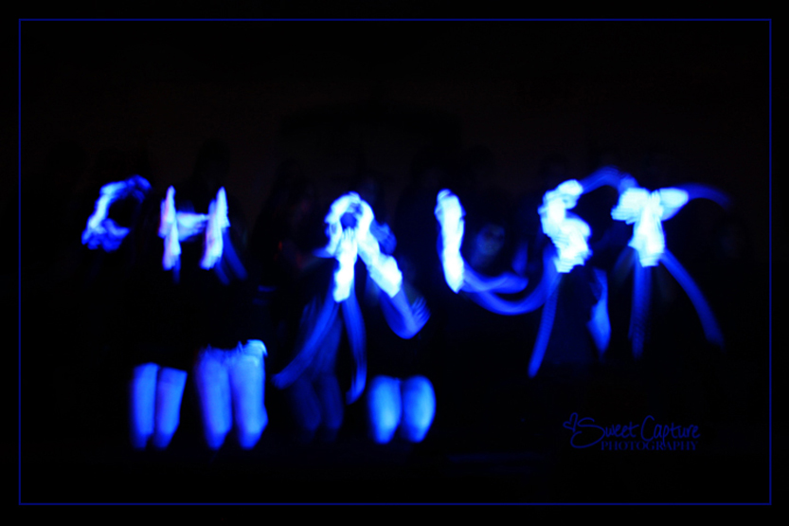
Light of the World -- Presentation by youth with gloves in dark space

Slide 12
There was a man sent from God, whose name was John.
John 1:6

Slide 13
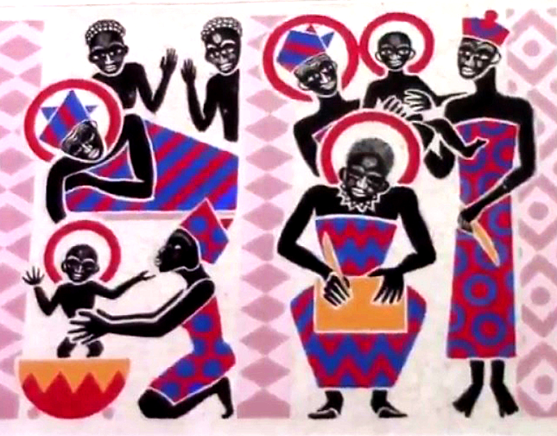
Birth and Naming of John the Baptist -- Father George Saget, Keur Moussa Abbey, Kenya

Slide 14
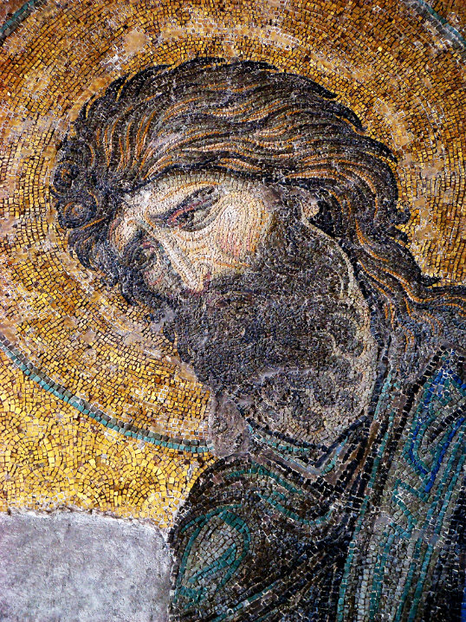
John the Baptist
Mosaic,
Hagia Sophia
Istanbul, Turkey

Slide 15
He came as a witness to testify to the light, so that all might believe through him.
John 1:7

Slide 16
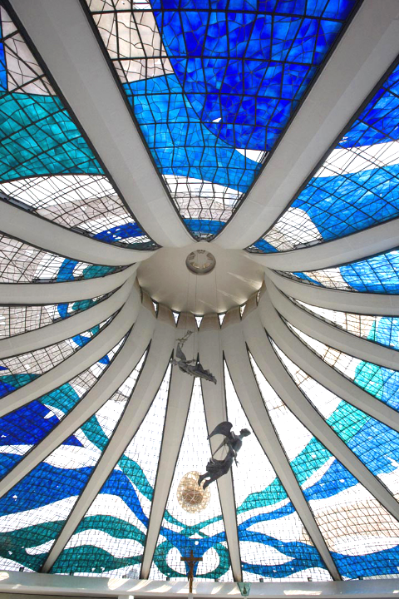
Light from the Dome
Oscar Niemeyer
Brasilia Cathedral
Brasilia, Brazil

Slide 17
He himself was not the light, but he came to testify to the light.
John 1:8

Slide 18
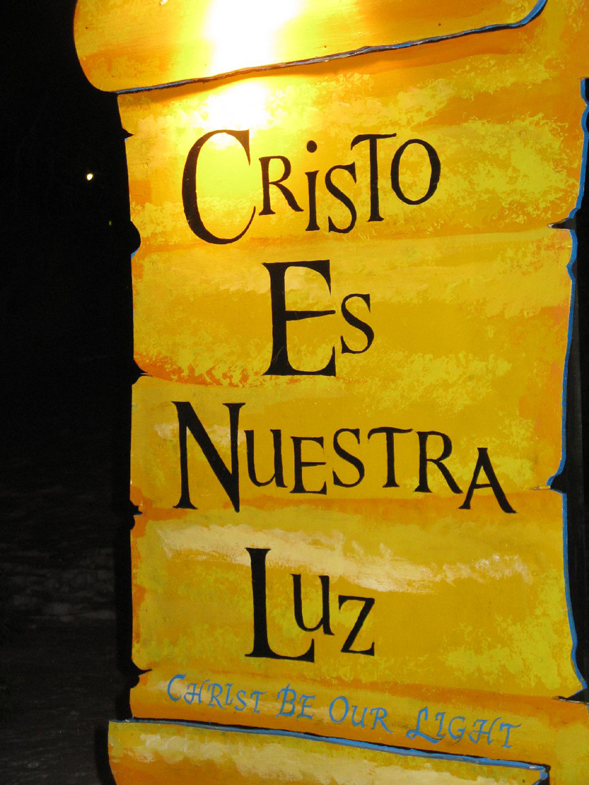
Christ Be Our Light
LaSalette Festival
Attleboro, MA

Slide 19
The true light, which enlightens everyone, was coming into the world.
John 1:9

Slide 20
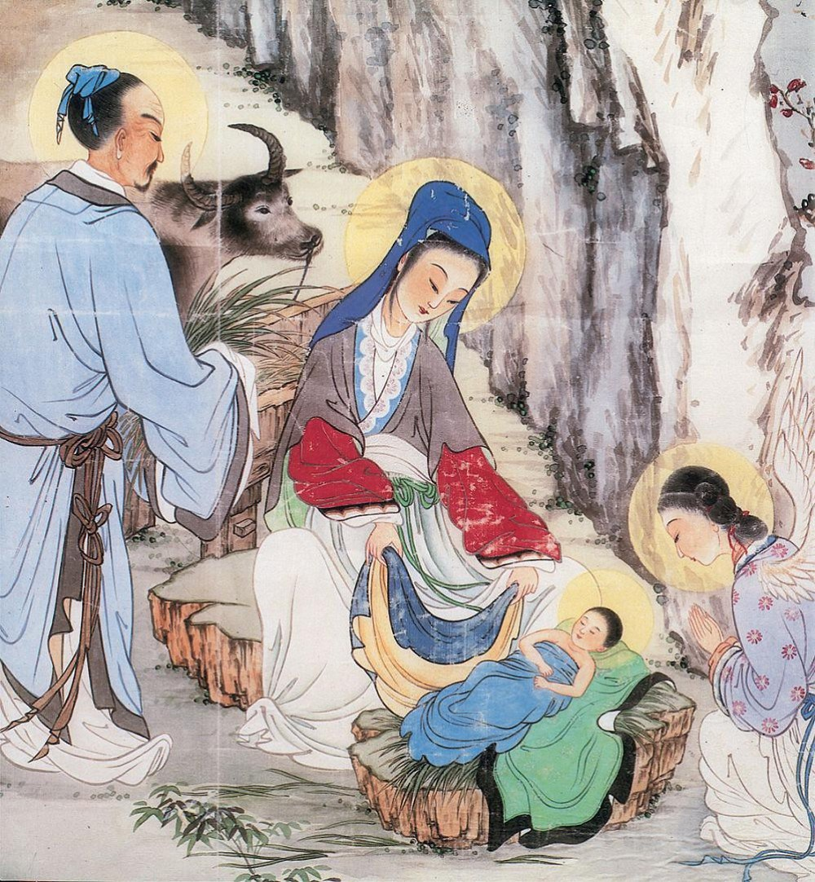
Birth of Christ
Chinese
c. 2000

Slide 21
And the Word became flesh and lived among us … full of grace and truth.
John 1:14ac

Slide 22
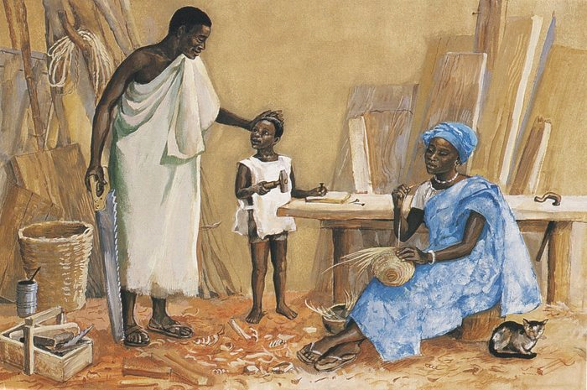
Jesus as a Child -- JESUS MAFA, Cameroon

Slide 23
Credits
New Revised Standard Version Bible, copyright 1989, Division of Christian Education of the National Council of the Churches of Christ in the United States of America. Used by permission. All rights reserved.
https://commons.wikimedia.org/wiki/File:St_Dionysius_Hauptportal_Tuer_1.jpg – J. H. Jansen
https://www.flickr.com/photos/seth_drum/34308713902 - Seth Drum
https://www.flickr.com/photos/damiavos/14859315278
https://commons.wikimedia.org/wiki/File:Gerard_van_Honthorst_001.jpg
https://commons.wikimedia.org/wiki/File:Charles_W._Bartlett_-_%27Hawaiian_Mother_and_Child%27,_watercolor_and_pastel_on_art_board,_c._1920.jpg
www.robertharding.com
http://www.flickr.com/photos/cuonhigh/3398636812/
https://www.flickr.com/photos/frenchieb/590576803 – F. Tronchin
http://www.flickr.com/photos/babasteve/3124402502/
http://www.flickr.com/photos/heartlover1717/4141462290/
https://commons.wikimedia.org/wiki/File:Chinese_painting_of_birth_of_Christ.jpg
http://diglib.library.vanderbilt.edu/act-imagelink.pl?RC=48304
Additional descriptions can be found at the Art in the Christian Tradition image library, a service of the Vanderbilt Divinity Library, http://diglib.library.vanderbilt.edu/. All images available via Creative Commons 3.0 License.

