Slide 1
RESURRECTION OF THE LORD
Year C
Acts 10:34-43 or Isaiah 65:17-25 Psalm 118:1-2, 14-24
1 Corinthians 15:19-26 or
Acts 10:34-43 • John 20:1-18 or Luke 24:1-12

Slide 2
They put him to death by hanging him on a tree; but God raised him on the third day …
Acts 10:39b-40a

Slide 3
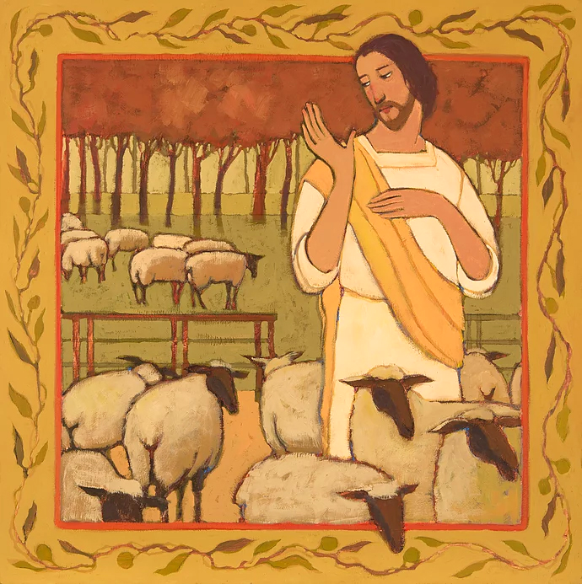
Christ the Good Shepherd
Kathleen Peterson

Slide 4
For I am about to create new heavens and a new earth; … be glad and rejoice forever …
Isaiah 65:17a, 18a

Slide 5
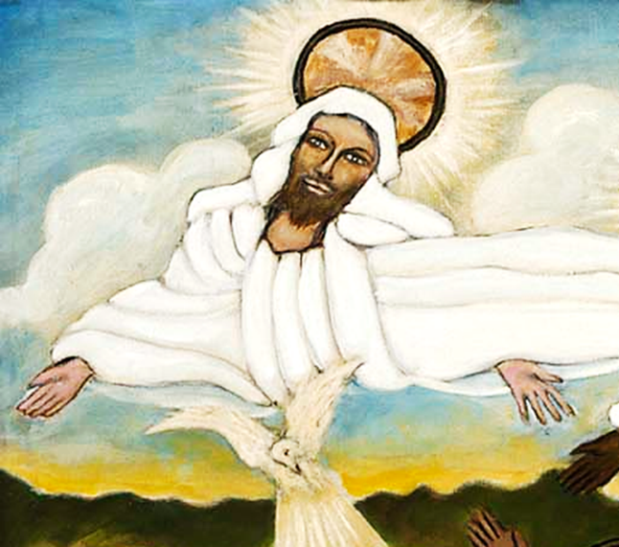
Baptism of Christ, detail of God -- Lorenzo Scott, Smithsonian Museum of American Art, Washington, DC

Slide 6
Christ has been raised from the dead … so all will be made alive in Christ.
1 Corinthians 15:20b, 22b

Slide 7
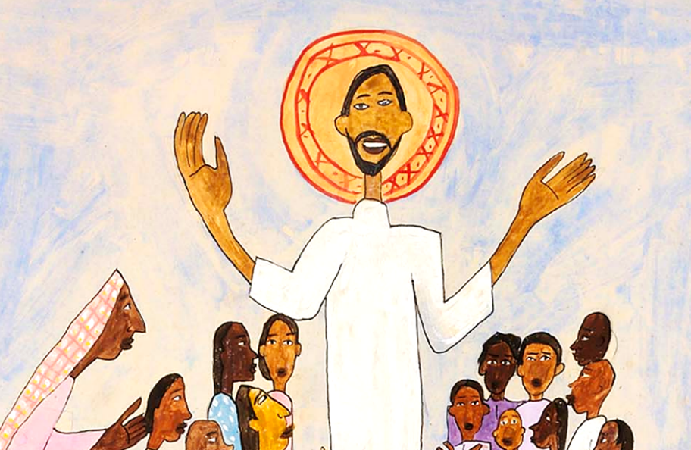
Come Unto Me, Little Children -- William H. Johnson, Smithsonian Museum of American Art, DC

Slide 8
But on the first day of the week, at early dawn, they came to the tomb, taking the spices that they had prepared.
Luke 24:1

Slide 9
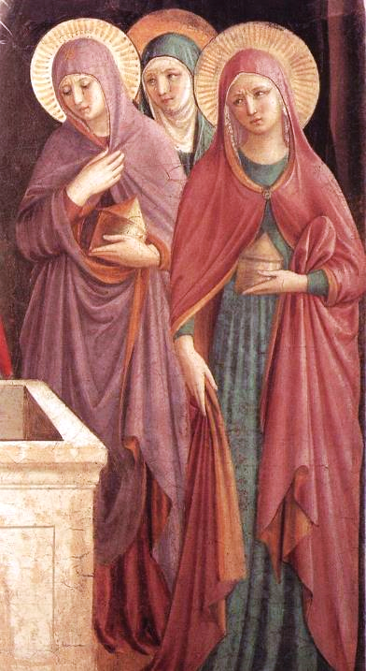
Women at the Tomb
Gozzoli and Fra Angelico
Museum of San Marco
Florence, Italy

Slide 10
They found the stone rolled away from the tomb, but when they went in, they did not find the body.
Luke 24:2-3

Slide 11
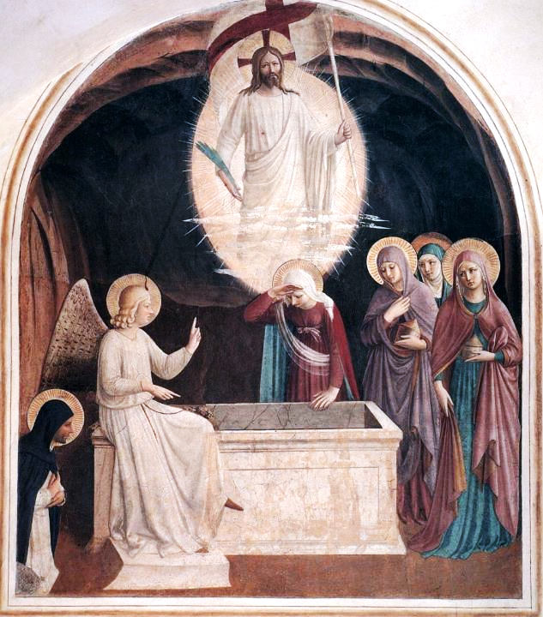
The Women at the Empty Tomb
Gozzoli and Fra Angelico
Museum of San Marco
Florence, Italy

Slide 12
While they were perplexed about this, suddenly two men in dazzling clothes stood beside them.
Luke 24:4

Slide 13
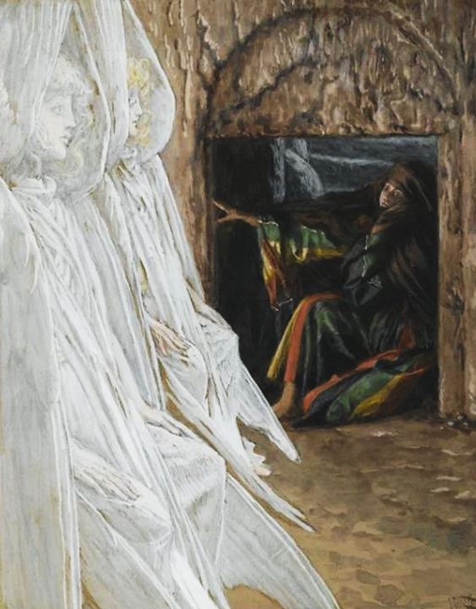
Mary and the Two Angels
James Tissot
Brooklyn Museum
New York, NY

Slide 14
The women were terrified … but the men said to them, "Why do you look for the living among the dead? He is not here, but has risen.
Luke 24:5ac

Slide 15
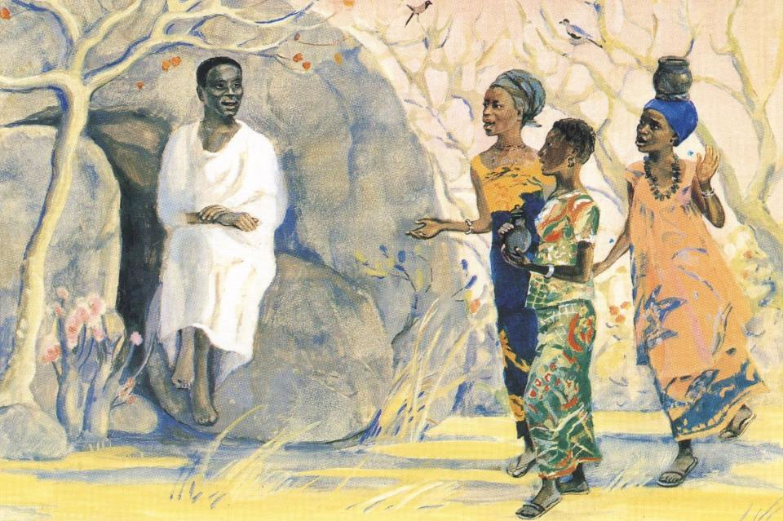
Women at the Tomb -- JESUS MAFA, Cameroon

Slide 16
Remember how he told you, while he was still in Galilee, that the Son of Man must be handed over to sinners,
Luke 24:6-7a

Slide 17
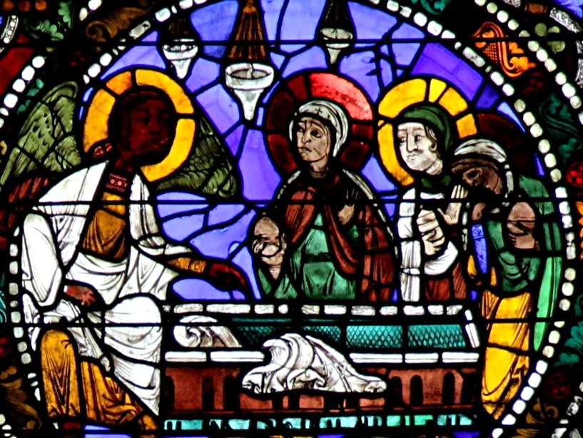
Women at the Tomb -- Chartres Cathedral, Chartres, France

Slide 18
and be crucified, and on the third day rise again."
Luke 24:7b

Slide 19
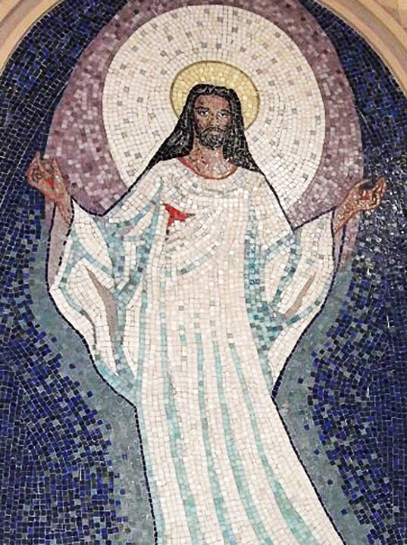
Resurrection of Christ
Church of Saint Sebastian
Porto Alegre, Brazil

Slide 20
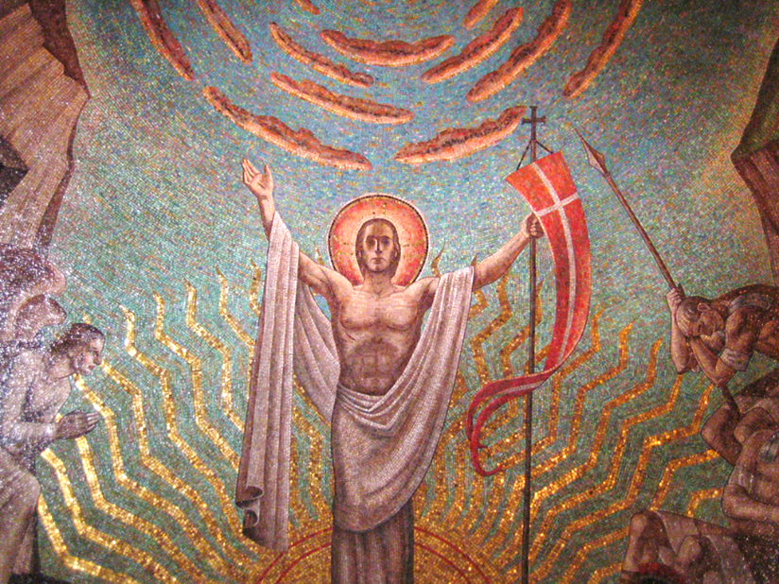
Resurrection of Christ -- Hildreth Meire, Washington National Cathedral, Washington, DC

Slide 21
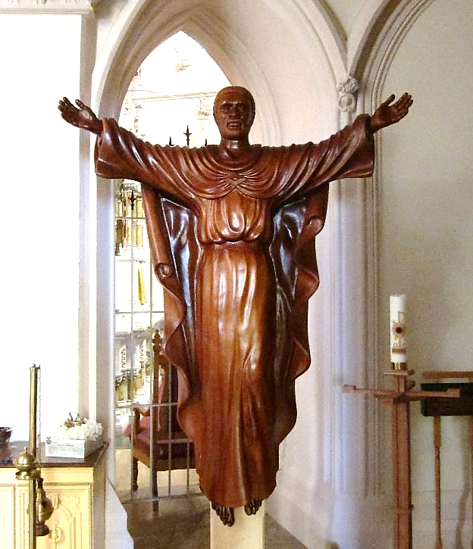
Risen Christ from Uganda
Basilica of Saint Mary
Norfolk, VA

Slide 22
Credits
New Revised Standard Version Bible, copyright 1989, Division of Christian Education of the National Council of the Churches of Christ in the United States of America. Used by permission. All rights reserved.
https://www.kathleenpetersonart.com
http://americanart.si.edu/collections/search/artwork/?id=33953
http://americanart.si.edu/collections/search/artwork/?id=11621
https://commons.wikimedia.org/wiki/File:Benozzo_Gozzoli_-_Women_at_the_Tomb_(detail)_-_WGA10210.jpg
https://commons.wikimedia.org/wiki/File:Fra_Angelico_-_Resurrection_of_Christ_and_Women_at_the_Tomb_(Cell_8)_-_WGA00542.jpg
https://commons.wikimedia.org/wiki/File:Brooklyn_Museum_-_Mary_Magdalene_Questions_the_Angels_in_the_Tomb_(Madeleine_dans_le_tombeau_interroge_les_anges)_-_James_Tissot.jpg
http://diglib.library.vanderbilt.edu/act-imagelink.pl?RC=48301
https://commons.wikimedia.org/wiki/File:Chartres-051_-_e2_-_Resurrection_-_tombeau_vide.jpg - Micheletb
https://commons.wikimedia.org/wiki/File:0000_Mosaics_of_Resurrection_of_Christ.JPG
https://www.flickr.com/photos/mcolburn/394714737
https://commons.wikimedia.org/wiki/File:Basilica_of_Saint_Mary_of_the_Immaculate_Conception_(Norfolk,_Virginia),_interior,_wooden_statue_of_the_risen_Christ,_from_Uganda.jpg
https://commons.wikimedia.org/wiki/File:0000_Mosaics_of_Resurrection_of_Christ.JPG - Eugenio Hansen, OFS
Additional descriptions can be found at the Art in the Christian Tradition image library, a service of the Vanderbilt Divinity Library, http://diglib.library.vanderbilt.edu/. All images available via Creative Commons 3.0 License.

