Slide 1
Second Sunday after Pentecost
Year C
1 Kings 19:1-4, (5-7), 8-15a and Psalm 42 and 43 • Isaiah 65:1-9 and Psalm 22:19-28 • Galatians 3:23-29 • Luke 8:26-39

Slide 2
Now there was a great wind …
but the LORD was not in the wind;
and after the wind an earthquake,
but the LORD was not in the earthquake; and after the earthquake a fire,
but the LORD was not in the fire;
and after the fire a sound of sheer silence.
I Kings 19:11bd, 12

Slide 3
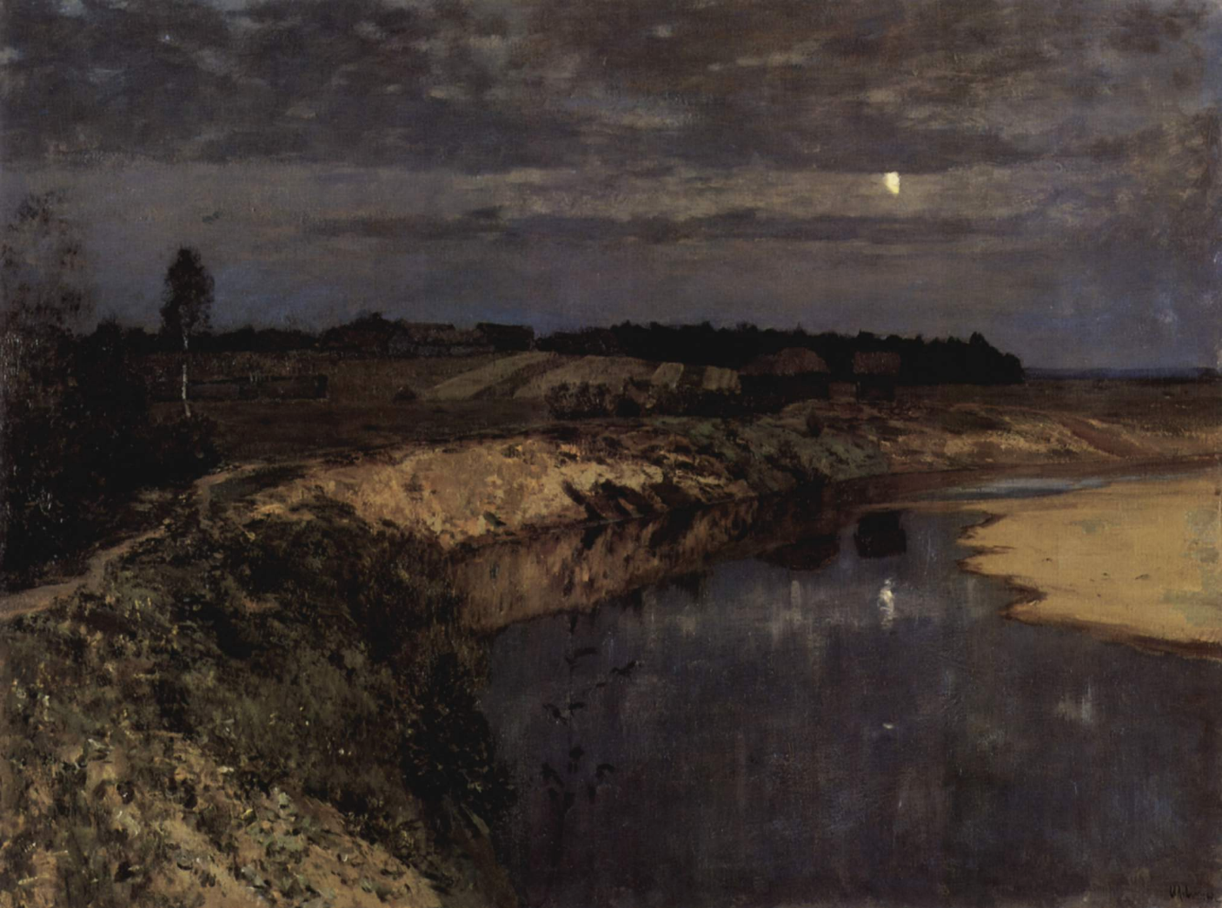
Silence -- Isaac Levitan, State Russian Museum, St. Petersburg

Slide 4
Deep calls to deep at the thunder of your cataracts; all your waves and your billows have gone over me.
Psalm 42:7

Slide 5
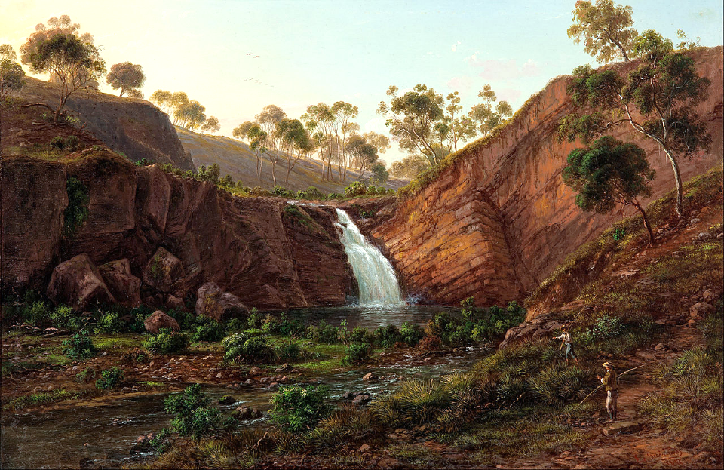
Waterfall on the Clyde River, Tasmania -- Eugene von Guerard, Art Gallery of South Australia, Adelaide

Slide 6
By day the LORD commands his steadfast love, and at night his song is with me, a prayer to the God of my life.
Psalm 42:8

Slide 7
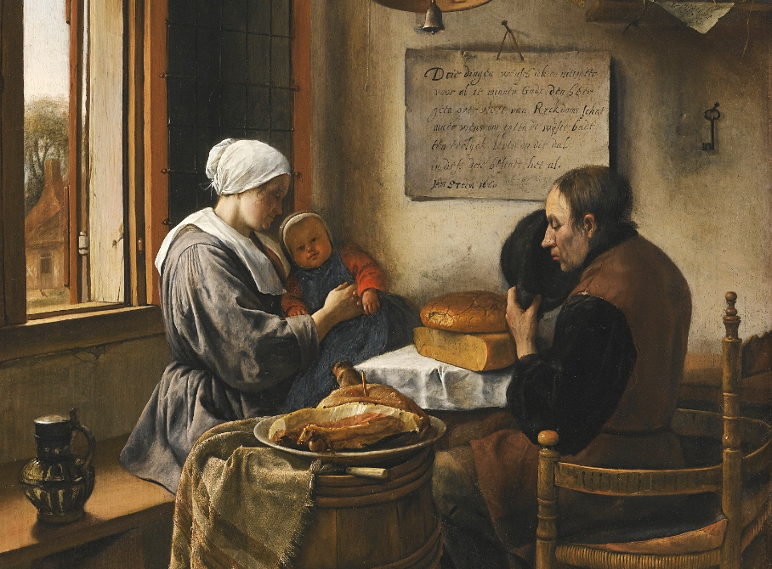
The Prayer Before the Meal -- Jan Steen, 1660

Slide 8
I held out my hands all day long to a rebellious people, who walk in a way that is not good, following their own devices;
Isaiah 65:2

Slide 9
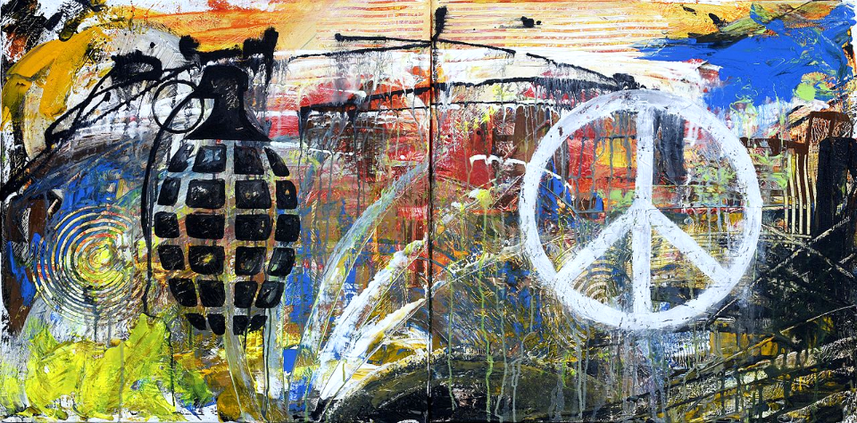
War and Peace -- Staff Sgt. Jamal Sutter, Charleston Air Force Base, Charleston, SC

Slide 10
For he did not despise or abhor the affliction of the afflicted; he did not hide his face from me, but heard when I cried to him.
Psalm 22:24

Slide 11
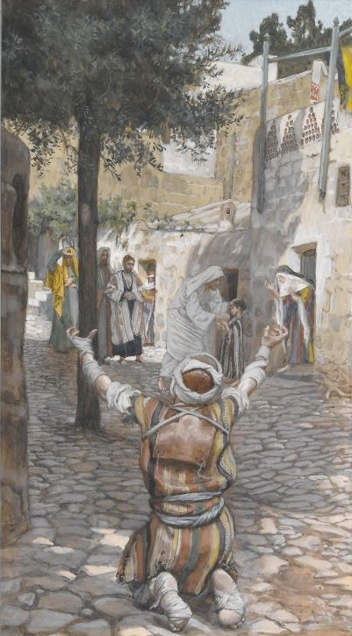
Healing of the Leper at Capernaum
James Tissot
Brooklyn Museum
New York, NY

Slide 12
There is no longer Jew or Greek, there is no longer slave or free, there is no longer male and female; for all of you are one in Christ Jesus.
Galatians 3:28

Slide 13
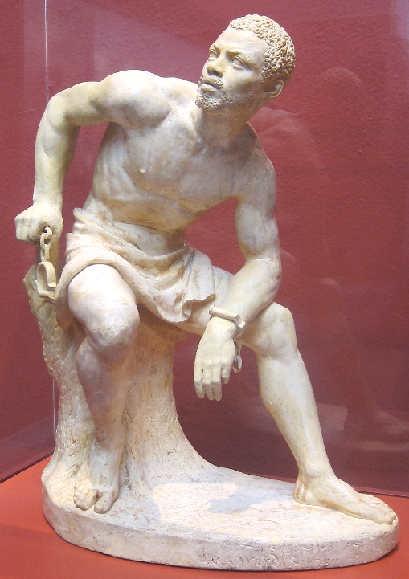
Freedman
John Quincy Adams Ward
Pennsylvania Academy of Fine Arts
Philadelphia, PA

Slide 14
They arrived at the country of the Gerasenes … a man of the city who had demons met him. "What have you to do with me, Jesus, Son of the Most High God? I beg you, do not torment me"--
Luke 8:26a, 27b, 28c

Slide 15
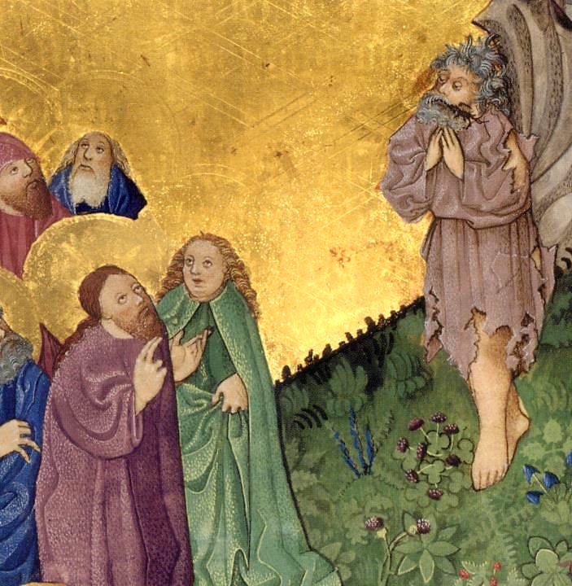
Jesus Meets the Gerasene Demoniac
Ottenreich Folio
Bavarian State Library
Munich, Germany

Slide 16
Now there on the hillside a large herd of swine was feeding; and the demons begged Jesus to let them enter these. So he gave them permission.
Luke 8:32

Slide 17
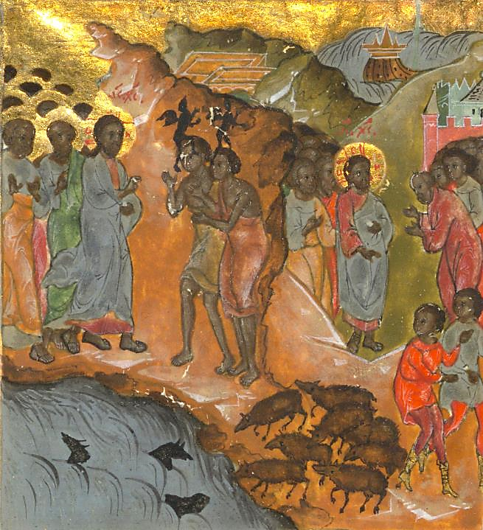
The Gerasene Demoniac
Luke the Cypriot
Walters Art Museum
Baltimore, MD

Slide 18
Then the demons came out of the man and entered the swine, and the herd rushed down the steep bank into the lake and was drowned.
Luke 8:33

Slide 19
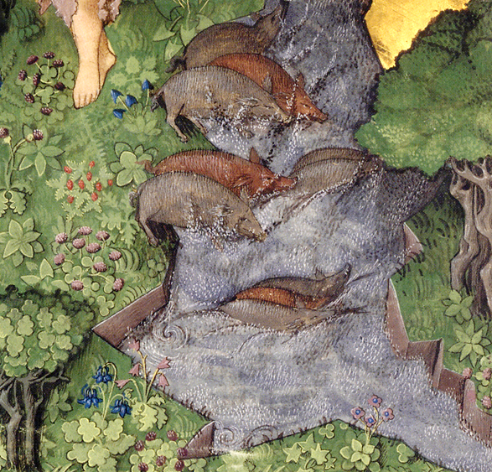
The Demons Enter the Pigs
Ottenreich Folio
Bavarian State Library
Munich, Germany

Slide 20
The man from whom the demons had gone begged that he might be with him; but Jesus sent him away, saying,
Luke 8:38

Slide 21
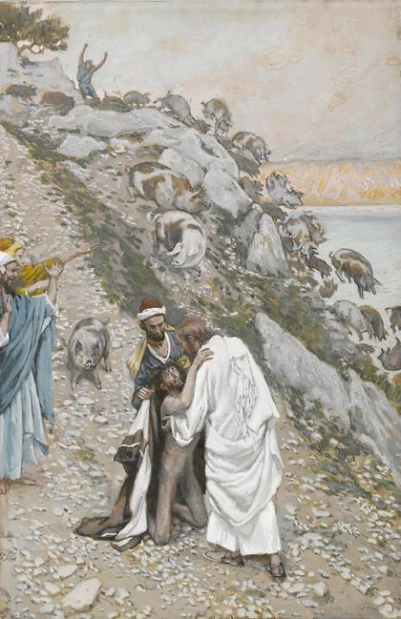
Jesus, the Gerasene, and the Unclean Spirits
James Tissot
Brooklyn Museum of Art
New York, NY

Slide 22
"Return to your home, and declare how much God has done for you." So he went away, proclaiming throughout the city how much Jesus had done for him.
Luke 8:39

Slide 23
Credits
New Revised Standard Version Bible, copyright 1989, Division of Christian Education of the National Council of the Churches of Christ in the United States of America. Used by permission. All rights reserved.
https://commons.wikimedia.org/wiki/File:Isaak_Ilitsch_Lewitan_003.jpg
https://commons.wikimedia.org/wiki/File:Eugene_von_GU%C3%89Rard_-_Waterfall_on_the_Clyde_River,_Tasmania_-_Google_Art_Project.jpg
https://commons.wikimedia.org/wiki/File:Jan_Steen_-_The_Prayer_Before_the_Meal,_1660.jpg
https://commons.wikimedia.org/wiki/File:Fine_Art,_War_and_peace_(Honorable_Mention)_141202-F-PO994-001.jpg
https://commons.wikimedia.org/wiki/File:Brooklyn_Museum_-_Healing_of_the_Lepers_at_Capernaum_(Gu%C3%A9rison_des_l%C3%A9preux_%C3%A0_Capernaum)_-_James_Tissot_-_overall.jpg
https://commons.wikimedia.org/wiki/File:%27Freedman%27,_plaster_sculpture_by_John_Quincy_Adams_Ward,.JPG - Wmpearl
https://commons.wikimedia.org/wiki/File:Ottheinrich_Folio051r_Mc5A.jpg
https://www.flickr.com/photos/medmss/7352474870/
https://commons.wikimedia.org/wiki/File:Ottheinrich_Folio051r_Mc5A.jpg
https://commons.wikimedia.org/wiki/File:Brooklyn_Museum_-_The_Swine_Driven_into_the_Sea_(Les_porcs_pr%C3%A9cipit%C3%A9s_dans_la_mer)_-_James_Tissot.jpg
Additional descriptions can be found at the Art in the Christian Tradition image library, a service of the Vanderbilt Divinity Library, http://diglib.library.vanderbilt.edu/. All images available via Creative Commons 3.0 License.

