Slide 1
Third Sunday after Pentecost
1 Kings 21:1-10, (11-14) and Psalm 5:1-8 or 2 Samuel 11:26-12:10 and Psalm 32
Galatians 2:15-21
Luke 7:36-8:3
Year C

Slide 2
Now there came a traveler to the rich man, and he was loath to take one of his own flock or herd to prepare for the wayfarer who had come to him, but he took the poor man’s lamb, and prepared that for the guest who had come to him.
2 Samuel 12:4

Slide 3
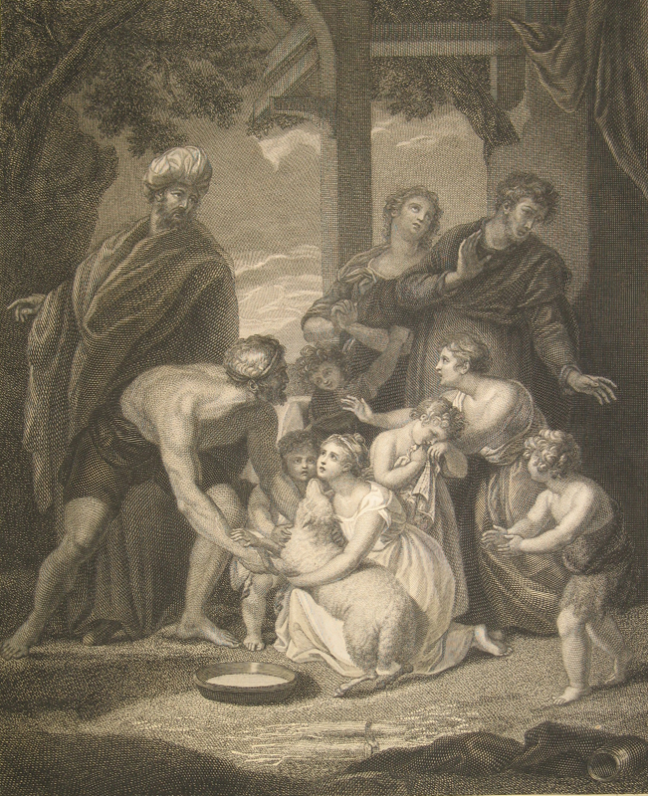
The Macklin Bible—Nathan’s Parable
Richard Martin Paye and Jean Marie Delattre, 1796

Slide 4
I will instruct you and teach you the way you should go; I will counsel you with my eye upon you.
Psalm 32:8

Slide 5
Lenten Labyrinth
Mike Moyers, 2012

Slide 6
Yet we know that a person is justified not by the works of the law but through faith in Jesus Christ.
Galatians 2:16a

Slide 7
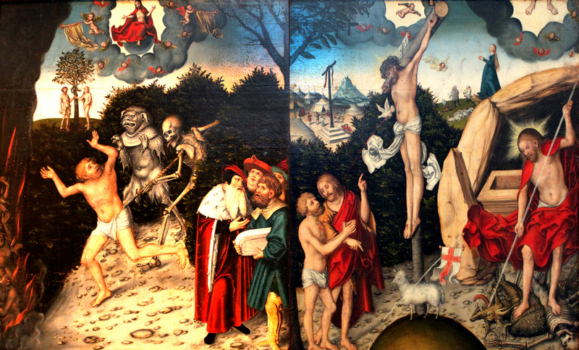
Allegory of Law and Grace, Lucas Cranach, 1529

Slide 8
And a woman in the city, who was a sinner, having learned that he was eating in the Pharisee’s house, brought an alabaster jar of ointment.
Luke 7:37

Slide 9
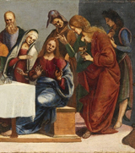
Anointing the Feet of Jesus in the House of Simon, the Pharisee, Luca Signorelli, ca. 1488-1490

Slide 10
She stood behind him at his feet, weeping, and began to bathe his feet with her tears and to dry them with her hair. Then she continued kissing his feet and anointing them with the ointment.
Luke 7:38

Slide 11
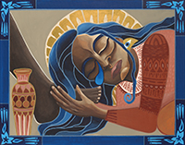
Anointed, Lauren Wright Pittman, 2018

Slide 12
Now when the Pharisee who had invited him saw it, he said to himself, “If this man were a prophet, he would have known who and what kind of woman this is who is touching him—that she is a sinner.”
Luke 7:39

Slide 13
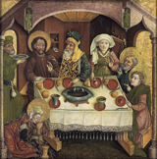
Anointing the Feet of Jesus in the House of Simon, the Pharisee, Allgau, Germany, ca. 1470-1480

Slide 14
Then turning toward the woman, he said to Simon, “Do you see this woman? I entered your house; you gave me no water for my feet, but she has bathed my feet with her tears and dried them with her hair.”
Luke 7:44

Slide 15
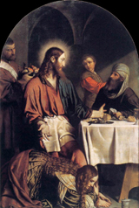
Anointing the Feet of Jesus in the House of Simon, the Pharisee
Moretto de Brescia
ca. 1550-1554

Slide 16
Therefore, I tell you, her sins, which were many, have been forgiven; hence she has shown great love. But the one to whom little is forgiven, loves little.”
Luke 7:47

Slide 17
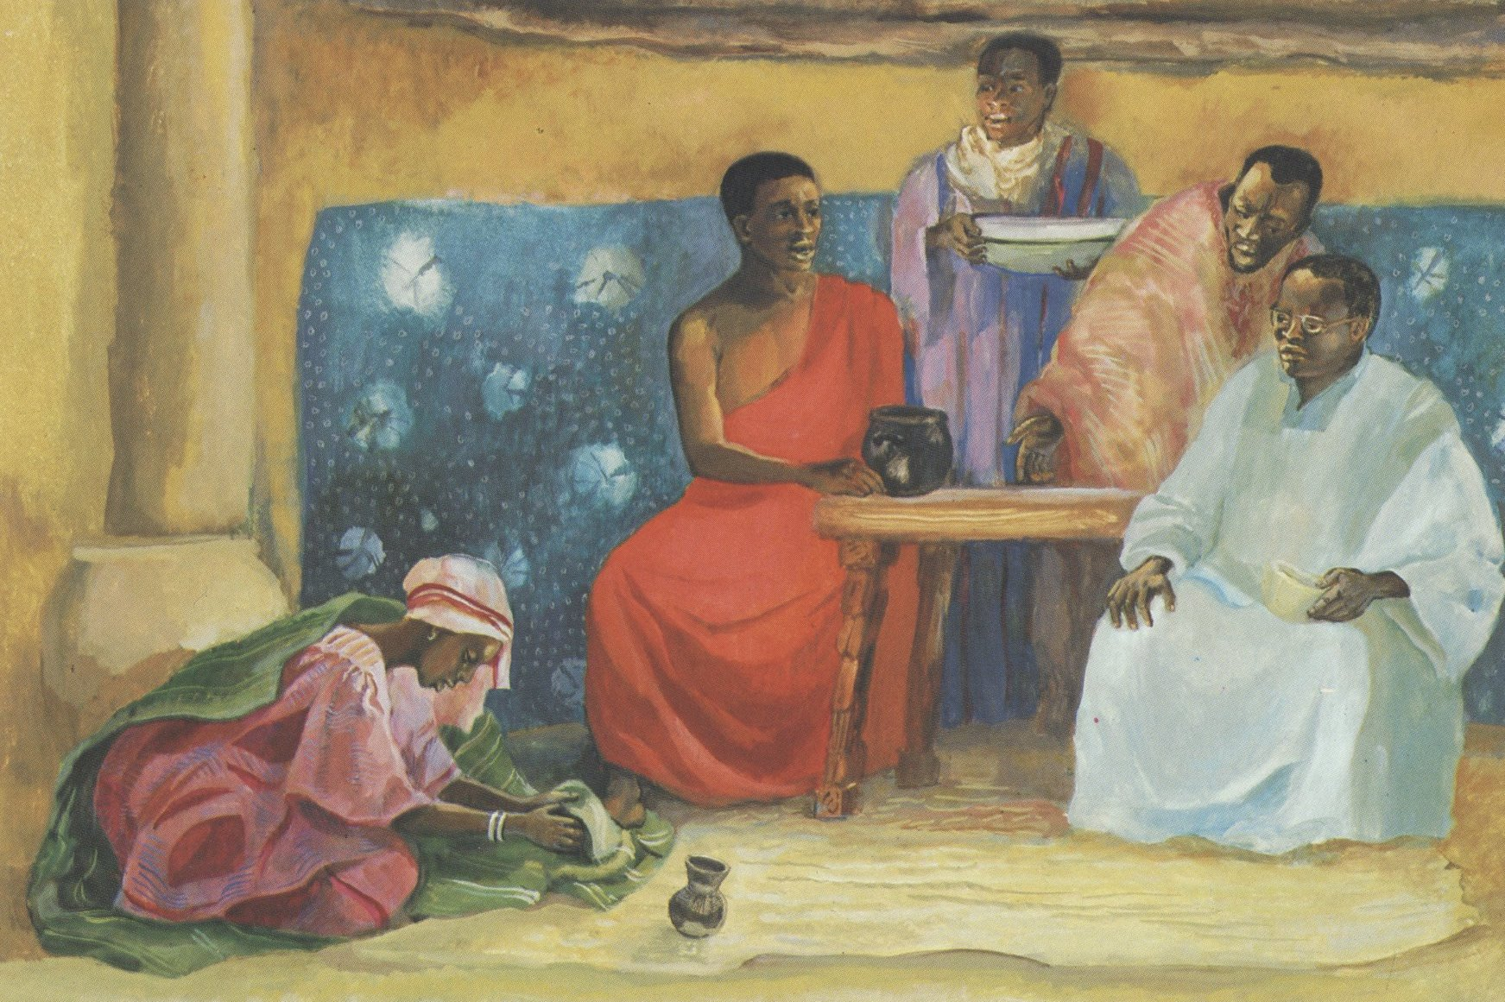
Jesus Speaks About Forgiveness, JESUS MAFA, 1973

Slide 18
But those who were at the table with him began to say among themselves, “Who is this who even forgives sins?”
Luke 7:49

Slide 19
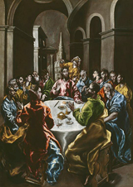
Anointing the Feet of Jesus in the House of Simon, the Pharisee
Greco
ca. 1608-1614

Slide 20
And he said to the woman, ”Your faith has saved you; go in peace.”
Luke 7:50

Slide 21
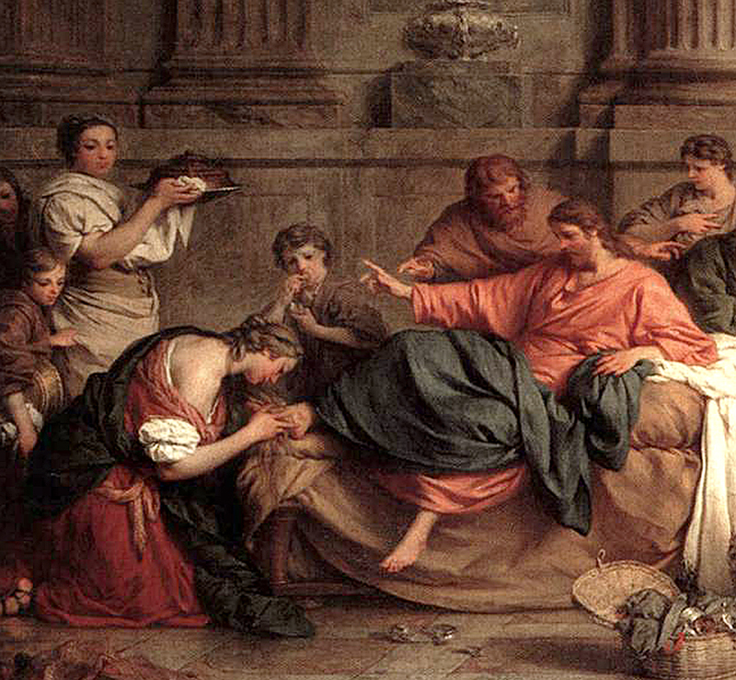
Anointing the Feet of Jesus in the House of Simon, the Pharisee
Pierre Subleyras, ca. 1737

Slide 22
Credits
New Revised Standard Version Bible, copyright 1989, Division of Christian Education of the National Council of the Churches of Christ in the United States of America. Used by permission. All rights reserved.
https://diglib.library.vanderbilt.edu/diglib-fulldisplay.pl?SID=20211125298000197&code=act&RC=54111&Row=18
https://www.mikemoyersfineart.com/
http://commons.wikimedia.org/wiki/File:1529_Cranach_Allegorie_auf_Gesetz_und_Gnade_anagoria.JPG
https://commons.wikimedia.org/wiki/File:Luca_Signorelli_-_Christ_in_the_House_of_Simon_the_Pharisee_-_National_Gallery_of_Ireland_(1).jpg
http://www.lewpstudio.com
https://commons.wikimedia.org/wiki/File:Christ_in_the_House_of_Simon_1470s.jpg
https://commons.wikimedia.org/wiki/File:Moretto_da_Brescia_-_Supper_in_the_House_of_Simon_Pharisee_-_WGA16229.jpg
https://diglib.library.vanderbilt.edu/diglib-fulldisplay.pl?SID=20211125298000197&code=act&RC=48384&Row=1
https://commons.wikimedia.org/wiki/File:Feast_in_the_House_of_Simon,_1608-14_El_Greco.jpg
https://commons.wikimedia.org/wiki/File:Pierre_Subleyras_-_Christ_at_the_House_of_Simon_the_Pharisee_-_WGA21959.jpg
Additional descriptions can be found at the Art in the Christian Tradition image library, a service of the Vanderbilt Divinity Library, http://diglib.library.vanderbilt.edu/. All images available via Creative Commons 3.0 License.

