Slide 1
Second Sunday after Pentecost
1 Kings 17:8-16, (17-24) and Psalm 146 or 1 Kings 17:17-24 and Psalm 30
Galatians 1:11-24
Luke 7:11-17
Year C

Slide 2
Elijah took the child, brought him down from the upper chamber into the house, and gave him to his mother; then Elijah said, ‘See, your son is alive.’
1 Kings 17:23

Slide 3
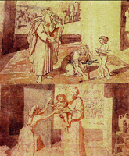
Elijah and the Widow of Zarephath
Aleksandr Andreevich, ca. 1850

Slide 4
You have turned my mourning into dancing; you have taken off my sackcloth and clothed me with joy …
Psalm 30:11

Slide 5
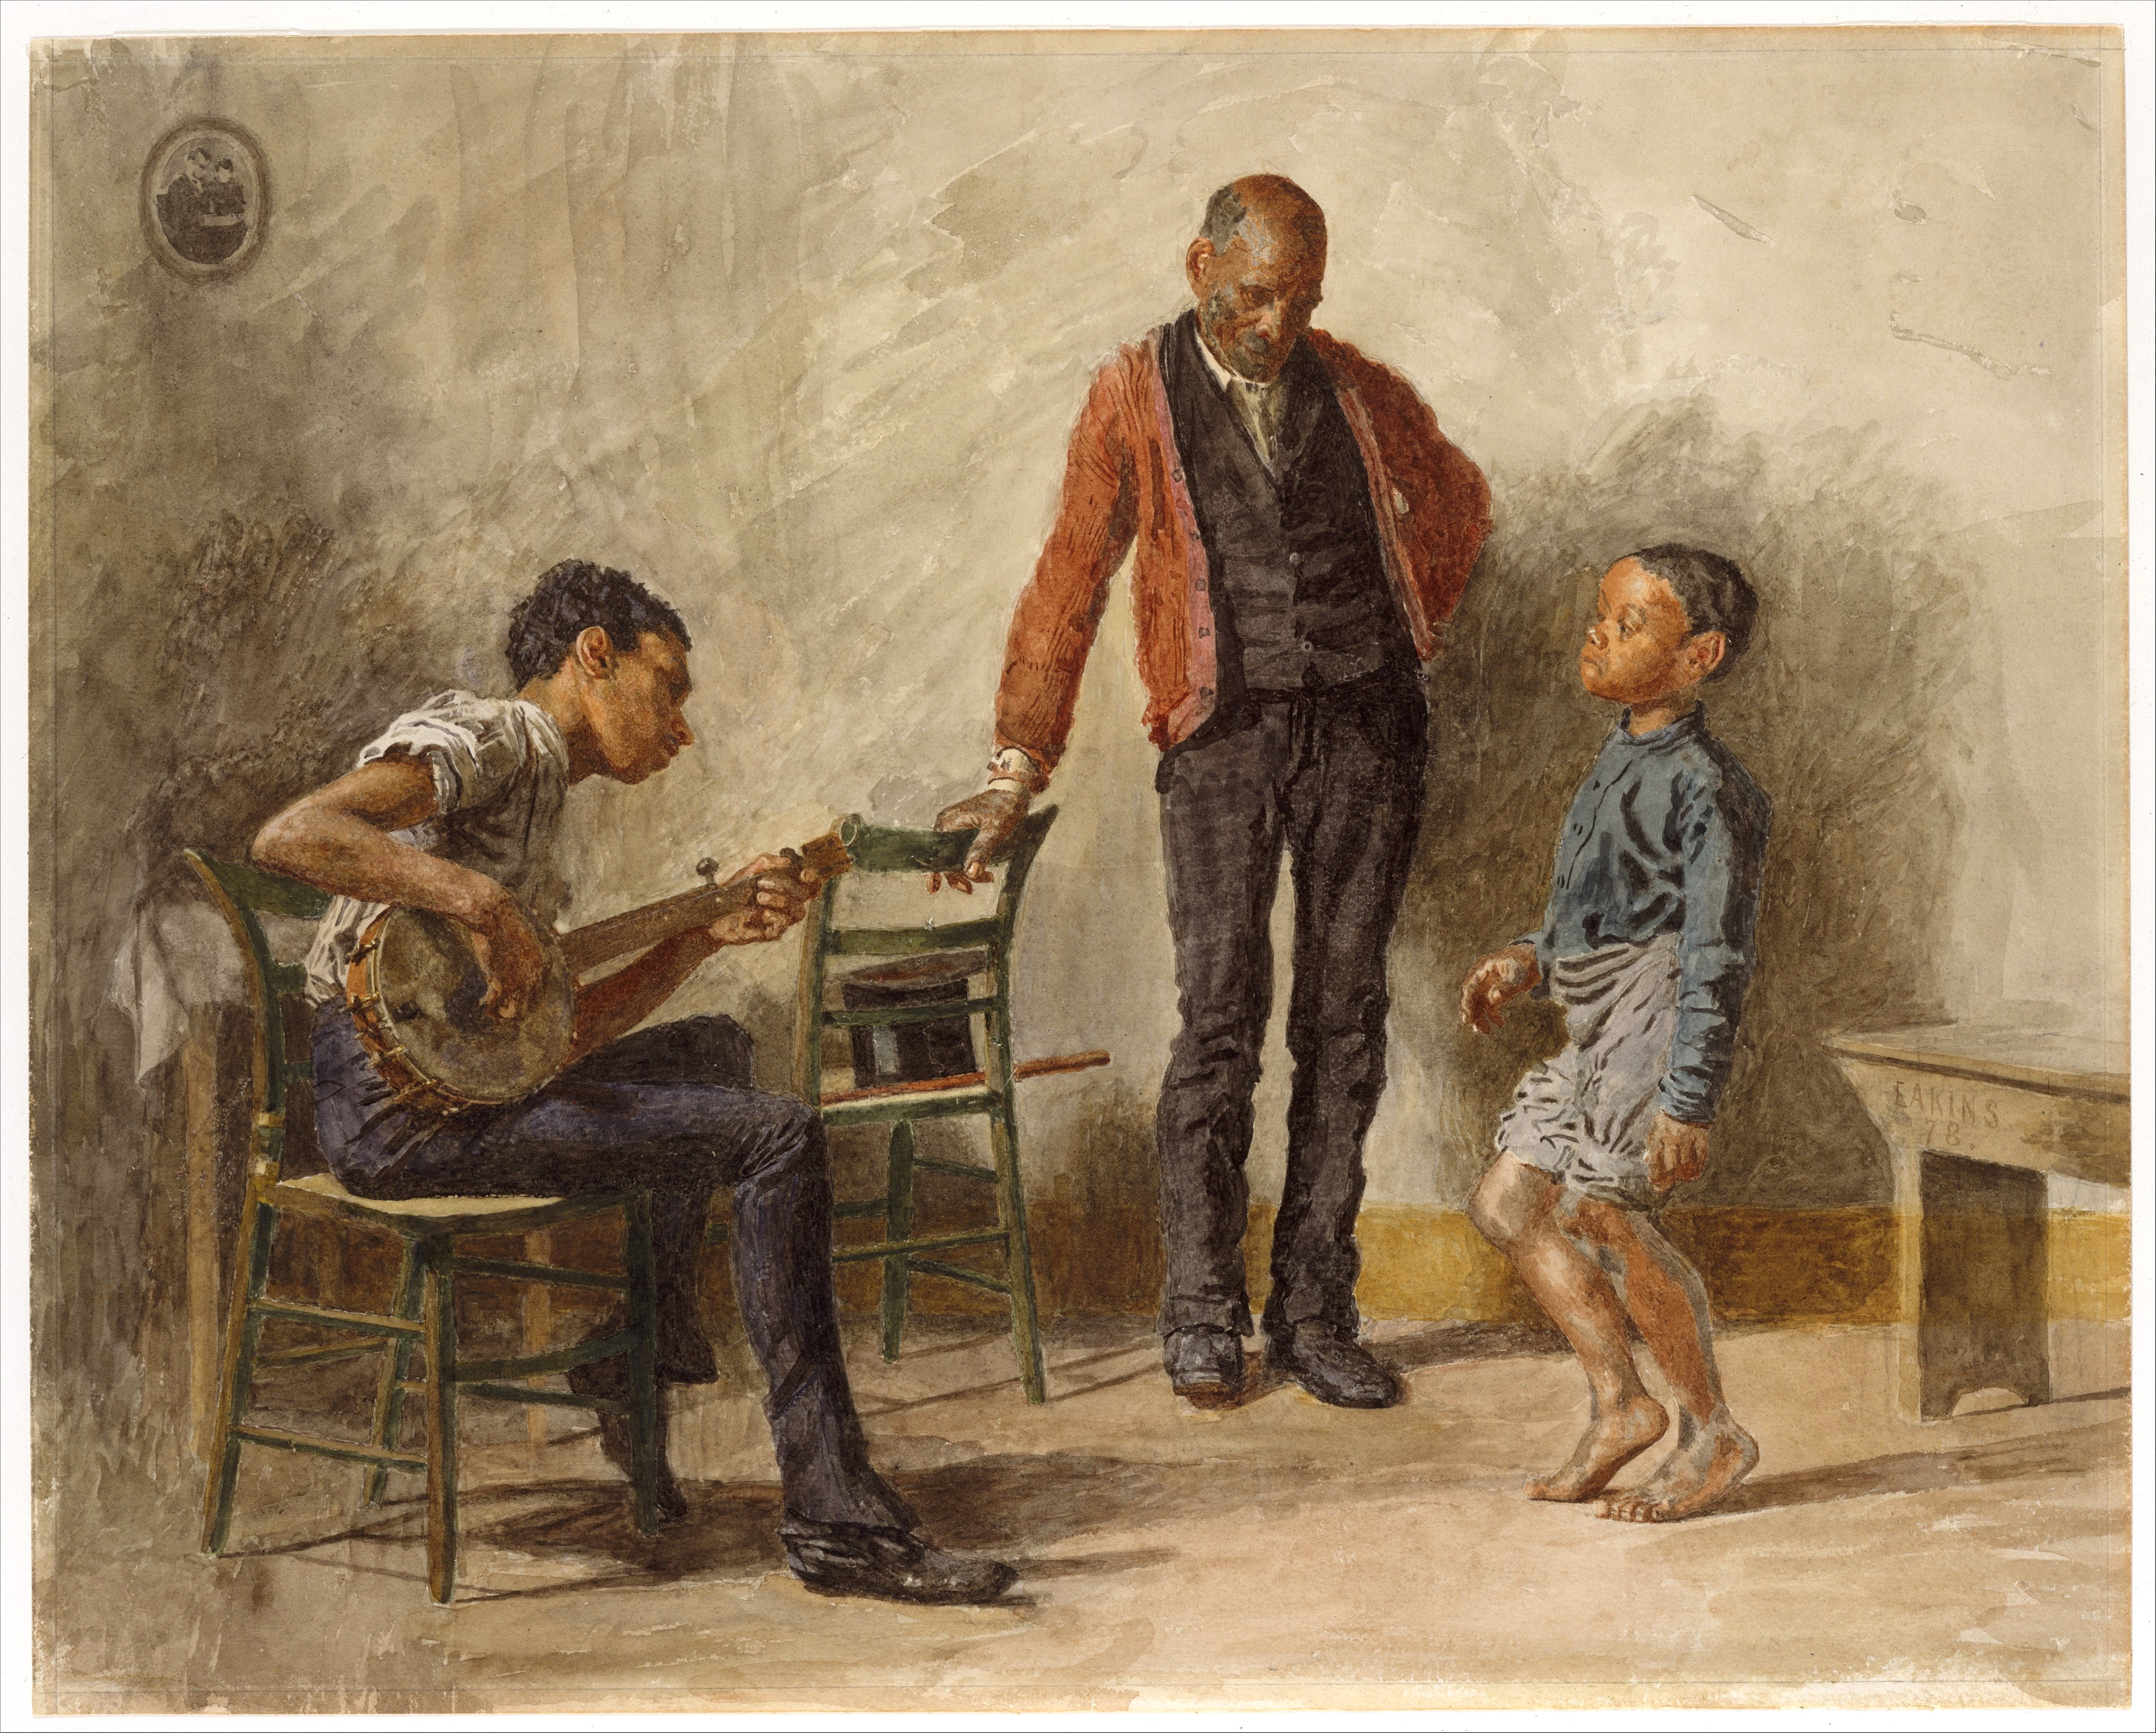
Dancing Lesson
Thomas Eakins, 1878

Slide 6
They only heard it said, “The one who formerly was persecuting us is now proclaiming the faith he once tried to destroy.”
Galatians 1:23

Slide 7
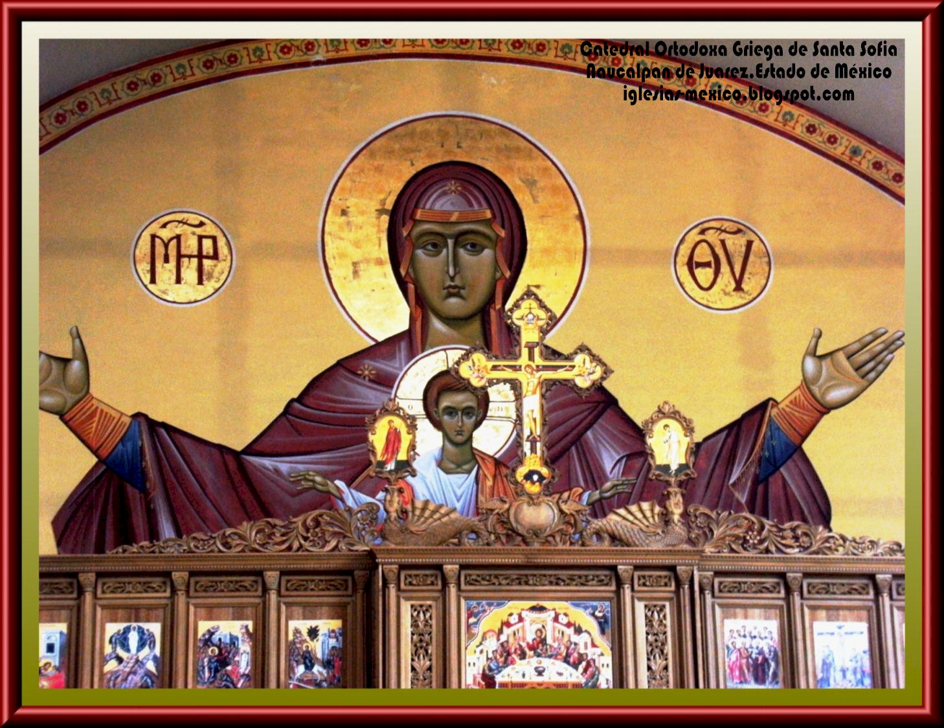
Iglesia Ortodoxa Griega, icon, Naucalpan, Mexico

Slide 8
“Soon afterwards he went to a town called Nain, and his disciples and a large crowd went with him.
Luke 7:11

Slide 9
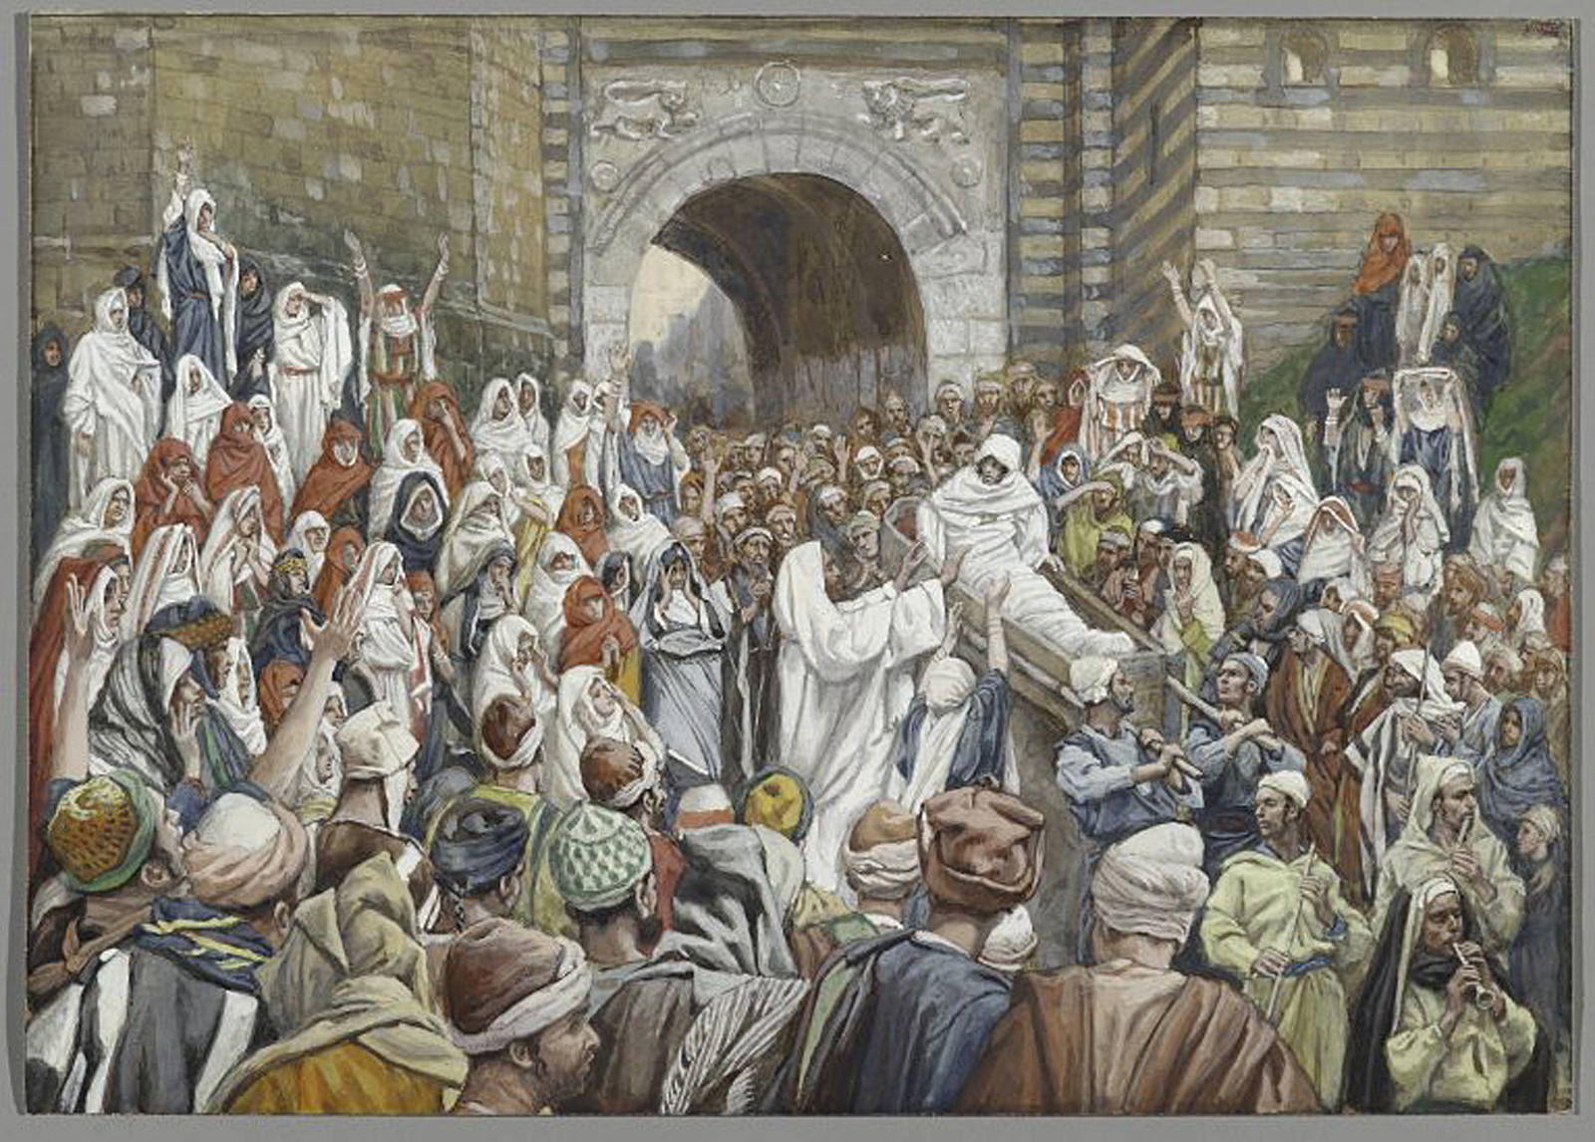
Raising of the Son of the Widow of Nain, James Tissot, ca. 1886-1894

Slide 10
As he approached the gate of the town, a man who had died was being carried out. He was his mother’s only son, and she was a widow, and with her was a large crowd from the town.
Luke 7:12

Slide 11
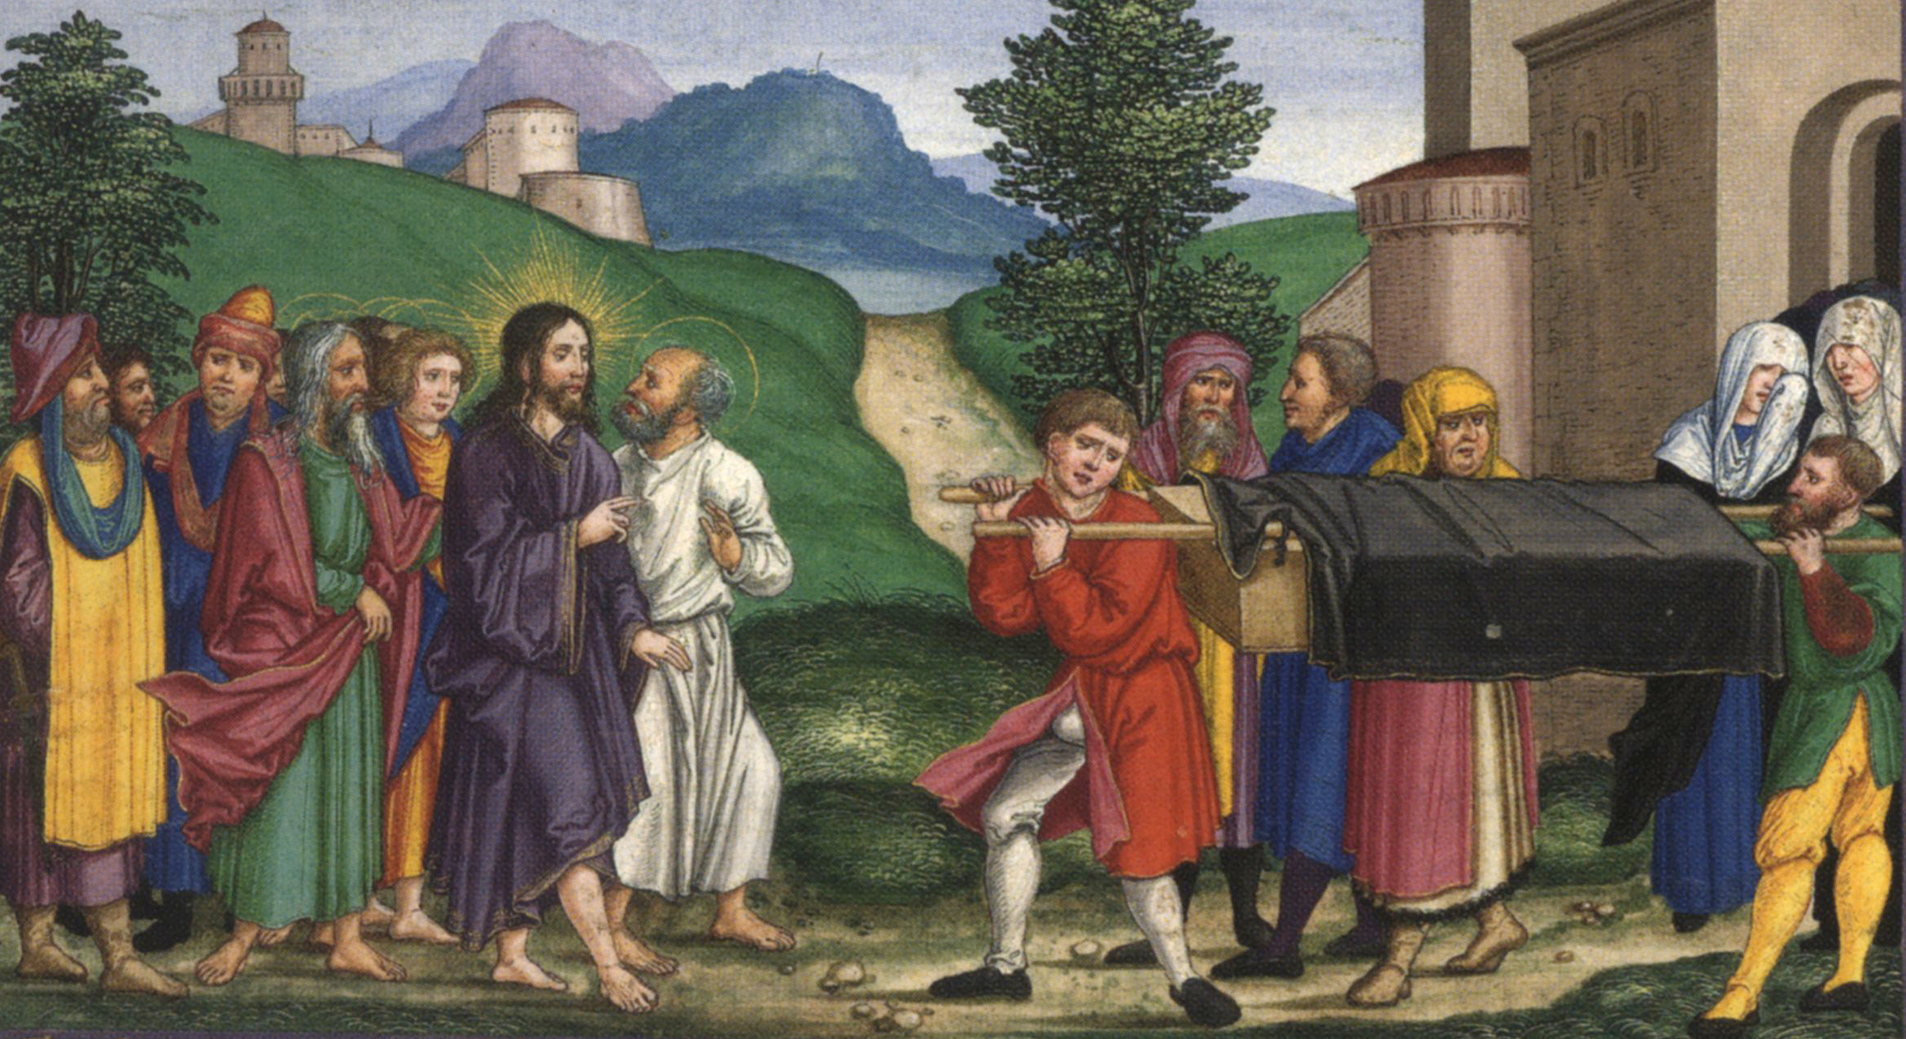
Raising of the Son of the Widow of Nain, Matthias Gerung, from the Ottheinrich Bible, ca. 1530-1532

Slide 12
When the Lord saw her, he had compassion for her and said to her, “Do not weep.”
Luke 7:13

Slide 13
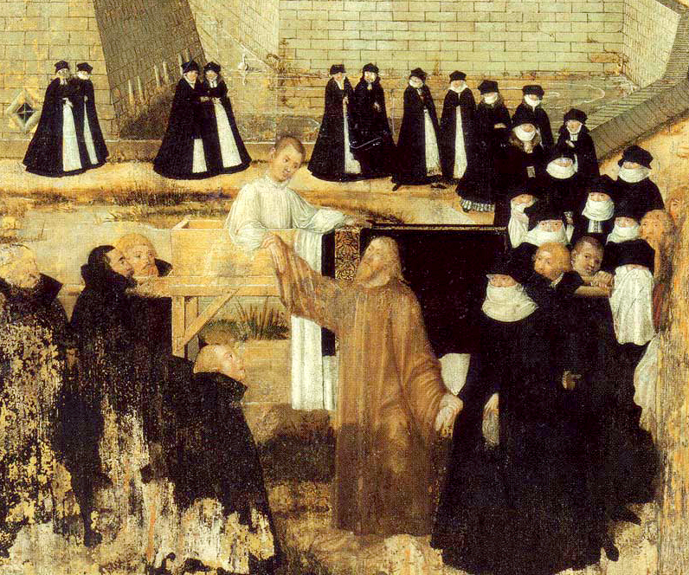
Raising of the Son of the Widow of Nain, Lucas Cranach, 1569

Slide 14
Then he came forward and touched the bier, and the bearers stood still. And he said, “Young man, I say to you, rise!”
Luke 7:14

Slide 15
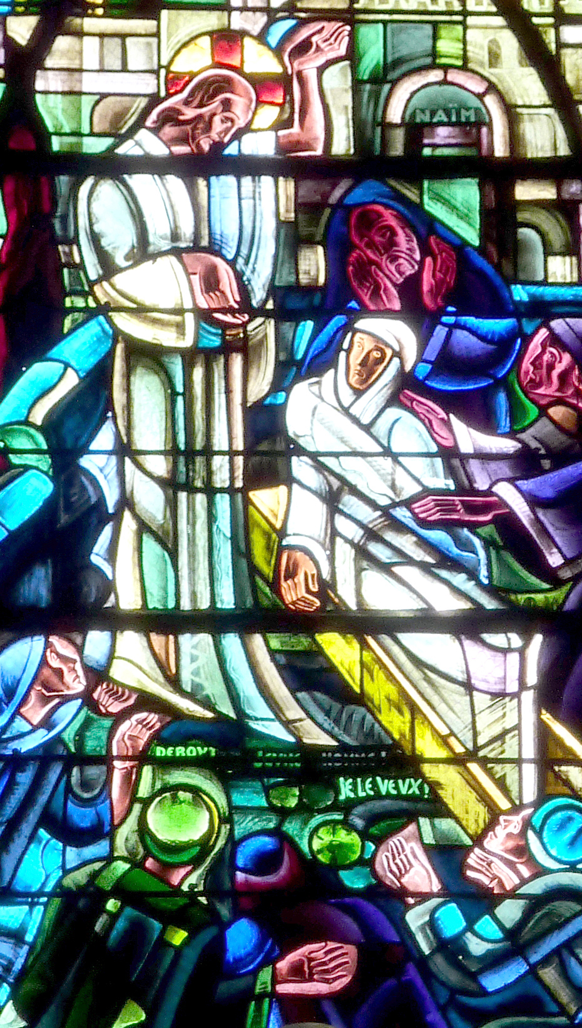
Raising of the Son of the Widow of Nain, detail
Jules Pierre Maumejean,
ca. 1950

Slide 16
The dead man sat up and began to speak, and Jesus gave him to his mother.
Luke 7:15

Slide 17
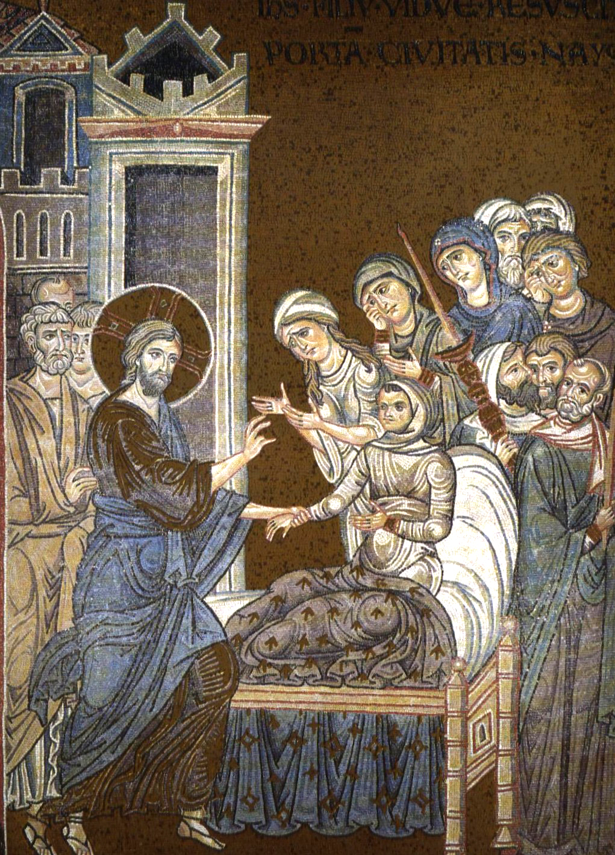
Raising of the Son of the Widow of Nain
Monreale, Italy
ca. 1180

Slide 18
Fear seized all of them; and they glorified God, saying, “A great prophet has risen among us!” and “God has looked favorably on his people!”
Luke 7:16

Slide 19
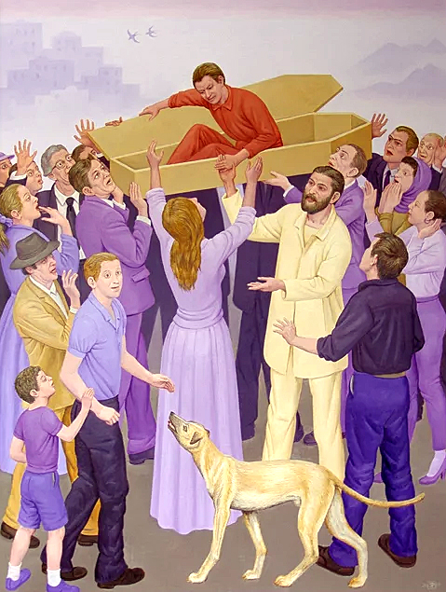
Widow’s Son
Peter Koenig
20th century

Slide 20
This word about him spread throughout Judea and all the surrounding country.
Luke 7:17

Slide 21
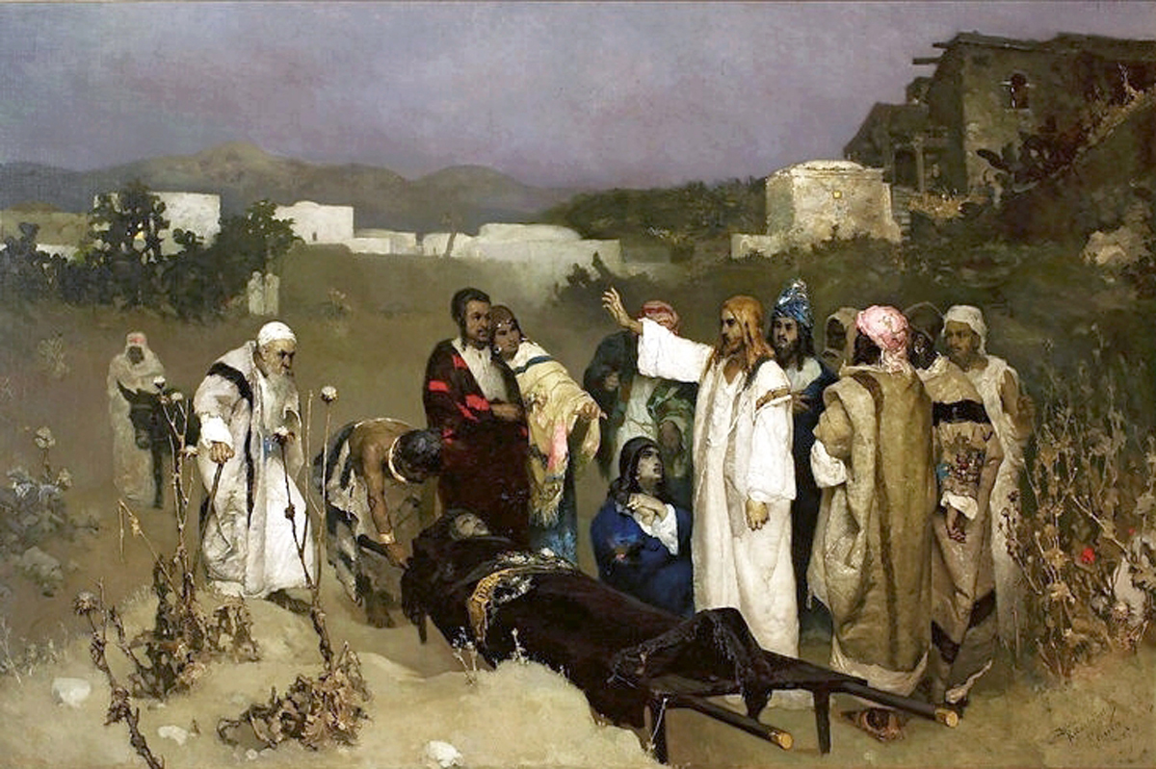
Raising of the Son of the Widow of Nain
Wilhelm Kotarbiński, 1879

Slide 22
Credits
New Revised Standard Version Bible, copyright 1989, Division of Christian Education of the National Council of the Churches of Christ in the United States of America. Used by permission. All rights reserved.
http://commons.wikimedia.org/wiki/File:Alexandr_Ivanov_075.jpg
http://commons.wikimedia.org/wiki/File:The_dancing_lesson_thomas_eakins.jpeg
http://www.flickr.com/photos/eltb/3376892545/
https://commons.wikimedia.org/wiki/File:Brooklyn_Museum_-_The_Resurrection_of_the_Widow%27s_Son_at_Nain_(La_r%C3%A9surrection_du_fils_de_la_veuve_de_Na%C3%AFm)_-_James_Tissot_-_overall.jpg
https://commons.wikimedia.org/wiki/File:Ottheinrich_Folio081v_Lc7B.jpg
https://commons.wikimedia.org/wiki/File:Aufweckung-J%C3%BCngling-Nain-15.jpg
https://commons.wikimedia.org/wiki/File:Corbeil-Essonnes_Saint-Spire_174.JPG
https://commons.wikimedia.org/wiki/File:Nain_widow%27s_son_is_resurrected_by_Christ.jpg
https://www.pwkoenig.co.uk/
https://commons.wikimedia.org/wiki/File:Kotarbi%C5%84ski_Resurrection_of_the_son.jpg
Additional descriptions can be found at the Art in the Christian Tradition image library, a service of the Vanderbilt Divinity Library, http://diglib.library.vanderbilt.edu/. All images available via Creative Commons 3.0 License.

